Slide 1
Coding in Java Part 1 – Variables, Decisions, and Loops
Java is everywhere

Slide 2
More code comments
// Single line
/* Multiple lines */
/** JavaDoc */

Slide 3
Storing and using data with variables
Named storage box
Values in memory
Naming convention

Slide 4
Types of variables
Primitive types
Reference types

Slide 5
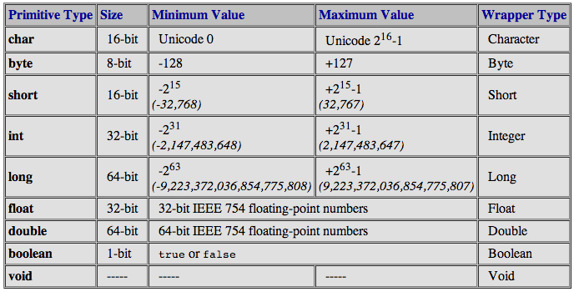
Primitive types

Slide 6
Reference types
Objects
Strings
Arrays

Slide 7
Using variables
Variable declaration
Variable definition

Slide 8
Changing values in variables with
operators
Assignment operators
Increment and decrement

Slide 9
Operators
Number of operands
Precedence
Context dependence
Associativity
Postfix, infix, prefix

Slide 10
Calculations
Arithmetic
Comparison
Logical
Bitwise
Other

Slide 11
Conditionals
if-else
switch

Slide 12
Loops
while
do-while
for
for-each
break
continue

Slide 13


