Slide 1
The First App
Introduction

Slide 2
How Java and Android work together
Dalvik EXecutable (DEX)
Dalvik Virtual Machine (DVM)
Adapted version of the Linux operating system

Slide 3
The Android API
Bunch of Java code
We use all this code without need to understand its complexity

Slide 4
Java is object-oriented
It uses the concept of reusable programming objects
A blueprint is called a class
Class transformed into a working instructions it is an object

Slide 5
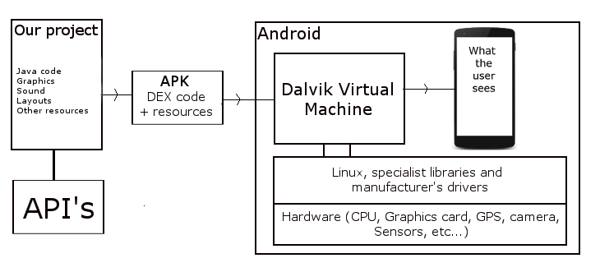
What exactly is Android

Slide 6
The development environment
Everything you need in order to develop
  Java Development Kit
  Android Software Development Kit
Integrated Development Environment
  Eclipse
  Android Studio

Slide 7
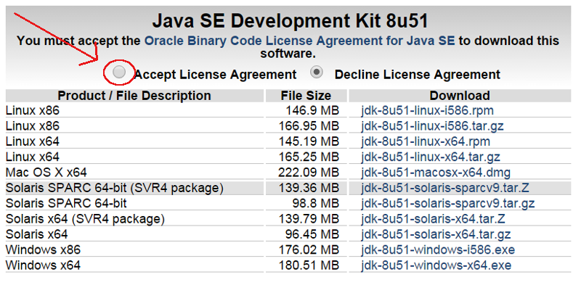
Installing the JDK
http://www.oracle.com/

Slide 8
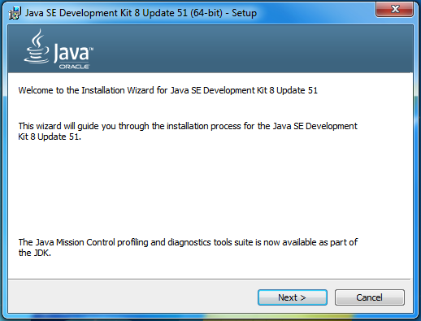

Slide 9
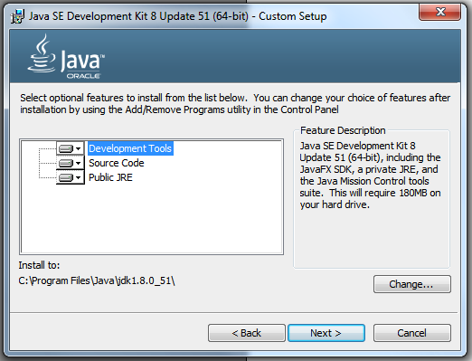

Slide 10
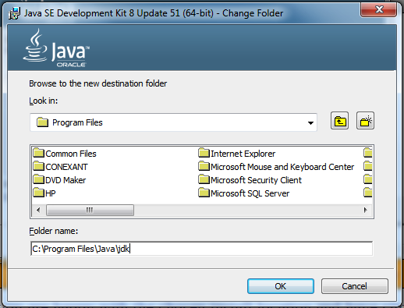

Slide 11
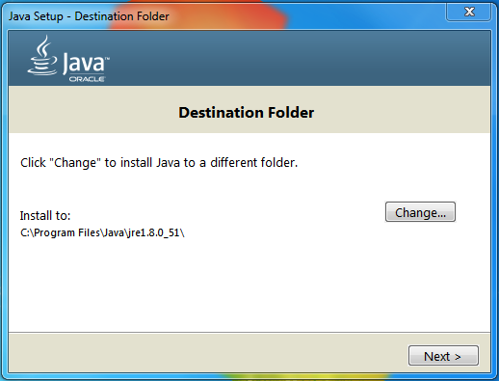

Slide 12
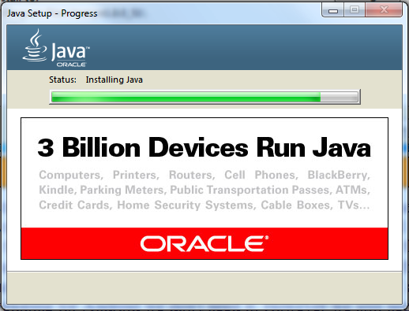

Slide 13
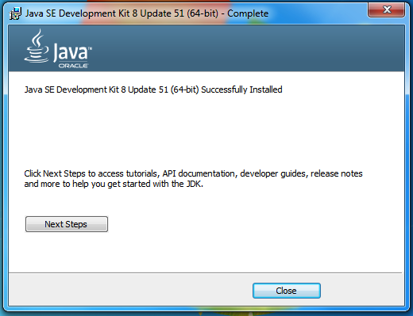

Slide 14
Setting up Android Studio
http://developer.android.com/

Slide 15
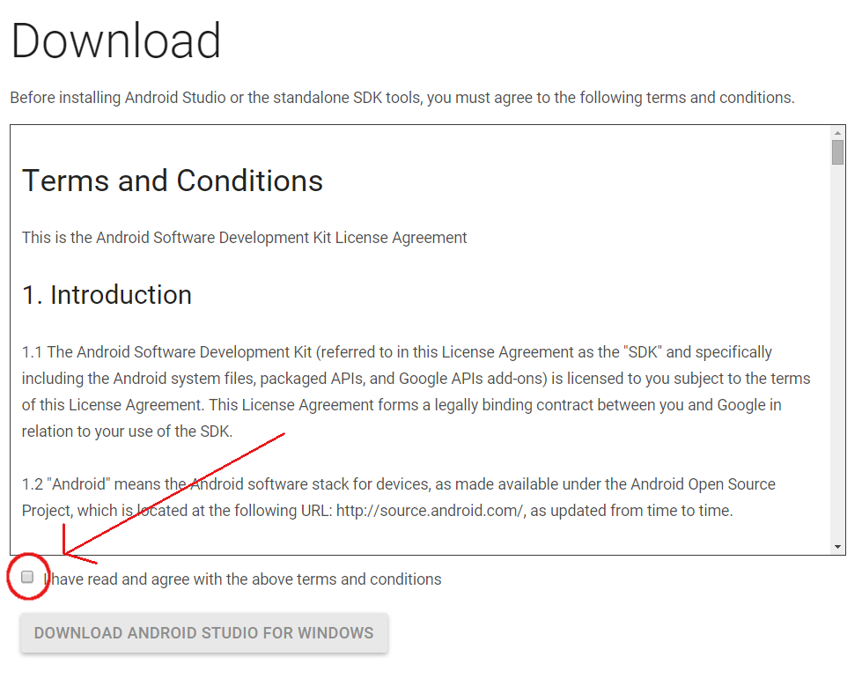

Slide 16
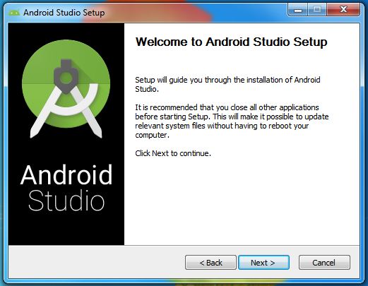

Slide 17
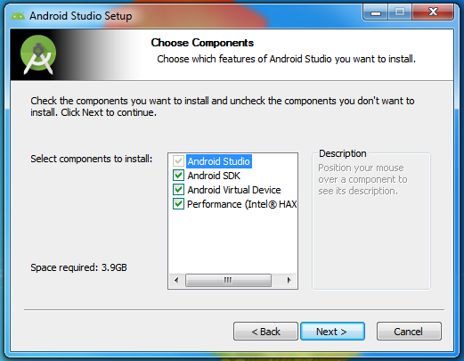

Slide 18
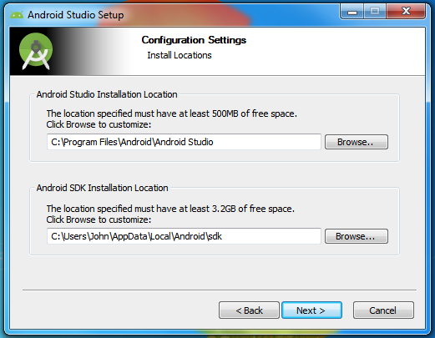

Slide 19
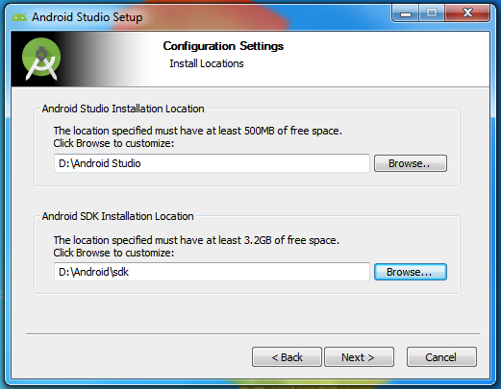

Slide 20
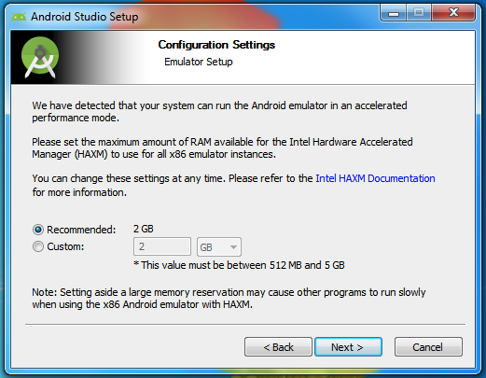

Slide 21
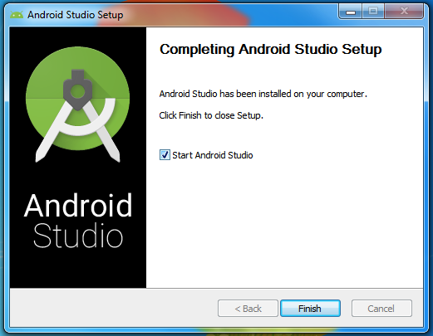

Slide 22
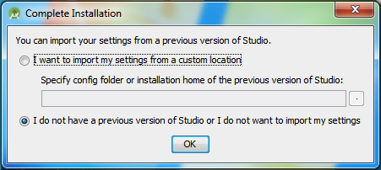

Slide 23
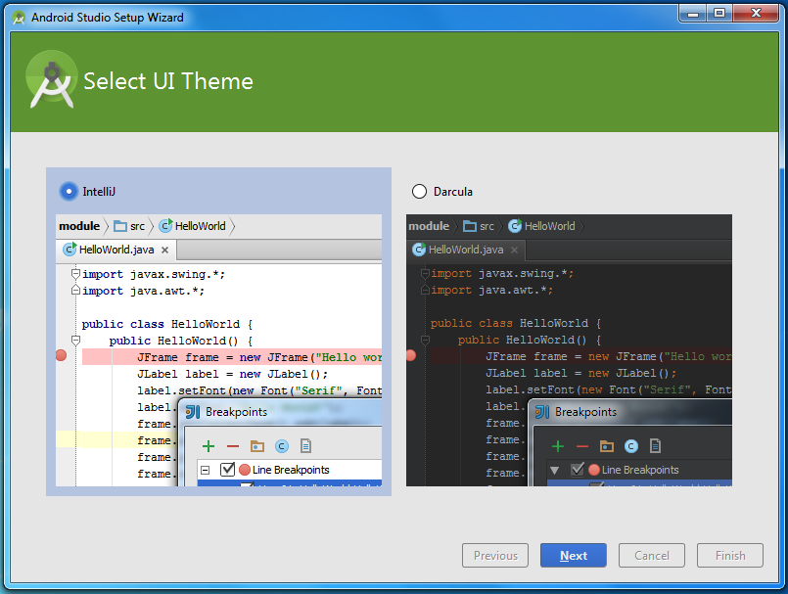

Slide 24
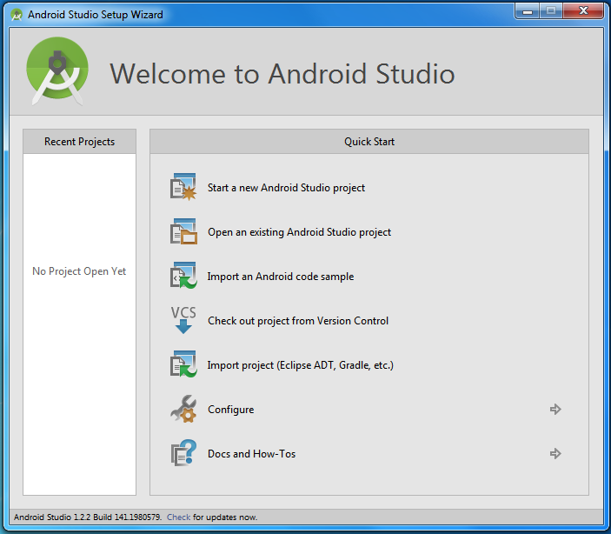

Slide 25
What makes an Android app
Android resources
  images, sounds, and user interface layouts
  Extensible Markup Language (XML)
Android's Java code
  Android packages

Slide 26


