Slide 1
The Life and Times of an Android App
The lifecycle of an Android app

Slide 2
A simplified explanation of the
Android lifecycle
Тhe user decides which app they are using
Тhe OS decides to close down (destroy) an application (user's data included) and when

Slide 3
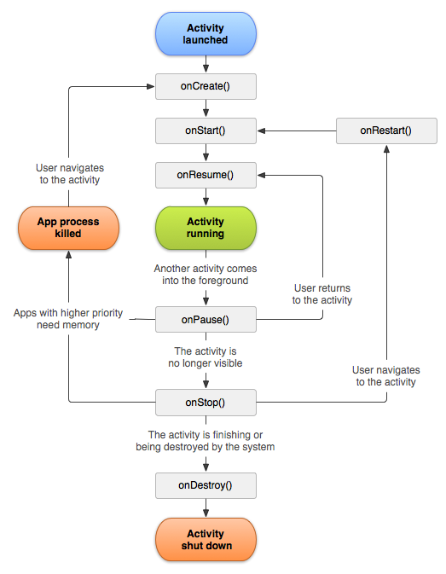
Introduction to the Android lifecycle

Slide 4
Lifecycle phases – what we need to know
Being created
Starting
Resuming
Running
Pausing
Stopping
Being destroyed

Slide 5
Lifecycle phases – what we need to do
Each Activity has its own lifecycle
Methods corresponding to the phases
  onCreate - when the Activity is being created
  onStart - executed when the app is in the starting phase
  onResume - runs after onStart or after previously paused
  onPause - occurs when app is pausing, always transition into a paused state when another UI element is displayed on top of the current activity or when the activity is about to be stopped
  onStop - relates to the stopping phase, used for undo everything done in onCreate, app probably going to get destroyed sometime soon
  onDestroy - activity is finally being destroyed, last chance to dismantle app in an orderly manner

Slide 6
Few simple rules
Set up app ready to run in the onCreate method
Load user's data in the onResume method
Save user's data in the onPause method
Tidy up app and make it a good Android citizen in the onDestroy method
Some times it will be proper to use onStart and onStop

Slide 7
Some other overridden methods
onCreateOptionsMenu - loads the menu from the XML resources
onOptionsItemSelected - is called when the user taps the menu button

Slide 8


