Slide 1
Integrating Google Maps and GPS Locations
Global Navigation Satellite System

Slide 2
Global Positioning System
The system works with 27 satellites in space known as the GNSS
Out of these, 24 of the satellites are active and three are a backup
Each satellite orbits the Earth every 12 hours constantly broadcasting the changing position data

Slide 3
API used
Most of the functionality is provided by the LocationListener interface
LocationManager instance is used
  Call getSystemService and casting the result accordingly
  Declare and initialize a Criteria instance
  Call getBestProvider method
  Declare and initialize a Location object by calling getLastKnownLocation method

Slide 4
Listening for GPS location updates
Start listening by calling requestLocationUpdates
  First argument is the provider that was established
  Second argument is the minimum number of milliseconds between updates
  Third argument is the minimum change in location in meters
Stop listening by calling removeUpdates

Slide 5
Ways to use Google Maps
Use an Intent to open the Google Maps app
Connect directly to the Google Map's servers
  Gives the flexibility of making a better featured app

Slide 6
Preparing to connect to Google Maps
Get an API key that the app will use to communicate with the servers
Acquiring an API key
  Need a Google account
  Google Developers Console website to obtain API key
  Copy the API key into the <string> element in the google_maps_api.xml file

Slide 7
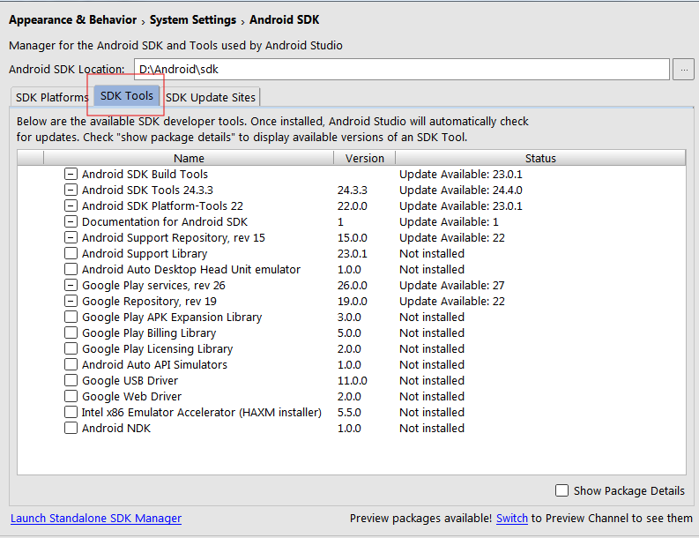
Installing the Google Play services API

Slide 8


