Slide 1
For many years, process ID 1 of Linux and UNIX systems has been the init process. This process was responsible for activating other services on the system. Frequently used daemons were started on system at boot time with System V scripts.

Slide 2
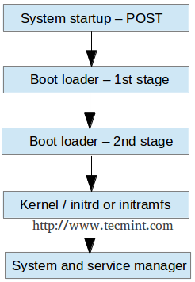
SSystemd is the new service/system manager in RHEL distros that is responsible for starting the first process and controlling other ones. Systemd is used to start and manage units.
The most important unit is called service. Apart from services, other unit types exist, such as socket, mounts …
Exercises:
man systemd
Which is the first process in Linux, according to the above man page ?

Slide 3
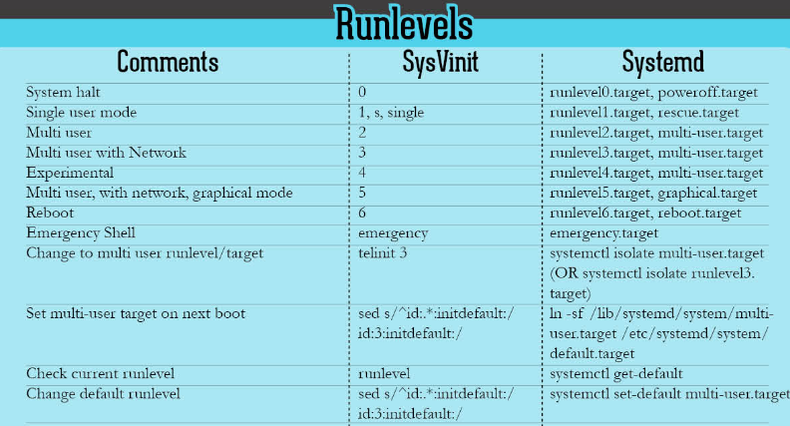
S systemd replaced ‘init’ as a more flexible way to load services. Instead of runlevels, now we are working with targets.

Slide 4
Exercises: 1. systemctl –t help The major benefit of working with systemd is that it provides a uniform interface to start units. This interface is defined in the unit file. The system unit files are in /usr/lib/systemd/system Exercises: 1. SYSTEMD=/usr/lib/systemd/system 2. cd $SYSTEMD 3. pwd 4. file default.target 5. cat default.target Overriding the default configurations happens in /etc/systemd/system You would rarely configure your own unit, so do not focus too much on the units content, instead focus on controlling(status, stop, restart, reload) them at this point.

Slide 5
E
Exercises:
systemctl status sshd
systemctl stop sshd
systemctl status sshd
systemctl start sshd
systemctl is-enabled sshd
systemctl disable ssh
systemctl enable sshd
Enabled services will start once the OS is booted. Other common services: network, NetworkManager, firewalld httpd

Slide 6
E
Masking services
At times, a system may have conflicting services installed.
For example, there are multiple methods to manage networks(network and NetworkManager) and firewalls(iptables and firewalld).
To prevent an administrator from accidentally starting a service, that service may be masked.
Masking will create a configuration directories so that if the service is started, nothing will happen.
Exercises:
1. systemctl status network
2. systemctl status NetworkManager
3. systemctl mask network
4. systemctl status network
Do we still have network?

Slide 7
On systemd machines, there are a couple of targets. A target is a collection of units. Some targets could be isolated if they have the ‘isolate’ option. 1. cat /usr/lib/systemd/system/graphical.target 2. systemctl get-default => multi-user.target 3. systemctl isolate graphical.target 4. Nothing ? Ok, we installed minimal .iso CentOS, it does not have the libraries for a graphical target, let’s install it and have a cup of coffee: yum –y groups install “GNOME Desktop” 5. startx 6. systemctl set-default graphical.target 7. systemctl reboot
Target(the new way) | Runlevel (the old way)
Poweroff.target | Runlevel 0
Rescue.target | Runlevel 1
Multi-user.target | Runlevel 3
Graphical.target | Runlevel 5
Reboot.target | Runlevel 6

Slide 8
The GRUB 2 boot loaders makes sure that you can boot Linux. GRUB2 is installed in the boot sector of your server’s hard drive and is configured to load a Linux kernel and initramfs. Initramfs contains drivers that are needed to start your server. It contains a mini file system that is mounted during boot. Inside it are kernel modules that are needed during the rest of the boot process (eg.LVM and SCSI modules for accessing disks that are not supported by default). Exercises: 1.cat /etc/default/grub 2. cat /proc/cmdline You won’t have to modify anything if you want to select from different kernels. GRUB2 picks up new kernels automatically. The base configuration file is /boot/grub2/grub.cfg => never change it manually! To change GRUB2 settings, use grub2-mkconfig. Exercise: 1. man grub2-mkconfig 2. That was a short man page : )

Slide 9
To apply modifications to the GRUB 2 boot loader, the file /etc/default/grub is your entry point. Exercises: 1. Remove ‘rghb’ and ‘quiet’ options from there. They tell the kernel to hide all the output while it’s booting. 2. Set GRUB_TIMEOUT = 10 seconds. 3. Save changes to the file. 4. grub2-mkconfig > /boot/grub2/grub.cfg 5. Reboot

Slide 10
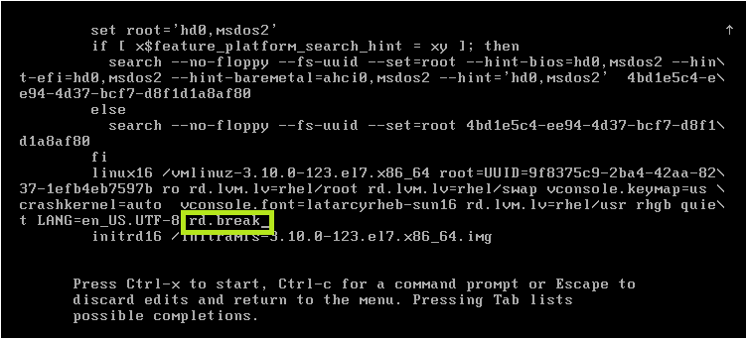
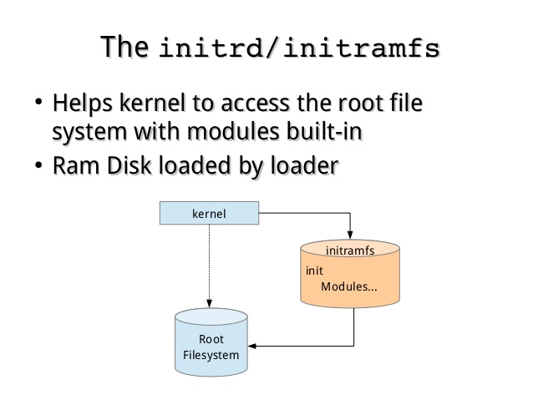
Resetting the root password, yeah it’s possible in Linux ☺ 1. Boot your system and wait until the GRUB2 menu appears. 2. Highlight the any entry and press ‘e’. 3. Add ‘rd.break’ to the end of the line that starts with linux / ctrl + x to restart ‘rd.break’ interrupts the boot process before control is passed from initramfs to systemd .

Slide 11
Now we are in initramfs. The real root file system is under /sysroot 1. ls 2. ls /sysroot 3. mount –o remount, rw /sysroot (make /sysroot available for writing) 4. chroot /sysroot 5. passwd 6. touch /.autorelabel ( needed for SELinux, outside of the scope of the course. ) 7. exit 8. exit

Slide 12
Homework: No specific homework, go back and try to see which things have been hard to understand. Try to reset your root password.

