Slide 1
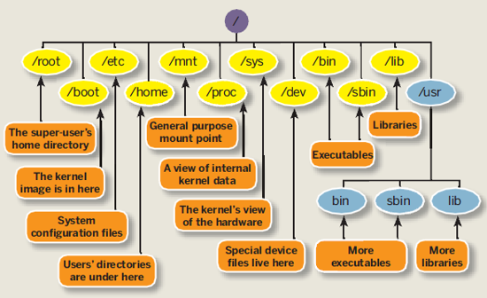
The Filesystem Hierarchy Standard(FHS) defines the directory structure and content in Unix-like OS. ”
File System

Slide 2
The ‘/’ character is also used as a directory separator in file names. For example, ’etc’ is a subdirectory of the ‘/’ directory, we could call it like ‘/etc’. Subdirectories of ‘/’ are used for standardized purposes to organize files by types and purpose. This makes it easier to find files. For example, in the root directory, the subdirectory ‘/boot’ is used for storing files needed to boot the system.

Slide 3
Location | Purpose
/usr | Installed software, shared libraries, /usr/bin (user commands), /usr/sbin (system administration commands)
/etc | Configuration files
/var | Variable data specific to the system that should persist between boots. Files that dynamically change ( databases, website content ) may be found under it.
/tmp | A world-writable space for temporary files. Files which are more than 10 days old are deleted automatically.
/boot | Files needed in order to start the boot process.
/dev | Special devices files which are used by the system to access hardware
/home | Home directories where users store their personal data and configuration files.

Slide 4
I In RHEL7, four older directories in ‘/’ now have identical contents as their counterparts located in ‘/usr’ 1. /bin and /usr/bin 2. /sbin and /usr/sbin 3. /lib and /usr/lib 4. /lib64 and /usr/lib64 In older versions of RHEL, these were distinct directories containing different sets of files.

Slide 5
Exercises: 1. List all files in /boot starting with ‘vm’, what do u you think are those files ? 2. Cat the content of /etc/passwd, /etc/resolv.conf, what kind of configuration files are those ? 3. Print your home directory. Create a local user and have a look at the hidden files in his home directory. 4. Google for ‘proc’ file system, dig deeper into /proc directory. 5. List the content of /dev, pay attention to each first letter of the file permissions rows. Absolute Path => the whole path starting from the root directory, example “/etc/sysconfig/network-scripts” Relative Path => relative to the present working directory. example “cd ../etc”

Slide 6
Working with files
cp => cp /path/to/file /path/to/destination
-R(recursive) for entire subdirectory.
-a(archive) for keeping the same permissions.
mv => moves or renames a file.
mv myfile /tmp;
mv myfile mynewfile
rm => by default prompts for confirmation.
-f(do not ask for confirmation).
-r(recursive) => for deleting subdirectory.
rm –f /tmp/file_not_needed_anymore

Slide 7
Exercises: 1. Create two new files in your home directory. 2. Input some content with vim inside them. 3. Make one of the files executable. 4. Copy one of them with preserved permissions. 5. Rename it to some other name. 6. Delete it, but provide confirmation answer. 7. Do you think there is a way back to revert back the deleted file ?

Slide 8
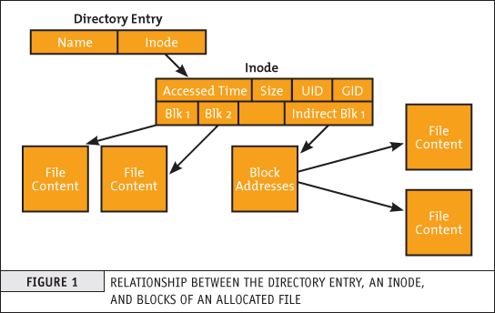
Inode/Soft Links/Hard Links
The inode is a data structure used to represent a filesystem object( file, directory ). Example => “ls –l /tmp/file”
Basically behind each file name in Linux, stands an integer, that helps the file system ( ext4, xfs … ) to keep track and modify files and directories.

Slide 9
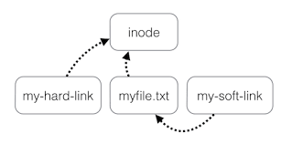
Spend 5 minutes on the below picture:

Slide 10
When we create a soft link, it is like an alias to the file. It applies its permissions. When we create a hard link, it points to the inode.

Slide 11
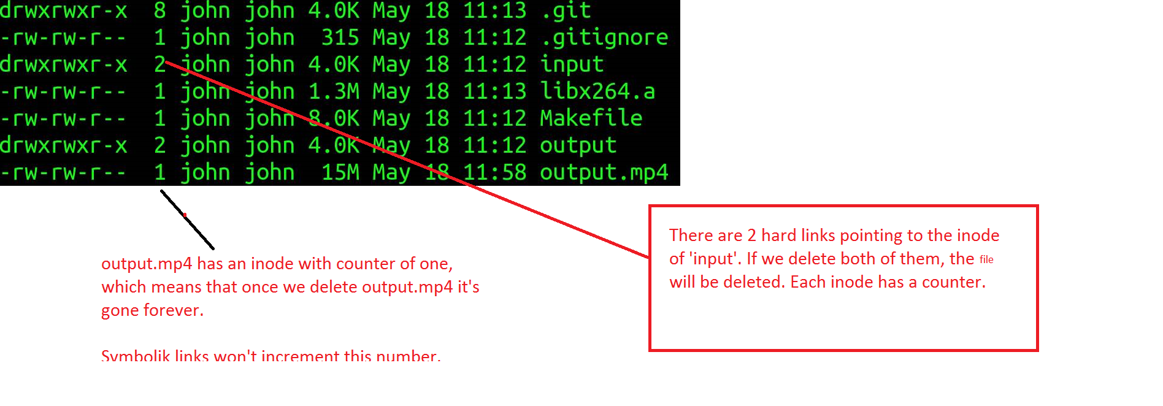
Create a symbolic link(soft link) with ‘ln –n /root/source /tmp/file_does_need_to_exist’
Create a hard link with ‘ln /root/source /tmp/file_does_not_need_to_exist’

Slide 12
Exercises: 1. Create two files => first_file and second_file. 2. Create a symlink to first_file. 3. Get the output of ‘ls –li first_file’ 4. Get the output of ‘ls –li newly_soft_link’ 5. Do you see the pointer ? 6. Create a hard link to second file. 7. Repeat step 3 and 4. 8. Do you see the same number and counter ? 9. Remove second_file, do the new hard link remained ? 10. Repeat step 3 for the new hard link.

Slide 13
Archiving and Compression.
tar => saves many files together into a single archive, and can restore individual files from archive.
Example:
tar –cf archivename.tar /files-you-want-to-archive;
tar –cf /root/homes.tar /home;
You could add ‘-v’ for verbose.
Restoring from an archive:
tar –xvf /archivename; add –C /target_dir to specify the target directory where u want to extract the file.
Get the size of a file or directory:
du –sh file

Slide 14
Compression Allows you to make files take less disk space by taking out the redundancy. Compression utilities: gzip and bzip2. After creating the archive, it had to be compressed. Example => gzip home.tar You could include the –z (gzip) or j (bzip2) options while creating the archive with tar. tar cvzf archive_compressed.tar.gz content Uncompress the compressed archive: tar xvzf content.tar.gz

Slide 15
Homework: 1. Create a file and rename it to ‘renamed’ 2. Make 3 hard links to it. 3. List the inode number and redirect it to /tmp/inodeinfo 4. Remove all above files. 5. Create a compressed archive of your /etc directory. 6. How big is that archive? How did you find out ? 7. What does the ‘du’ command do ? 8. Compare ‘du’ vs ‘df’.

