Slide 1
TCP/IP is conceptual model and set of communications protocols used on the Internet. TCIP/IP standards follow a four-layer network model: * Application => each application has specifications for communication so that client and servers may communicate across platforms. Common protocols, include SSH(remote login), HTTPS(secure web), NFS or CIFS(file sharing), SMTP(electronic mail delivery). * Transport => transport protocols are TCP and UDP. TCP is reliable connection-oriented protocol, while UDP is connectionless. Application protocols use TCP/UDP ports. A list of well-known and registered ports can be found in /etc/services file. When a packet is sent on the network, the combination of the service port and IP address forms a socket. *Internet => caries data from the source host to the destination host. * Link => provides the connection to physical media. The most types of networks are wired Ethernet and wireless WLAN. Each physical device has a hardware address(MAC) which is used to identify the destination of packets on the local network segment.

Slide 2
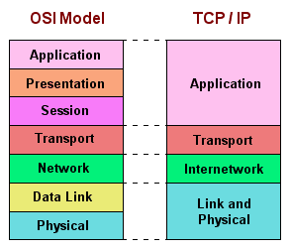
Networking
OSI model is just a theoretical one. TCP/IP was inspired by it and implemented.

Slide 3
If you want your Linux node to reach other nodes, you need to have networking available. You are going to need: 1. IP address => numerical label assigned to each device, participating in a computer network that uses the Internet protocol for communication. 2. Subnet mask => to know to which network a computer belongs. 3. Default gateway => access point to send information to another computer. 4. DNS server => to translate the IP addresses into FQDNs. Exercises: 1. Create a file in your home directory. 2. List it’s permissions. 4. Do you think it’s safe to let the root user to log in inside a server from remote ( SSH ) ?
Networking

Slide 4
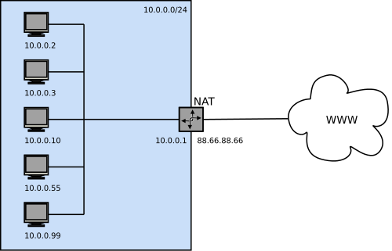
Private network addresses are for use in internal networks only:
10.0.0./8 172.16.0.0/12 192.168.0.0/16
When private addresses are used, the nodes cannot access the Internet, and nodes from the Internet cannot easily access them. That’s why Network Address Translation (NAT) is often used.
In NAT the nodes use a private IP address, but when facing the Internet, this private IP is replaced with the IP address of the NAT router. Hence, nodes on the Internet think that they are communicating with the NAT router, and not with the induvial hosts. The NAT router on its turn uses tables to keep track of all connections.

Slide 5
IPv4 addresses
An IPv4 address is a 32-bit number, normally expressed in decimal as four octets ranging in value from 0 to 255, separated by dots. The address is divided into two parts: the network part and the host part. All hosts on the same subnet, which can talk to each other directly without a router, have the same network part. ; the network part identifies the subnet
To know which part of an IPv4 address is the network part and which the host, an admin must know the netmask, which is assigned to the subnet.

Slide 6
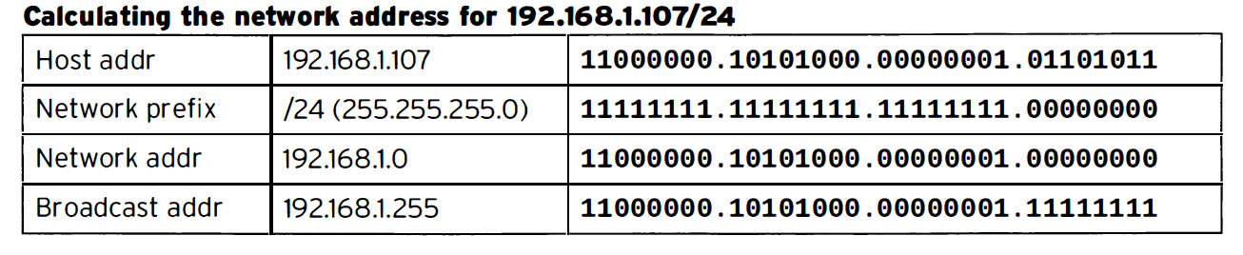
The lowest possible address on a subnet is called the Network Address, the highest is used for broadcasting messages in IPv4 and is called the broadcast address. Network masks could be expressed in 255.255.255.0 for example, or with a network prefix like ‘/24’.TT The

Slide 7
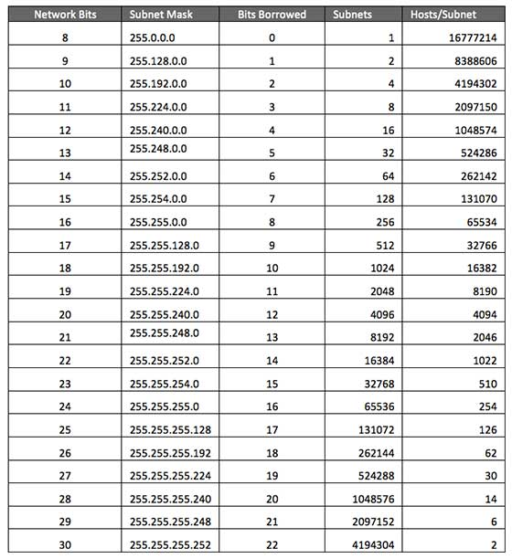
A subnet mask separates the IP address into the network and host addresses. IP address: 212.209.113.33 Subnet Mask: /27 = 1111 1111 . 1111 1111 . 1111 1111 . 1110 0000 We will get 32 addresses, but 1 is for Broadcast, the second one is the network address, so that makes it 30 total.
Exercise: create a network prototype for small office ( 30 – 50 nodes ).

Slide 8
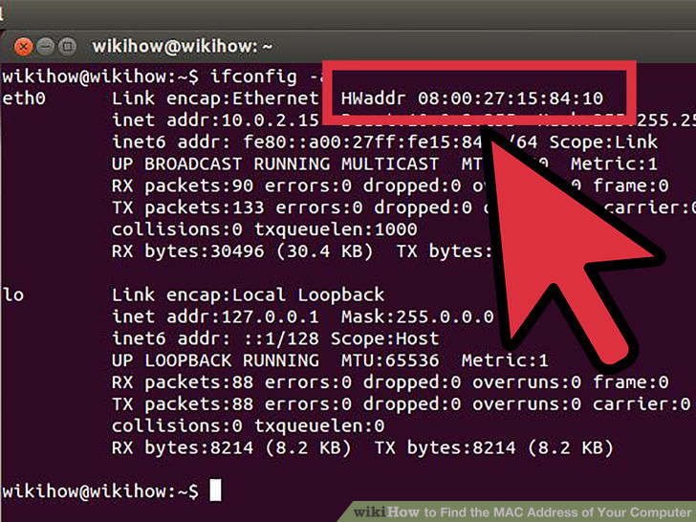
IP addresses are the addresses that allow nodes to communicate to any other node on the Internet. MAC addresses are assigned on each network card and are used on the local network.
The network addresses can be static or dynamic(DHCP). Usually the DHCP also assigns the DNS servers to be used as well. In CentOS 7 the interface(network card) names have new labels:
Ethernet interfaces begin with ‘en’. WLAN interfaces being with ‘wl’. The next part represents the type of the adapter. An ‘o’ is used for onboard (built in), ‘s’ is for hot plug spot, ‘p’ is for PCI location (externally attached). It ends with a number representing index, ID or port.
Example => eno16777734 on boarded Ethernet interface with unique index number.

Slide 9
Network traffic needs to move from host to host and network to network. Each host has a routing table, which tells it how to route traffic for particular networks. Show current network settings => ip addr show Validate the routing => ip route show Validate the Availability of Ports and services => ss Exercises: 1. Get your current network settings. 2. Get your routing. 3. Look for all listening TCP services and redirect the output to a file Configuring network with nmtui and nmcli. nmcli => the preferred and advisable tool by RedHat. Easy to work it, since it has tab completion. nmcli con show nmcli dev status nmcli con add con-name “static” ifname eth0 autoconnect no type Ethernet ip4 10.0.0.10/24 gw 10.0.0.1 Configuring network with nmtui Easy to use graphical tool. Every connection that you create is stored as a configuration file in the directory /etc/sysconf/network-scripts.

Slide 10
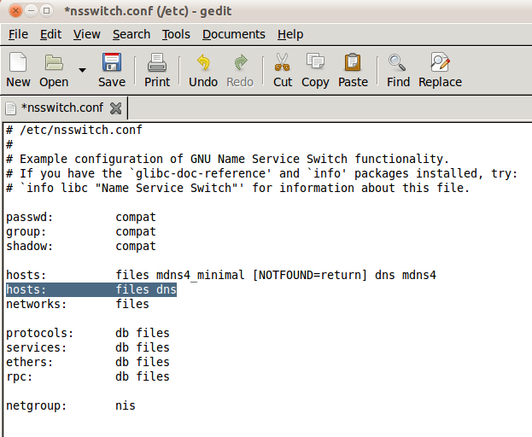
Exercises: 1. Use nmtui and create an imaginary connection. Setting up hostnames and Name resolution A hostname typically consists of name of the host and the DNS domain in which the host resides. linuxcourse.softintellect.bg => linuxcourse = name of host, softintellect.bg = DNS domain. Exercises. 1. Run ‘hostnamectl status’ and analyze the output. 2. Change your Linux node hostname, read the ‘hostnamectl’ man page. Resolution files introduction: /etc/nsswitch.conf => how the system uses name resolutions.

Slide 11
/etc/hosts => you might want to put some hostname to ip resolutions before DNS can be referenced(mail servers, isolated nodes without networking) 192.168.1.10 foo.mydomain.org foo /etc/resolv.conf => put the DNS servers for usually internet look up. It could be static or done by the DHCP. Exercises: 1. What is the content of /etc/nsswitch.conf ? What does the line ‘hosts: files dns’ do according to you ? 2. List your /etc/hosts files ? Add an imaginary printer FQDN ( linuxprinter.softintellect.bg), IP 192.168.0.3 3. List your DNS servers ? What is the DNS server used by google ? Try to switch it ? Homework: 1. What is a bond interface ? Why would we want to use one ? 2. Add a static connection using nmcli, you could choose the settings. 3. Change your hostname. 4. Change your DNS server with Googles. 5. Trace the connection from your host to http://soft-intellect.com/linux/, what command did you use ?

