Slide 1
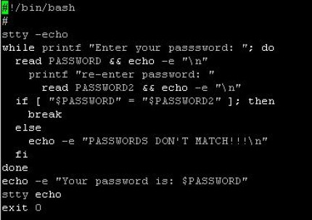
A Bash shell script is simply an executable file composed of a list of commands. Bash shell scripts are a good choice for tasks which can be accomplished mainly by calling other command-line utilities. If the task involves heavy data processing and manipulation, other languages such as Perl/Python will be better The first line of a Bash shell script begins with ‘#!’ (sha-bang). It indicates that the file is an executable shell script and the command interpreter.

Slide 2
After a Bash shell script is written, its file permissions and ownership need to be modified so that it is executable. Once it is executable, it can be invoked by: 1. entering its name in the command line, if the directory where the script resides is inside the PATH env variable. 2. entering the full destination to it. 3. get inside the script directory, run it from there. 1. script.sh 2. /home/user/script.sh 3. cd /home/user; ./script.sh A number of character or words have special meanings to the Bash shell in specific context!!!

Slide 3
# is interpreted by bash as the beginning of a comment and is therefore ignored, along with everything following it. The meanings of special characters or words can be disabled through the use of escape character, \ , single quotes(‘’) or double quotes(“”). The escape character \ removes the special meaning for the single character immediately following it echo # not a comment echo \# not. a comment Exercises: 1. Write a simple bash script, displaying the last two values.

Slide 4
The escape character, \, only removes the special meaning of the next single character. When more than one character in a text needs to be escaped, users can either use the escape character multiple times or employ single quotes ‘ ’. Single quotes preserve the literal meaning of all characters they enclose. echo \# not a comment\# echo ‘#not a comment #’ While single quotes preserve the literal value of all characters they enclose, double quotes differ in that they do not preserve the literal value of the dollar sign($), the back-ticks(` `), and the backslash(\). echo ‘$HOME’ echo ’`pwd`’ echo “$HOME” echo “`pwd`”

Slide 5
As the complexity of a shell script increases, it is often helpful to make use of variables. A variable serves as a container, within which a script can store data in memory. VARIABLENAME=value Variable names are typically uppercase letters. COUNT=40 Two common types of data stored in variables are integer values and string. It is good practice to quote string values, since the space character is interpreted by Bash as a word separator. NAME=John Doe => oops, bash interprets the space as separator by default. NAME=“John Doe”

Slide 6
EExpanding variable values The value of a variable can be recalled through a process known as variable expansion by preceding the variable name with a dollar sign. FIRST=Mecho SECOND=Puh echo “$FIRST $SECOND” Command substitution, like expanding variable, but for command ☺ echo “Current time: $(date)” Arithmethic expansion echo $[1+1] Space characters are allowed in arithmetic expansion

Slide 7
Iiii Iterating with the for loop => execution an action multiple times. for <VARIABLE> in <LIST>; do <COMMAND> … DONE Iterating all over the content in a directory. for for i in $( ls ); do echo item: $i done Ite=

Slide 8
For HOST in host1 host2 host3; do echo $HOST; done for HOST in host{1,2,3}; do echo $HOST; done Exercises: 1. Write a shell script that greets the user, takes his name as input and then prints it 5 times on the screen. Google if you need help. bash –x <SCRIPTNAME> to put the debug mode on a script.

Slide 9
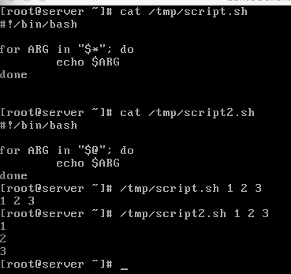
Positional parameters are variables which store the values of command-line arguments to a script. 0 => refers to the script name itself 1 => the first argument to the script Exercises: 1. Write a bash script that prints its name and its first parameter, do not forget provide it. $* and $@ refer to all arguments in a script, but in a different way. Exercises: . 1. Copy and run the below script and explain the difference

Slide 10
Every command returns an exit status, commonly referred to as return status/exit code. A successful command exits with an exit status of 0. Upon completion, a command’s exit status is passed to the parent process and stored in the ? Variable. Therefore, the exit status of an executed command can be retrieved by displaying the value of $? Exercises: 1. ls /etc/hosts 2. echo $? 3. ls /etc/nofile 4. echo$? The ’exit’ command can be executed with an optional integer argument between 0 and 255. Exercises: #!/bin/bash echo “Hello, World!” exit 0

Slide 11
IInteger comparison
Operator | Meaning | Example
-eq | Is equal to | [ “$a” –eq “$b” ]
-ne | Is not equal to | [ “$a” –ne “$b” ]
-gt | Is greater than | [ “$a” –gt “$b” ]
-ge | Is greater than or equal to | [ “$a” –ge “$b” ]
-lt | Is less than | [ “$a” –lt “$b” ]
-le | Is less than or erqual to | [ “$a” –le “$b” ]

Slide 12
IString comparison
Operator | Meaning | Example
= | Is equal to | [ “$a” = “$b” ]
== | Is equal to | [ “$a” == “$b” ]
!= | Is not equal to | [ “$a” != “$b” ]
Examples:
[ 1 eq 1]; echo $?
[ 8 gt 2]; echo $?
[ abc = abc ]; echo $?
Exercises:
Write a bash script that takes 2 numbers and compares them, use if else statements, google them.

Slide 13
Functions, grouping a logical piece of code together. #!/bin/bash function greet { echo “hello” } greet Homework: 1. Write a script, that takes directory addresses as his first and second argument and checks whether they exist. 2. Encapsulate the above in a function. 3. Call the function. 4. Write a shell script to check if a process is running, do not be afraid to use google, but spend some time doing it on your own.

