Slide 1
Every process (running program) on the system runs as a particular user. Every file is owned by a particular user. Access to files and directories are restricted by user. The user associated with a running process determines the files and directories accessible to that process.

Slide 2
The ‘id’ command is used to show information about the current logged-in user. To view the user associated with a file or directory, use the ’ls –l’. The third column shows the username, the fourth one the group Exercises: 1. List your current user id. 2. List a file and take a look his ownership.

Slide 3
To view process information, use the ‘ps’ command. The default is to show only processes in the current shell. Exercises: 1. Run ‘ps au’ to view the current process in your shell and see the user for each process. In Linux there are privileged users and unprivileged. The default privileged user is “root”. This user has full access to everything on a Linux server and is allowed to work in system space without any restrictions. Be careful if you are logged as root , since each command that you type is with enough privileges. Exercises: 1. Find information on the internet about the file /etc/passwd. 2. Cat /etc/passwd and then grep for the root user. 3. What is the root user id ? Run ‘id root’ 4. Do you think it’s safe to let the root user to log in inside a server from remote ( SSH ) ?

Slide 4
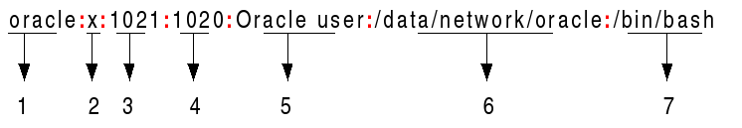
In Linux behind each user, there is an id. The mapping of names to numbers is defined the below file: /etc/passwd => information about each user is stored there.
1 => user_name.
2 => x indicates that encrypted password is stored in /etc/shadow.
3 => user_id.
4 => group_ud.
5 => primary group.
6 => home directory.
7 => the shell that the user is using.

Slide 5

/etc/shadow => encrypted passwords of users are stored here. Linux is following the Unix tradition, to count the time from Jan, 1st 1970 ( the official Birthday of UNIX). 1. Username 2. Encrypted password. 3. Days since last password change. 4. Min number of days required between password change. 5. Max 6. Warning 7. Inactive Simple way to get this information: chage –l user_name

Slide 6
Groups in Linux: Linux users can be a member of two different kinds of groups: primary group and secondary groups. By default each user is created with primary group identical as his name. Exersises: 1. Add a user with ‘useradd user_name’. 2. Run the id command on that user. 3. In which file do you think that groups are stored ? 4. Create two groups sales and account. 5. Create users bob, betty, bill and Beatrix. 6. Make bob and betty members of the group sales, and bill and Beatrix member of the group account. Use the ‘usermod’ man page. Verify with the ‘id’ command that they are members of it. 7. Set a password policy that requires users to change their password every 90 days. Use the man page of ‘chage’.

Slide 7
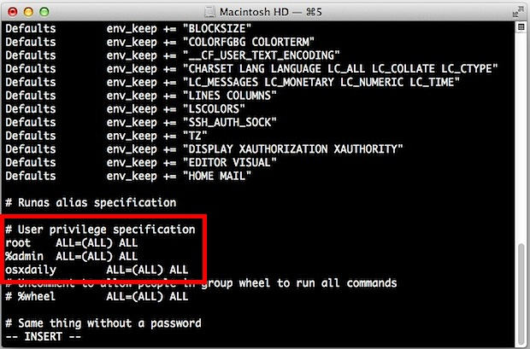
Sudo => super user do. A program that allows users to run programs with the security privileges of another user based on settings in ‘/etc/sudoers’, by default the superuser(root). man visudo. One additional benefit to using sudo is that all commands executed using sudo are logged by default to ‘/var/log/secure’. Whenever you edit the sudo file /etc/sudoers, always use visudo, since it locks it for the current user. Exercises: 1. Add a local user as a sudo. 2. Set his password 3. List a directory 4. View /var/log/secure

Slide 8
In RH 7, all members of group wheel can use sudo to run commands as any user, including root. ‘su’ command allows a user to switch to a different user account. usermod modifies existing users. userdel deletes users. userdel username removes the user from /etc/passwd, but leaves the home directory. userdel –r username removes the user’s home directory. In RHEL7 the useradd command assigns new users the first free UID number available in the range starting from UID 1000 or above. Do you see the problem ? Exercises: 1. Create two users, make one of them a member of the wheel group. 2. Delete the non-sudo user with his home directory. 3. Set the password for the sudo user to ‘johny’, use passwd.

Slide 9
Regular expressions => a text string that describes a particular search pattern.
^anna => lines that start with anna.
$py => files that end with py.
r[aou]t => rat, rot, rut.
Exercises:
List all users starting with ‘r’.
List all files ending in ‘sh’.

Slide 10
LDAP = Lightweight Directory Access Protocol
It manages related information from a centralized location through the use of directory hierarchy. LDAP is hierarchical tree based database. Information is stored as key-value pairs.
Example LDAP tree structure:
dc=bg
dc=softintellect
ou=students
uid=ibeli
cn=Iliya Belichev
Homework:
Review the previous three slides + this one and think about what’s most challenging for you? Try to understand something more about it, implemented in the VM, ask me questions.

