Slide 1
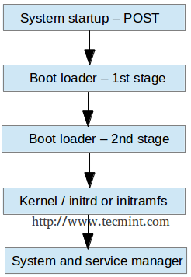
SSystemd is the new service in RHEL distros that is responsible for starting all kinds of different services. Systemd is used to star stuff. The stuff is referred to as units.
The most important unit is called service. Apart from services, other unit types exist, such as socket, mounts …
Exercises:
man ‘systemd‘
Which is the first process in Linux, according to the above man page ?

Slide 2
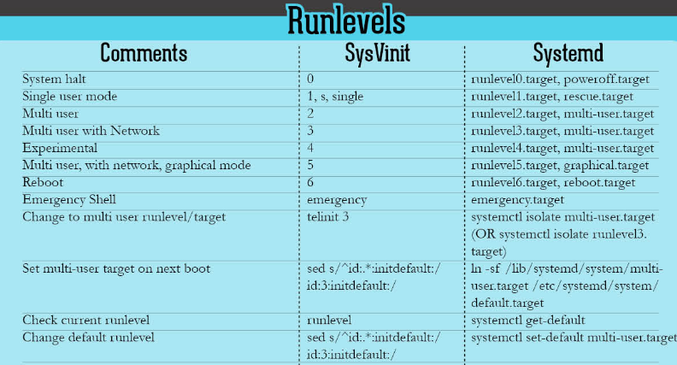
S systemd replaced ‘init’ as a more flexible way to load services. Instead of runlevels, now we are working with targets.

Slide 3
Exercises: 1. systemctl –t help The major benefit of working with system is that it provides a uniform interface to start unites. This insterface is defined in the unit file. The system unit files are in /usr/lib/systemd/system Exercises: 1. SYSTEMDD=/usr/lib/systemd/system 2. cd $SYSTEMDD 3. pwd 4. file default.target 5. cat default.target Overriding the default configurations happens in /etc/systemd/system You would rarely config your own unit, so do not focus too much on the units content, instead focus on controlling them.

