Slide 1
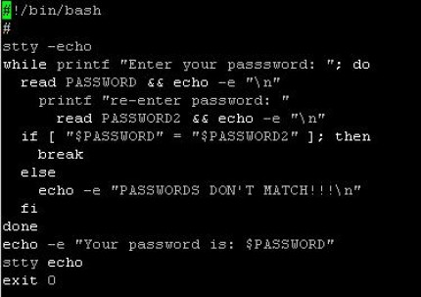
A Bash shell script is simply an executable file composed of a list of commands. Bash shell scripts are a good choice for tasks which can be accomplished mainly by calling other command-line utilities. If the task involves heavy data processing and manipulation, other languages such as Perl/Python will be better suited for the job. The first line of a Bash shell script begins with ‘#!’ (sharp-bang, sha-bang). It indicates that the file is an executable shell script and the command interpreter.

Slide 2
After a Bash shell script is written, its file permissions and ownership need to be modified so that it is executable. Once it is executable, it can be invoked by: 1. entering its name on the command , if the directory where the script resides is inside the PATH env variable. 2. entering the full destination to it. A number of character or words have special meanings to the Bash shell in specific context!!!

Slide 3
# is interpreted by bash as the beginning of a comment and is therefore ignored, along with everything following it. The meanings of special characters or words can be disabled through the use of escape character, \ , single quotes(‘’) or double quotes(“”). The escape character \ removes the special meaning for the single character immediately following it echo # not a comment echo \# not. a comment Exercises: 1. Write a simple bash script, displaying “I am a s#x machine”

