Slide 1
A process is a running instance of launched, executable program(browser, office suite). A process consist of an address space of allocated memory. Security properties, including ownership credentials and privileges. One or more execution threads of program code. A process state. Exercises: 1. Create a file in your home directory. 2. List it’s permissions. 4. Do you think it’s safe to let the root user to log in inside a server from remote ( SSH ) ?
Processes

Slide 2
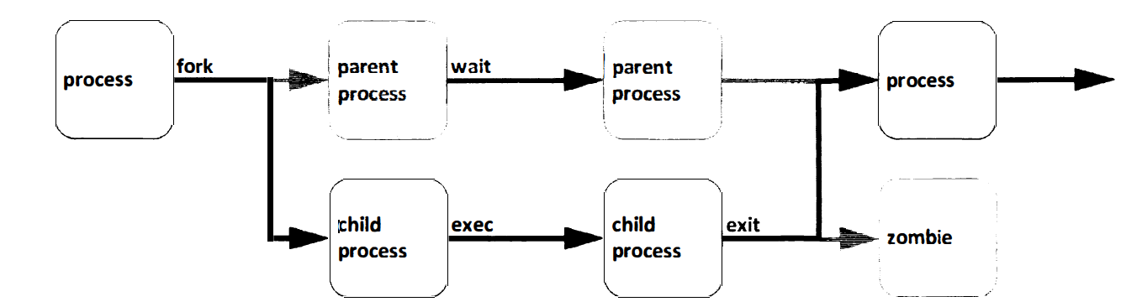
An A An existing (parent) process duplicates its own address space(fork) to create a new (child) process structure. Every new process is assigned a unique process ID(PID) for tracking and security. The PID and the parent’s process ID(PPID) are elements of the new process environment.

Slide 3
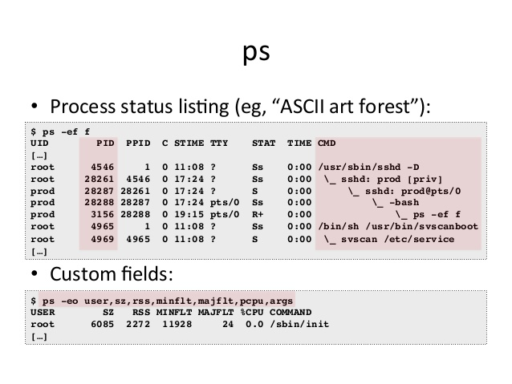
Listing your processes: ps –ef => if used without any arguments, ps shows only processes that have been started by the current user. ps aux => a more detailed info. top => gives an overview of the most active processes. pstree => display a tree of processes. Exercises: 1. List all your processes 2. Sort them by memory usage. Any process may create a child one. All processes are descendants of the first system process, which is systemd(1). Normally, a parent process sleeps while the child process run, setting a request(wait) to be signaled when the child completes. Exercise: 1. Find in the ‘ps’ man page does the STAT column value mean?

Slide 4
Name | Flag | Kernel-defined state name and descipriont
Running | R | The process is either executing on a CPU or waiting to run.
Sleeping | S | Process is waiting for some condition, a hardware request, system resource access, or signal.
Stopped | T | The process has been Stopped(suspended), usually by being signaled by a user or another process.
Zombie | Z | X | Z => EXIT_ZOMBIE: a child process signals its parent as it exits. All resources except for the process identity(PID) are released.
 |  | X => EXIT_DEAD; when the parcent cleans up the remainig child process structure, the process is now released completely.

Slide 5
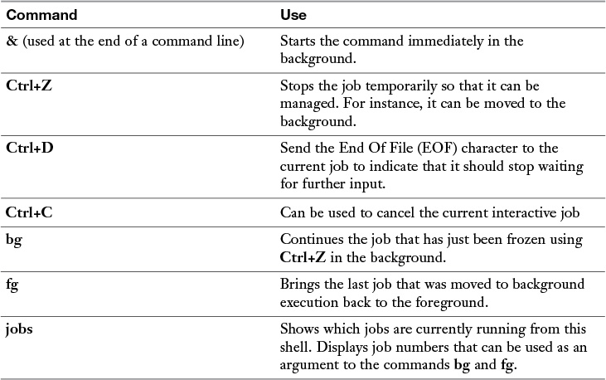
Managing shell jobs => when a user types a command, a shell job is started. If no particular measures have been taken, the job is started as a foreground process, occupying the terminal.
Running jobs in the foreground and background => by default as stated above, any executed command is started as foreground job. For many commands, that does not matter because the command often takes a little while to complete, after which it returns access to the shell from which it was started.
Sometimes however, it might be useful to start commands in the background. This makes sense for processes that do not require user interaction. If you know that a job will take a long time to complete, you can start it with an ‘&’ behind it.

Slide 6
Let’s do this together! 1. (while true; do echo “I smell Linux power”; sleep 1; done) 2. Are u able to use the shell ? Ctrl + Z; 3. Run jobs, anything familiar there ? 4. Run fg 1, what do you think happened ? 5. Run the first command in the background, but add –n to echo and change it to Unix power. Tasks on Linux are started as processes. Once process can start several worker threads. As a Linux admin, you cannot manage individual threads, it is the programmer of the multithreaded application that has to define how threads relate to one another.

Slide 7
Managing Parent Child Relations When a process is started from the shell, it becomes a child process of that shell. The parent is needed to manage the child. For that reason, all processes started from a shell are terminated when that shell is stopped.
Sending to a process a signal.
You could inform a process that you are expecting a behavior out of it. Most often it’s the ‘kill’ command to terminate the process either gently(by releasing all resources that it covers) or by a quick murder no matter what.
Signal number | Short name | Definition | Purpose
1 | HUP | Hangup | Used to report termination of the controlling process of a terminal.
9 | KILL | Kill, unblockable | Causes program termination. Cannot be ignored, always fatal.
15 | TERM | Terminate | This is the default kill signal, it asks politely the program to terminate.

Slide 8
Exercises: 1. List your processes and try to gently kill a process that is not needed. 2. See the result, run the killed process again and try to brutally kill it. 3. Try to kill the first systemd process, what happens ? 4. Run pstree to see a tree representation of all running processes. killall => send a signal to one or more processes matching selection criteria. pkill => uses advanced search criteria. Examples: pkill –SIGKILL –u bob => kills all processes owned by bob. When Linux processes are started, they are started with a specific priority. By default, all regular processes are equal and started with the same priority (20). In some cases, it is useful to change the default priority that was assigned to the process when it was started. Use nice/renice.

Slide 9
Homework: 1. Explain in class what does ‘load average’ metric means. 2. Grep for ‘model name’ in ‘/proc/cpuinfo’, explain to your colleague sitting why you are searching in /proc 3. Start a process with ‘nice –n 5 dd if=/dev/zero of=/dev/null &’ 4. Find PID of the above process, and change it’s priority to 10.

