Slide 1
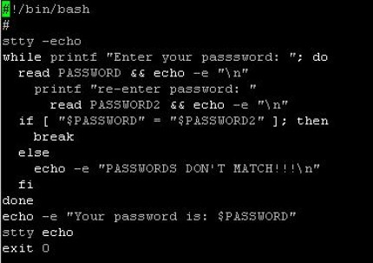
A Bash shell script is simply an executable file composed of a list of commands. Bash shell scripts are a good choice for tasks which can be accomplished mainly by calling other command-line utilities. If suited for the job. the task involves heavy data processing and manipulation, other languages such as Perl/Python will be better The first line of a Bash shell script begins with ‘#!’ (sharp-bang, sha-bang). It indicates that the file is an executable shell script and the command interpreter.

Slide 2
After a Bash shell script is written, its file permissions and ownership need to be modified so that it is executable. Once it is executable, it can be invoked by: 1. entering its name on the command , if the directory where the script resides is inside the PATH env variable. 2. entering the full destination to it. A number of character or words have special meanings to the Bash shell in specific context!!!

Slide 3
# is interpreted by bash as the beginning of a comment and is therefore ignored, along with everything following it. The meanings of special characters or words can be disabled through the use of escape character, \ , single quotes(‘’) or double quotes(“”). The escape character \ removes the special meaning for the single character immediately following it echo # not a comment echo \# not. a comment Exercises: 1. Write a simple bash script, displaying the last two values.

Slide 4
The escape character, \, only removes the special meaning of a single character. When more than one character in a text needs to be escaped, users can either use the escape character multiple times or employ single quotes ‘ ’. Single quotes preserve the literal meaning of all characters they enclose. echo \# not a comment echo ‘#not a comment #’ While single quotes preserve the literal value of all characters they enclose, double quotes differ in that they do not preserve the literal value of the dollar sign($), the back-ticks(` `), and the backslash(\). echo ‘$HOME’ echo ’`pwd`’ echo “$HOME” echo “`pwd`”

Slide 5
As the complexity of a shell script increases, it is often helpful to make use of variables. A variable serves as a container, within which a script can store data in memory. VARIABLENAME=value Variable names are typically uppercase letters. COUNT=40 Two common types of data stored in variables are integer values and string. It is good practice to quote string values, since the space character is interpreted by B ash as a word separator. NAME=John Doe NAME=“John Doe”

Slide 6
EExpanding variable values The value of a variable can be recalled through a process known as variable expansion by preceding the variable name with a dollar sign. FIRST=Mecho SECOND=Puh echo “$FIRST $SECOND” Command substitution, like expanding variable, but for command ☺ echo “Current time: $(date)” Arithmethic expansion echo $[1+1] Space characters are allowed in arithmetic expansion

Slide 7
Iiii Iterating with the for loop => execution an action multiple times. for <VARIABLE> in <LIST>; do <COMMAND> … DONE Iterating all over the content in a directory. for for i in $( ls ); do echo item: $i done Ite=

Slide 8
For HOST in host1 host2 host3; do echo $HOST; done for HOST in host{1,2,3}; do echo $HOST; done Exercises: 1. Write a shell script that greets the user, takes his name as input and then prints it 5 times on the screen. Google if you need help. bash –x <SCRIPTNAME> to put the debug mode on a script.

Slide 9
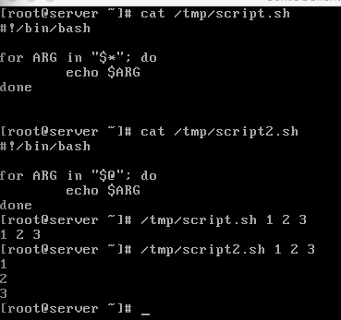
Positional parameters are variables which store the values of command-line arguments to a script. 0 => refers to the script name itself 1 => the first argument to the script Exercises: 1. Write a bash script that prints its name and its first parameter, do not forget provide it. $* and $@ refer to all arguments in a script, but in a different way. Exercises: . 1. Copy and run the below script and explain the difference

Slide 10
Every command returns an exit status, commonly referred to as return status/exit code. A successful command exits with an exit status of 0. Upon completion, a command’s exit status is passed to the parent process and stored in the ? Variable. Therefore, the exit status of an executed command can be retrieved by displaying the value of $? Exercises: 1. ls /etc/hosts 2. echo $? 3. ls /etc/nofile 4. echo$? The ’exit’ command can be executed with an optional integer argument between 0 and 255. Exercises: #!/bin/bash echo “Hello, World!” exit 0

Slide 11
IInteger comparison
Operator | Meaning | Example
-eq | Is equal to | [ “$a” –eq “$b” ]
-ne | Is not equal to | [ “$a” –ne “$b” ]
-gt | Is greater than | [ “$a” –gt “$b” ]
-ge | Is greater than or equal to | [ “$a” –ge “$b” ]
-lt | Is less than | [ “$a” –lt “$b” ]
-le | Is less than or erqual to | [ “$a” –le “$b” ]

Slide 12
IString comparison
Operator | Meaning | Example
= | Is equal to | [ “$a” = “$b” ]
== | Is equal to | [ “$a” == “$b” ]
!= | Is not equal to | [ “$a” != “$b” ]
Examples:
[ 1 eq 1]; echo $?
[ 8 gt 2]; echo $?
[ abc = abc ]; echo $?
Exercises:
Write a bash script that takes 2 numbers and compares them, use if else statements, google them.

Slide 13
Functions, grouping a logical piece of code together. #!/bin/bash function greet { echo “hello” } greet Homework: 1. Write a script, that takes directory addresses as hist first and second argument and checks whether they exist. 2. Encapsulate the above in a function. 3. Call the function.

