Slide 1
What is Configuration management ? Wikipedia => Configuration management (CM) is a systems engineering process for establishing and maintaining consistency of a product's performance, functional, and physical attributes with its requirements, design, and operational information throughout its life. In our context, managing a set of servers from one central location using a tool called Ansible ☺ Exercises: 1. yum info ansible 2. yum –y install ansible 3. man ansible

Slide 2
Ansible depends on SSH access to the servers you are managing. Ansible works best when you have SSH public key authentication configured so that you don’t have to use passwords to access your hosts.
Ansible uses an inventory file to determine what hosts to work against. In its simplest form, an inventory file is just a text file containing a list of host names or IP addresses - one on each line.
The default location is /etc/ansible/hosts
Ansible will attempt to remote connect to the machines using your current user name, just like SSH would. To override the remote user name, just use the ‘-u’ parameter.
Exercises:
1. add ‘ansible’ user to the ansible server as sudo. Generate ssh-keys for him, set its password to ‘linuxacademy’
2. add ‘ansible’ user to the ansible slave node. Repeat the password.
3. ansible all –m ping
4. ansible all -m ping -u ansible --ask-pass
5. Google search about Ansible modules.
6. Discussion between 3 and 4.
- one on each line. For example:

Slide 3
Running a live command on all nodes Exercises: ansible all -a "/bin/echo hello“ ansible all -a “df –hT | grep –v tmfs” Did you see, we could get information about our nodes without loosing time to login and check, so great ! There is a large catalog of modules available for Ansible out of the box => users, groups, packages, ACLs, files, firewall rules, mysql and postgresql databases, docker images

Slide 4
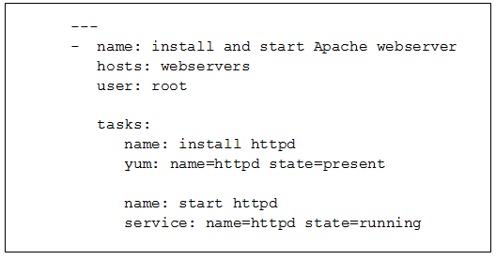
Playbooks allow you to organize your configuration and management tasks in simple, human-readable files. Each playbook contains a list of tasks and are defined in a YAML. file.

