Slide 1
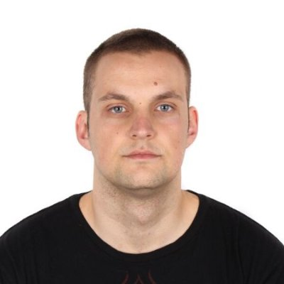


Who am I ?

Slide 2
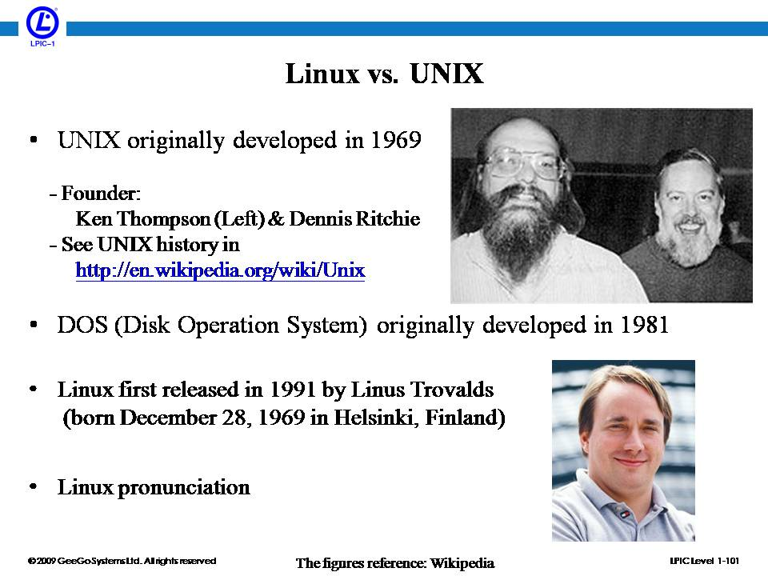
By the beginning of the 90s, home PCs were powerful enough to run UNIX. In 1991, Linus Torvalds thought it would be a good idea to have some sort of freely available academic version of UNIX. He called it ‘Linux’. The first truly free Unix-like OS.

Slide 3
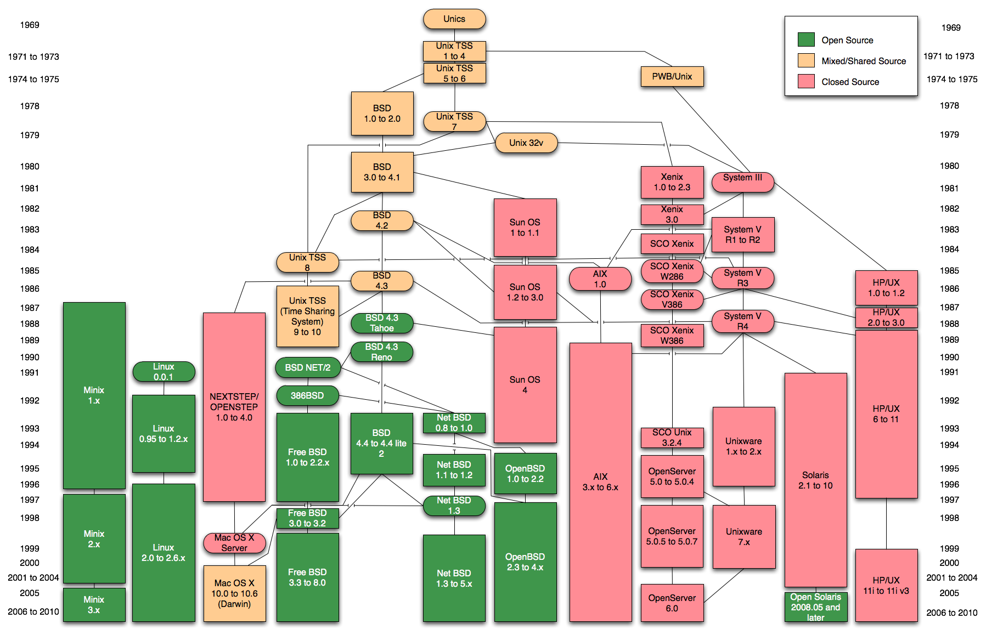

Slide 4

Linux System Administration

Slide 5

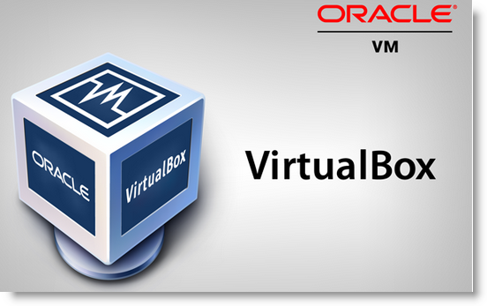
Hypervisor => software that creates and runs virtual machines. Virtualization => Oracle Virtual box Distribution => CentOS 7

Slide 6
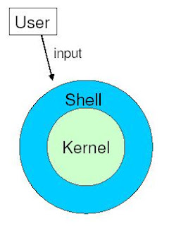

Shell, Different types of shell, Bash shell

Slide 7
Basic shell commands
pwd => print working directory;
ls => list the content of a directory;
cat => print the content of a file;
touch => create new file;
cd => change directory;
echo => display some content ;
Exercises:
Print your current working directory.
Go to the root directory.
Create a file there.
Print it’s content.
List the content of the root directory.
Display the string ‘I am gonna become a solid linux admin’.

Slide 8
Environment variables => set of dynamic named values that can affect how processes will behave on a computer.
env => show all of them in the current shell;
Echo $ENVIRONMENT_VARIABLE_NAME
Eg => echo $PWD; echo $HOME
Exercises:
Print your PATH environment variable
Try to explain what do you think is its meaning, google search if necessary.

Slide 9

VIM => command line universal text editor for Linux/Unix hosts.
Exercises/Homework:
Start and finish the ‘vimtutor’

