Slide 1
DNS is a hierarchical naminng system that servers as a directory of networked hosts and resources. Domain is a collection of resource records that ends in a common name and represents an entire subtree of the DNS name space, such as example.com A subdomain is a domain that is a subtree of another domain. This term is used when discussing the relationship of two domains to each other. A zone is the portion of the domain for which a particular nameserver is directly responsible or authoritative.
DNS

Slide 2
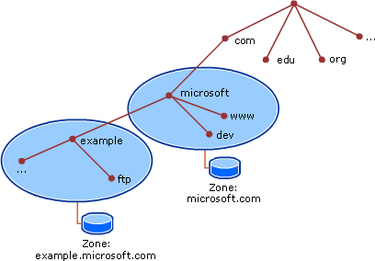

Slide 3
Anatomy of DNS lookups When a system needs to perform name resolution using a DNS server, it begins by sending queries to the servers listed in /etc/resolv.conf in order, until it gets a response or runs out of servers. The ‘host’ or ‘dig’ can be used to manually look up DNS names. 3 possible options after a query has been submitted: 1. Local authoritative data => when the query arrives at a DNS server, the server first determines whether the information resides in a zone that it is responsible for. If it is, the server responds with information contained in its local zone file, AA(authoritative answer). 2. Local cached non-auhtoritative data => not responsible, but still might have a copy in its cache. 3. Remote non-authoritative data via recursion => not responsible, does not have the record in the cache, the DNS server will then perform another iterative query to the Top Level Domain(TLD) authoritative name server it was referred to. The DNS server with empty cache begins the recursion process by querying onf of the root name servers IP address retrieved from its local, pre-populated root hints file.

Slide 4
DNS resource records
DNS RR are entries in a DNS zone file that specify information about a particular name or object in the zone. A resource record contains a type, a TTL, a class and data elements
The network addresses can be static or dynamic(DHCP). Usually the DHCP also assignes the DNS servers to be used. In CentOS 7 the interface(network card) names have new labels:
Ethernet interfaces begin with ‘en’. WLAN interfaces being with ‘wl’. The next part represents the type of the adapter. An ‘o’ is used for onboard (built in), ‘s’ is for hot plug spot, ‘p’ is for PCI location (externally attached). It ends with a number representing index, ID or port.
Example => eno16777734 on boarded Ethernet interface with unique index number.

