Slide 1
DNS is a hierarchical naming system that servers as a directory of networked hosts and resources. Domain is a collection of resource records that ends in a common name and represents an entire subtree of the DNS name space, such as example.com A subdomain is a domain that is a subtree of another domain, such as lab.example.com. This term is used when discussing the relationship of two domains to each other. A zone is the portion of the domain for which a particular name server is directly responsible or authoritative.

Slide 2
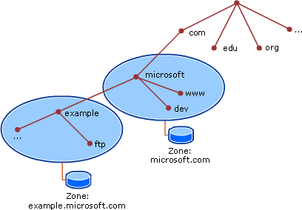
EEach level of the DNS hierarchy is delineated by the “.”, with “.” as the top level.

Slide 3
Anatomy of DNS lookups When a system needs to perform name resolution using a DNS server, it begins by sending queries to the servers listed in /etc/resolv.conf in order, until it gets a response or runs out of servers. The ‘host’ or ‘dig’ can be used to manually look up DNS names. 3 possible options after a query has been submitted: 1. Local authoritative data => when the query arrives at a DNS server, the server first determines whether the information resides in a zone that it is responsible for. If it is, the server responds with information contained in its local zone file, AA(authoritative answer). 2. Local cached non-auhtoritative data => not responsible, but still might have a copy in its cache. 3. Remote non-authoritative data via recursion => not responsible, does not have the record in the cache, the DNS server will then perform another iterative query to the Top Level Domain(TLD) authoritative name server it was referred to. The DNS server with empty cache begins the recursion process by querying onf of the root name servers IP address retrieved from its local, pre-populated root hints file.

Slide 4
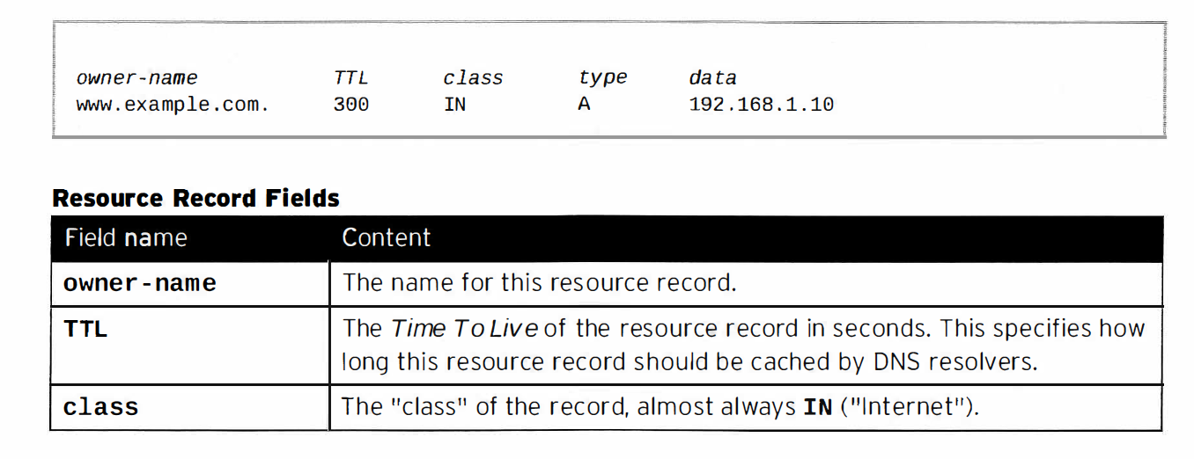
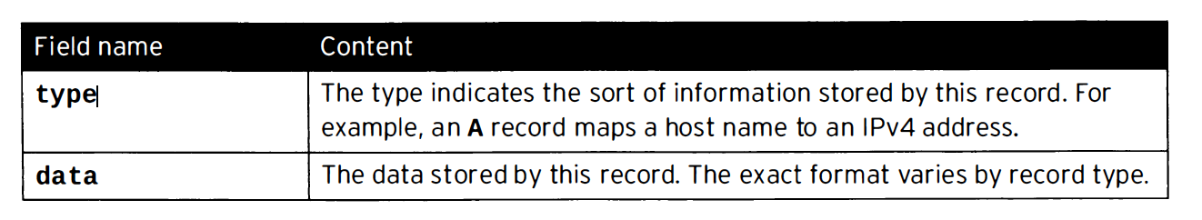
DNS resource records
DNS RR are entries in a DNS zone file that specify information about a particular name or object in the zone. A resource record contains a type, a TTL, a class and data elements
.

Slide 5
Resource record types:
AbbreviationS | Meaning
cname(canonical name) | Aliases one name to another.
ptr(pointer) | Maps ipv4/ipv6 address to a host name
ns(name server) | Maps a domain name to a DNS name server which is authoritative for its DNS zone.
SOA(start of authority) | Provides information how a DNS zone works.
MX(mail exchange) | Maps a domain name to a mail exchange which will accept email for that name.
SRV(service) | Locate the hosts which support a particular service for a domain.

