Slide 1
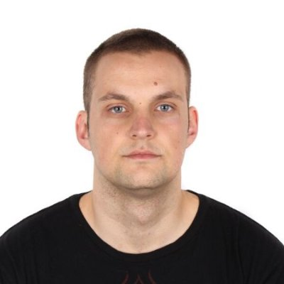


Who am I ?

Slide 2
History of Linux In order to understand the popularity of Linux, we need to travel back in time, about 30 years ago. Every computer had a different operating system. Software was always customized to serve a specific purpose, and software for one given system didn't run on another system. In 1969, a team of developers in the Bell Labs laboratories started working on a solution. => “UNIX”. It was initially found only in very large environments with mainframes. You had to work at a university, for government … Smaller computer were being developed, and by the end of the 80’s, many people had home computers. None of the UNIX versions were truly free and they were terribly slow.

Slide 3
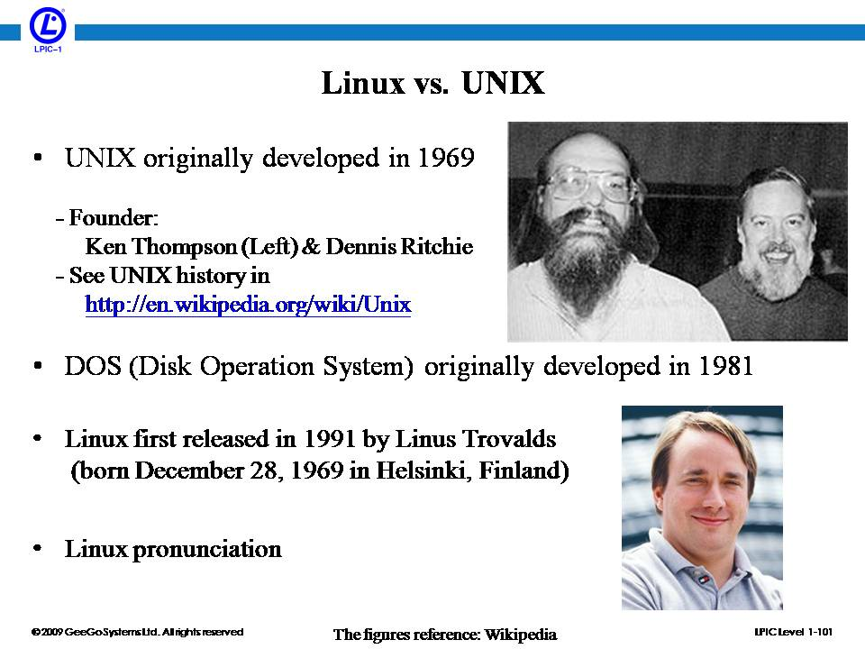
By the beginning of the 90s, home PCs were powerful enough to run UNIX. In 1991, Linus Torvalds thought it would be a good idea to have some sort of freely available academic version of UNIX. He called it ‘Linux’. The first truly free Unix-like OS.

Slide 4
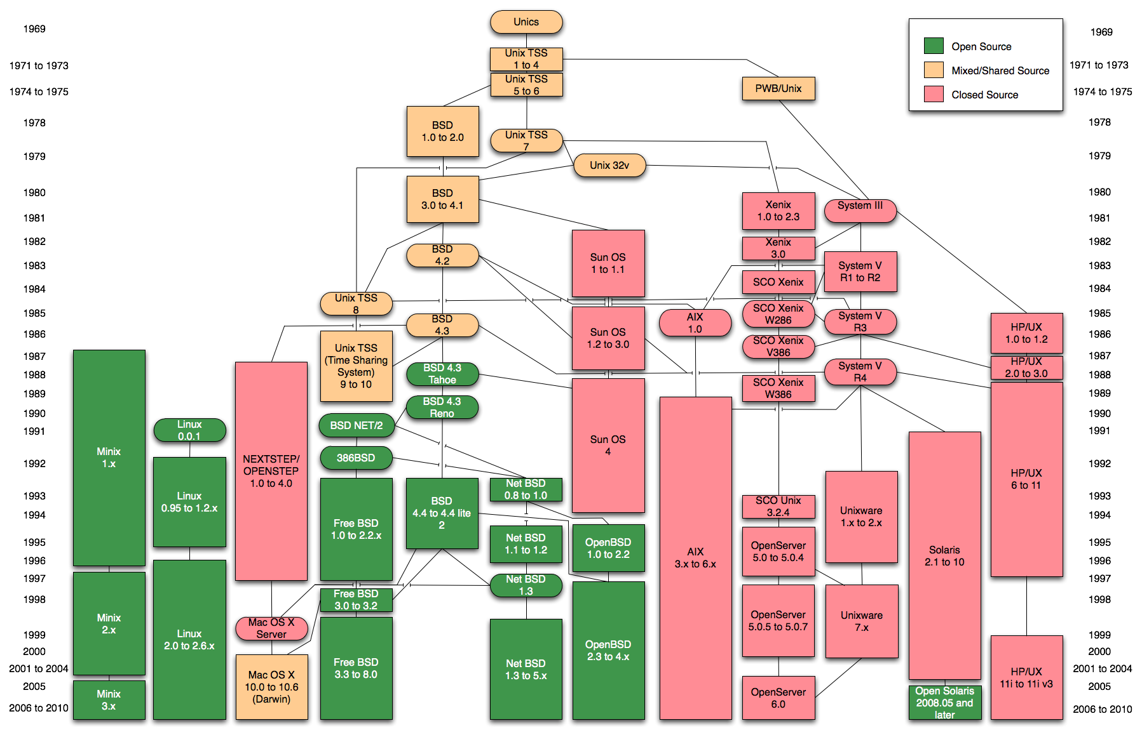

Slide 5

Linux System Administration

Slide 6


Hypervisor => software that creates and runs virtual machines. Virtualization => Oracle Virtual box Distribution => CentOS 7

Slide 7
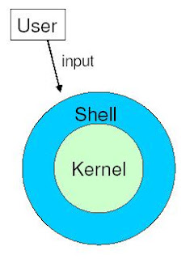

Shell, Different types of shell, Bash shell

Slide 8
Basic shell commands
pwd => print working directory;
ls => list the content of a directory;
cat => print the content of a file;
touch => create new file;
cd => change directory;
echo => display some content ;
Exercises:
Print your current working directory.
Go to the root directory.
Create a file there.
Print it’s content.
List the content of the root directory.
Display the string ‘I am gonna become a solid linux admin’.

Slide 9
Environment variables => set of dynamic named values that can affect how processes will behave on a computer.
env => show all of them in the current shell;
Echo $ENVIRONMENT_VARIABLE_NAME
Eg => echo $PWD; echo $HOME
Exercises:
Print your PATH environment variable
Try to explain what do you think is its meaning, google search if necessary.

Slide 10

VIM => command line universal text editor for Linux/Unix hosts.
Exercises/Homework:
Start and finish the ‘vimtutor’

