Slide 1
§ Logging Processes and the operating system kernel need to be able to record a log of events that happen. These logs can be useful for auditing the system and troubleshooting problems. By convention, the /var/log directory is where these logs are persistently stored.

Slide 2
Most services used on a Linux node write information to log files. This information can be written to different destinations. There are 3 ways to store logs under Linux:
Direct write => some services write logging information directly to the log files(Apache, Samba).
rsyslogd => A service that takes care of managing centralized log files.
journald => with the introduction of system, the journald log service has been introduced as well. It is tightly integrated with systemd. It collects messages from the kernel, the entire boot procedure, and services and write these messages to an event journal. This even journal is stored in a binary format, and it can be queried using the journalctl command.
Because the journal that is written by journald is not persistent between reboots, messages are also forwarded to the rsyslogd service. Rsyslod writes the messages to different files in the /var/log directory. Journald is not a replacement of rsyslog, it is just another way of logging information.
Exercises:
Explain to your classmates in how many ways the logging is done in Linux?

Slide 3
Once again the files in /var/log are written by rsyslogd, journalctl can be used to get more information from the journal. Systemctl status _unit_ => also shows you the last log entries. Some of the files in /var/log directory:
Log File | Explanation
/var/log/messages | The most commonly used log file, it is the generic log file where most messages are written to.
/var/log/dmesg | Contains kernel log messages.
/var/log/secure | Authentication related messages.
/var/log/boot.log | Messages related to system startup.
/var/log/samba | Log files for the Samba service.
/var/log/httpd | Log files for the Apache service.

Slide 4
Exercises: 1. tail –n 20 /var/log/messages 2. Analyze a log line. Date and Time? Host ? Service or process name ? Message Content ? 3. tail –f /var/log/audit/audit.log ; open another process => ssh localhost; what happened ?

Slide 5
The ‘logger’ command enables users to write messages to rsyslog from the command line. Logger is really useful, when you are writing a script and would like to leave a good message why something happened. Exercises: 1. tail –f /var/log/messages 2.open another shell 3. logger ne_obicham_zakuska_bez_banana

Slide 6
Configuring rsyslogd The configuration file for rsyslogd is /etc/rsyslog.conf The most well-known way to filter syslog messages is to use the facility(cathegory)/severity(priority) method.
Facility list | Priority list
Kern | Debug
User | Info
Mail | Notice
Auth | Warning
Syslog | Err
Cron | Crit
ftp | Alert
auth | Emerg
The columns are not connected with each other, they are more like a list !

Slide 7
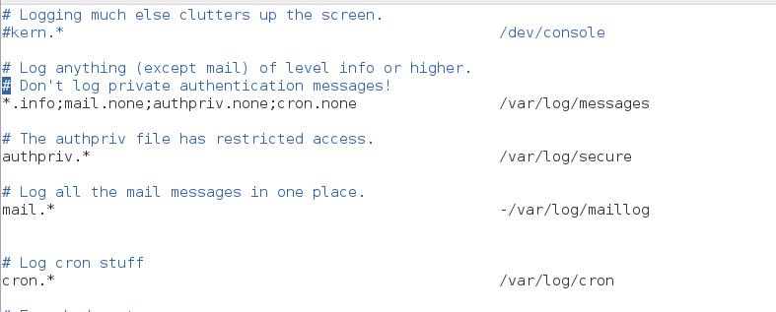
Examples: kern.* => select all kernel syslog messages with any priority. kern = Facility(Cathegory) * = Severity(Priority) mail.crit => All messages from Facility mail with Severity crit cron.!info,!debug => All messages from Facility cron with Severity different than info and debug. Exercise: 1. Analyze the below screenshot:

Slide 8
To prevent syslog messages from filling up your system completely, the log messages can be rotated. That means that when a certain threshold has been reached, the old log file is closed a new log file is opened. The ‘logrotate’ utility is started periodically through the crond service to take care of rotating log files. When a log file is rotated, the old log file is typically copied to a file that has the rotation date in it. /var/log/messages rotated on 9th June, would become /var/log/messages-20170906. By default four old log files are kept on the system. Files older than that period are removed from the system automatically. cat /etc/logrotate.conf

Slide 9
Exercises: 1. journactl –f 2. journalctl 3. journalctl (tab tab) _UID=0 4. journalctl –p err

