Slide 1
On Linux, every file and every directory has two owners: a user and a group. These owners are set when a file or a directory is created. On creation, the user who creates the file becomes the user owner, and the primary group of that user becomes the group owner. Displaying ownership: ls –l Exercises: 1. Create a file in your home directory. 2. List its permissions. 4. Do
Permissions

Slide 2
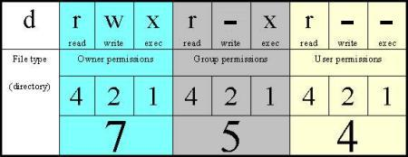
For directory: read => list the content of it, write => creating files, exec => go inside the directory.
For files: read => open a file, write => change content of a file, execute: run a program file.
Each permission has a decimal value: read = 4, write = 2, exec = 1
You could modify the permissions with the sum of those values.

Slide 3
Changing file/directory permissions Symbolic method: chmod who?what?which? File|directory Who ? u, g, o, a (user, group, other, all) What ? +,-,= (add, remove, set exactly) Which ? r, w, x(read, write, execute) Numeric method: chmod 750 sampledir The chmod commands supports the –R option for recursively setting permissions on an entire directory tree. When using this option, be sure to use the X permissions instead of the x to indicate that execute permissions should only be set on directories, not regular files.

Slide 4
CChanging file/directory user or group ownership chown student file chown -R student dir chown :admins dir

Slide 5
Special permissions SUID/Set User Id => a program is executed with the file owner’s permissions. Decimal value: 4. ls –l /bin/passwd; ls –l /etc/passwd; SGID/Set Group Id => files created in the directory inherit it’s group id. Decimal value: 2. Sticky bit => any user can create files, but only the owner of the file can delete it. Decimal value: 1. ls –l /tmp; Exercises: 1. Create a file and list its permissions, what is their value in decimal ? 2. Modify the permission using ‘chmod’, read the manual page first. 3. List the permission on ‘/tmp/’ directory, do you see something different ? 4. Create two local users john and url, su to each one of them and add a file in /tmp, change the file other permission to be writeable. Su to to other one and try to delete it. 5. Think about a valid case for using SGID. 6. Apply the advanced permissions on a newly created directory of your choice, use sticky bit and group collaboration. List the permissions first and test them.

Slide 6
When creating a new file, some default permissions are set. These permissions are determined by the umask setting. In the mask, a numeric value is used that is subtracted from the maximum permissions that can be set automatically to a file, the max for file is 666, for directory is 777. Exercises: 1. Why do you think the max for a file is 666 ? 2. Get the default umask value. 3. Change it to something else. 4. Revert it back to default.

Slide 7
The system default umask values for Bash shell users are defined in ‘/etc/profile’ and ‘/etc/bashrc’. Users can override the system defaults in their .bash_profile and .bashrc Exercises: 1. Create a new file and directory to see how the default umask affects permissions. 2. Set the umask value to 0. 3. Repeat step 1 with the new umask 4. Change the umask to 007 5. Repeat step 1

Slide 8
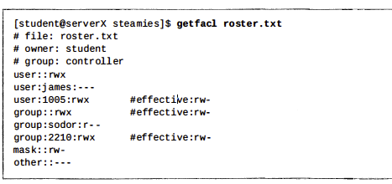
Standard Linux file permissions are satisfactory for most situations, but they have limitations. It may not be appropriate for the process to be a member of the file’s owning group, and even less desirable to grant permission to everyone. The “+” at the end indicates that there are ACL settings associated with this file. ACL ( Access Control Lists ) => a way to add user-extended permissions. The same permission flags apply. New files and subdirectories can automatically inherit ACL settings from the parent directory default ACLs, if they are set. getfacl /tmp/gosho setfacl -m u:lisa:r /tmp/gosho With ACL you can enable inheritance by working with default ACL. setfacl –m d: .

Slide 9
Homework: 1. Set up a shared group environment. Create two directories: /data/account and /data/sales. Make the group sales owner of the directory sales, and make the group account owner of the directory account. 2. Ensure that users are only allowed to remove files of which they are the owner. 3. Make the groups to be able to execute files. 4. Create simple bash script ( google search ) and try to run it as a member of this group.

