Slide 1
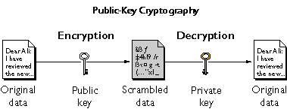
Secure Shell(SSH) is a cryptographic network protocol for operating network services securely over an unsecured network. Securely run a shell on a remote system.
SSH uses public-key cryptography also known as asymmetrical encryption. That means we have 2 keys, a public key(might be widely distributed) and a private key(must remain private). In public key encryption system, any person can encrypt a message using the public key of the receiver, but such a message can be decrypted only with the receiver’s private key.
In SSH client, the client first sends its public key and then the server sends back a decrypted message that could be encrypt with only the client private key(math abstraction). Once the message has been encrypted, the server lets the client in.

Slide 2
SSH host keys When an ssh client connects to an SSH server, before the clients logs in, the server sends it a copy of its public key. This is used to set up the secure encryption for the communication channel and to authenticate the server to the client. The first time a user uses ssh to connect to a particular server, the ssh command stores the server’s public key in the user’s ~/.ssh/known_hosts Things to remember: 1. Host IDs are stored in ~/.ssh/known_host 2. System-wide SSH configuration information is under /etc/ssh/ 3. User specific SSH under ~/.ssh/ Exercises: 1. man ssh-keygen 2. ssh-keygen 3. ssh-keygen generates our private key in ~/.ssh/id_rsa and public ~/.ssh/id_rsa.pub, by default the algorithm is rsa. 4. What are the permissions of the .ssh directory ? And the permission of the keys ?

Slide 3
Besides being secure, with SSH we could create a no login session. 1. ssh localhost 2. ssh localhost It asked for a password in both cases, this is quite uncomfortable since we might want to run a script on the remote server or just do not deal with any password, a set of users sharing the same account. Users can authenticate ssh logins without password by using public key authentication. Since we have the keys generated, we are ready for action. Exercises: 1. man ssh-copy-id Before key-based authentication can be used, the public key needs to be copied to the destination. Exercises: 1. ssh-copy-id localhost; When the key is copied to another system using ssh-copy-id, it copies the ~/.ssh/id_rsa.pub file by default. 2. ssh localhost Much more comfortable ?

Slide 4
The OpenSSH configuration file In 99%, security measures are needed. 1. Advisable to prohibit the root user from directly logging into the system with ssh ? Why ? - The username ‘root’ exists on every Linux system by default, so a potential attacker only has to guess the password, instead of a valid username and password combination. Exercises: 1. vim /etc/ssh/sshd_config 2. #PermitRootLogin no 3. systemctl restart sshd 2. Prohibit password authentication. 3. Change the standard port on which ssh is listening. Exercises: 1. Change ssh to listen on port 50683

Slide 5
Before starting with NFS and Samba, we would set SELinux to be in ‘permissive’ mode. SELinux is beyond the scope of the course. setenforce 0 getenforce Network File System(NFS) allows remote hosts to mount file systems over a network and interact with them as though they are mounted locally. A NFS server setup requires the nfs-utils package to be installed. The configuration file for the NFS server exports is the /etc/exports file. An entry in /etc/exports looks like: directory machine(option1,option2) machine(option1, option2) /home 192.168.0.1(rw, no_root_squash) 192.168.0.2(rw)

Slide 6
Option | Meaning
ro | The directory is shared read only; the client machine will not be able to write to it. This is the default.
rw | The client machine will have read and write access to the directory.
no_root_squash | By default, any file request made by user root on the client machine is treated as if it is made by user nobody on the server. If no_root_squash is selected, then root on the client machine will have the same level of access to the files on the system as root on the server.
no_subtree_check | If only part of a volume is exported, a routine called subtree checking verifies that a file that is requiested from the client is in the appropriate part of the volume. If the entire volume is exported, disabling this check will speed up transfers.

Slide 7
Typical workflow to configure NFS Server 1. start nfs-server process ( systemctl start nfs-server ) 2. enable it ( systemctl enable nfs-server ) 3. create the exported directory ( mkdir /myshare ) 4. Edit the /etc/exports file ( /myshare some_other_node(rw) ) 5. exportfs –r 6. The NFS port 2049/TCP for nfsd must be open on the server. firewall-cmd –permanent –add-service=nfs firewall-cmd –reload 7. mount –t nfs nfs_server_hostname_or_ip:/myshare /mnt Exercises: 1. Export a directory 2. Mount it on another virtual machine with _netdev option.

Slide 8
Server Message Block(SMB) is the standard file-sharing protocol for Microsoft Windows servers and clients. Using a software package named Samba, Linux is able to act as a server for SMB file shares. The Samba service can share Linux file systems as SMB network file shares. 1. Install the samba package. => yum install samba. 2. Prepare the directory => mkdir /sharedpath 3. Configure the /etc/samba/smb.conf, validation of the file content using testparm [data] path = /sharedpath read only = No guest ok = Yes vs valid users = dave comment = data for samba 4. If we have a valid user, we should add it to our database with ‘smbpasswd –a username’; pdbedit –l , the user must exist at our Linux box. 5. Open the firewall firewall-cmd --permanent --zone=public --add-service=samba firewall-cmd --reload

Slide 9
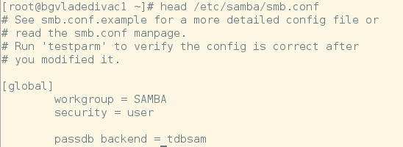
3. Configuration of /etc/samba/smb.conf The main configuration file for Samba. Each section starts with a section name in square brackets, followed by a list of parameters set to particular values. The [global] section used to general server configuration.
Field | Meaning
workgroup | The Windows workgroup for the server. Most Windows systems default to WORKGROUP.
security | Controls how clients are authenticated by Samba. For security = user clients log in with a valid username and password managed by the local Samba server. This is the default.
hosts allow | Comma/Space delimited list of hosts that are permitted to access the Samba service.

Slide 10
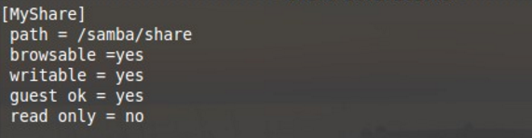
3. Configuration of /etc/samba/smb.conf File share sections To create a file share, at the enf of /etc/samba/smb.conf, place the share name in brackets to start a new section for the share.
Field | Meaning
Path | Indicate which directory to share.
Writable = yes/no | All authenticated users should have read-write access to the share.
Valid users | A list of users allowed to access the share.

Slide 11
Client side action 1. Install samba-client 2. Install cifs-utils 2. smbclient –L server_ip –U user_added_before 3. mount –t cifs –o username=user_added_before //samba_server_ip/share /mnt

Slide 12
Homework: 1. Review todays lesson and try to reimplement the exercises. Explain each step to yourself. 2. Think about more useful option to mount a samba share persistantly.

