Slide 1
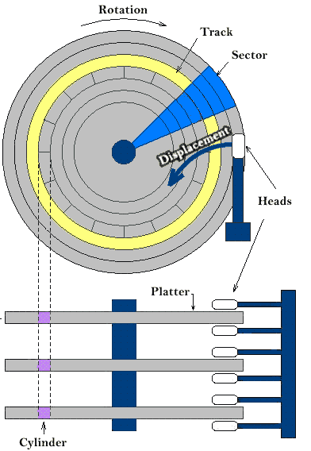
A partition is just a slice of the hard disk. Some operating systems are installing everything to one partition, while other such as Linux normally have several partitions on one hard disk. Using more than one partition makes sense because it makes it easier to distinguish between the different types of data. A sector is a unit in which partitions are measured. Example => partition starting at 1 sector, ending in 26. “Blue” = partition.
Understanding MBR and GPT partitions

Slide 2
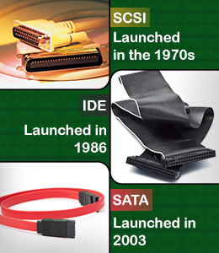
How devices are represented in Linux ? In Linux, for the most part you have ‘Character’ and ‘Block’ devices. Exercises: 1. ls –l tty0 2. ls –l /dev/sda All devices in Linux are under /dev directory or file system. Block devices can be cached in memory and read back from cache, writes can be buffered. Character devices writing/reading is an immediate action. An interface is a channel capable of transferring data in parallel mode – transmitting multiple bits simultaneously. The most common interfaces are SCSI and SATA. Linux started representing the device with the SCSI/IDE interfaces and continued to use just SCSI, no matter that the hard disk might use SATA. IDEs are no longer used.

Slide 3
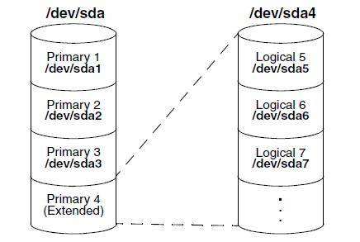
When the personal computer was invented in early 1982s, a system was needed to defines hard disk layout. It became known as Master Boot Record(MBR). It is stored on the first sector ( boot sector ) and represents how the hard disk is partitioned and it also loads the boot loader. The limitation of MBR is that only 4 partitions could be created. A workaround is to create an extended partition, within it, a number of logical partitions.
You could manipulate the partition table on MRB with ‘fdisk’
Exercises:
Add a new disk on your VM.
Create 3 main partition and one extended.
3. Read the manual page for ‘partprobe’.
4. On the extended partition, create two more partitions.
5. Google what does a ‘swap’ partition do, create one swap partition.

Slide 4
The need for GPT Partitions
Current computer hard drives have become too big to be addressed by the MBR partitions. That is why a new partitioning scheme was needed. This scheme is the GUID Partition Table(GPT). On computers using the new Unified Extensible Firmware Interface (UEFI) as a replacement for the old BIOS, GPT partitions are the only way to address disks.
In GPT, up to 128 partitions can be created. A backup copy of the GPT partition table is created by default at the end of the disk, which eliminates the single point of failure that exists in MBR. The 2TB limit no longer exists.
GPT support in fdisk is not stable, for GPT use gdisk. Do not ever use gdisk on a disk that has been formatted with fdisk and already contains fdisk partitions. Gdisk will detect that an MBR is present and it will convert this to a GPT>
Exercises:
Try to run gdisk on the previously created partitions.
Add a new disk and apply GPT partition table on it, create 5 partitions. The partitions size needs to be 5GB, 20GB, 20GB, 25GB, 45GB.

Slide 5
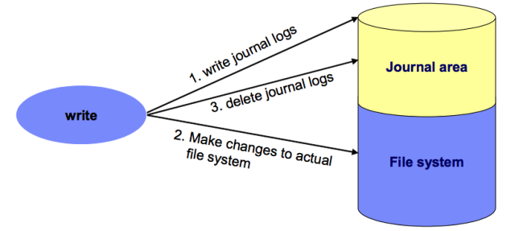
In computing, a file system is used to control how data is stored and retrieved. The most common file systems under Linux are ‘XFS’ and ‘ext4’. Almost each file system has a journal that helps it to recover after a crash(unexpected power off).
Exercises:
1. Read the ‘fsck’ man page. 2. Google ‘superblock’, try to explain it to your colleagues ?

Slide 6
We have GPT disk and MBR disk partitioned, let’s create some file systems on them. Each file system on Linux has a mount point, a place in the / file system where it’s attached. Each file system also needs a blocking device to store and retrieve its data. What we need ? 0.1. man mount 0.2. man df 0.3 man mkfs 1. Blocking device(partition) 2. File system type 3. Mount point mkfs –t ext4 /dev/sdb1 => analyze the output mount /dev/sdb1 /mnt df vs df –hT vs df –HT Exercises: 1. Mount one xfs and one ext4 file system on each of the two disks. 2. List the available file systems and grep for the new ones. 3. Go inside their mount points and create some content

Slide 7
When you mount a file system on a partition, always use UUID. Unique Identified for each block device, run blkid. Using UUID is independent from the actual device number the OS gives you hard disk. If your file system is not temporary solution, you want it to be mounted in the file /etc/fstab. Exercises: 1. man blkid 2. man fstab 3. cat /etc/fstab In the /etc/fstab file systems will be mounted automatically on a reboot or immediately with ‘mount –a’ in case you add an entry.
Option | Use
Auto/noauto | The file system will [not] be mounted automatically.
Acl | Adds support for file system access control lists.
Ro | Mount the file system in read-only mode.
_netdev | Wait until the network is available, before mounting this file system.

Slide 8
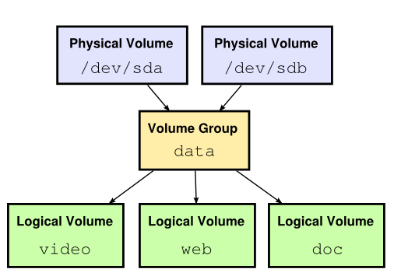
Scenario: You partitioned the disk, but you are running out of space on your local musical partition, and there are more pop-folk songs that you have not downloaded yet ? Issue ? 1. Reformat the disk, change the partition scheme and reinstall ? 2. Buy a new disk, think about new partition scheme that will require some movement of data. ??? 3. What if it happens again ? Once allocated the space for partition pretty much remains static, in order to overcome this some smart guys invented Logical Volume Manager(LVM).

Slide 9
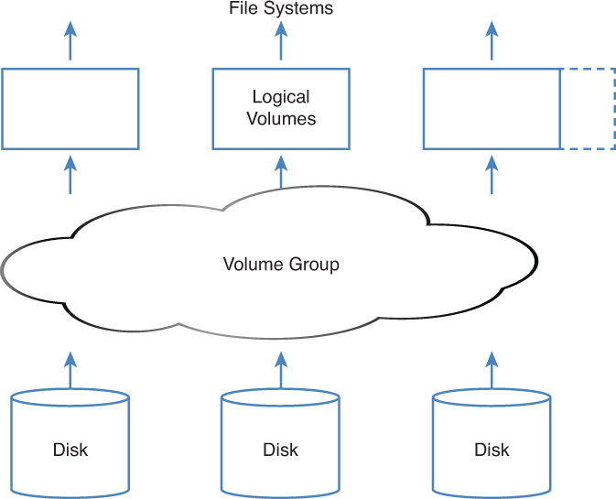
On the lowest layer, the storage devices are used. These can be any storage devices, such as complete disks, partitions, logical units(LUNs) on a storage area network(SAN). The storage devices need to be flagged as physical volumes. A storage device that is a physical volume can be added to the volume group, which is the abstraction of all available storage, like a container. On the top of the volume group are the logical volumes. Logical volumes do not act on disks directly, but get their disk space from available disk space in the volume group. That means that a logical volume may consist of available storage from multiple physical volumes.

Slide 10
Exercises: 1. Add 2 disks to the OS 2. Man ‘pvcreate’ 3. Man ‘vgcreate’ 4. Man ‘lvcreate’ 5. Create a volume group of the two disks called ‘container’, make 3 logical volumes out of it called ‘logical_volume_1’, ‘logical_volume_2’ and ‘logical_volume_3’ Why LVM is great ? Discussion! Answers: 1. Flexible solution for managing storage. 2. Support for snapshot( a snapshot keeps the current state of a logical volume and can be used to revert to a previous situation or to make a backup of the file system on the logical volume ) 3. Replace failed hardware easily(man pvmove) 4. For now, focus on just 1.

Slide 11
Homework: 1. Add 3 file systems on the previous logical volumes(two ext4, one xfs) and mount them in /etc/fstab, you pick up the mounting point. 2. What kind of device is the logical volume according to you ? Blocking or a character ?

