Slide 1
Selenium Automation A Concise Introduction
Instructor: Michael Gaffney (670800)

Slide 2
Course Overview

Slide 3
Purpose of the course
To provide you with an overview of Selenium WebDriver
To enable you to use WebDriver in your own projects
To look at and practice some basic Selenium testing
To provide you with resources to continue mastering WebDriver on your own.
This course has no assessment.

Slide 4
Selenium WebDriver architecture
Installation
Controlling a web page with WebDriver
Using JUnit with WebDriver

Slide 5
Course Format
Other than this introductory slide deck, the course material will be presented in the form of heavily annotated code, which will be posted to https://github.com/AcademyGaffney/SeleniumBasicsNA
There will be a few short challenges to get you some practice.

Slide 6
Selenium WebDriver Overview

Slide 7
What WebDriver Is
Selenium WebDriver is an automated web testing framework that
Tests from the perspective of the user
Interacts with the HTML of the page and the actual displayed page.
Does not send its own HTTP requests or intercept responses.
Can be coded in a number of popular languages
Can test against a number of popular browsers

Slide 8
What WebDriver Does
In short, WebDriver is a way to automate almost everything that can be tested manually by using the web site.
Does does submitting a form bring up the correct result page?
Are elements visible and enabled (or not) and where they're supposed to be?
Does mouseover text appear correctly?
Does an input field allow only what it should?

Slide 9
What WebDriver Doesn't Do
Get through captchas
Track file downloads
Read HTTP response codes and messages
Accurate performance testing
Efficient dead link checking

Slide 10
WebDriver Architecture

Slide 11
WebDriver Architecture
User code
Language-specific Selenium libraries
Browser-specific web driver
Website
Java
Python
C#
Ruby
JavaScript

Slide 12
WebDriver Architecture
User Code
Is typically written in a testing framework such as JUnit or TestNG
Is plain old <language> code, and thus can be as simple or complex as it needs to be
Is the only part we're responsible for

Slide 13
Selenium Libraries
There are several officially-supported Selenium libraries to install in your system or project.
Java (via Maven)
Python (via pip or python)
C# (via Install-Package or dotnet)
Ruby (via gem)
JavaScript (via npm)
Unofficial libraries exist for other languages – such as PHP, Perl, and R – as well.

Slide 14
Web Drivers
Web drivers are relatively small programs that interface between your code and your target browser.
These are available for Chrome/Chromium, Firefox, Edge, Internet Explorer, and Opera. Safari has support built in.
These are all maintained by the same organization that maintains the browser, with the exception of IE, which is maintained by the Selenium Project.
These can be placed in the system path of testing machines, included in a project directory for portability or, of course, fully qualified wherever they are used.

Slide 15
Website
Selenium WebDriver can be used to automate the interaction with any web site, since it works through the client. Accessing 3rd party websites in your testing should be avoided however.
Sites often change their underlying HTML regularly to break automated tools
Sites often have terms of service forbidding automated access
Instead, check to see if there's a public API that can be used to access the site's data in an approved manner.

Slide 16
WebDriver Installation

Slide 17
Remote Lab
If you're unable to set up Selenium locally (most likely because your system isn't set up for Java development) we have a remote Toolwire lab that should be fine.
From 1C search for CLearn and then CSEST689
Selenium - Virtual lab [301-ADVANCED]
select, register, register again, then start.
It may take a while
I haven't tested the functionality
It's flakey for me today.

Slide 18
Pre-requisites to work with Selenium locally
Java: Download and install OpenJDK 11 with the HotSpot JVM from https://adoptopenjdk.net/
Eclipse IDE: https://www.eclipse.org/downloads/ (You can use any, but it's what I'm using.)
Maven: This is likely included in your IDE, but can be downloaded from http://maven.apache.org/download.cgi. Remove from the archive and put the /bin folder in your system path.

Slide 19
Web Driver Installation
Download the driver for your browser. Links to download pages can be found here: https://www.selenium.dev/documentation/en/webdriver/driver_requirements/
Drivers are version-specific.
Remove the executable from the archive.
If desired, add to your system's path or include in your project folders. (I'll have mine in my project folder, but you'll need to change the file if you're on a PC.)

Slide 20
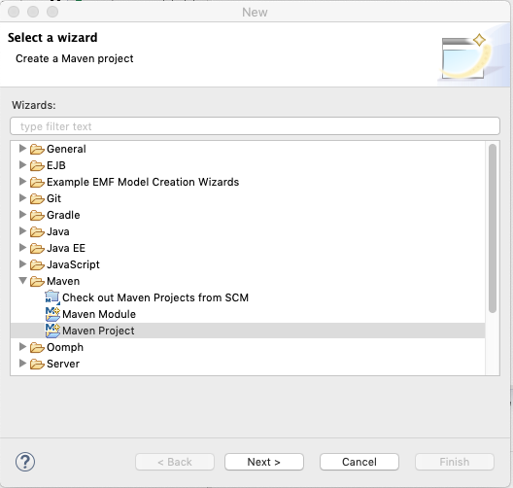
Project creation (Eclipse examples, Mac environment)
Create a new Maven project

Slide 21
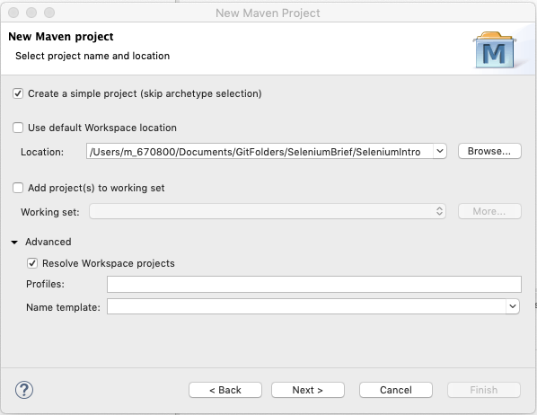
Creating a project
Create a simple project. In Location, be sure to have your project folder specified (it doesn't need to exist yet) or the project will be dumped in the parent folder. "Resolve Workspace projects" is only relevant if our project is going to be a dependency in another, which it won't ne.

Slide 22
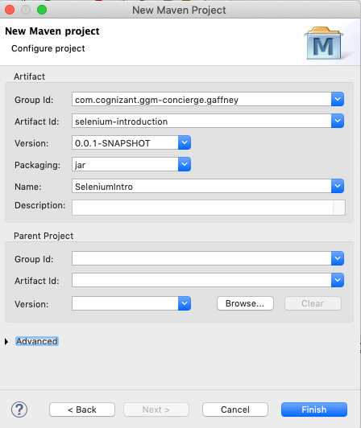
Project Creation
"Group Id" is the organization and overall project. "Artifact ID" is the specific component and what you're Maven project will show up as in Eclipse
"Name" is just a human-readable project name.

Slide 23
Project Creation
In Eclipse, open your project then open the file pom.xml. Add the following between the <name> line and the </project> line:
<dependencies>
<dependency>
<groupId>org.seleniumhq.selenium</groupId>
<artifactId>selenium-java</artifactId>
<version>3.141.59</version>
</dependency>
</dependencies>

Slide 24
Eclipse Gotcha – Compiler compliance
Your version of Eclipse may create projects with defaults that are incompatible with Selenium. To check and fix:
Right-click the archive id name in your project explorer and choose properties
Select Java Compiler on the left
Uncheck "Use compliance from execution environment"
Select "Compiler compliance level" 1.8 (or 11, if you've installed 11)

Slide 25
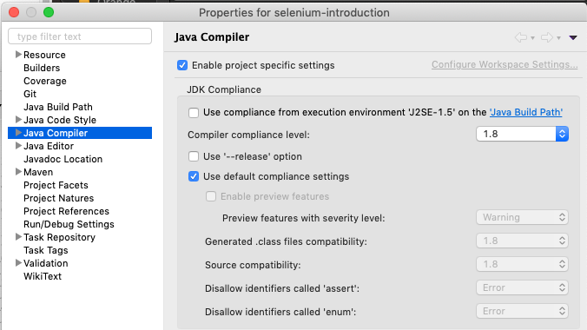
Eclipse compiler compliance

Slide 26
Further materials
https://www.guru99.com/selenium-tutorial.html
Very solid web tutorial with it's own mock website for running tests against
We'll use their mock website for examples and practice, and I'll reference it.
https://cognizant.udemy.com/
Everyone in Cognizant has access to our Udemy for Business license now. Use it so we can keep it.
A number of options available for "Selenium WebDriver" from 6 to 90 hours. I've not had a chance to review.

Slide 27
Going forward
Today: Connecting to pages and finding elements
Wednesday: Interacting with elements
Thursday: Mouse actions and multiple windows
Friday: JUnit suites for Selenium

