Slide 1
Introduction to Python
Basics of Python Programming Language
Day 4 | Duration: 2 Hours

Slide 2
The Zen of Python
“There should be one- and preferably only one- obvious way to do it.”
- The Zen of Python (by Tim Peters)
Object1
Object2
Object3
Output

Slide 3

Terminal Objectives
We will understand what is the OOP and how it has been implemented in Python.
We will learn to know the four major principles of object-orientation and the way Python deals with them, i.e. Encapsulation, Data-Abstraction, Polymorphism & Inheritance.
To learn how to write object oriented programs using Python.

Slide 4
Why Object Oriented Programming?
OOP
Benefits
It provides a clear modular structure.
Objects can also be reused within an across applications.
It makes software easier to maintain.
Reusability also enables faster development.
The software components can be easily adapted and modified by the programmers.
It implements real life scenario.
The productivity of programmers increases.
Data is safe and secure with data abstraction.

Slide 5
Topics to Cover
Object Oriented Programming using Python
Overview of OOP in Python
Class & Object in Python
Inheritance
Overloading

Slide 6
Overview of OOP in Python

Slide 7
Overview of OOP in Python
Object-oriented Programming, or OOP for short, is a programming paradigm which provides a means of structuring programs so that properties and behaviors are bundled into individual objects.
OOP models real-world entities as software objects, which have some data associated with them and can perform certain functions.
The concept of OOP in Python focuses on creating reusable code. This concept is also known as DRY (Don't Repeat Yourself).

Slide 8



Overview of OOP in Python
Class
OOP
Encapsulation
Polymorphism
Inheritance
Data Abstraction
Class Student

Slide 9
Overview of OOP in Python
Class: A user-defined prototype for an object that defines a set of attributes & methods that characterize any object of the class.
Object: A unique instance of a data structure that is defined by its class. An object comprises both data members and methods.
Data Member: A class variable or instance variable that holds data associated with a class and its objects.
Class Variable: A variable that is shared by all instances (object) of a class.
Instance Variable: A variable that is defined inside a method and belongs only to the current instance (object) of a class.
Method: A function that is defined in a class.

Slide 10
Class & Object in Python

Slide 11
Class & Object in Python
Classes are used to create new user-defined data structures that contain arbitrary information about something.
A class just provides structure, it is a blueprint for how something should be defined, but it doesn’t actually provide any real content itself.
The class statement creates a new class definition in Python.
The class consists of all the component statements defining class members, data attributes and functions.

Slide 12
Class & Object in Python
An object or instance is a copy of the class with actual values & functionalities, and we can create as many object we want from a class, which is called Instantiation.
James
sayHello()
Class User
David
Instantiation
Message Passing
Attribute: name
sayHello()
Method: sayHello()
Bill
sayHello()

Slide 13
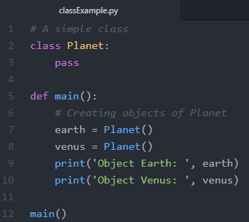
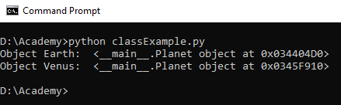
Class & Object in Python
Creating a very basic class & object of it in Python:

Slide 14
Class & Object in Python
Few important built-in class methods:
__init__(): This is called the constructor function. A constructor is called whenever an object is created. It helps to assign initial values to objects of your class right after they have been created.
__del__(): This is a destructor function. A destructor function is called whenever an object is deleted/destroyed. We can delete an object using ‘del <object>’ command. Objects are also automatically deleted when the program terminates, or the object goes out of scope. The destructor can be used to perform some cleanup activities before an object is destroyed, like freeing up resources, closing file pointers, etc.
__str__() : This method returns whatever we want an object to display if we print the object itself, or explicitly convert an object into a string.

Slide 15
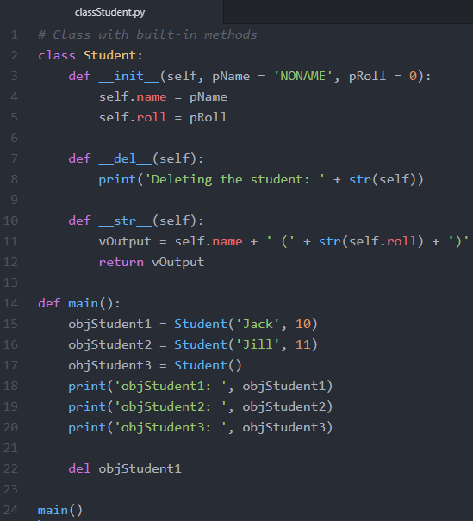
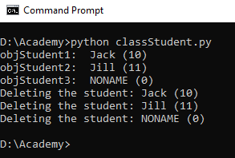
Class & Object in Python
Note: Even if we are not using del keyword to delete an object, the __del__() method is automatically called when the object goes out of scope.

Slide 16
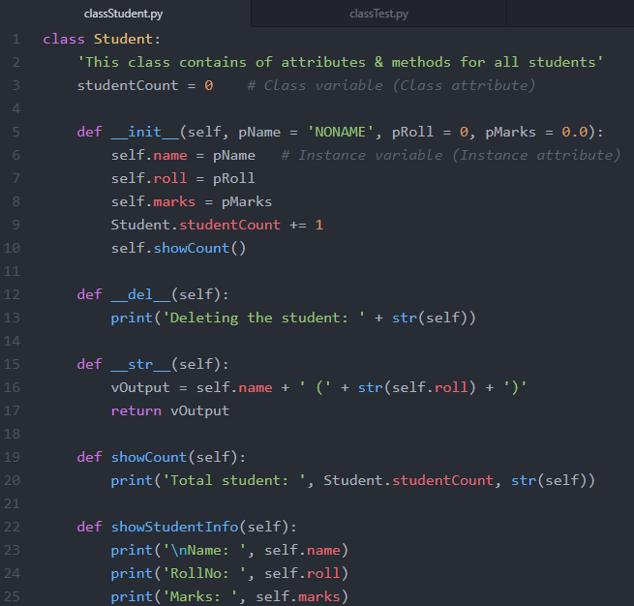
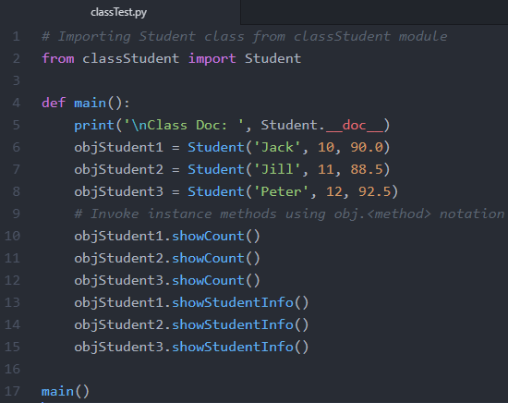
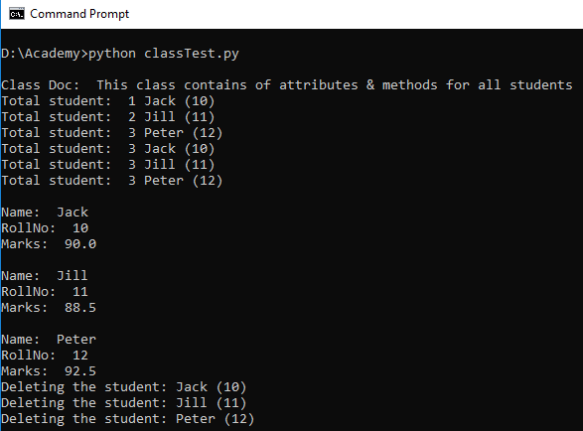
Class & Object in Python

Slide 17
Class & Object in Python
Few important built-in class attributes:
__dict__: Dictionary containing the class’s namespace.
__doc__: Class documentation string or none, if not defined.
__name__: Returns the name of the Class.
__module__: Returns the module name in which the class is defined. This attribute returns “__main__” in interactive mode (shell).
__bases__: A tuple containing the base classes, in the order of their occurrence in the base class list.

Slide 18
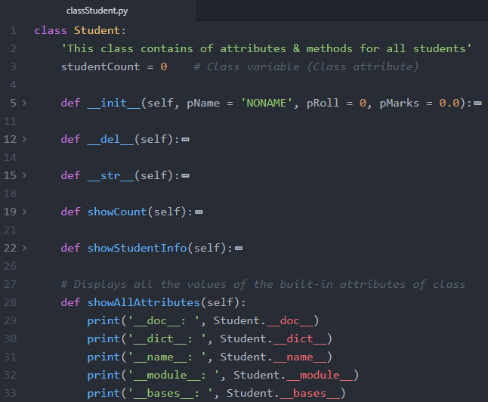
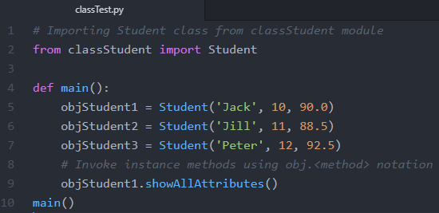
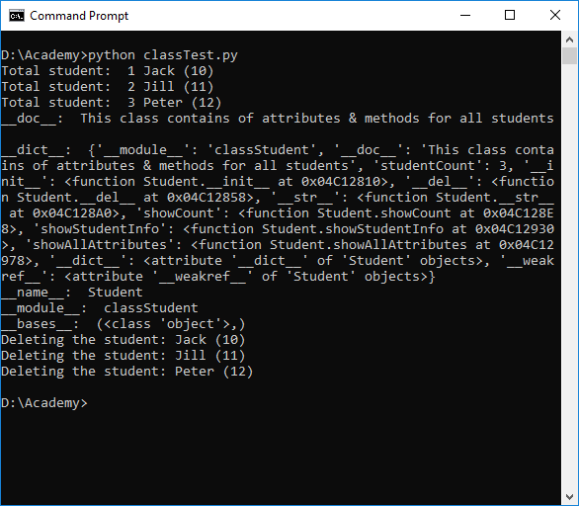
Class & Object in Python

Slide 19
Class & Object in Python
Data Encapsulation
Data Hiding
Data Abstraction
Encapsulation is seen as the bundling of data with the methods that operate on that data.
Data Hiding on the other hand is the principle that some internal information or data is “hidden”, so that it can’t be changed.
Data encapsulation via methods doesn’t necessarily mean that the data is hidden. You might be capable of accessing and seeing the data anyway, but using the methods is recommended.
Data Abstraction is present, if both data hiding & data encapsulation is used.

Slide 20
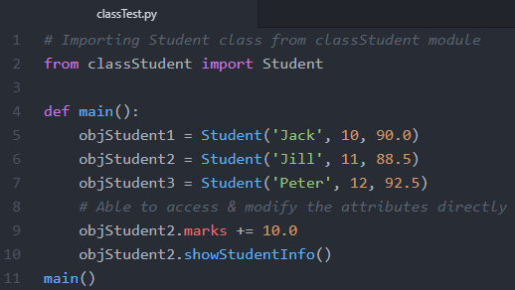
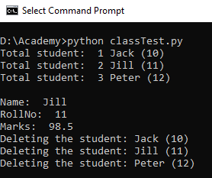
Class & Object in Python
We are able to access as well as modify the instance attributes directly by the object.<attribute> notation.
Python uses a special naming scheme for attributes to control the accessibility of the attributes.
We can prefix an attribute name with a leading underscore “_”. This marks the attribute as protected. It tells users of the class not to use this attribute unless, somebody writes a subclass.
We can prefix an attribute name with two leading underscores “__”. The attribute is now inaccessible and invisible from outside. It’s neither possible to read nor write to those attributes except inside of the class definition itself.

Slide 21
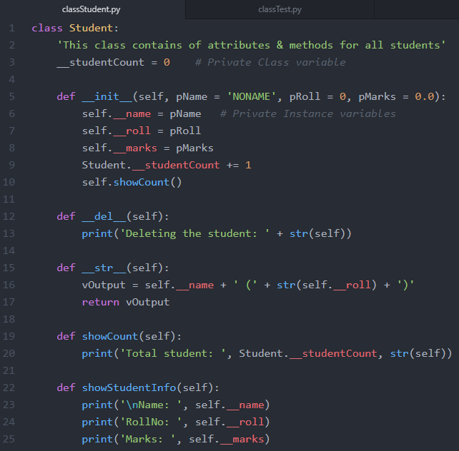
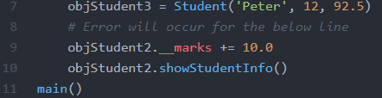
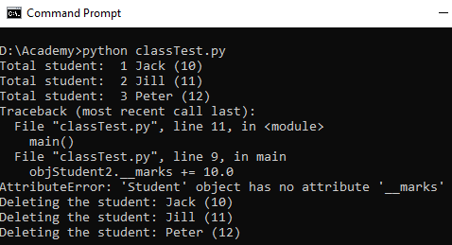
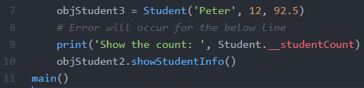
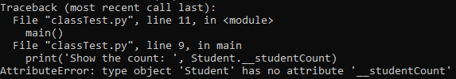
Class & Object in Python

Slide 22
Challenge
Create a class called Alien with two properties, name and planet.
Create a constructor to set those properties
Create a method called greeting in the class that prints ”Hello. I am <name> from planet <planet>”
Create two Alien objects and have them greet each other.

Slide 23
Inheritance

Slide 24
Inheritance
Inheritance is the process by which one class takes on the attributes and methods of another.
Newly formed classes are called Child Classes (Sub Class or Derived Class), and the classes that Child Classes are derived from are called parent classes (Base Class).
Child classes override or extend the functionality (e.g., attributes and methods) of parent classes. In other words, child classes inherit all of the parent’s attributes and behaviors but can also specify different behavior to follow.
The most basic type of class is Object, which generally all other classes inherit as their Parent.

Slide 25
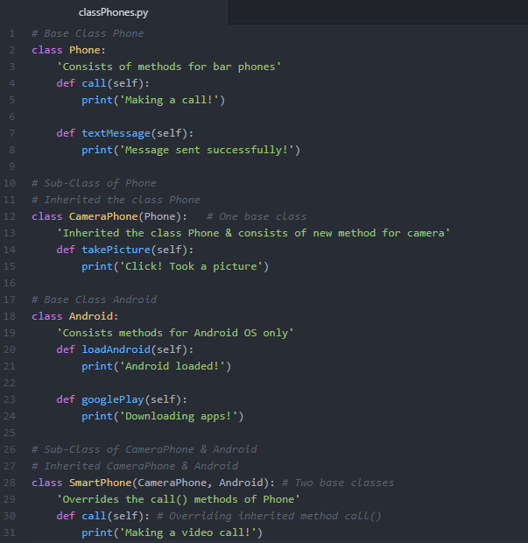
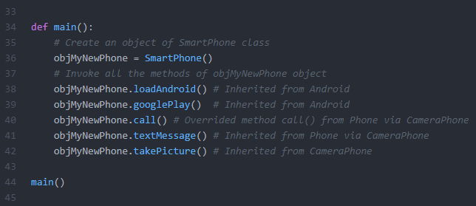
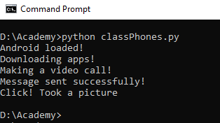
Inheritance

Slide 26
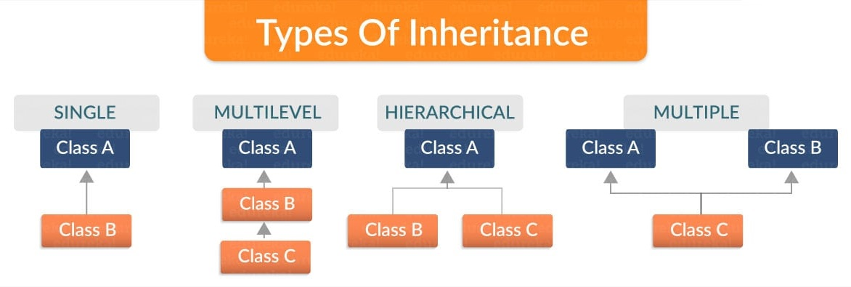
Inheritance
Types of Inheritance:
Single inheritance: A child class inherits from only one parent class.
Multilevel inheritance: A parent class has child and grand child relationship.
Hierarchical inheritance: More than one derived classes are created from a single base.
Multiple inheritance: A child class inherits from multiple parent classes.

Slide 27
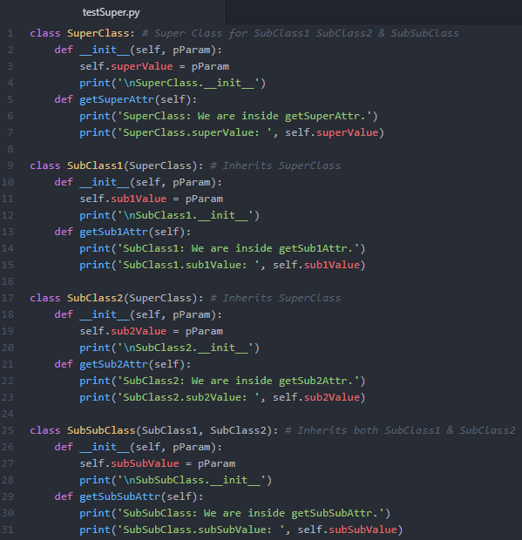
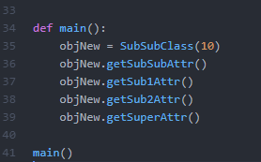
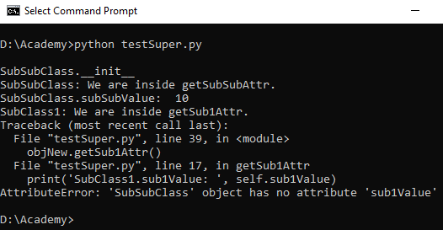
Inheritance
The super class’s attributes were not initialized, we have to explicitly call the __init__() of the super classes from their respective sub classes.

Slide 28
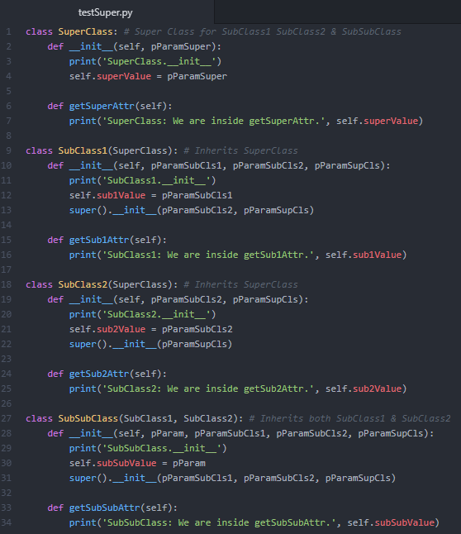
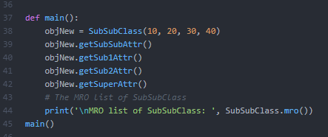
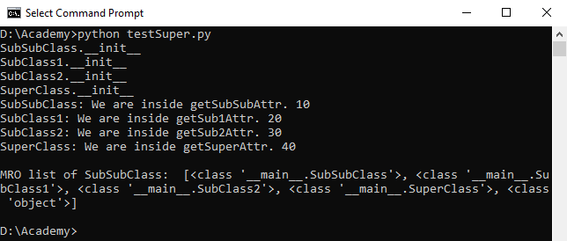
Inheritance
It is Method Resolution Order (MRO), which helps super() functions to makes its decision that which class has to be used. It is based on the “C3 Superclass Linearization” algorithm. This is called a linearization, because the tree structure is broken down into a linear order.

Slide 29
Overloading

Slide 30
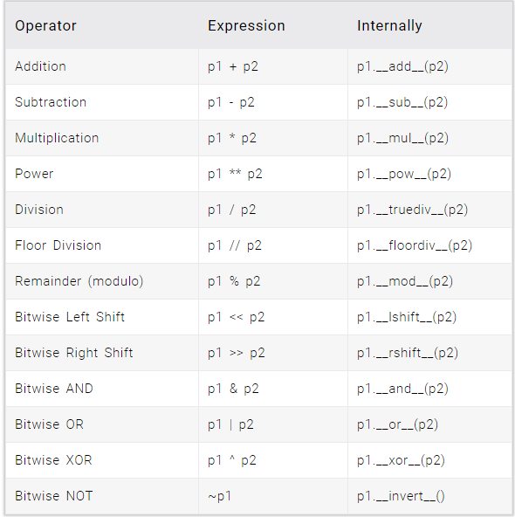
Overloading
Operator Overloading is used to allow us to perform +, -, *, /, etc. operations between two objects.
We need to define the behavior regarding what the result should be when two objects are added, subtracted, multiplied, divide, etc.

Slide 31
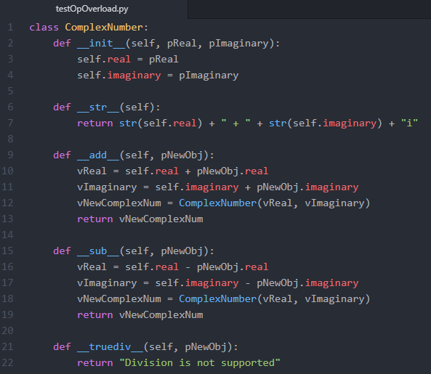
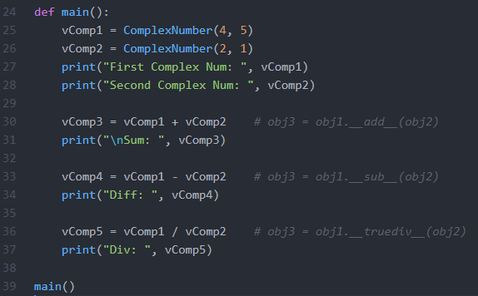
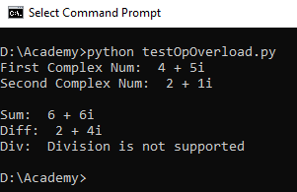
Overloading

Slide 32
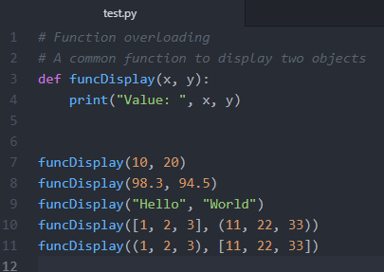
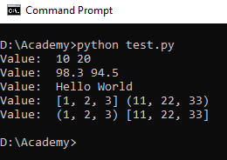
Overloading
We can’t use same name (based on different argument length or order) to define multiple functions unlike C++ or Java, as the latest version of a function will override the previous one’s definition.
Python is implicitly polymorphic. We can call this above function with various types.

Slide 33
Activities
Define a class named Shape and its subclass Square. The Square class has an __init__() function which takes a length as argument. Both classes have a area function which can print the area of the shape where Shape’s area is 0 by default.
Define two named as Employee which inherits the class Project. Build some methods set all the attribute values, to show employee's information. Save all employee details in a file, use “|” as delimiter. Load the file in start to fetch existing employee’s information.

Slide 34
Summary
Class is user defined prototype for an object & objects are unique instance of the data structure defined within the class.
Object has data (attributes) & behavior (methods).
Python follows OOP concept & implements Encapsulation, Data Abstraction, Inheritance, Polymorphism (Overloading).
We can define a class using class <classname> syntax.
__init__() is constructor & __del__() is destructor both get invoked automatically when we are creating an object, or when an object is getting out of scope respectively.
Inheritance is the process by which one class takes on the attributes and methods of another.

Slide 35
Summary
Python supports single, multiple, multi-level & hierarchical inheritance.
Prefixing a instance attribute by “__” make it private and not accessible directly from outside the class.
Python also supports the operator overloading and there are respective function which are invoked automatically when we use the corresponding operators to perform some operation.

Slide 36
Check on learning
We have learnt the benefits of OOP.
Now we know what is OOP & how it has been implemented in Python.
We have gone through the concepts of Encapsulation, Data-Abstraction, Polymorphism & Inheritance. We also learnt how Python deals with these.
We can now start writing object oriented programs.

Slide 37
Links
https://docs.python.org/3/tutorial/
https://www.youtube.com/watch?v=ZDa-Z5JzLYM&list=PL-osiE80TeTsqhIuOqKhwlXsIBIdSeYtc

Slide 38

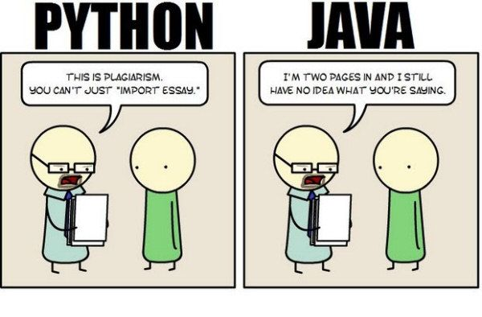
Hello, World! This is.. S
‘Pythnoic’… the way it talks. Are you following it?

Slide 39
Thank you
Indranil Paul (424241)
Python Developer
Banking & Financial Services | WMC Account

