Slide 1
Introduction to Python
Basics of Python Programming Language
Day 2 | Duration: 2 Hours

Slide 2
The Zen of Python
“If the implementation is hard to explain, it’s a bad idea.”
- The Zen of Python (by Tim Peters)
Get Data
Process Data
Show Result
Stop

Slide 3

Terminal Objectives
To learn how to write functions.
To know what are the modules & packages.
To learn how to design your own module and use it.
To learn how to handle exceptions in program.
To learn how files can be handled using Python.
To learn how to use regular expressions in Python.

Slide 4
Why Modular Approach?
Benefits
Modular code can be reused.
Modular code is easier to write well.
Modular code is easier to maintain.

Slide 5
Topics to Cover
Functions
Module & Package
Exception Handling
File Handling
Working with Regular Expression

Slide 6
Functions

Slide 7
Function
A function is a block of organized, reusable code that is used to perform a single, related action.
Functions provide better modularity for your application and a high degree of code reusing.
A function is a set of statements that takes inputs, do some specific computation and produces output.
Syntax:
def functionName(arg1,.. argN):
<function body>
return <object>
Example:
def dispWelcome(pName):
print(‘Hello {0}’.format(pName))
print(‘Welcome to my function.’)

Slide 8
Function
Types of Arguments
Positional Argument
Arguments that are passed to a function in correct positional order
Default Argument
Arguments that assume a default value if a value is not provided in the function call for that argument.
Keyword Argument
Arguments that are passed to a function by name.
Variable-Length Argument
This can be achieved by ‘*’ symbol used in-front of the last parameter name

Slide 9
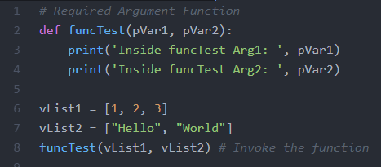
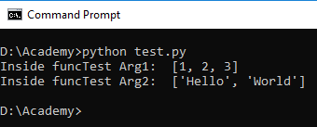
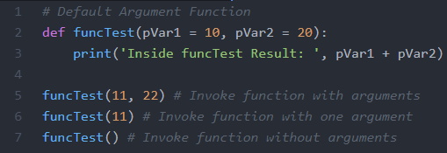
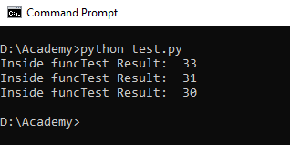
Function

Slide 10
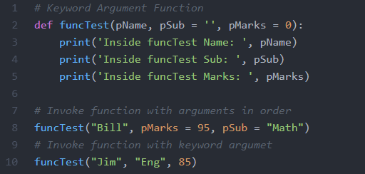
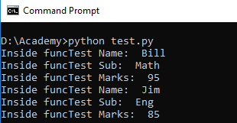
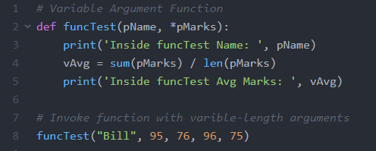
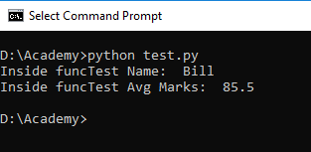
Function

Slide 11
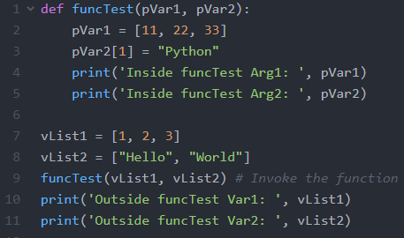
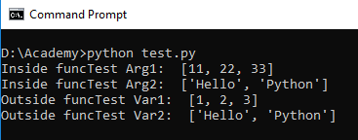
Function
In Python every variable name is a reference. When we pass a variable to a function, a new reference to the object is created.
When we pass a reference and change the received reference to something else, the connection between passed and received parameter is broken.

Slide 12
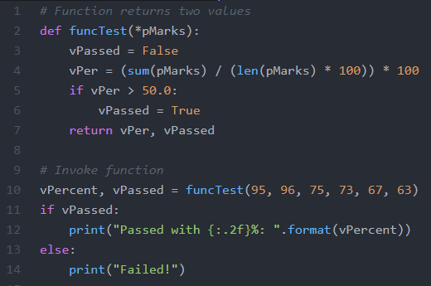
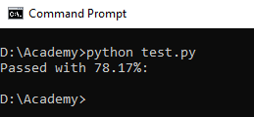
Function
The return statement exits a function, optionally passing back an object to the caller.
A return statement with no arguments is the same as return None.
In Python you can return more than one values from a function.

Slide 13
Module & Package

Slide 14
Module & Package
A module allows you to logically organize your Python code. Grouping related code into a module makes the code easier to understand and use.
Module is a file consisting of Python code, that defines functions, classes and variables.
A module can be included in another script file using import <module> statement, which will include all the components (functions, classes & variables) defined within the module.
Another way to import only selected components i.e. from <module> import <object>.

Slide 15
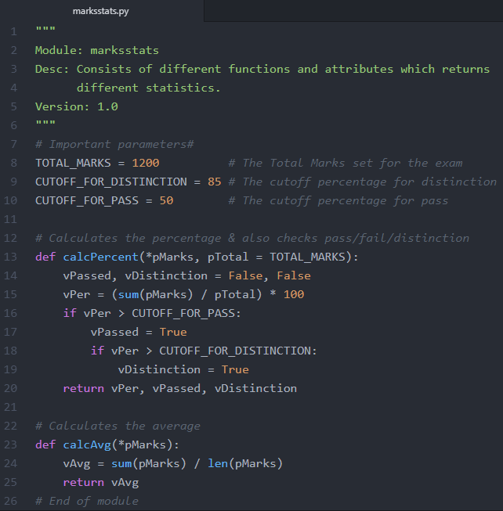
Module & Package
In this example the marksstats.py is a module. This module consists of two functions & three variables with some values.
We can import this module in our other Python scripts and can use these components for our own logic implementation purposes.

Slide 16
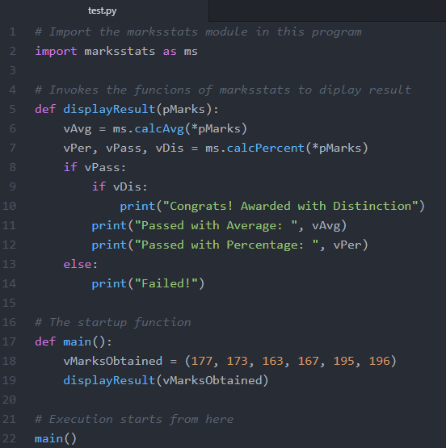
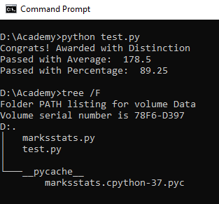
Module & Package
We have imported the marksstatus module in test.py and invoked the calcAvg() & calcPercent() functions. Below is the result of execution of test.py

Slide 17
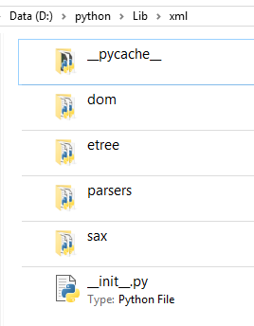
Module & Package
A package is a hierarchical file-directory structure that defines a single Python application environment, consists of modules and sub-packages and sub-sub-packages, and so on.
package
module1
module2
module3
sub-package1
sub-package2
module1
module2
__init__.py

Slide 18
Challenge
Create a package named “geometry” containing a module named “shapes.py”. shapes contains:
A constant for pi (any precision is fine)
A function that takes in the radius of a circle and returns it’s area
A function that takes in the length and width of a rectangle and returns both it’s area and it’s perimeter

Slide 19
Challenge cont.
Create a script named “shaperunner.py”, also in the geometry package, that imports shapes.py and calls it’s functions.
Run shaperunner.py from the command line.

Slide 20
Exception Handling

Slide 21
Exception Handling
When exceptions occur, it causes the current process to stop and passes it to the calling process until it is handled. If not handled properly then, our program will crash.
If we have some suspicious code that may raise an exception, we can put the suspicious code inside try block, and followed by try block is the except statement & block, which actually handles the problem.
We can handle specific exceptions using syntax: except <error name>.
We can also add a generic error handling block which manages all exceptions using syntax: except.
An else block is processed only when try block executes without any error.
The finally block is processed irrespective of whether or not any exception occurs inside try block.

Slide 22
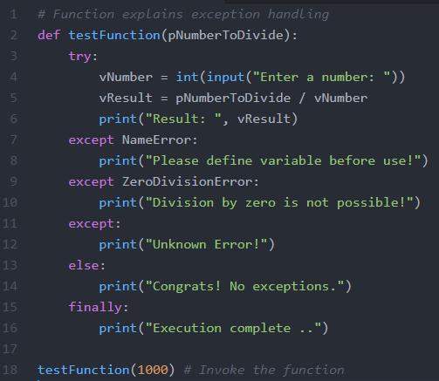
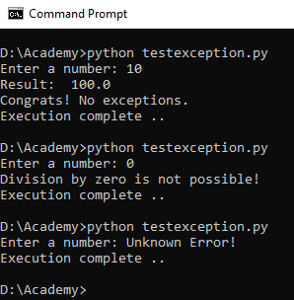
Exception Handling
Syntax & Example:
try:
<Suspicious code..>
except Exception1:
<Handle the exception>
except Exception2:
<Handle the exception>
else:
<If NO exception do this>
finally:
<Finally do this>

Slide 23
Exception Handling
If you’re writing a function and wish to create an exception, you do so with the raise keyword.
if denominator == 0:
raise Exception("cannot divide by zero”)
*We would want a more specific exception here. We’ll look at custom exceptions later.

Slide 24
Challenge
Modify one of your functions from the previous challenge to raise an exception if any argument is negative.
Add a try-except to your script that calls the function with a negative argument and outputs an error message.

Slide 25
File Handling

Slide 26
File Handling
Python provides basic functions to handle files.
We can do most of the file manipulation using a file object.
The open() function creates a file object, which is used to invoke other file handling methods.
The read() & readlines() function reads the content of a file and returns a string and a list respectively.
The write() function writes a string into a file.
The close() function flushes any unwritten information and closes the file object.

Slide 27
File Handling
There are mainly three modes of opening a file:
r - Read mode (Default mode)
w - Write mode
a - Append mode
Other modes are:
r+ - Both read & write
w+ - Both write & read
a+ - Both append & read
rb, wb & ab - All are same like r, w & a respectively but in binary format .
Syntax: Object = open(<filename>, <mode>)
Example: objMyFile = open(‘D:\myfile.dat’, ‘r’)

Slide 28
File Handling
In ‘r’ (read) mode, if the file is not present in the path then the code will generate an error.
In ‘w’ (write) mode if the file is not present then a new file will be created, but if exists then the old content will be removed.
The file object has the following three attributes:
fileobj.closed - Returns True if closed or False
fileobj.name - Returns the name of the file
fileobj.mode - Returns access mode with which file was opened
The file object has the following two function also:
tell() - Returns current position within the file
seek(offset, form) - Changes the current file position

Slide 29
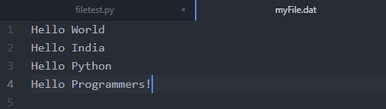
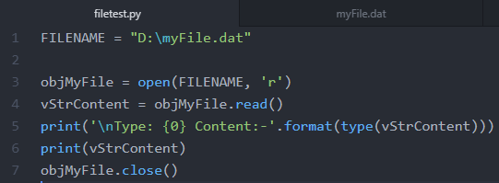
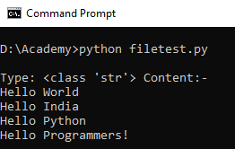
File Handling
The read() function reads the whole file and returns the content in a String format.
Syntax:
var = Object.read(<file>)

Slide 30
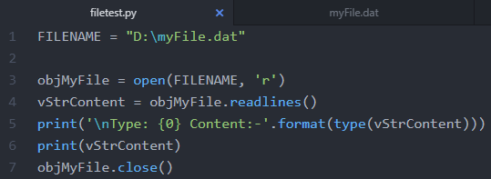
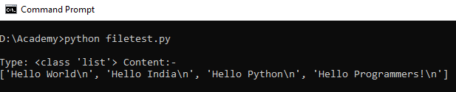
File Handling
The readlines() function reads the whole file and returns the content in a List format.
Syntax:
var = Object.readlines(<file>)

Slide 31
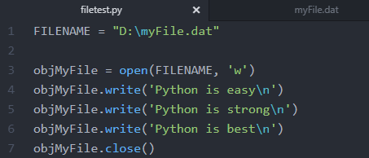
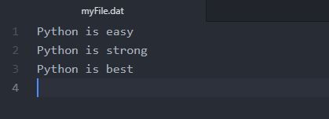
File Handling
The write() function writes a string into the file.
Syntax:
Object.write(<string>)
Note: write() function doesn't add newline at the end (we have to explicitly add a newline).

Slide 32
Working with Regular Expression

Slide 33
Working with Regular Expression
A regular expression is a special sequence of characters that helps you match or find other strings or sets of strings, using a specialized syntax held in a pattern.
The module re provides full support for regular expressions in Python, and raises the exception re.error if an error occurs while compiling or using a regular expression.
There are various characters, which would have special meaning when they are used in regular expression. To avoid any confusion while dealing with regular expressions, we would use Raw Strings as r'expression'.

Slide 34
Working with Regular Expression
The match function - attempts to match RE pattern to string with optional flags.
The search function - searches for first occurrence of RE pattern within string with optional flags.
Items | Description
Pattern | Pattern is the regular expression to be matched.
String | String is the object which would be searched to match the pattern within it.
Flags | These are modifiers

Slide 35
Working with Regular Expression
Both re.match() & re.search() functions return a match object on success and None on failure.
The re.match() checks for a match only at the beginning of the string, while re.search() checks for a match anywhere in the string.
We can use groups() method to get all matching expressions. We can use group(<num>) this syntax to fetch individual groups.
There is another important function is re.sub(pattern, repl, string) which replaces all occurrences of the RE pattern within a string with repl.

Slide 36
Working with Regular Expression
Modifier
re.I – Case Insensitivity
re.L – Interprets words to the current locale
re.M – Makes match at EOF
Control Characters
( ) – Groups regular expressions
re.S – Makes a dot match any character
re.U – Interprets letter as per Unicode set
re.X – Permits ‘cuter’ regex syntax
{n} – n number of occurrences of preceding expression
[ ] – Any single character in brackets
+ – 1 or more occurrence of preceding expression
? – 1 or more occurrence of preceding expression
* – 0 or more occurrences of preceding character
^ – Beginning of line
$ – End of line
. – Any character except newline

Slide 37
Working with Regular Expression
Character Class
[a-z] - Match any lowercase ASCII letter
[0-9] - Match any digit (same as /d)
[A-Z] - Match any uppercase ASCII letter
[a-zA-Z0-9] - Match any ASCII letter (upper or lower) or digit
\s - Match a whitespace (same as [\t\r\n\f])
\S - Match non whitespace (same as [^\t\r\n\f])
\w - Match a single word-character (same as [a-zA-Z0-9_])
[^0-9] - Match anything other than digits (same as /D)
\W - Match a non word-character (same as [^a-zA-Z0-9_])

Slide 38
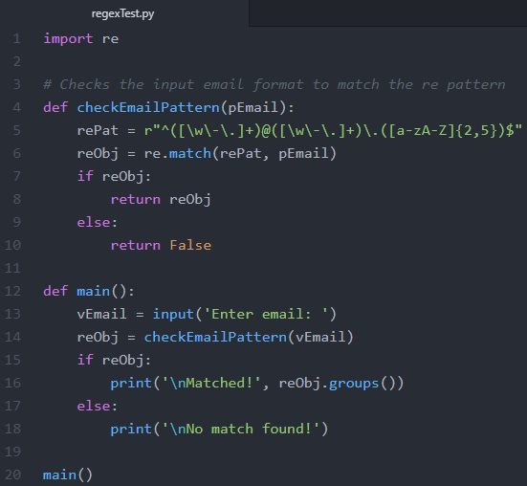
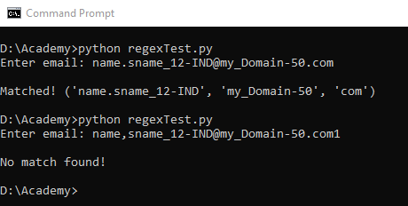
Working with Regular Expression
Example:

Slide 39
Summary
Functions are sets of statements that takes inputs, do some specific computation and produces output.
Python functions are capable of returning more than one values to the caller.
We can import our own modules like other Python modules, that can be defined by putting functions, classes or variables into one file (with .py extension).
Package is nothing but collection of related modules and/or sub-packages.
Exceptions can be handled using try & except block.
The else statement can also be used with try, and if there is no error then else block executes.

Slide 40
Summary
There is a finally block which will be processed if an exception is caught by a except block or if there is no exception occurred inside try block.
We can use open(<file>, <mode>) function to opens a file by creating a file-object with given mode.
The file object can be used to read or write or close a file.
We can build our regular expressions and that can be used to check whether the pattern is getting match with a given string.
The match() & search() function returns valid regex object if the pattern matches with the given string.
The groups() & group(<num>) function returns the all the groups or individual group respectively.

Slide 41
Check on learning
We learnt how to write functions in Python.
We also learnt what are modules & packages.
We learnt how to design our own module & packages and use them in other programs.
Now we can handle exceptions in Python program.
We can also work with files using Python.
We learnt how to use regular expressions in Python.

Slide 42
Links
https://docs.python.org/3/tutorial/
https://www.youtube.com/watch?v=rfscVS0vtbw

Slide 43

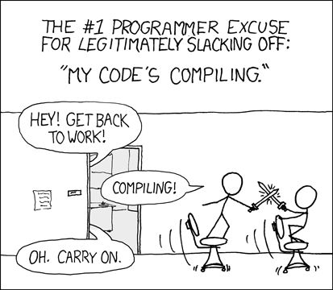
Hello, World! This is.. S
Development became faster in Python, do you agree?

Slide 44
Thank you
Indranil Paul (424241)
Python Developer
Banking & Financial Services | WMC Account

