Slide 1
Annual Review for
PROJECT NAME

Slide 2
Instructions (REMOVE SLIDE IN FINAL)
Please use this deck in preparation for your project’s annual review. Depending upon your project’s stage, the review will have different points.
Sandbox project:
Review of progress towards Incubation Stage
Incubation project:
Review of progress towards Adopted Stage
Adopted project:
Review of project maintaining positive growth and adoption
Working group:
Status on deliverables and work left to be completed
Please use the appropriate section in this deck for building the review deck. Add additional slides for addressing specific review points.
Each project has 20 minutes for both their presentation and Q/A, so plan your presentation accordingly.

Slide 3
<your project name>
Brief Description:
This is a description of the project, in no more than 3-4 sentences
TSC Chairperson:
Name and email
TSC Members and Affiliations:
list...
Contributed by:
Contribution organization
Key Links:
Github: URL
Website: URL
Artwork: URL
Mailing lists:
mailing list name and link
mailing list name and link
mailing list name and link
OpenSSF Best Practice Badge URL: URL
Update with your project’s information

Slide 4
Incubation Project review criteria
To be accepted at the Incubation stage, a project must meet the Sandbox requirements plus:
Have completed and approved the Technical Charter and agree to transfer any relevant trademarks to The Linux Foundation or its affiliate, LF Projects, LLC, and to assist in filing for any relevant unregistered ones. The ASWF maintains a template for projects to use.
Have defined its technical governance, including:
A LICENSE file in every code repository, with the license chosen an OSI-approved license.
A README file welcoming new community members to the project and explaining why the project is useful and how to get started.
A CONTRIBUTING file explaining to other developers and your community of users how to contribute to the project. The file should explain what types of contributions are needed and how the process works.
A CODEOWNERS or COMMITTERS file to define individuals or teams that are responsible for code in a repository; document current project owners and current and emeritus committers.
A CODE_OF_CONDUCT file that sets the ground rules for participants’ behavior associated and helps to facilitate a friendly, welcoming environment. By default, projects should leverage the Linux Foundation Code of Conduct unless an alternate Code of Conduct was previously approved.
A RELEASE file that provides documentation on the release methodology, cadence, criteria, etc.
A GOVERNANCE file that documents the project’s technical governance.
A SUPPORT file to let users and developers know about ways to get help with your project.

Slide 5
Incubation Project review criteria ( continued )
Have achieved and maintained a Core Infrastructure Initiative Best Practices Badge at the passing level.
Have had a successful license scan with any critical issues remedied.
Have a defined project mission and scope
An overview of the project’s architecture and features defined.
A project roadmap defined, which should address the following questions.
What use cases are possible now?
What does the next year look like in terms of additional features and use cases covered?
Community and contributor growth assessment
The current number of contributors and committers, and the number of different organizations contributing to the project.
Demonstrate a sustained flow of commits / merged contributions
A credible plan for developing a thriving user community, in particular expanding the number of committers and contributors?
Outline of the plan for the project to complete the requirements for Adopted Stage
Obtain an affirmative vote of the TAC.

Slide 6
Adopted Project review criteria
To be considered for the Adopted stage, a project must meet the Incubation stage requirements plus:
Demonstrate a substantial ongoing flow of commits and merged contributions, authored by a healthy number of diverse contributors*.
Demonstrable roadmap progress.
A healthy number of public adopters that are identified within the project ( using an ADOPTERS file or showcased on the project’s website ).
Have achieved and maintained a Core Infrastructure Initiative Best Practices Gold Level Badge
Have a technical lead appointed for voting representation of the project to the TAC.
Be deemed by the TAC to add value to the mission of ASWF.
Obtain both a 2/3 supermajority vote of the TAC and an affirmative majority vote of the Governing Board

Slide 7
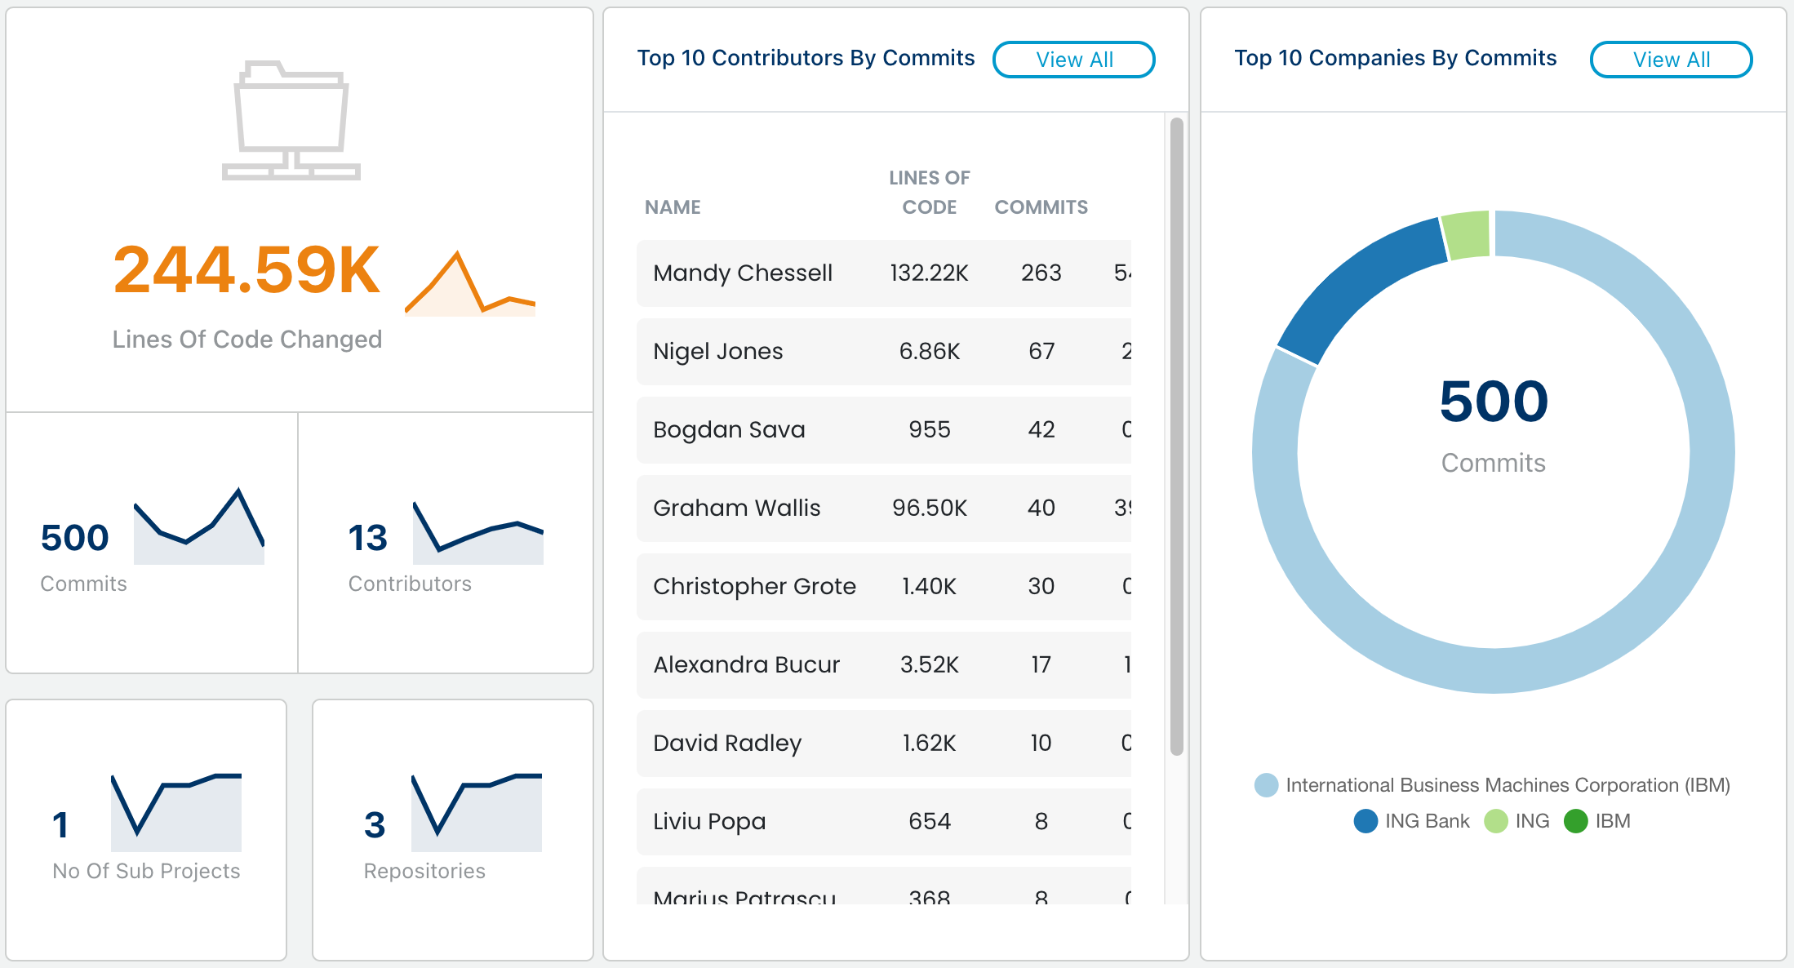
Contributions
UPDATE FROM LFX INSIGHTS

Slide 8
Organizations contributing and/or using in production
Provide list of organizations, with logos if available

Slide 9
Key Achievements in the past year

Slide 10
Areas the project could use help on

Slide 11
Feedback on working with LF Energy

Slide 12
TAC Open Discussion

