Slide 1





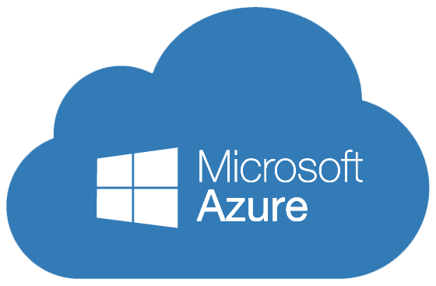
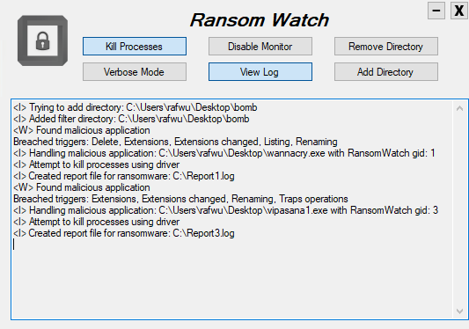



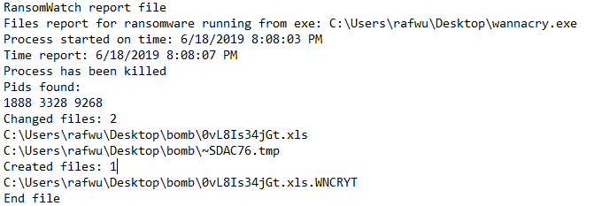
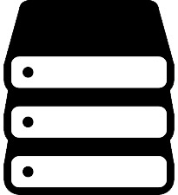
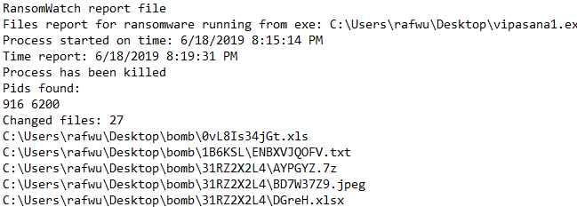
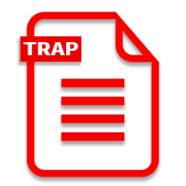

RansomWatch
As part of project in ransomware, 236499, Spring 2019
Rafael Wurf, Aviad Gafni
Prof. Eli Biham, Dr. Nir Levy and Assaf Rosenbaum
RansomWatch is a solution which monitors and analyses data collected from the file system in real time in order to identify suspicious ransomware behavior on the file system.
RansomWatch autonomously stops ransomware applications and backup files and directories to prevent data loss. It innovates by grouping related multi-processes application into a “single-process” for analysis.
Introduction
Architecture
Results
Cloud storage
RansomWatch application
WannaCry’s exectuable
Vipasana’s exectuable
Method
RansomWatch detected WannaCry and Vipasana and stopped them.
It logged why it had stopped the applications: created, deleted and accessed large number of files, accessed large number of file types, changed large number of file extensions, listed folders large number of times and wrote with high entropy.
process read/write/list files and directories in protected zone
Driver hooks are called
Driver collects data
User
Kernel
File System
WannaCry Report File
Driver notifies application of current state
Application analyses the state
Application identifies the process as malicious or safe
RansomWatch driver
Ransom Watch uses the following measures to identify suspicious ransomware behavior:
Feature | Description | Rationale
Write entropy | Average entropy of write operation, compared to the entropy of read. | Encryption generates high entropy data, compared to the entropy of its read operation.
Files access | Number of files read or changed. | Ransomware programs often read and write approximately the same amount of files. Also, ransomware processes must read files before encrypting.
Folder listing | Number of folder-listing operations. | Ransomware programs traverse the filesystem looking for target files.
File type coverage | Number of file type categories accessed (RansomWatch categorizes file types based on regular use scenarios). | Ransomware programs access numerous file types unlike regular applications which usually use only few file type categories.
Traps access | Number of traps files changed (RansomWatch plants traps throughout the protected zones). | Benign application typically will not change many trap files since these files are not user generated. Ransomware cannot differentiate trap files from regular files, thus will attempt to encrypt them as well.
Extension change | Number of file extension changes, compared to the number of files accessed. | Ransomware programs often change file extensions before/after encrypting files, appending an extension to the file.
Files rename | Number of files renamed or moved. | Ransomware programs often change files location or rename files.
Files deletion | Number of files deleted. | Ransomware programs often read files before encrypting and writing a new encrypted files before deleting the original files.
Multi-Processing | RansomWatch groups multi processes into one record group for analysis, increasing the accountability of multi processes applications. | Some ransomware evade detection by splitting the work among multiple processes, leading to reduced accountability and lower detection rate of each single measure.
Storage
Vipasana Report File
The log file contains the path to the executable of the process which RansomWatch detected and terminated, the related process identifiers (processes that correspond to the same group identifier) and a list of all files that the application succeeded to change in the protected zone before RansomWatch detected and stopped its operation.

