Slide 1
推荐系统简介

Slide 2
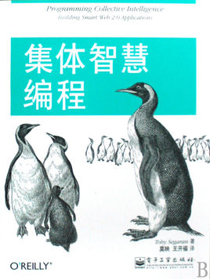
引言
第2章 提供推荐
计算传播
Netflix
今日头条
群体智慧
推荐系统
协作型过滤
搜集偏好
寻找相近的用户
推荐物品
匹配商品
构建一个基于delici0US的链接推荐系统
基于物品的过滤
使用MovieLens数据集
基于用户进行过滤还是基于物品进行过滤
练习

Slide 3
Collective intelligence
You don’t need the Web to collect data from disparate groups of people, combine it, and analyze it.
One of the most basic forms of this is a survey or census.
Collecting answers from a large group of people lets you draw statistical conclusions about the group that no individual member would have known by themselves.
Building new conclusions from independent contributors is really what collective intelligence is all about.

Slide 4
Why Recommendations ?
The world is an over-crowded place
We are overloaded
News, Blogs, Books, movies, music, places, offers, events, even friends.
We really need only a few of them!
What we have done? Ratings!!!

Slide 5
Recommendation system
数据
属性
模型
选择
推荐
评价

Slide 6
Popularity, Similarity, Factorization
Popularity-based recommenders
popularity_recommender.create
Item similarity models
item_similarity_recommender.create
Factorization recommenders
factorization_recommender.create

Slide 7
Collaborative Filtering
The low-tech way to get recommendations
ask your friends. A small group
How to ask a lot of people?
A collaborative filtering algorithm usually works by searching a large group of people and finding a smaller set with tastes similar to yours. It looks at other things they like and combines them to create a ranked list of suggestions.
User-Based Filtering & Item-Based Filtering

Slide 8
User-Based Filtering: Finding Similar Users
After collecting data about the things people like, you need a way to determine how similar people are in their tastes.
You do this by comparing each person with every other person and calculating a similarity score.
Euclidean distance
Pearson correlation

Slide 9
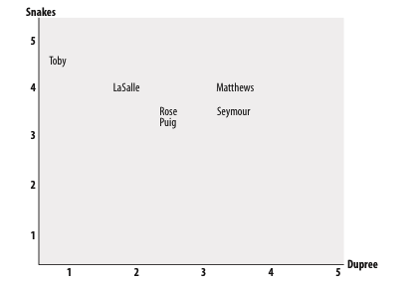
Similarity: Euclidean Distance Score
(1, 5)
the distance between Toby and LaSalle in the chart,
take the difference in each axis,
square them and add them together,
then take the square root of the sum.
(2, 4)

Slide 10
Similarity: Euclidean Distance Score
This formula calculates the distance, which will be smaller for people who are more similar. However, you need a function that gives higher values for people who are similar.
This can be done by adding 1 to the function (so you don’t get a division-by- zero error) and inverting it:
import numpy as np
1.0 /(1 + np.sqrt(np.power(5-4, 2) + np.power(4-1, 2)) )

Slide 11
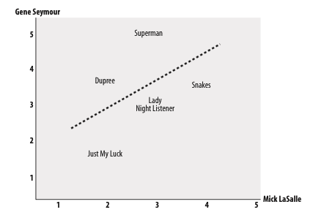
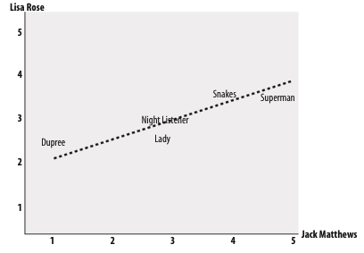
Similarity: Pearson Correlation Score
The correlation coefficient is a mea- sure of how well two sets of data fit on a straight line.

Slide 12


Similarity: Pearson Correlation Score
first finds the items rated by both critics.
calculates the sums and the sum of the squares of the ratings for the two critics,
calculates the sum of the products of their ratings.
Put them in to the formula below:
One interesting aspect of using the Pearson score, which you can see in the figure, is that it corrects for grade inflation.
e.g., Jack Matthews tends to give higher scores than Lisa Rose, but the line still fits because they have relatively similar preferences.

Slide 13
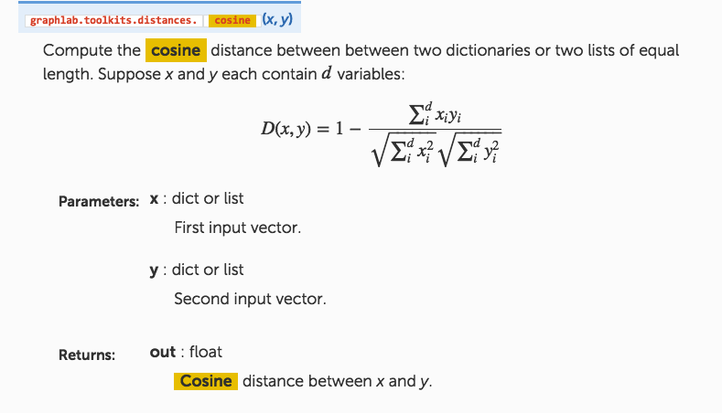
Similarity: Cosine Distance

Slide 14

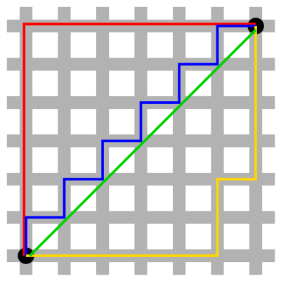
Similarity: More
Jaccard coefficient
Manhattan distance
Definition: The distance between two points measured along axes at right angles. In a plane with p1 at (x1, y1) and p2 at (x2, y2), it is |x1 - x2| + |y1 - y2|.
http://computational-communication.com/wiki/index.php?title=Similarity_distance

Slide 15
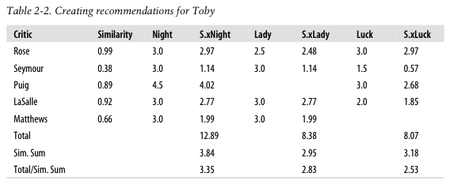
User-Based Filtering: Recommending Items
Look at the person who has tastes most similar to mine and look for a movie he likes that I haven’t seen yet. However, reviewers may haven’t reviewed some of the movies that I might like, and a reviewer may strangely like a movie that got bad reviews from all the other critics

Slide 16
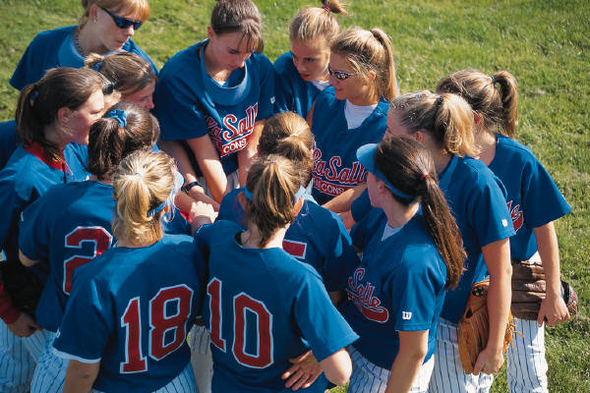
User-Based Filtering
Gets recommendations for a person by using a weighted average of every other user's rankings

Slide 17
Matching Products
Now you know how to find similar people and recommend products for a given person
but what if you want to see which products are similar to each other?
This is actually the same method we used earlier to determine similarity between people—you just need to swap the people and the items.

Slide 18
Item-Based Filtering
A very large site like Amazon has millions of customers and products—comparing a user with every other user and then comparing every product each user has rated can be very slow.
Also, a site that sells millions of products may have very little overlap between people, which can make it difficult to decide which people are similar.
The technique we have used thus far is called user-based collaborative filtering.
An alternative is known as item-based collaborative filtering.
Fast and Better
Computing in advance

Slide 19
Item-Based Filtering: item similarity dictionary
To precompute the most similar items for each item, and get the item similarity dictionary
Looking at a person’s top-rated items and create a weighted list of the items most similar to those.
comparisons between items will not change as often as comparisons between users.

Slide 20
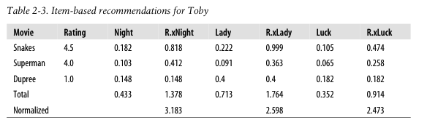
Item-Based Filtering: Getting Recommendations
Each row has a movie that I have already seen, along with my personal rating for it. For every movie that I haven’t seen, there’s a column that shows how similar it is to the movies I have seen
1.378/0.433 = 3.183

Slide 21
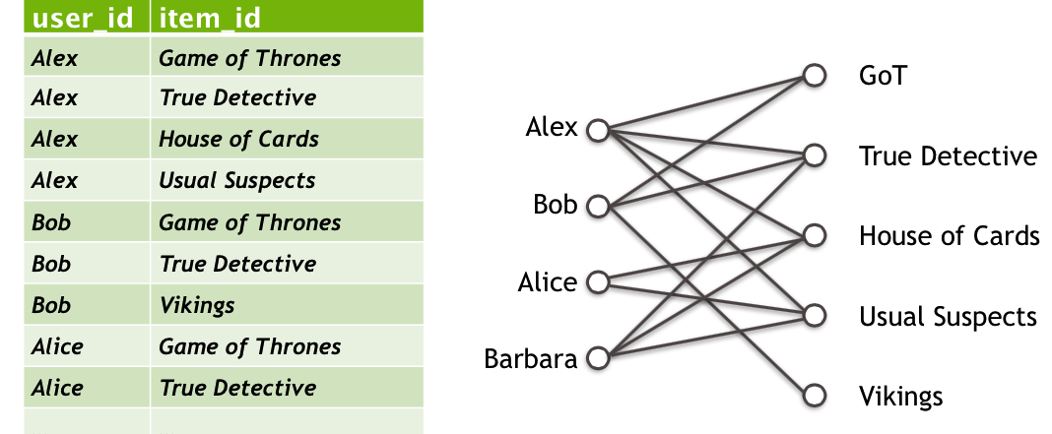
Demo
Recommendation systems and text analysis with GraphLab Create, Conference GraphLab 2014

Slide 22
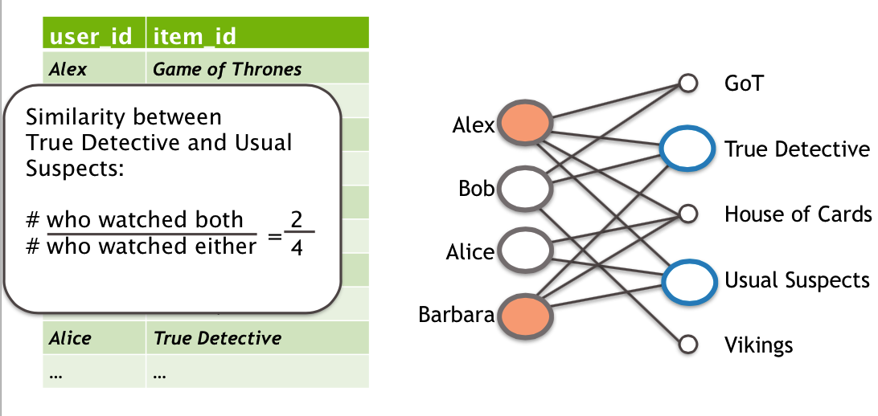
Recommendation systems and text analysis with GraphLab Create, Conference GraphLab 2014

Slide 23
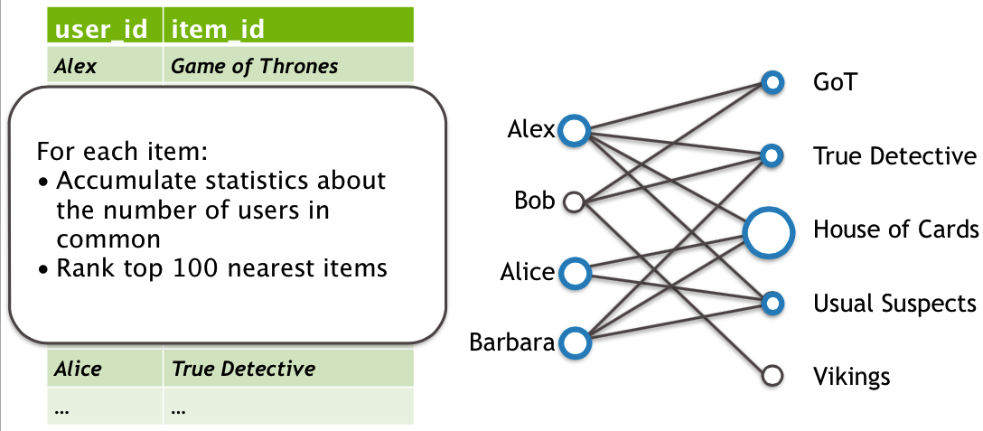
Recommendation systems and text analysis with GraphLab Create, Conference GraphLab 2014

Slide 24
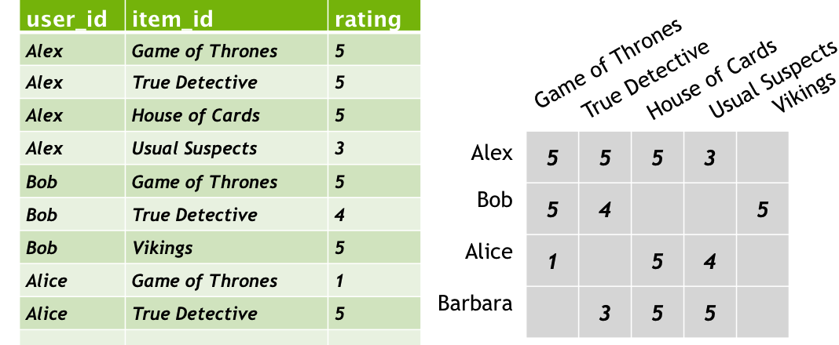
Rating
Recommendation systems and text analysis with GraphLab Create, Conference GraphLab 2014

Slide 25
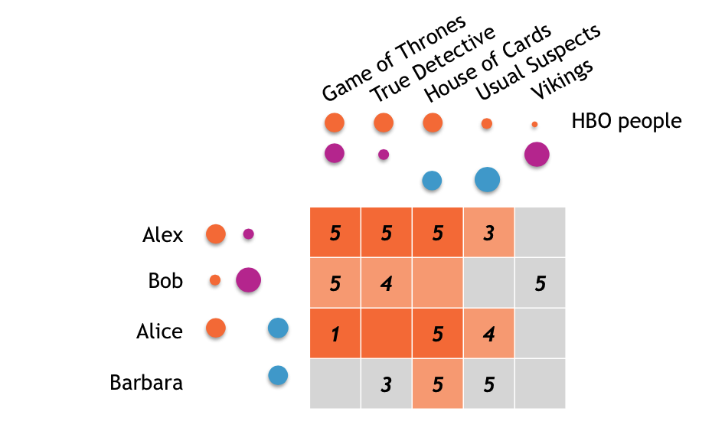
Factorization
Recommendation systems and text analysis with GraphLab Create, Conference GraphLab 2014

Slide 26
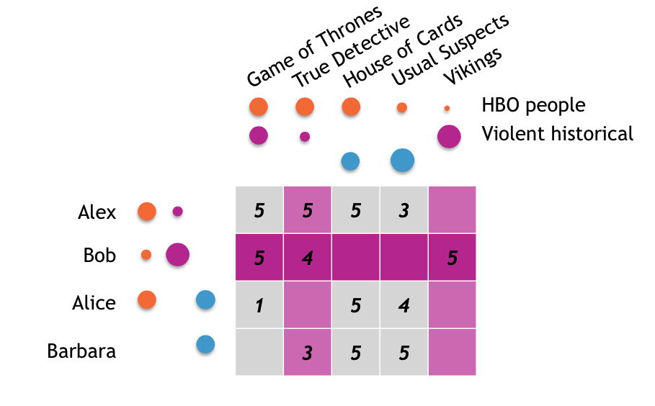
Recommendation systems and text analysis with GraphLab Create, Conference GraphLab 2014

Slide 27
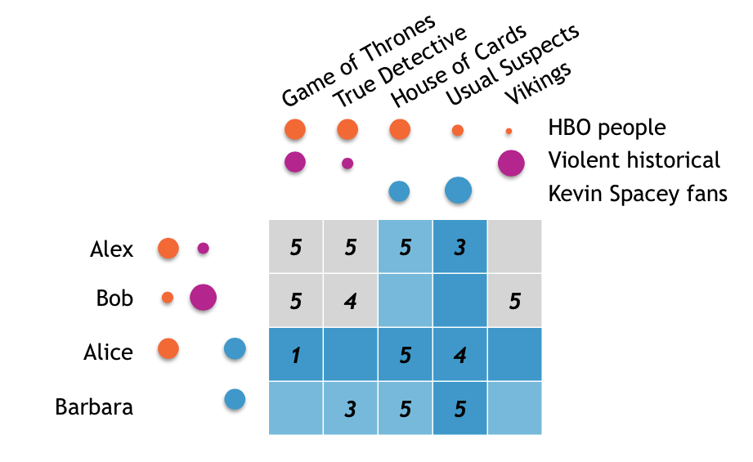
Recommendation systems and text analysis with GraphLab Create, Conference GraphLab 2014

Slide 28
Matrix factorization
Side features
factorization_machine
Ranking
Unobserved_rating
Overfitting
regularization
Recommendation systems and text analysis with GraphLab Create, Conference GraphLab 2014

Slide 29
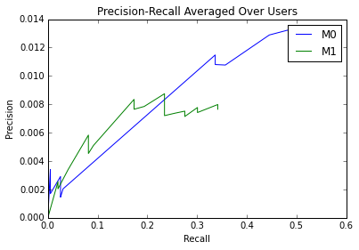
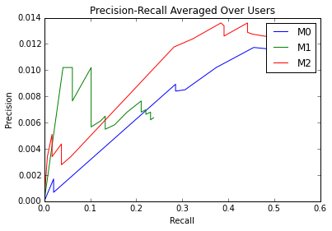
Precision-Recall

Slide 30


Graphlab
申请使用学术/教育版本
Dato会将Product Key通过邮件发送给你
https://dato.com/download/academic.html

Slide 31
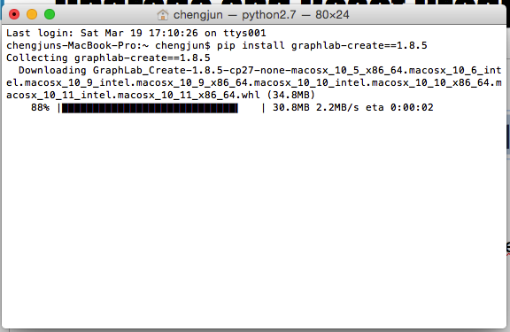
Upgrade and Reset Product Key
https://dato.com/download/upgrade-graphlab-create.html
pip install graphlab-create==1.8.5
# set product key using GraphLab Create API
import graphlab
graphlab.product_key.set_product_key('enter your product key')

Slide 32
graphlab.toolkits.recommender
https://dato.com/products/create/docs/graphlab.toolkits.recommender.html
https://dato.com/learn/userguide/recommender/introduction.html
https://www.youtube.com/watch?v=3_-nhHhNT94

Slide 33

Tutorials
GitHub/cjc2016/code/graphlab_recsys_mooc_courses.ipynb

Slide 34

homework
GitHub/cjc2016/code/movielens_recommendation-systems.ipynb

