Slide 1
CIRRUS
Smart Multi-Cloud Storage Pooling and Compression Platform

Slide 2
The Problem and Our Solution
• The Problem
– Free cloud storage is small and scattered, for example 15 GB on Drive and 2 GB on Dropbox.
– Users hold several accounts but cannot use the free space as one pool.
– No simple consumer tool unifies these free allocations.
• Our Solution: CIRRUS
– Connect many free accounts and treat them as one combined storage box.
– Compress every file, then auto-route it to the cloud with the most free space.
– Organize everything in one virtual folder tree, regardless of which cloud holds it.

Slide 3
System Architecture
• Three tier design
– Frontend: React and Vite, hosted on Vercel.
– Backend: Python FastAPI, hosted on Amazon Web Services.
– Database: managed PostgreSQL on Supabase (metadata and encrypted tokens only).
– Storage: files live on the user's Google Drive and Dropbox.
• Data flow
– Browser sends file to backend, backend compresses it, picks the emptiest cloud, uploads, and records metadata.

Slide 4
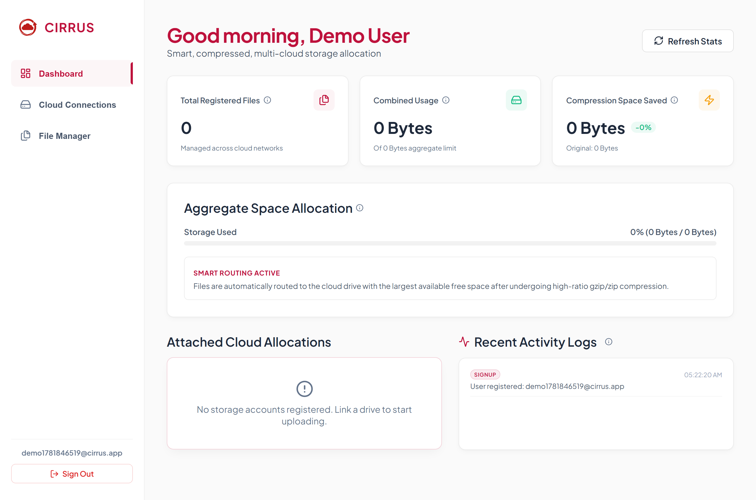
Key Features
• Storage pooling: combined free space shown as one box.
• Compression and smart routing of every upload.
• Virtual folders and bulk multi-file upload.
• Secure sign in with encrypted cloud credentials.
• Live dashboard with usage, savings, and activity log.

Slide 5
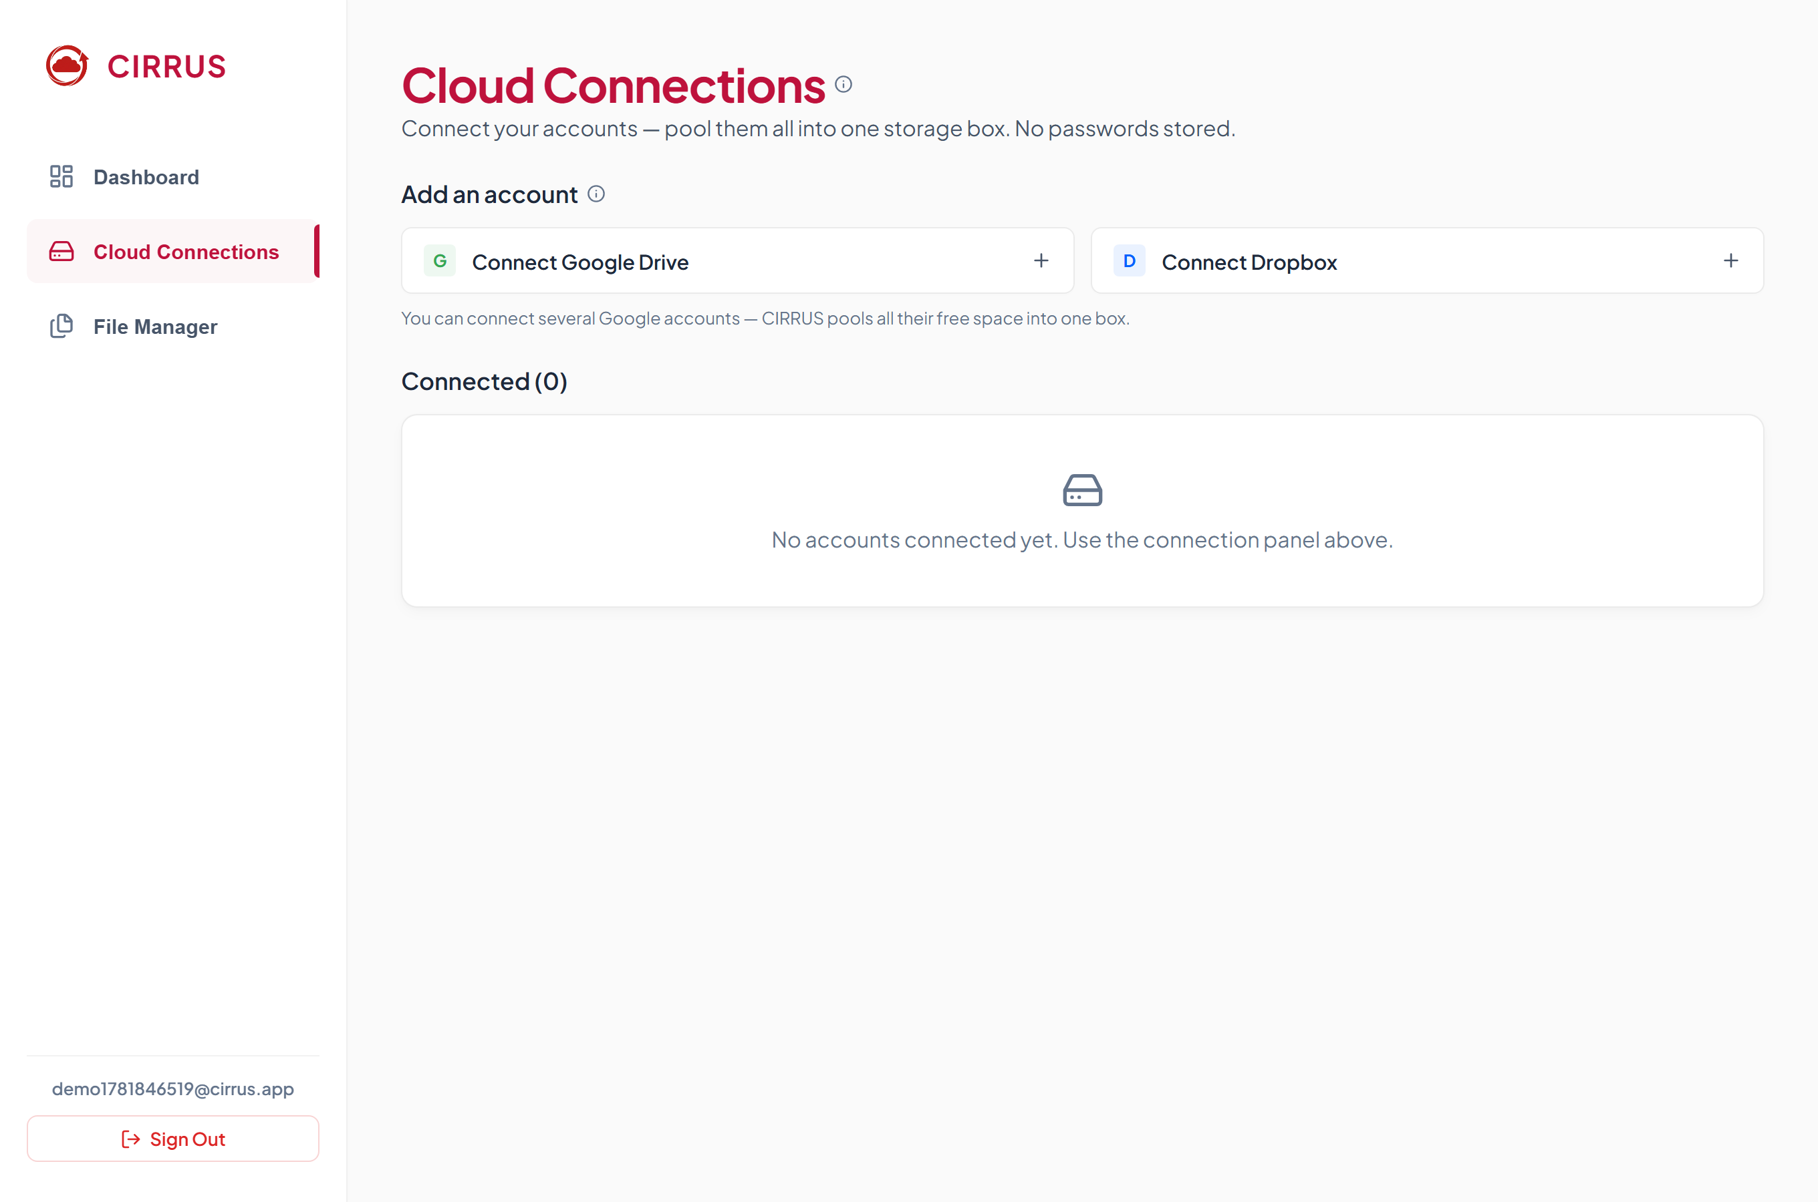
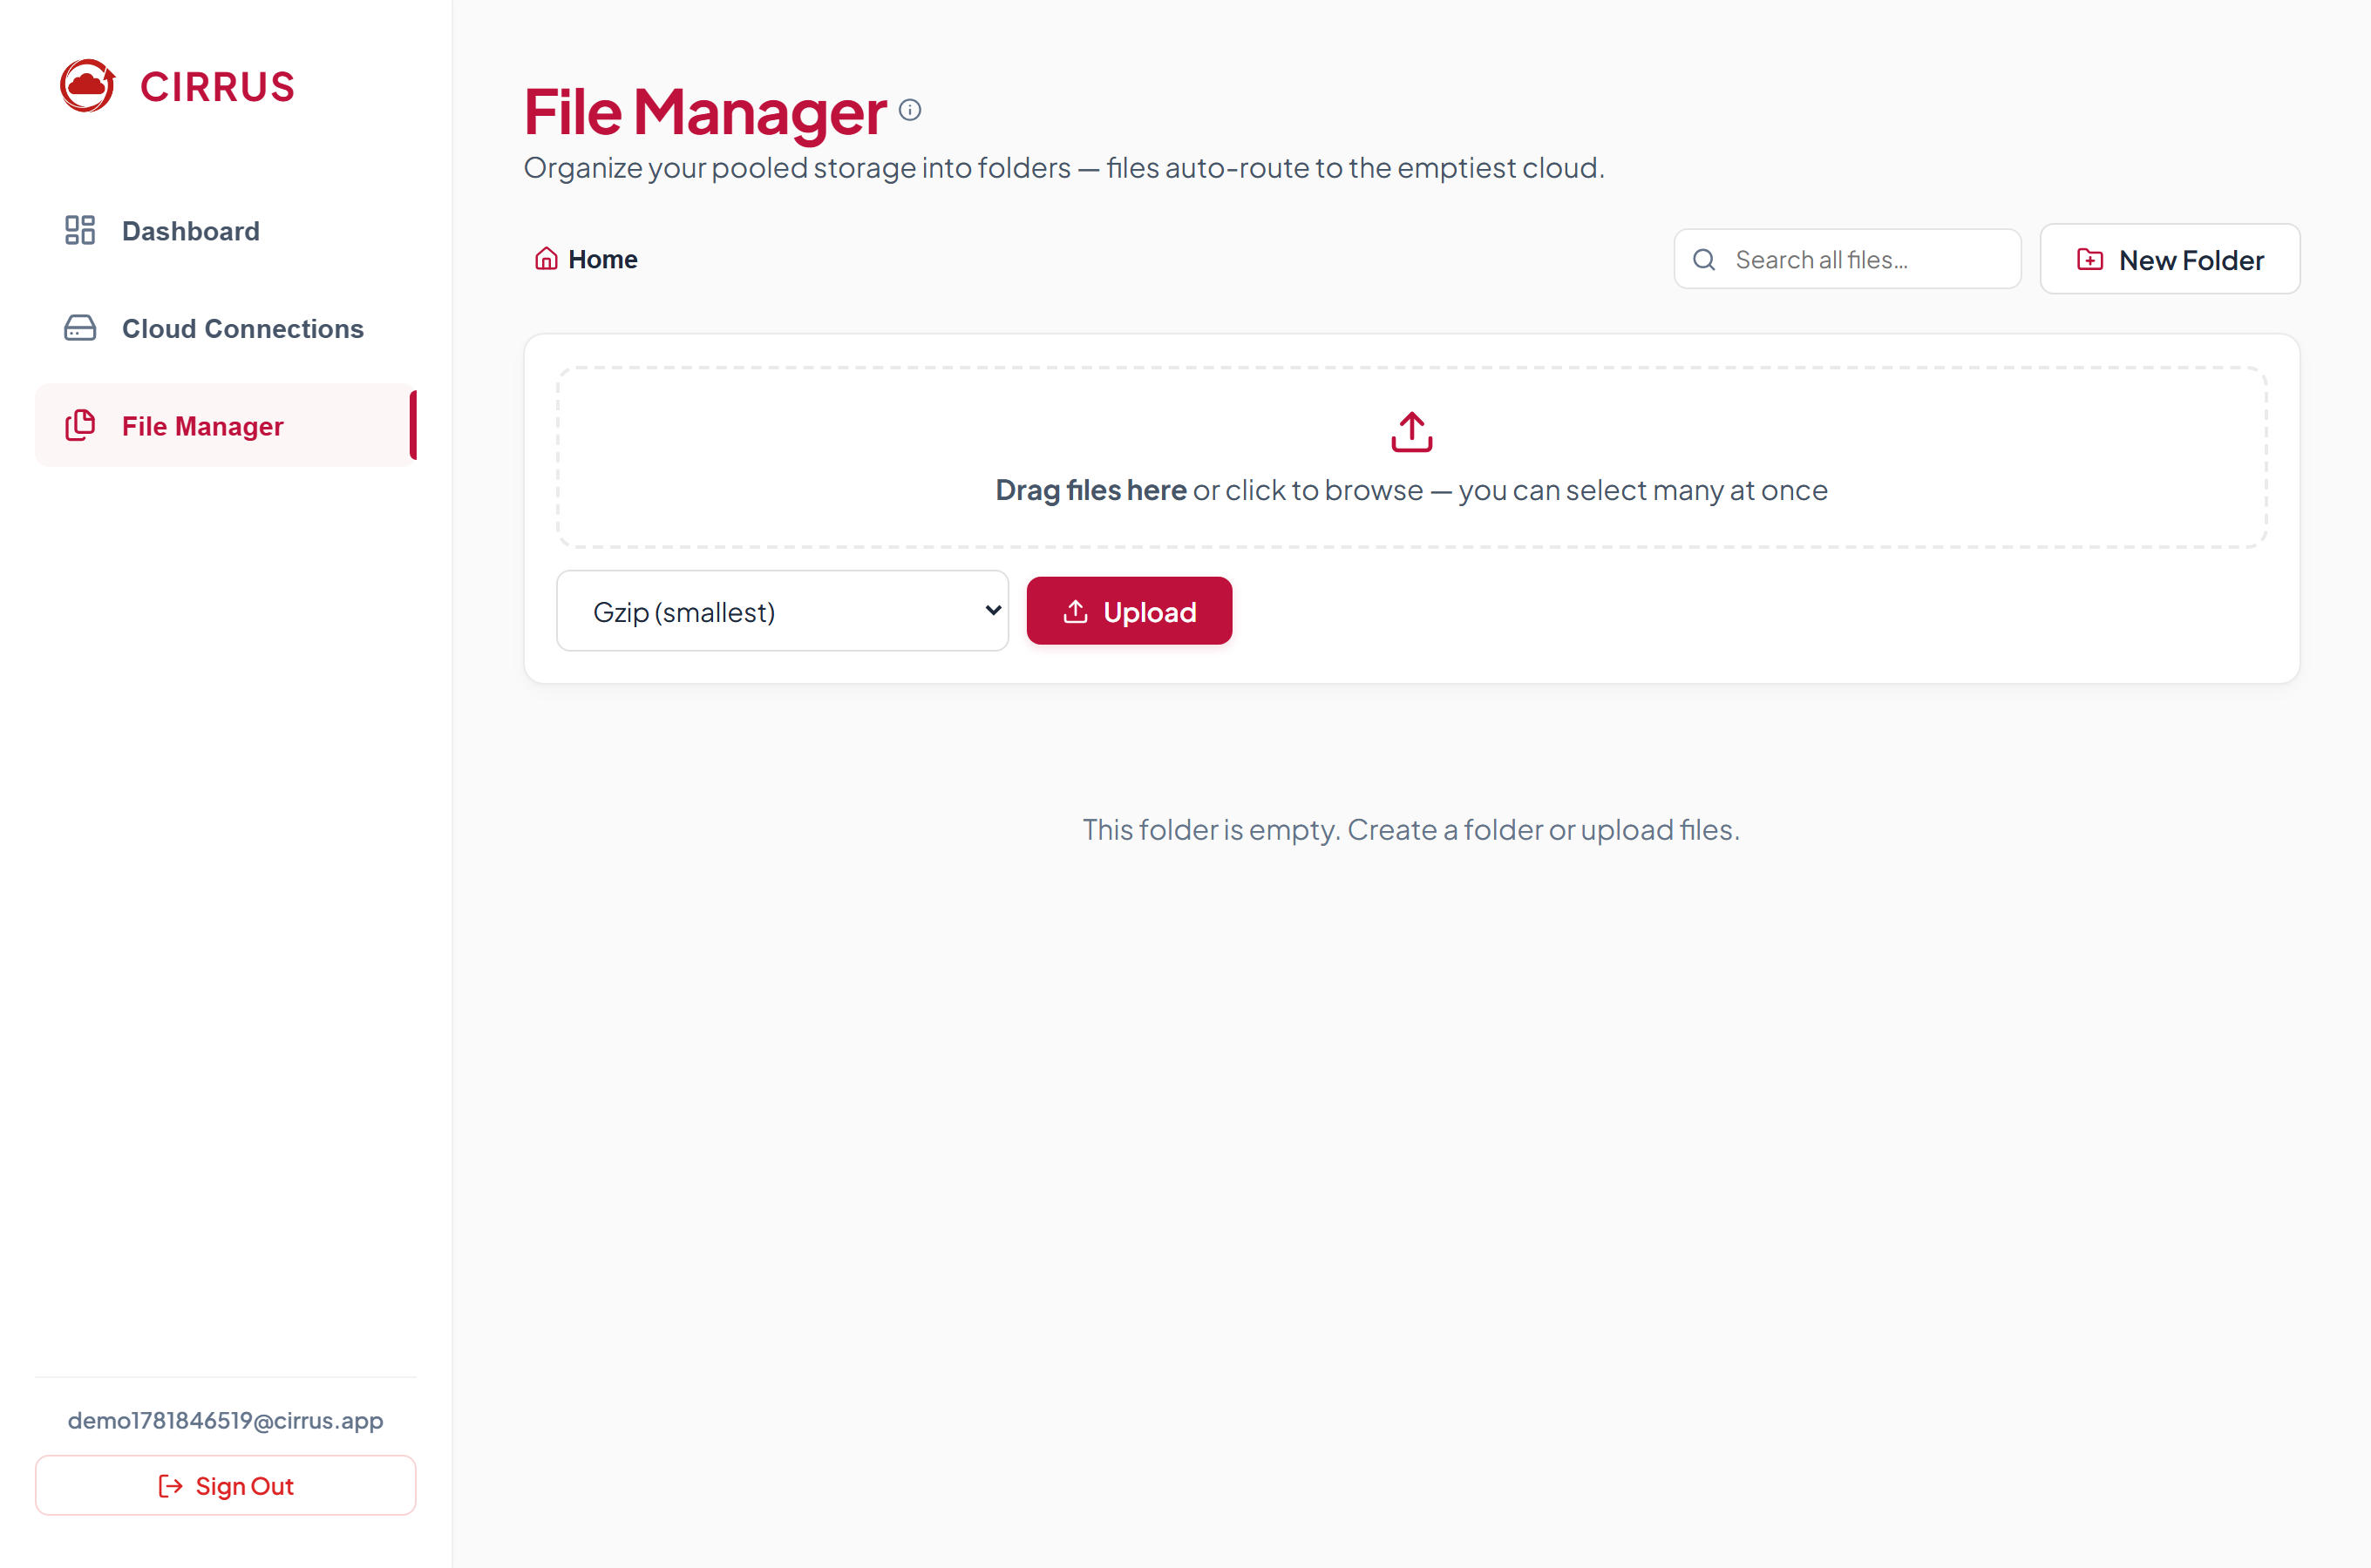
The Platform in Action
Connecting clouds (left) and the folder based file manager with bulk upload (right).

Slide 6
Team Contributions and Conclusion
• Member 1: Backend core, database schema, compression and routing engine.
• Member 2: Authentication, password hashing, credential encryption, audit logs.
• Member 3: Google Drive and Dropbox integration and token handling.
• Member 4: React interface, red and white design, and full deployment.
• Conclusion
– CIRRUS turns scattered free storage into one secure, compressed, and easy to use box.

