Slide 1
Our C
Ashley Caro
Web developer

Slide 2
Ashley
Medellin- Colombia.
Dance, Christmas, family.

Slide 3
Connected, no matter where your are

Slide 4




Our C
To interact
To be in contact
To enjoy

Slide 5
DEMO

Slide 6
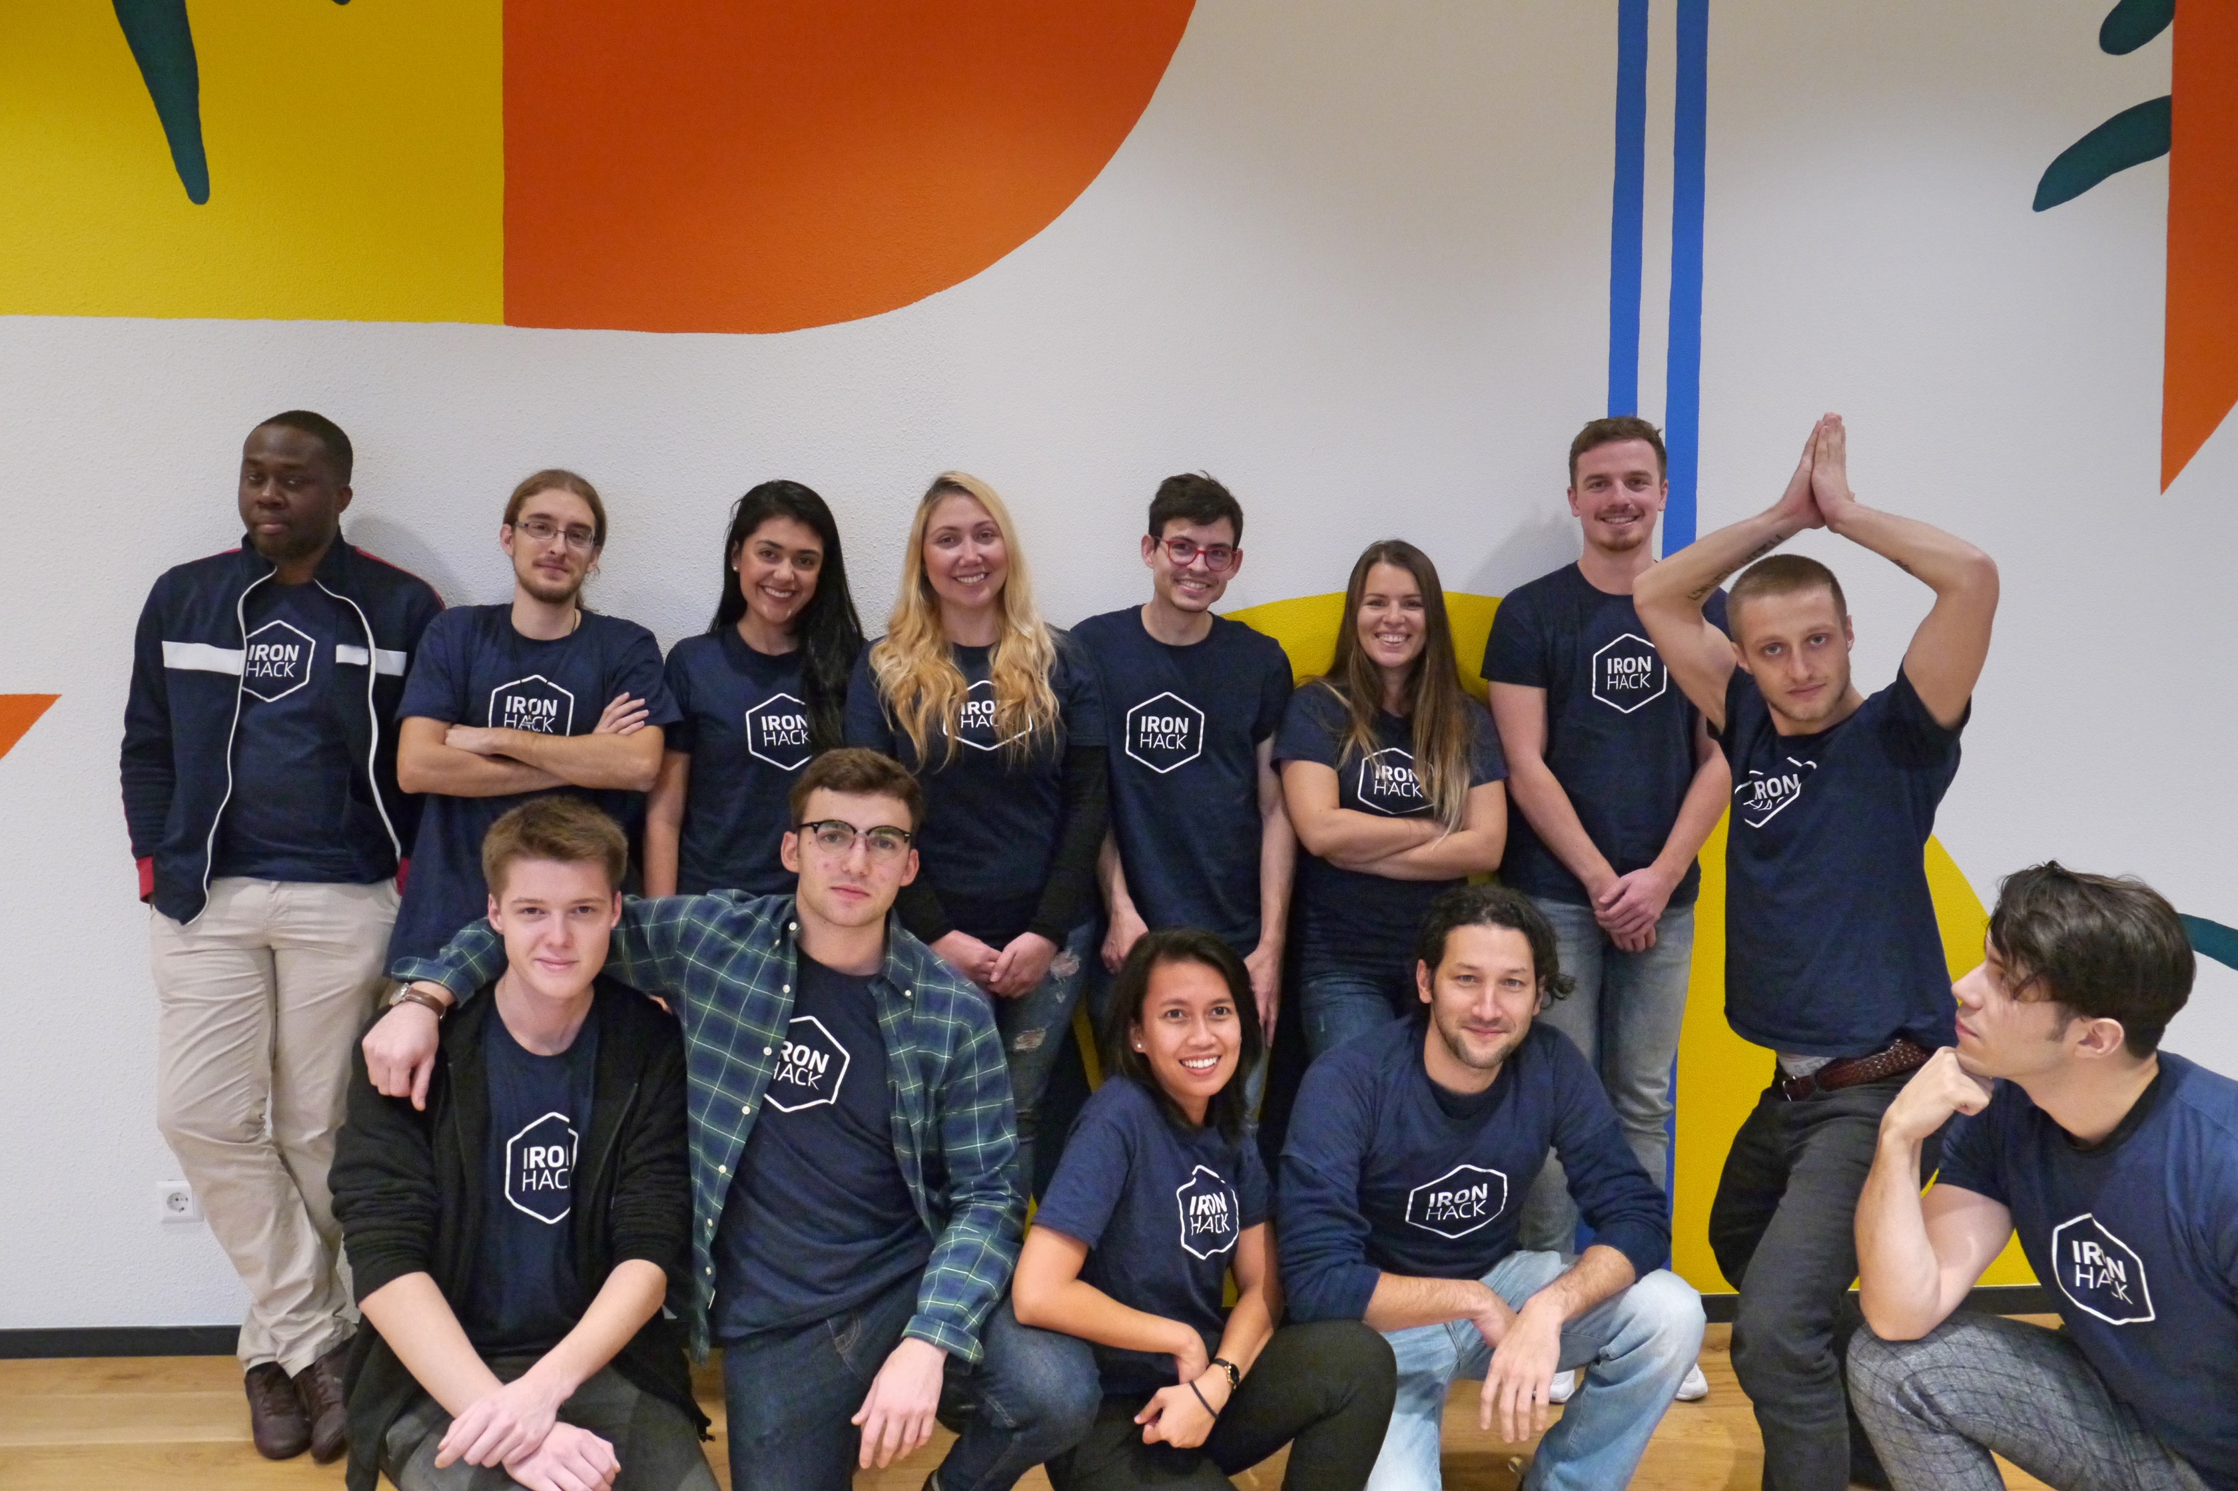
Thank you a lot mis amigos!

