Slide 1

Project: Fanuc Olympiads
Presentation of the sequence 5: activities and a pre-project analysis
CARVALHO BÜRGER Karoline
DE JESUS RODRIGUES Tiago
ELLER CRUZ Rafael
NOGUEIRA Rafael Accácio

Slide 2

Summary:
1 – Performed activities;
2 – Project management: principles and choices;
3 – Pre-project analysis;
3.1 – Problem presentation;
3.2 – Proposed Solutions;
3.2.1 – Robots choice;
3.2.2 – Robots positioning;
3.2.3 – Robots movements;
3.2.4 – Simulation issues;
4 – Conclusion.

Slide 3
1 – Performed activities

Slide 4
Sequence 5:
2 months
6 weeks
8 sessions

Slide 5
Objectives:
First approach to the Roboguide Software
Adaptation to the creation process of solving problems
Integration between members

Slide 6
1st Week (28/09/2016):
First contact with the Software
Creation of new Cell
Comprehension of programming language by observation
Utilisation of TEACH PENDANT to program
Reading of the “avant-projet”
Notes:
Talk about types of variables and coordinate systems

Slide 7
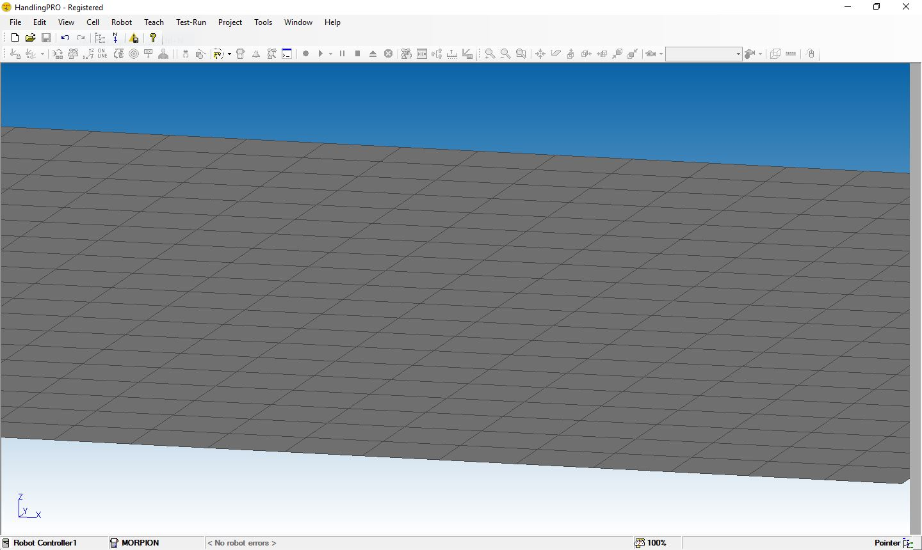

Slide 8
2nd Week (05/10/2016 and 07/10/2016):
Tic-Tac-Toe
Planification of activities
Notes:
Members divided into doubles

Slide 9
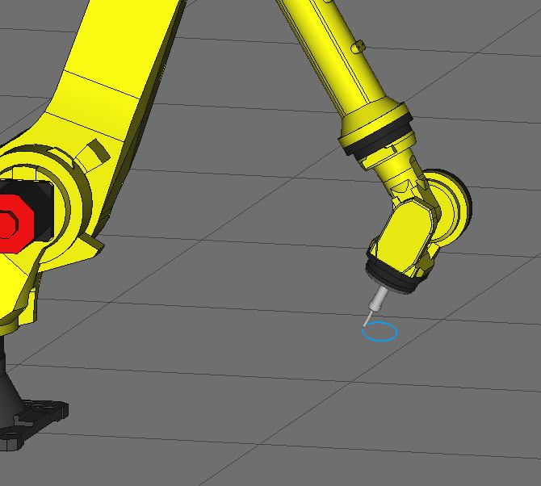
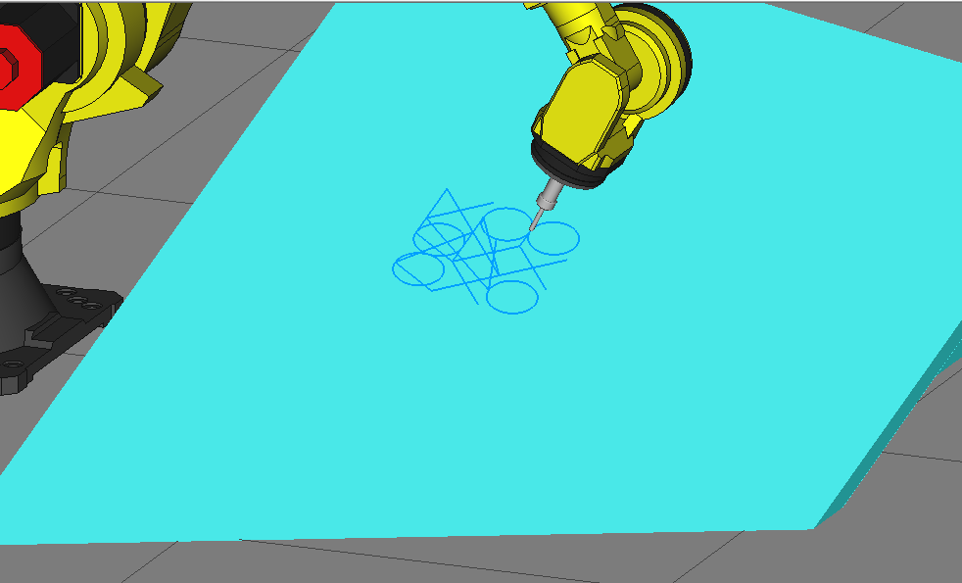

Slide 10
3rd Week (12/10/2016):
Pick and drop of a box
Insertion of peripheric elements
Setting of the simulation tool

Slide 11
4th Week (19/10/2016):
Meeting with Madam Makarov
Auto-evaluation of the groupe
Begin of the study of the “avant-projet” of previous years
Notes:
Meeting to discuss the progress
Auto-evaluation in respect to know how well do we master the Roboguide software

Slide 12
5th Week (26/10/2016):
Study of Simulation in Roboguide
Pick and drop of a box in oven
Proposition of a solution for the “avant-projet”

Slide 13
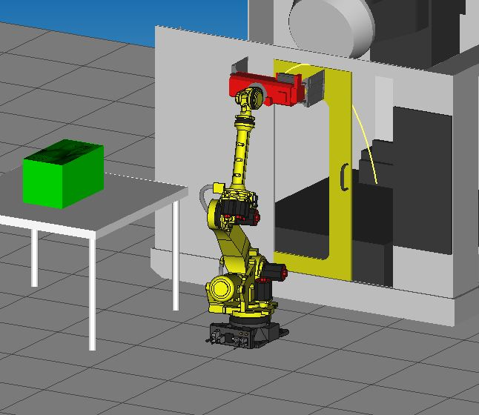
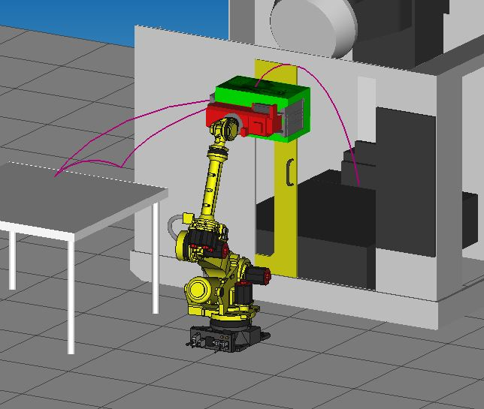
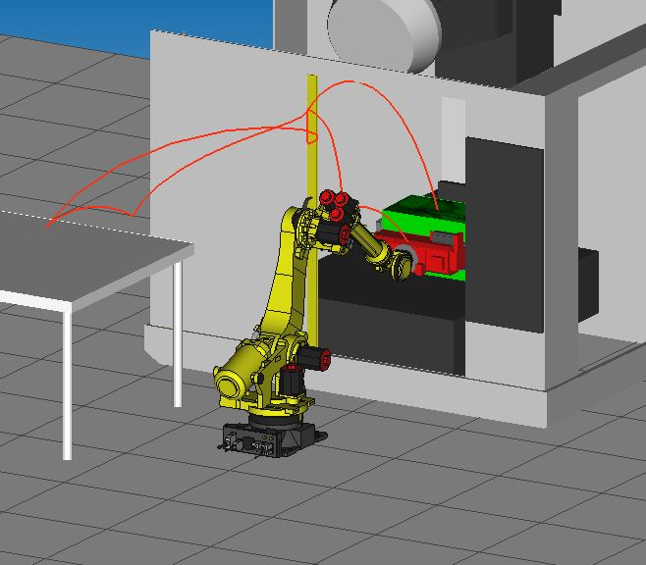

Slide 14
6th Week (02/11/2016 and 04/11/2016):
Proposition of steps to solve the problem
First contact with the subject of the test nº 1
Comprehension and hypothesis formulation

Slide 15
2 – Project management: principles and choices

Slide 16
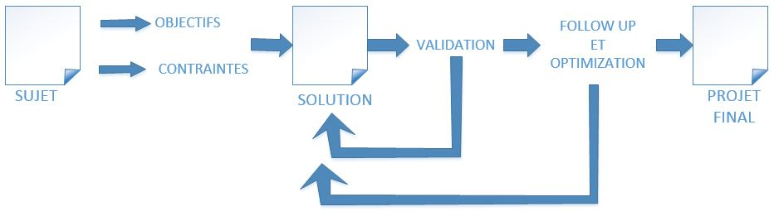

Slide 17
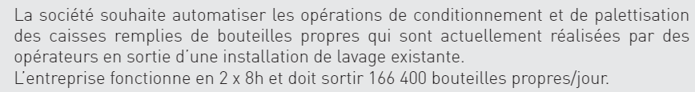
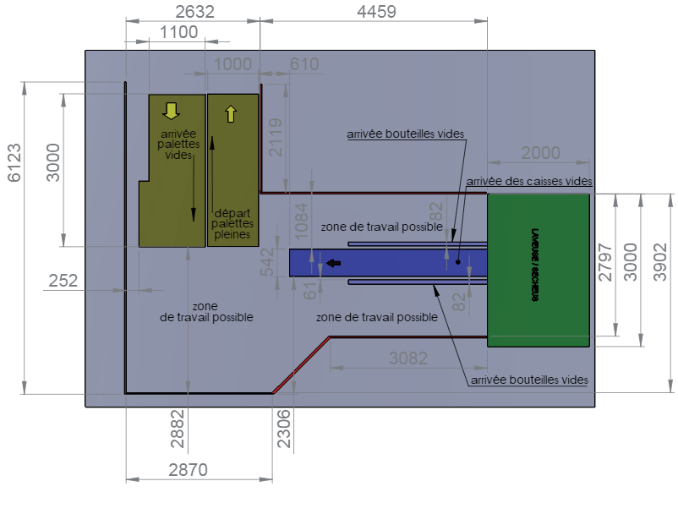
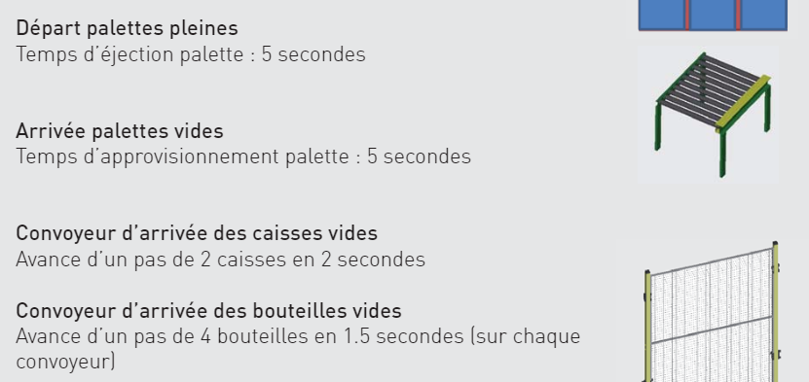
Objectives: What must be achieved
Constraints: Context and limitations

Slide 18
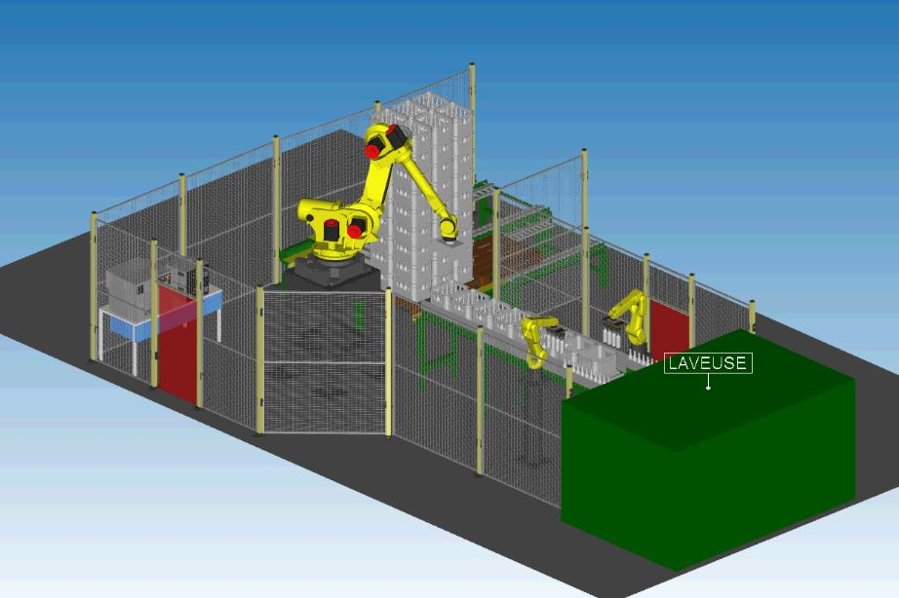
Solution: A functioning simulation

Slide 19
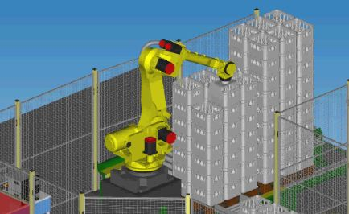
Validation: Checking that the simulation fulfills the objectives

Slide 20
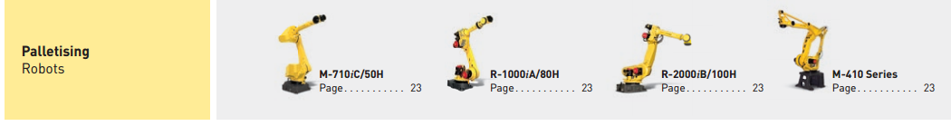
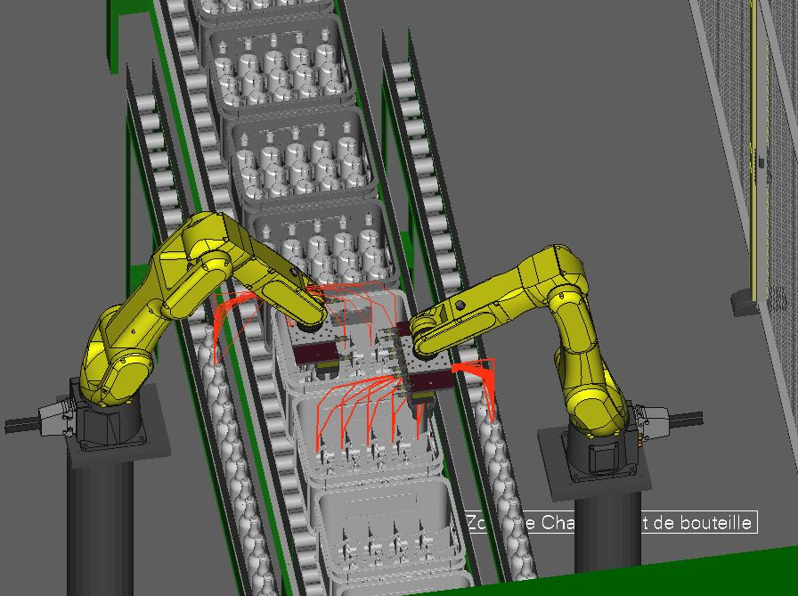
Follow up and Optimization: Criticizing and proposing better solutions (time, cost, space, energy consuption)

Slide 21

Final Project: Description, consolidation and argumentation

Slide 22
3 – Pre-project analysis

Slide 23
3.1 – Problem presentation
Objectives
Main constraints

Slide 24
3.2 – Proposed solution
We can divide the proposed solution analysis in four steps:
Robots choice;
Robots positioning;
Robots movements;
Simulation issues.

Slide 25
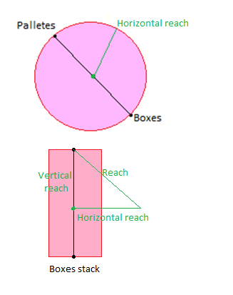
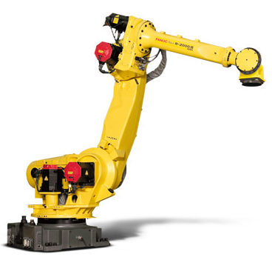
3.2.1 – Robots choice
Palletizer robot:
Project specifications:
- Load at wrist: 25.8 kg
- Minimum reach: 2075 mm
Robot chosen: R-2000iB/100H
- Maximum load capacity at wrist: 100 kg
- Maximum reach: 2655 mm
- Mechanical weight: 1150 kg
- Axis: 5
Robot palletizer series:
- M-710iC
- R-1000iA
- R-2000iB
- M-410

Slide 26
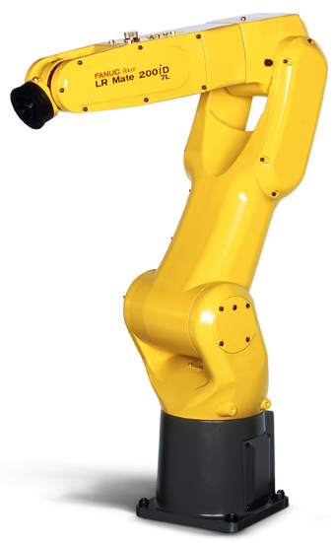
3.2.1 – Robots choice
Bottle robot:
Project specifications:
- Load at wrist: 5.74 kg
- Minimum reach: 414 mm
Robot chosen: LR Mate 200iD/7L
- Maximum load capacity at wrist: 7 kg
- Maximum reach: 911 mm
- Mechanical weight: 27 kg
- Axis: 6
LR Mate serie:
- LR Mate 200iD/7LC

Slide 27
3.2.1 – Robots choice
Bottle robot:
Especification:
- 1.75s for 8 bottles
By simulation:
- Robot takes 2.5s for 4 bottles
Conclusion:
- It’s necessary two bottle robots
Palletizer robot:
By simulation:
- 12.5s two boxes are filled
- Round-off trip in 5.55s
Conclusion:
- It’s possible for the palletizer robot chosen

Slide 28
3.2.2 – Robots positioning
Bottle robots:
Box conveyor height: 1085 mm
Robot’s maximum reach: 911 mm
Pedestal is needed!
Chosen height: 1100 mm
Furthest drop-off horizontal distance: 509.5 mm
Horizontal distance from the conveyor: 335 mm
Palletizing robot:
Boxes stack height: 3023.5 mm
Robot’s maximum reach : 2655 mm
Pedestal is needed!
Chosen height: 1400 mm
Horizontal placement: equidistant from boxes and pallets conveyors

Slide 29
3.2.3 – Robots movements
600 mm

Slide 30
3.2.3 – Robots movements

Slide 31
3.2.4 – Simulation issues
Controller
DCS
DCS

Slide 32
4 – Conclusion

Slide 34
Thank you for your attention!

Slide 35
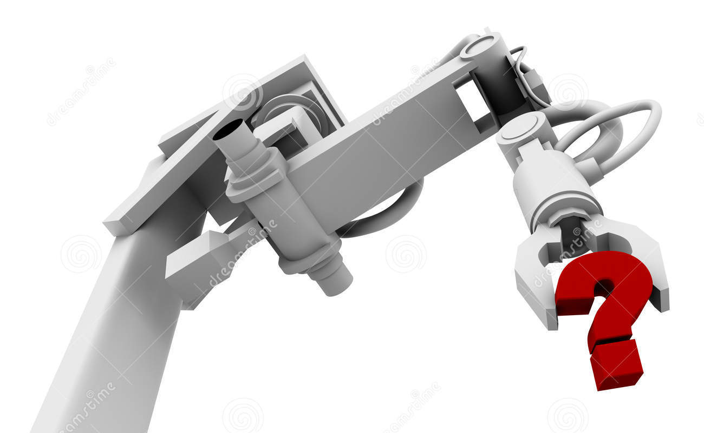
Any question?

