Slide 1
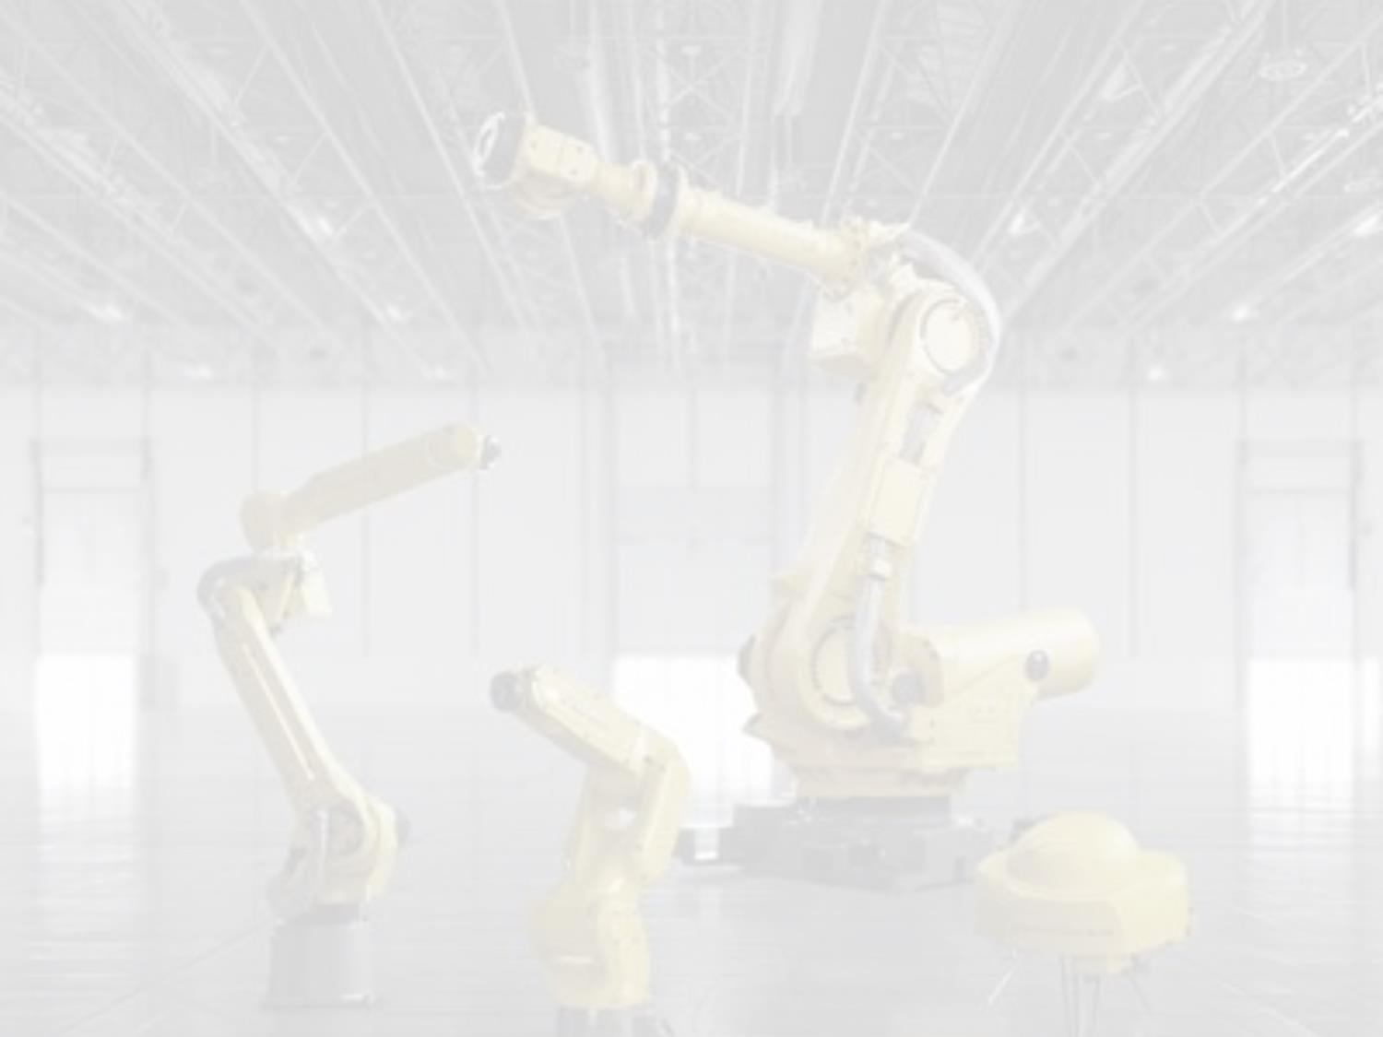

Olympiades FANUC Ingénieur
Équipe CentraleSupelec
CARVALHO BÜRGER Karoline
DE JESUS RODRIGUES Tiago
ELLER CRUZ Rafael
NOGUEIRA Rafael Accácio

Slide 2

Summary:
1 – Performed activities;
2 – Project management: principles and choices;
3 – Pre-project analysis;
3.1 – Problem presentation;
3.2 – Proposed Solutions;
3.2.1 – Robots choice;
3.2.2 – Robots positioning;
3.2.3 – Robots movements;
3.2.4 – Simulation issues;
4 – Conclusion.

Slide 3
Resultats

Slide 4
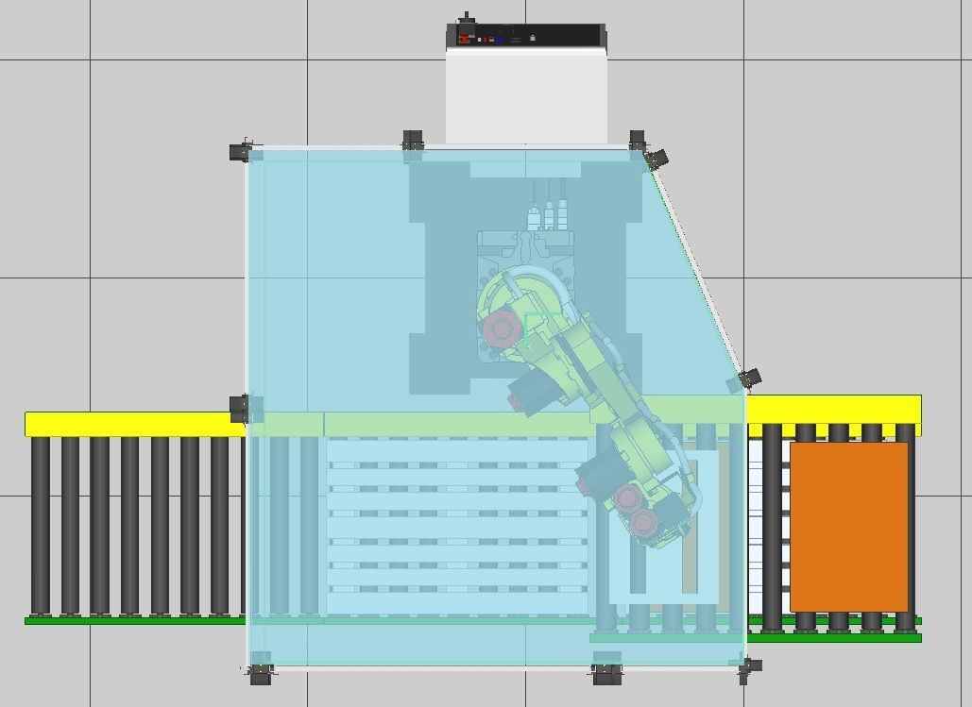
Surface de l’îlot

Slide 5
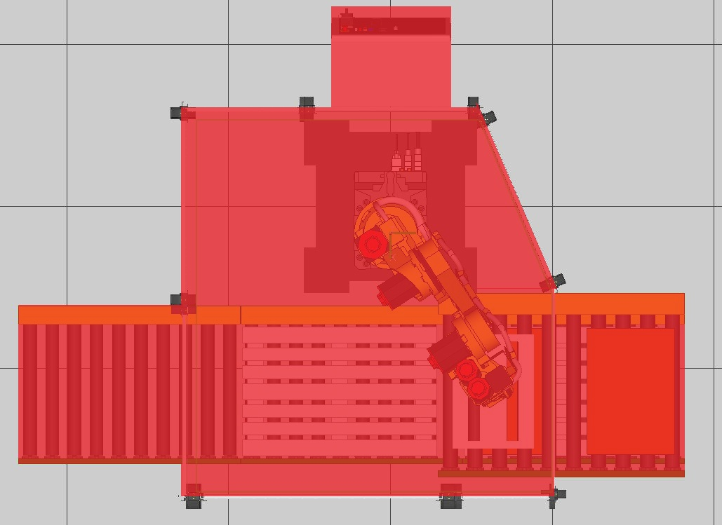
Surface de l’îlot

Slide 6
Cadence de production

Slide 7
Prévision Budgétaire
Élements | Prix
Robot R-1000iA | 45000 e
Fonction de sécurité DCS | 2000 e
Préhenseur à ventouses | 700 e
Total | 47700

