Slide 1
Text-Image Matching Survey
2019.4.25

Slide 2
主要分类
Common semantic vector space
Pairwise similarity learning
Image Captioning Based
Notes:
第一种方式：各自学习自己的表征，最后统一空间做匹配。 global alignment based methods
第二种方式：先做交互，然后在交互空间直接做匹配，可以利用更细粒度的信息。 local alignment based methods
第三种方式：直接从text生成图片，或者从图片生成text.
5篇文章

Slide 3

数据集
Notes:
第一种方式：各自学习自己的表征，最后统一空间做匹配
第二种方式：先做交互，然后在交互空间直接做匹配，可以利用更细粒度的信息
第三种方式：直接从text生成图片，或者从图片生成text

Slide 4

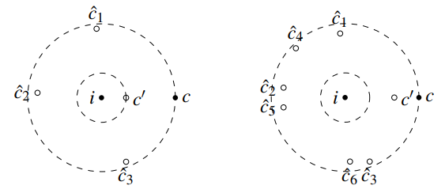



VSE++ 2017
Improving Visual-Semantic Embeddings with Hard Negatives. Faghri et al.
VGG 19 / ResNet152
GRU-based text encoder
Notes:
FC7，Dφ , is 4096 for VGG19 and 2048 for ResNet152.
hinge loss
the caption embedding is normalized, while the image embedding is not.

Slide 5
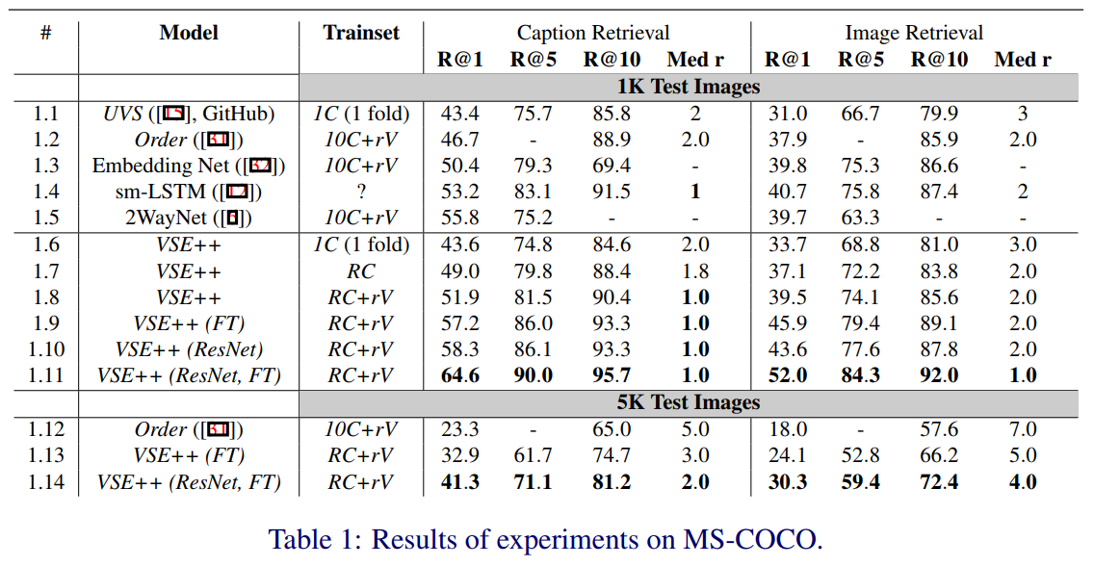
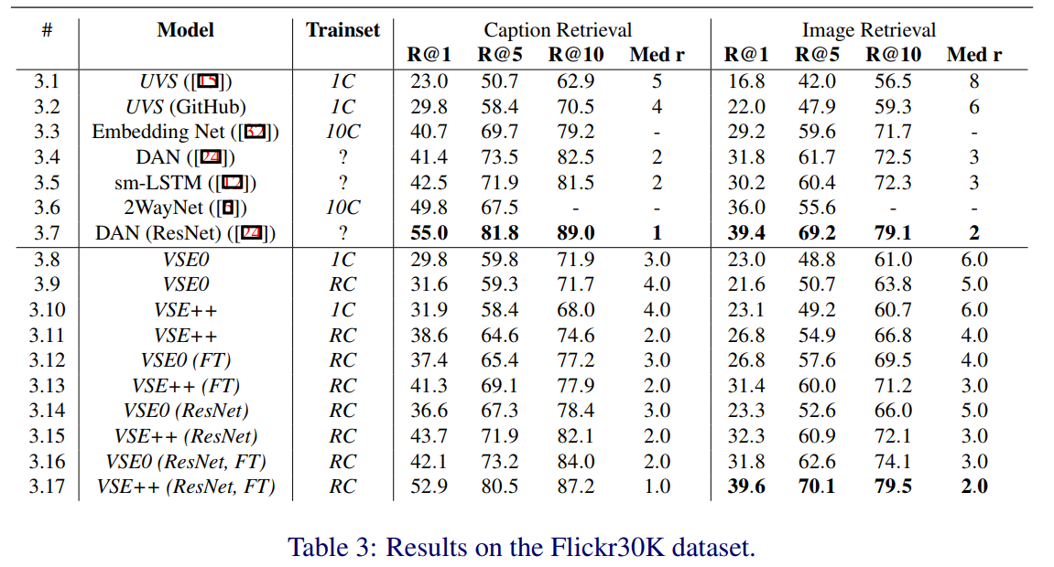
VSE++ 2017
Improving Visual-Semantic Embeddings with Hard Negatives. Faghri et al.

Slide 6
VSE++ 2017
Improving Visual-Semantic Embeddings with Hard Negatives. Faghri et al.

Slide 7
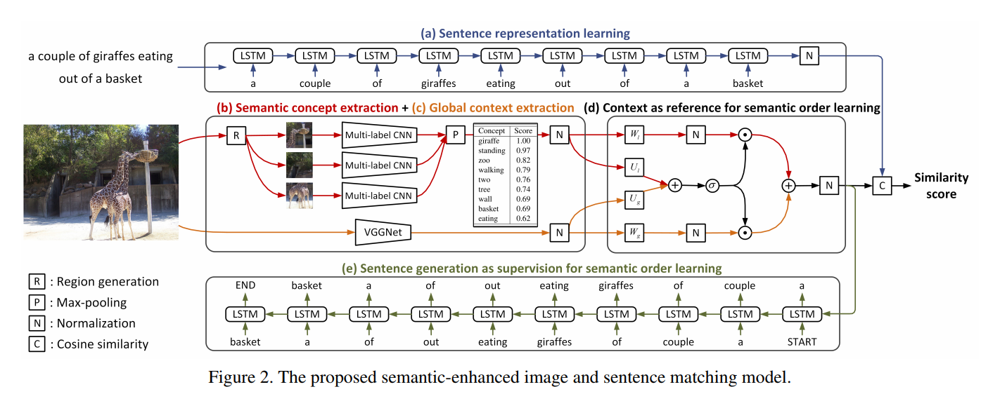

SCO 2018 CVPR
Learning Semantic Concepts and Order for Image and Sentence Matching, Huang et al.
Notes:
For images, their semantic concepts refer to various objects, properties, actions, etc.
keep the nouns, adjectives, verbs and numbers as semantic concepts
improving the image representation by learning semantic concepts and then organizing them in a correct semantic order.
VGGNet
concept multiple classification
multi-regional multi-label CNN
a context-gated sentence generation scheme that uses the image global context as reference and the sentence generation as supervision.
the global context can not only describe all the semantic concepts in a coarse level, but also indicate their spatial relations with each other.

Slide 8
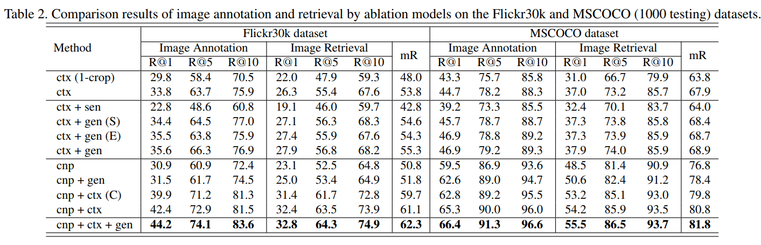
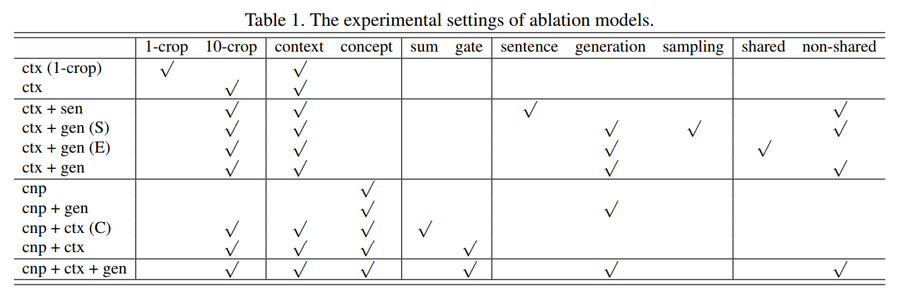
Notes:
“sentence” uses the state-ofthe-art image captioning method [32] to generate sentences

Slide 9
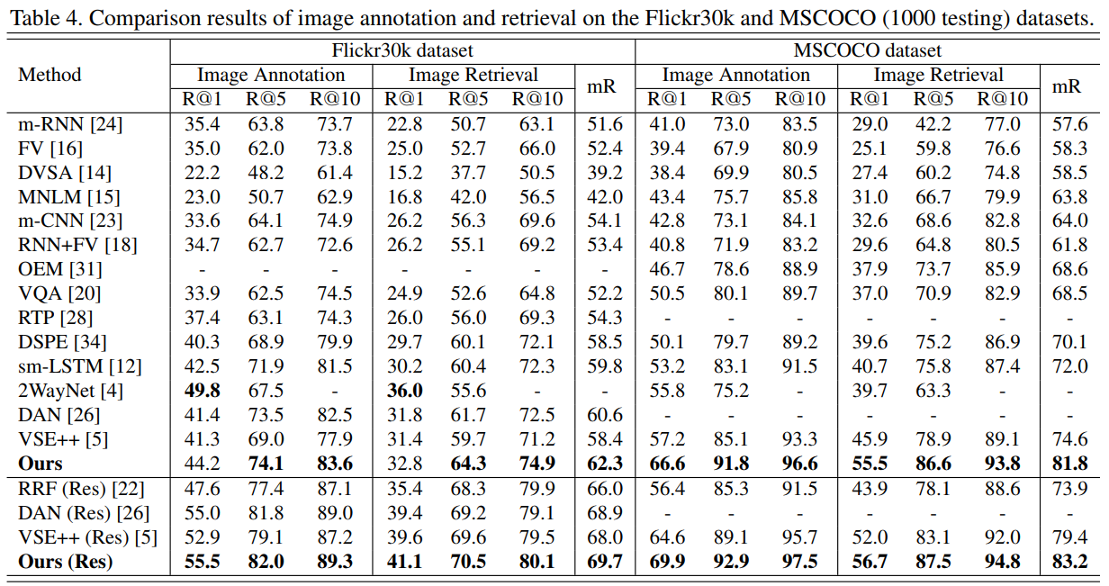

Slide 10
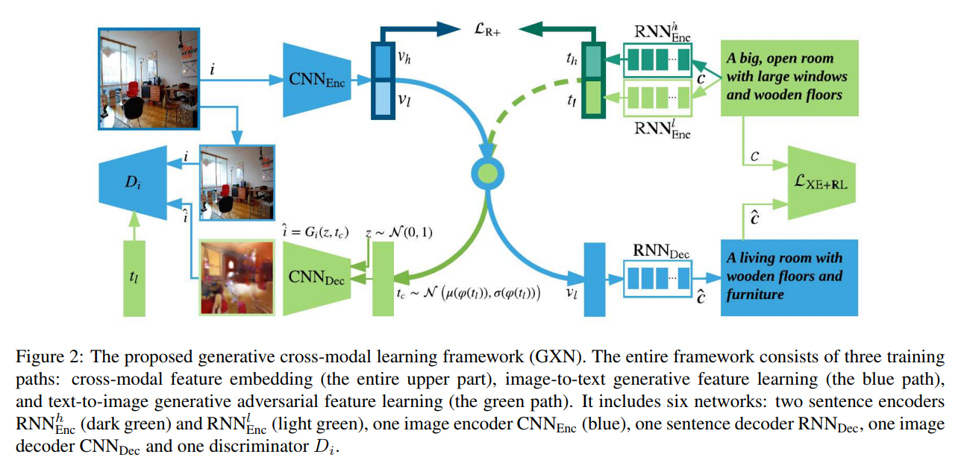
Gen-XRN 2018 CVPR
Look, Imagine and Match: Improving Textual-Visual Cross-Modal Retrieval with Generative Models. Gu et al.
Notes:
consider (vh, th) as high-level abstract features, (vl, tl) as detailed grounded features
Here we adopt the generative adversarial model, which comprises a generator/ decoder CNNDec and a discriminator Di
During the testing stage, {vh, vl} and {th, tl} will be used as the final feature representations for cross-modal retrieval.
Ranking loss,

Slide 11
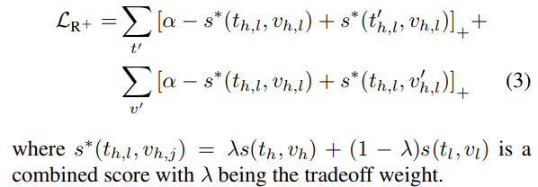
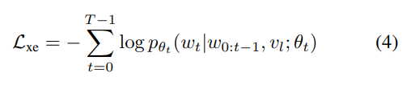

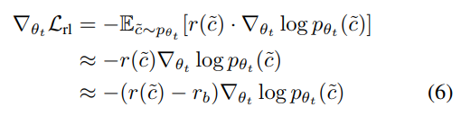


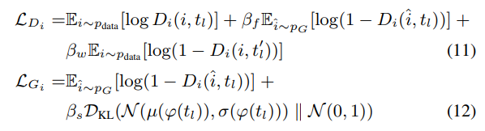
Gen-XRN 2018 CVPR
Look, Imagine and Match: Improving Textual-Visual Cross-Modal Retrieval with Generative Models. Gu et al.
Notes:
the XE loss is a word-level cost, and models trained on this suffer from the exposure bias problem. 都不能匹配到？为什么会有这个问题？
c˜ = ( ˜w0, · · · , w˜T −1)
r(˜c) is the reward calculated by comparing the generated sentence with the corresponding reference sentences using a standard evaluation metric like BLEU or CIDEr
RL: Monte-Carlo sample c˜ from pθtc
XE: readability and fluency
Text to Image: a conditional GAN: consists of a discriminator and a generator.
directly combining tl with z cannot produce satisfactory results. This is because of the limited amount of data and the unsmoothness between tl and z.

Slide 12
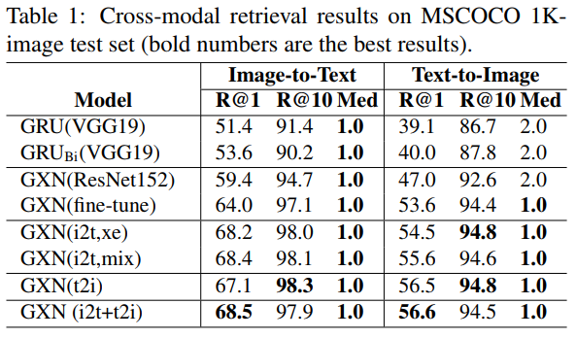
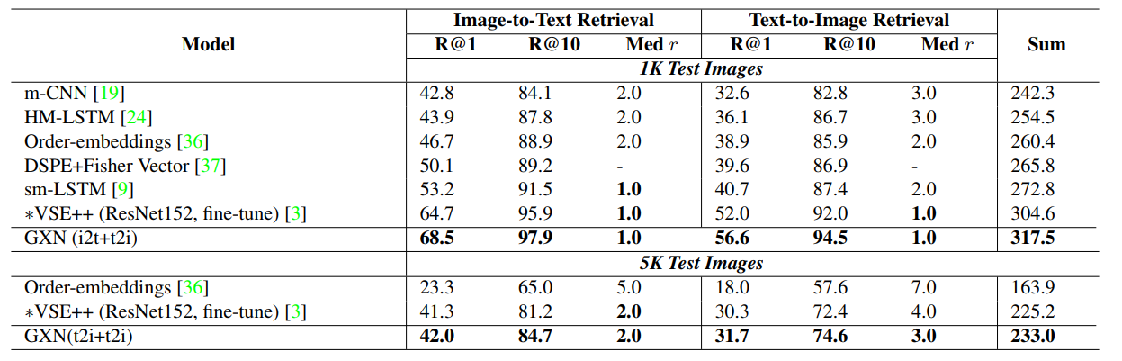
Gen-XRN 2018 CVPR
Notes:
vocabulary of 27,012
word embedding size to 300
joint embedding space to 1024
a bi-directional GRU-based encoder to get the abstract feature representation th
one GRU-based encoder to get the grounded feature representation tl
The number of hidden units of both GRUs is set to 1024.
CIDEr score as the sentence-level reward

Slide 13
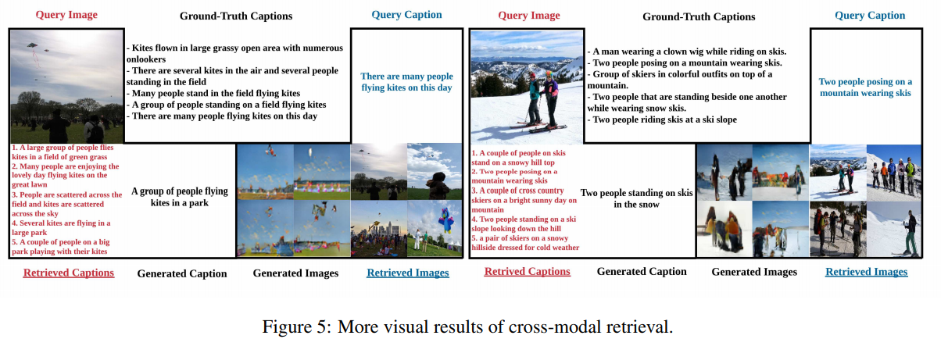
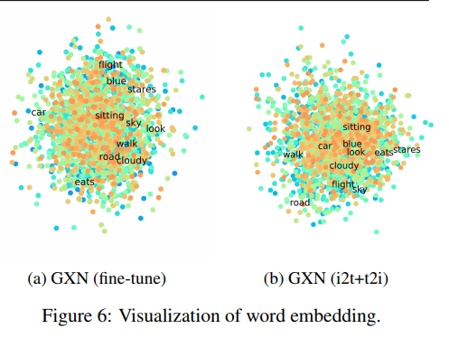
Gen-XRN 2018 CVPR
Notes:
"eat" and "stares"

Slide 14
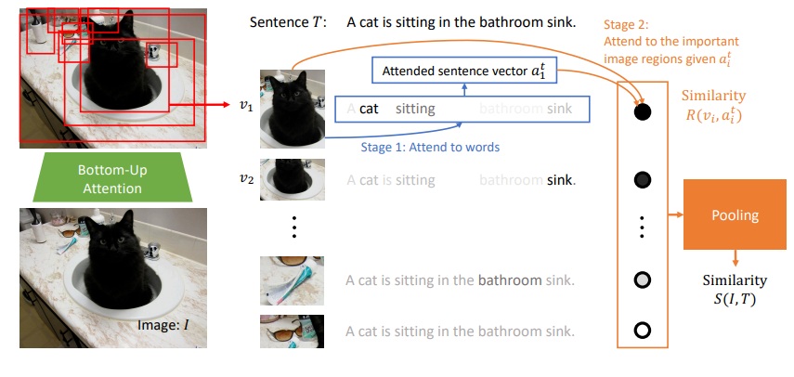
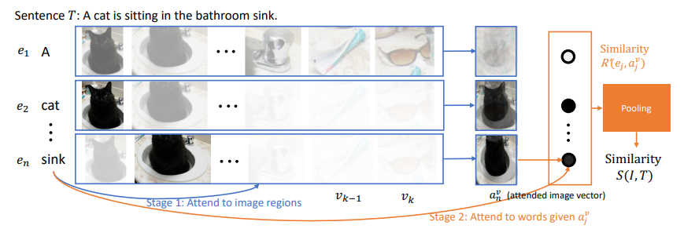











SCAN 2018 ECCV
Stacked Cross Attention for Image-Text Matching. Lee. et al.
Notes:
aligning image region and word features
refer to detection of salient regions as bottom-up attention and practically implement it with a Faster R-CNN [35] model. bounding boxes, ResNet-101.
LogSumExp pooling (LSE)

Slide 15
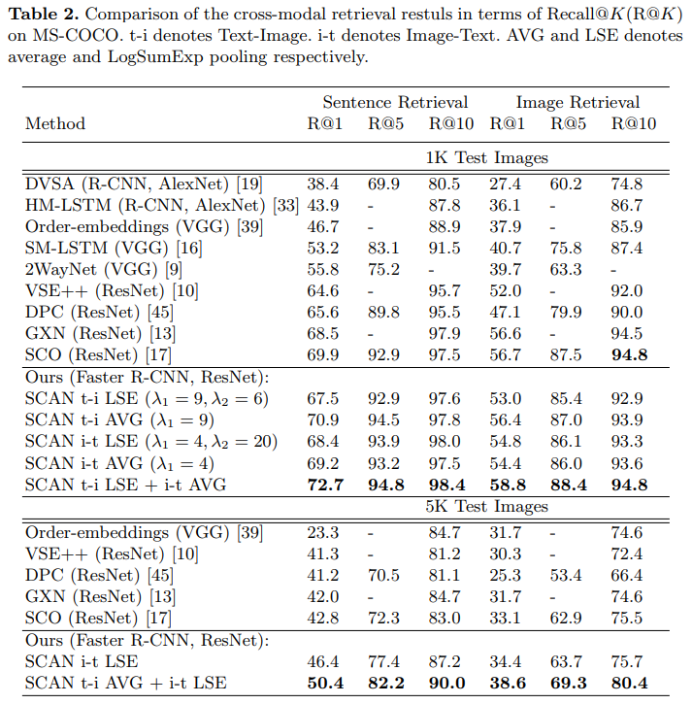
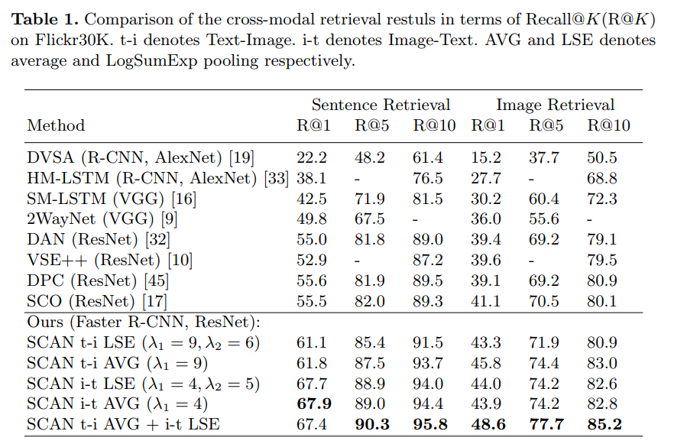
SCAN 2018 ECCV

Slide 16
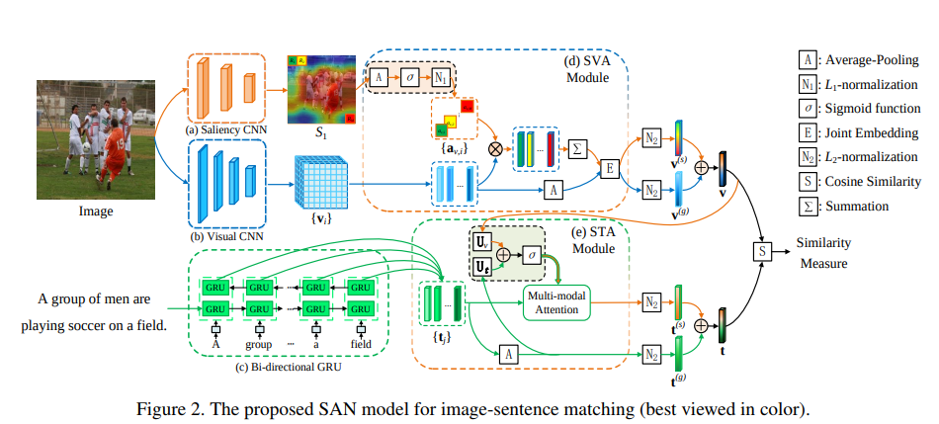
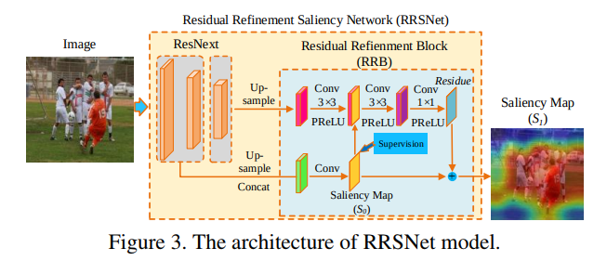
SGAN 2019
Saliency-Guided Attention Network for Image-Sentence Matching. Ji et al.
Notes:
visual saliency detection models are usually too big to fit into the networks for image-sentence matching. we design a lightweight saliency model, named Residual Refinement Saliency Network (RRSNet), which is able to detect salient regions with limited computing resources.
- saliency detector
- A lightweight saliency detection model provides the visual saliency information as the guidance for the two attention modules
- Saliency-weighted Visual Attention (SVA) module
- leverage the advantage of the saliency information to improve discrimination of visual representations.
- The visual attention module selectively attends to various local visual features via resorting to the lightweight saliency detector
- take a step towards selectively attending to various words of the sentence.
- Saliency-guided Textual Attention (STA) module
- By fusing the visual information from SVA and textual information as a multi-modal guidance, STA learns discriminative textual representations that are highly sensitive to visual clues.
- For the textual attention module, taking the intra-modality and inter-modality correlations into consideration, we merge the visual saliency, global visual and textual information effectively to generate multi-modal guidance for soft-attention mechanism, determining the importance of word-level textual features.
- design a gated fusion unit to fuse multi-modal information effectively.
- points
- an image usually has the capability to convey more detailed information than a sentence.
- Unlike the above methods that explicitly aggregate local similarities to compute the global one
- an asymmetrical architecture

Slide 17
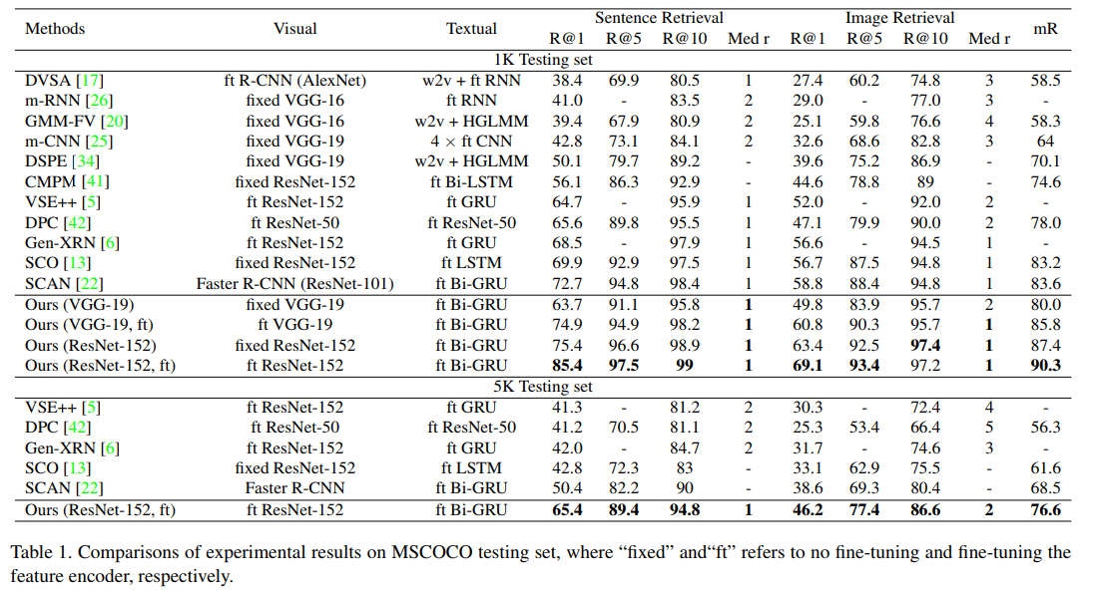
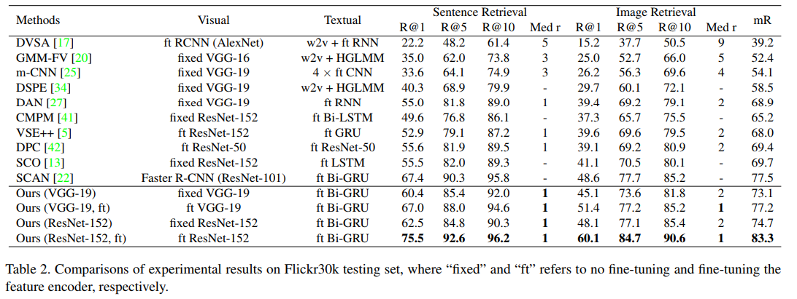

Slide 18
思考
学术上更细粒度，模型更复杂
Finetune效果更好
GAN，Attention用的比较多
分类问题 -> rank问题
可以利用Bert的Self-attention提取更细粒度的语义信息，在MSCOCO和Flickr30K

