Slide 1
M6D Targeting Model - paper reading
xueminzhao@tencent.com
7/23/2014

Slide 2
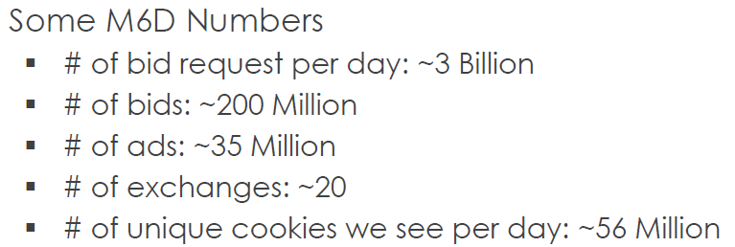
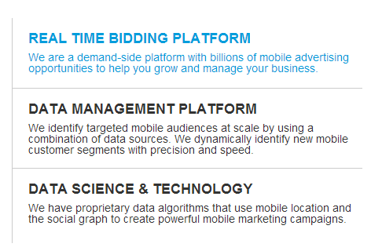
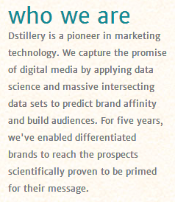



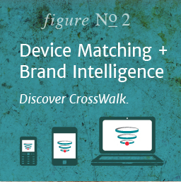
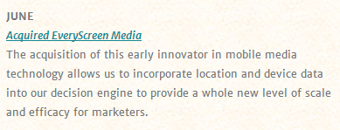
M6D(Media6Degrees) => Dstillery
2012年数据
http://dstillery.com/
http://www.everyscreenmedia.com/

Slide 3
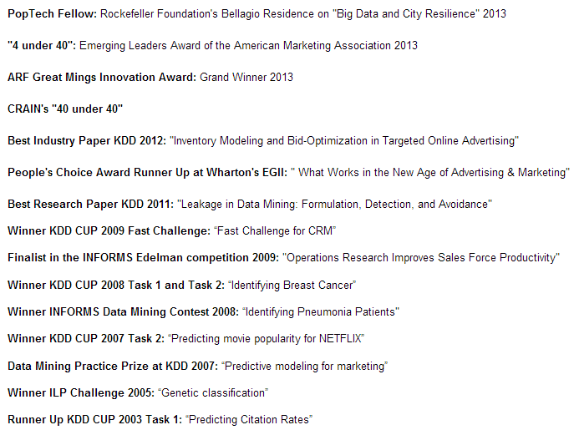

M6D Data Scientist
Chief Scientist: Claudia Perlich
Foster Provost, nyu
Brian Dalessandro
Troy Raeder
Ori Stitelman

Slide 4
Outline
Background
Targeting: Based-on CF
- Audience Selection for On-line Brand Advertising: Privacy-friendly Social Network Targeting. KDD'09.
Targeting: Predictive Models & Transfer Learning
- Machine Learning for Targeted Display Advertising: Transfer Learning in Action. MLJ’2014.
- Design Principles of Massive, Robust Prediction Systems. KDD’2012.
Bid Optimizing and Inventory Scoring
- Bid Optimizing and Inventory Scoring in Targeted Online Advertising. KDD’2012.

Slide 5
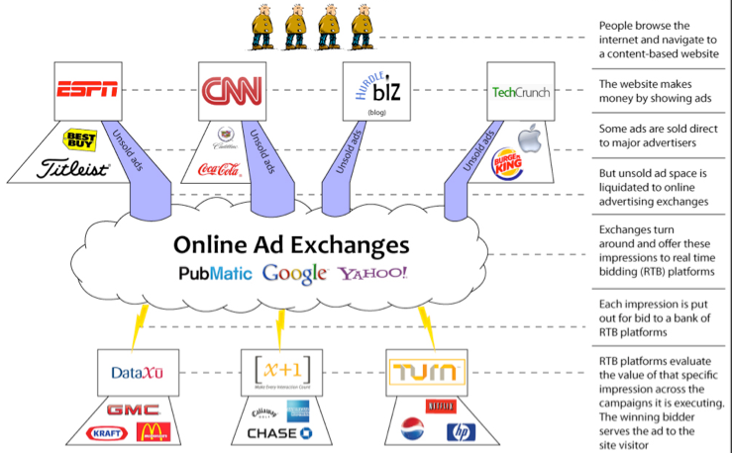
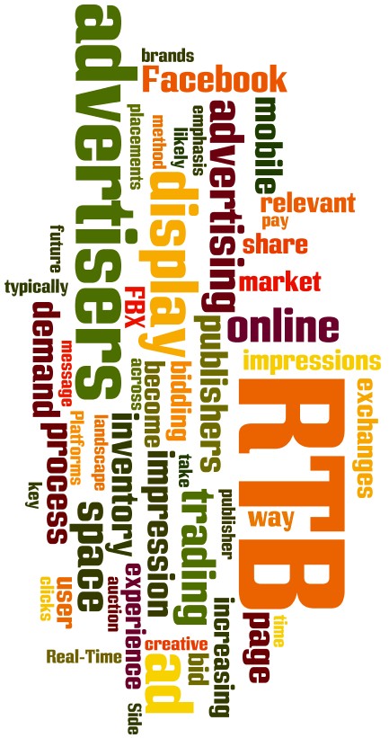

Real-Time Bidding

Slide 6
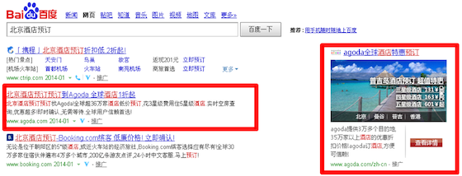



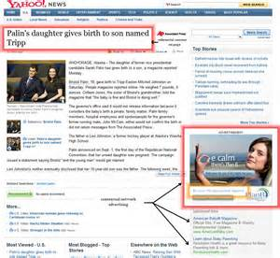


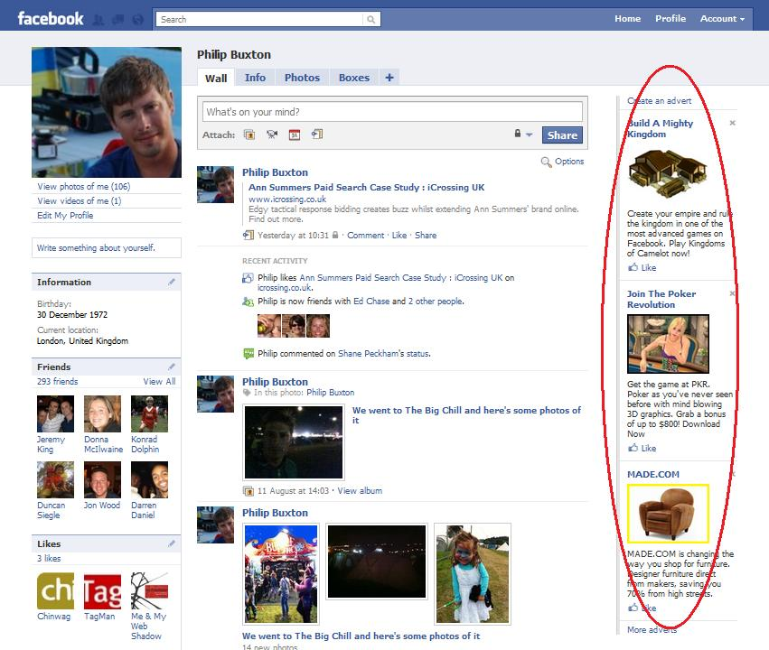

Advertising
Search-based Advertising
-
Contextual Advertising
-
Display Advertising
-
-
搜索推广
网盟推广

Slide 7
Computational Advertising
vs.

Slide 8
Life of a Brower
Targeting Model
Initiate: create cookie
Monitor
Score and Segment
Sync with Exchange
Activate Segment
Receive Bid Request
7. Bid
8. Show Impression
9. Track Conversion
10. The Cycle …
11. Cookie Deletion
Biding Model

Slide 9
Outline
Background
Targeting: Based-on CF
- Audience Selection for On-line Brand Advertising: Privacy-friendly Social Network Targeting. KDD'09.
Targeting: Predictive Models & Transfer Learning
- Machine Learning for Targeted Display Advertising: Transfer Learning in Action. MLJ’2014.
- Design Principles of Massive, Robust Prediction Systems. KDD’2012.
Bid Optimizing and Inventory Scoring
- Bid Optimizing and Inventory Scoring in Targeted Online Advertising. KDD’2012.

Slide 10
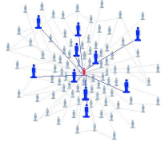
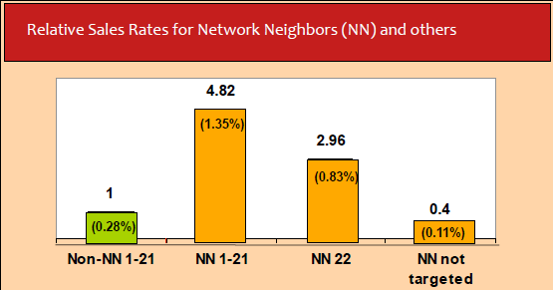
Network-Based Marketing
Take rates for the NN and non-network neighbors in segments 1–21 compared with the all-network-neighbor segment 22 and with the nontarget NNs. All take rates are relative to the non-NN group (segments 1–21).
Shawndra Hill, Foster Provost and Chris Volinsky. Network-Based Marketing: Identifying Likely Adopters via Consumer Networks. Statistical Science 2006, Vol. 21, No. 2, 256–276

Slide 11
Browser Interactions
Action Pixels
- Individual customer web sites,
define seed nodes, track CVR
Mapping Pixels
- Content-Generating Sites (e.g.
blogs)

Slide 12
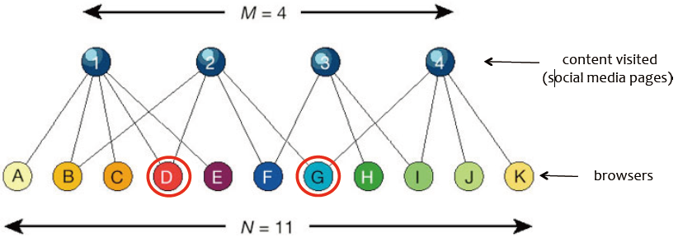
Doubly-Anonymized Bipartite Graph
“Mapping” Data
“Action” Data, Seed Nodes

Slide 13
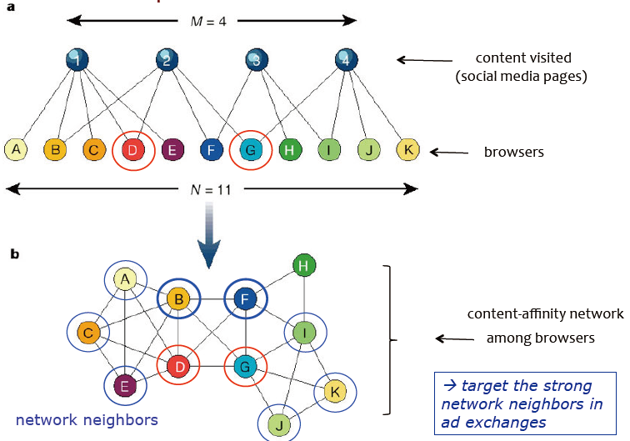
Bipartite Network => Quasi SN
Seed Nodes
+
User Similarity
+
Brand Proximity
||
Targeting Model

Slide 14
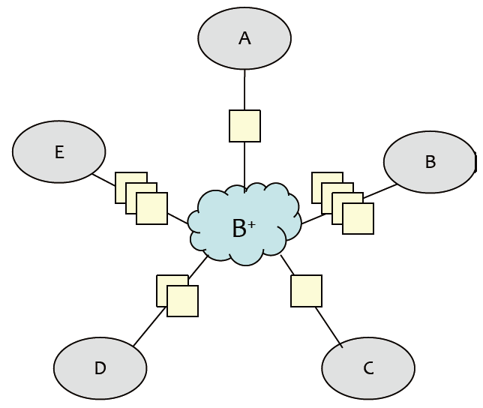
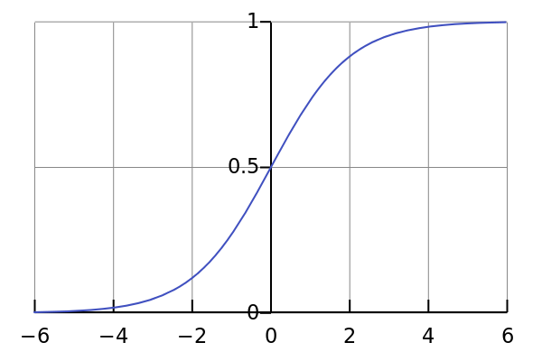
Brand Proximity Measures
POSCNT
- # of unique content pieces connecting browser to B⁺
MATL
- maximum # of content pieces through which paths connect browser
to seed node in B⁺
maxCos
- maximum cosine similarity to a seed node
minEUD
- minimum Euclidean distance of normalized content vector to a seed node
ATODD
- “odd” of a neighbor being an seed node
Multivariate Model
All of these are just features!

Slide 15
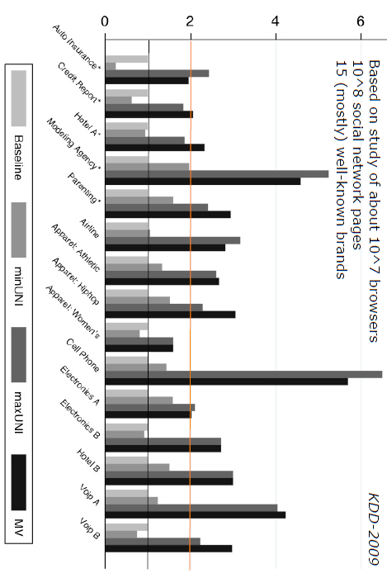
Lift for Top 10% of NNs
NNs often show similar demographics

Slide 16
Outline
Background
Targeting: Based-on CF
- Audience Selection for On-line Brand Advertising: Privacy-friendly Social Network Targeting. KDD'09.
Targeting: Predictive Models & Transfer Learning
- Machine Learning for Targeted Display Advertising: Transfer Learning in Action. MLJ’2014.
- Design Principles of Massive, Robust Prediction Systems. KDD’2012.
Bid Optimizing and Inventory Scoring
- Bid Optimizing and Inventory Scoring in Targeted Online Advertising. KDD’2012.

Slide 17
Targeting Model: the Heart and Soul
Triplet O=(U,A,I) of an ad A for a marketer to
a user U at a particular inventory I
Targeting Model
p(c|u, a, i) => p(c|u,a) => p_{a}(c|u)
Predictive modeling on hashed browsing history
10 Million dimensions for URL’s
Extremely sparse data
Positive are extremely rare

Slide 18
How to learn p_{a}(c|u): 10M features & no/few positives?
We cheat.
In ML, cheating is called “Transfer Learning”!
Source Task
Target Task

Slide 19
Clicks/SV/Conversions

Slide 20
Surrogate for Conversions

Slide 21
Bias and Variance
Bias-Variance Tradeoff

Slide 22
SV vs. Purchase
20-3-5 win-tie-loss

Slide 23
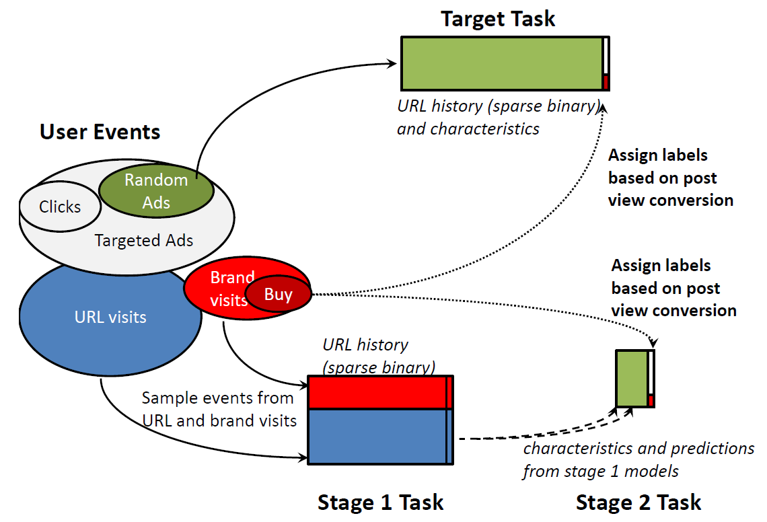
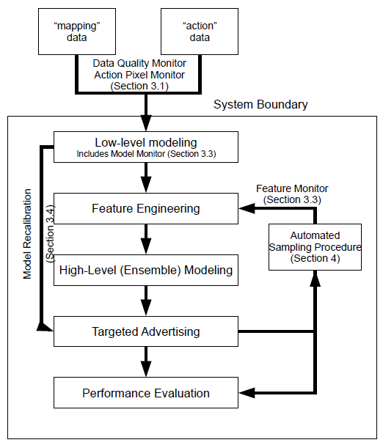
Stage-2 Ensemble Model

Slide 24
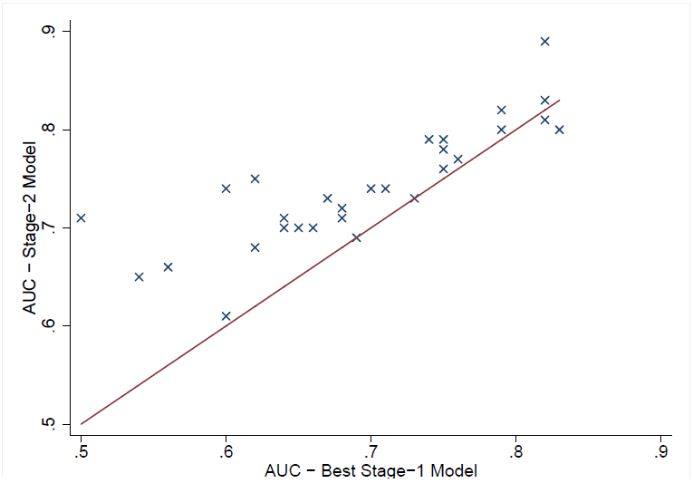
Stage-2 Performance
Stage-1 dramatically reduces the large target feature set X_{T}
Stage-2 learns based on the target sampling distribution P_{T}

Slide 25
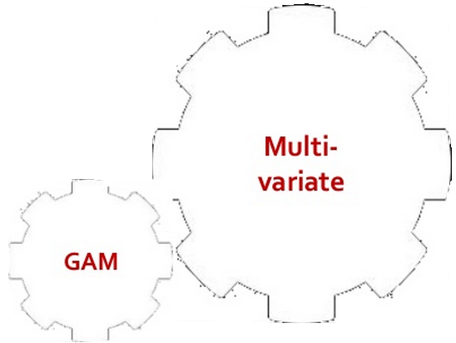
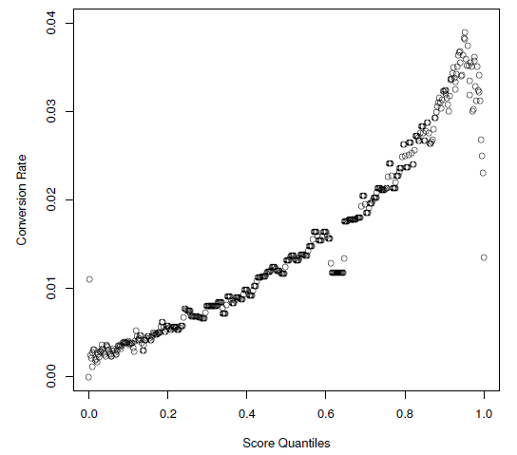
Re-calibration Procedure
Generalized Additive Model

Slide 26
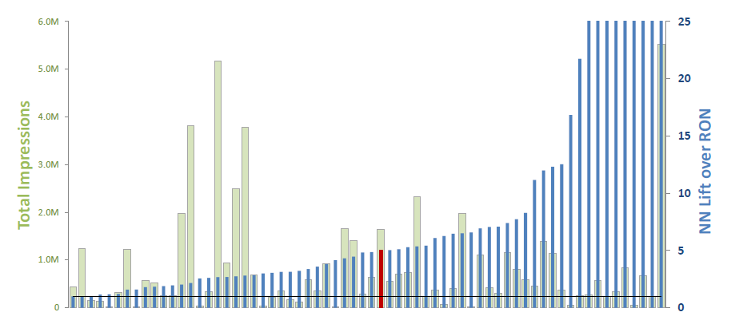
Production Results

Slide 27
Outline
Background
Targeting: Based-on CF
- Audience Selection for On-line Brand Advertising: Privacy-friendly Social Network Targeting. KDD'09.
Targeting: Predictive Models & Transfer Learning
- Machine Learning for Targeted Display Advertising: Transfer Learning in Action. MLJ’2014.
- Design Principles of Massive, Robust Prediction Systems. KDD’2012.
Bid Optimizing and Inventory Scoring
- Bid Optimizing and Inventory Scoring in Targeted Online Advertising. KDD’2012.

Slide 28
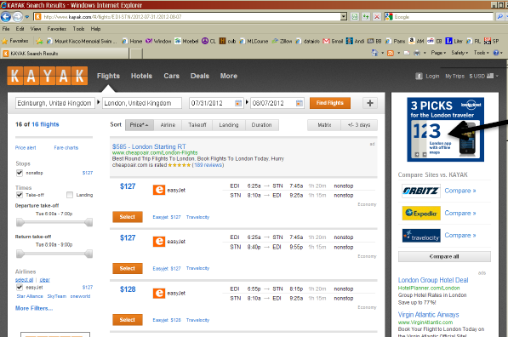
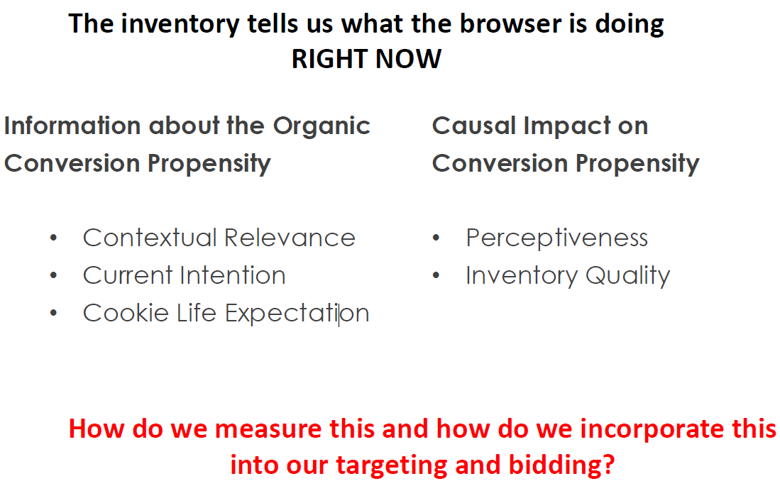
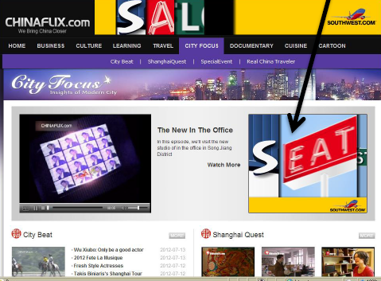
Why should the inventory matter?

Slide 29
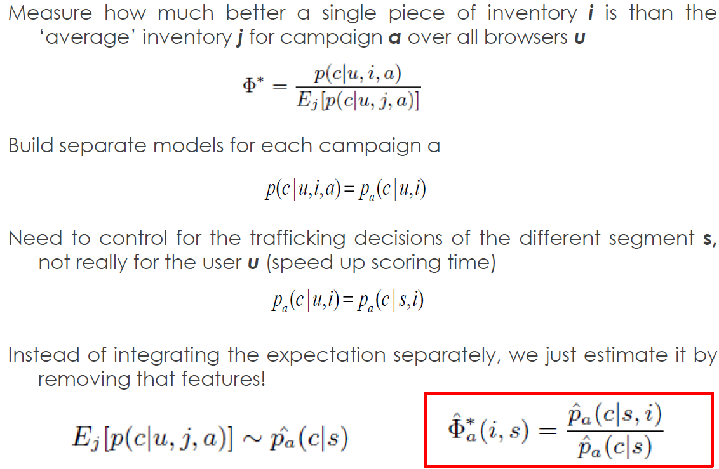
Bid Optimization and Inventory Scoring

Slide 30
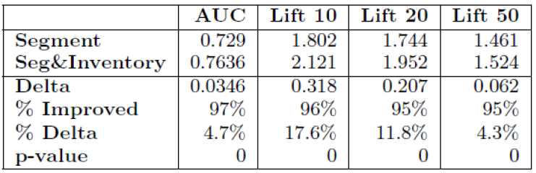
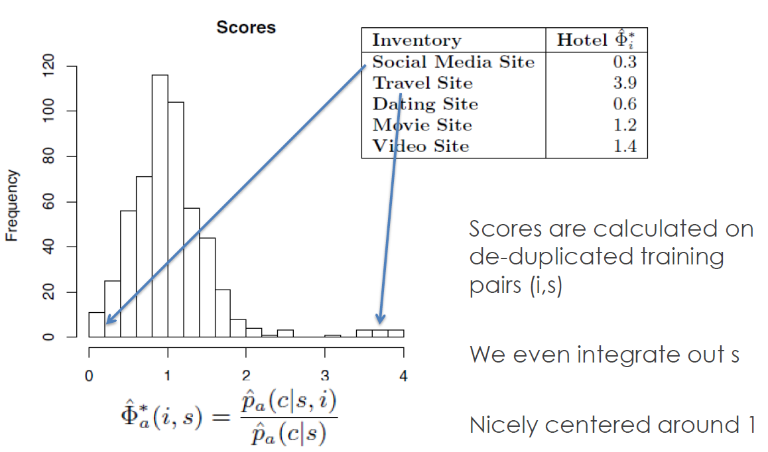
Model Performance

Slide 31

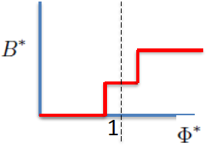
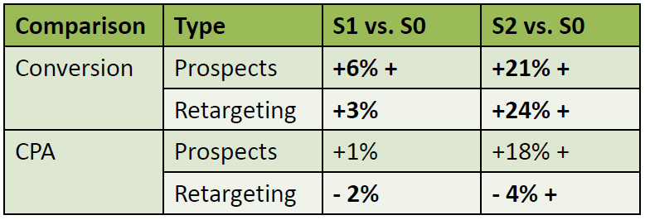
Biding Performance
S0, always bid base price B for segment
S1,
S2,

Slide 32
Outline
Background
Targeting: Based-on CF
- Audience Selection for On-line Brand Advertising: Privacy-friendly Social Network Targeting. KDD'09.
Targeting: Predictive Models & Transfer Learning
- Machine Learning for Targeted Display Advertising: Transfer Learning in Action. MLJ’2014.
- Design Principles of Massive, Robust Prediction Systems. KDD’2012.
Bid Optimizing and Inventory Scoring
- Bid Optimizing and Inventory Scoring in Targeted Online Advertising. KDD’2012.

Slide 33
Thank You!

