Slide 1
Network layer in aws
VPC. Subnet. Route table. NAT and Internet gateway. Security group. NACL.

Slide 2
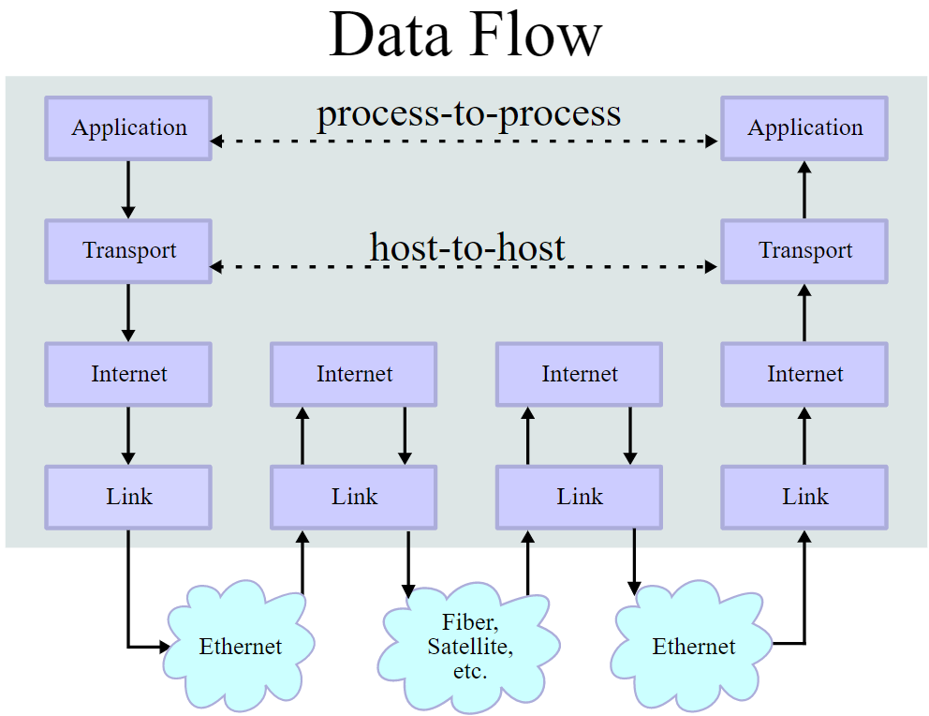
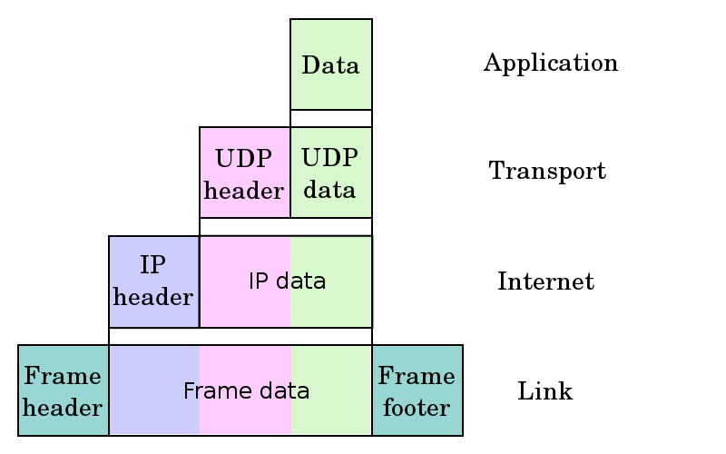
Preface – TCP/ip model
OS
Driver
MAC address

Slide 3
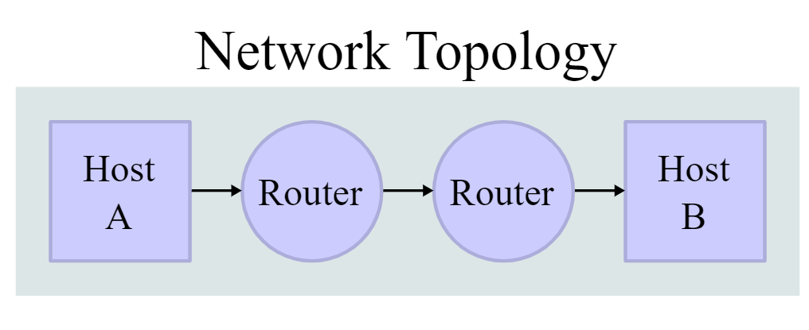
Preface – TCP/ip model
Route table
Route table
Border Gateway Protocol

Slide 4
ip addresses
Internet Protocol v4 address is 32bit number (IPv6 128 bit)
Address space is 2³² = 4,294,967,296 IPs
IP Notation: 0.0.0.0 to 255.255.255.255
Subnet mask – number of bits dedicated for network address (subnet)
CIDR Notation: /0 to /32
Remaining part is for host address
Example of CIDR Block: 10.0.0.0/24

Slide 5
NETWORKs and HOSTS
Network (24bits) Hosts (8bits)
CIDR block: 10.0.0.0/24 = 00001010.00000000.00000000.00000000
Mask: /24 = 255.255.255.0 = 11111111.11111111.11111111.00000000
Hosts: 2³²⁻²⁴=2⁸=256 ={00001010.00000000.00000000.00000000 -
00001010.00000000.00000000.11111111}=
={10.0.0.0 - 10.0.0.255}
Hosts in 10.0.0.0/24 are from 10.0.0.0 to 10.0.0.255

Slide 6
Subnetting and CIDR
The practice of dividing a network into sub-networks
Example:
Network 10.0.0.0/24 10.0.0.0 – 10.0.0.255
Subnet 1 10.0.0.0/25 10.0.0.0 – 10.0.0.127
Subnet 2 10.0.0.128/25 10.0.0.128 – 10.0.0.255
Classless Inter-Domain Routing (CIDR)
Fixes issues with previous Classful addressing
Variable-length subnet masking
Notes:
Clasful

Slide 7
NETWORKs and HOSTS SUBNET1
Network (26bits) Hosts (6bits)
CIDR block: 10.0.0.0/26 = 00001010.00000000.00000000.00000000
Mask: /26 = 255.255.255.192 = 11111111.11111111.11111111.11000000
Hosts: 2³²⁻²⁶=2⁶=64 ={00001010.00000000.00000000.00000000 -
00001010.00000000.00000000.00111111}=
={10.0.0.0 - 10.0.0.63}
Hosts in 10.0.0.0/26 are from 10.0.0.0 to 10.0.0.63

Slide 8
NETWORKs and HOSTS SUBNET2
Network (26bits) Hosts (6bits)
CIDR block: 10.0.0.64/26 = 00001010.00000000.00000000.01000000
Mask: /26 = 255.255.255.192 = 11111111.11111111.11111111.11000000
Hosts: 2³²⁻²⁶=2⁶=64 ={00001010.00000000.00000000.01000000 -
00001010.00000000.00000000.01111111}=
={10.0.0.64 - 10.0.0.127}
Hosts in 10.0.0.0/26 are from 10.0.0.64 to 10.0.0.127

Slide 9
NETWORKs and HOSTS SUBNET3
Network (26bits) Hosts (6bits)
CIDR block: 10.0.0.128/26 = 00001010.00000000.00000000.10000000
Mask: /26 = 255.255.255.192 = 11111111.11111111.11111111.11000000
Hosts: 2³²⁻²⁶=2⁶=64 ={00001010.00000000.00000000.10000000 -
00001010.00000000.00000000.10111111}=
={10.0.0.128 - 10.0.0.191}
Hosts in 10.0.0.0/26 are from 10.0.0.128 to 10.0.0.192

Slide 10
NETWORKs and HOSTS SUBNET4
Network (26bits) Hosts (6bits)
CIDR block: 10.0.0.192/26 = 00001010.00000000.00000000.11000000
Mask: /26 = 255.255.255.192 = 11111111.11111111.11111111.11000000
Hosts: 2³²⁻²⁶=2⁶=64 ={00001010.00000000.00000000.11000000 -
00001010.00000000.00000000.11111111}=
={10.0.0.192 - 10.0.0.255}
Hosts in 10.0.0.0/26 are from 10.0.0.192 to 10.0.0. 255

Slide 11
Private networks
Originated from IPv4 address exhaustion but now used for security
IP addresses reserved for Private networks
10.0.0.0/8 , 172.16.0.0/12 or 192.168.0.0/16
Private IP packets not routed in Internet
Network address translation (NAT) between Private networks and Internet (or other Private networks)
Mapping between IP addresses from different address spaces

Slide 12
Q&A

Slide 13
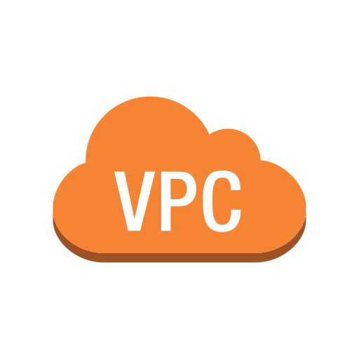
AWS VPC
What is VPC?
Deployment
CIDR blocks
Single,Multi-VPC and Multi-account setup
Accounts and VPC management

Slide 14
What is VPC?
Amazon Virtual Private Cloud
A virtual network residing in you AWS account
Supports IPv4 & IPv6
Defined by CIDR block
Notes:
The architectural need - You need to deploy and manage AWS resources in a networked environment that provides workload isolation.
Your private network space in the AWS Cloud
Provides logical isolation for your workloads: Dev,Test
Allows custom access controls and security settings for your resources
IPv4 vs. IPv6
Classless Inter-Domain

Slide 15
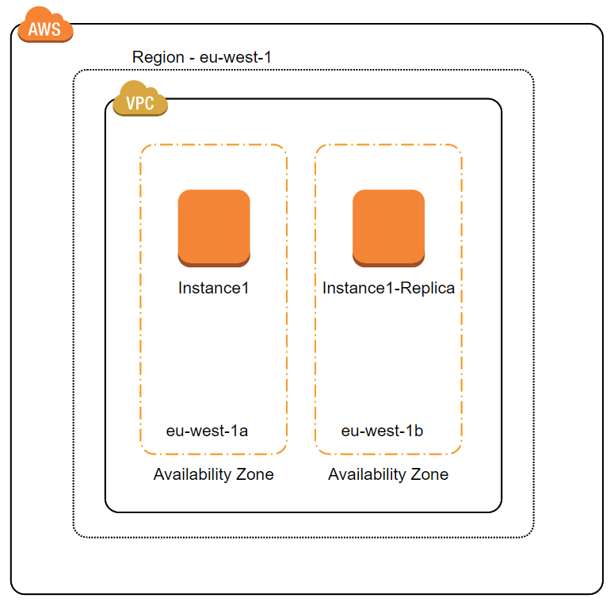
VPC Deployment
Located in 1 of 22 AWS Regions
Can host resources in any
Availability Zone within its Region

Slide 16
CIDR block of vpc
Each VPC reserves a range of private IP addresses
These addresses are available for use by resources deployed in that VPC
Defined using CIDR
Example: 10.0.0.0/16 = all 65,536 IPs from 10.0.0.0 to 10.0.255.255

Slide 17
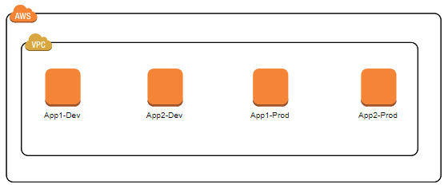
Single-VPC
Very limited use cases like :
Single application
High-performance computing
Pros:
No accounts to maintain
Easy to see all resources
Cons:
No isolation of internal and external threats
Complex to maintain Privileges
Notes:
Does not provide isolation
Easier to maintain than multiple accounts

Slide 18
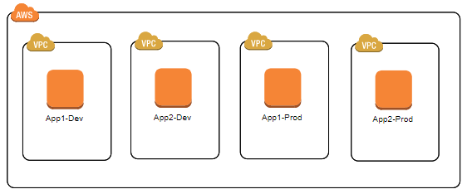
Multi-VPC
Pros:
Network level / External threats isolation
Cons:
Complex to maintain Least Privileges
Internal risks
Notes:
VPC1 = App1-Dev
VPC2 = App1-Prod
VPC3 = App2-Dev
VPC4 = App2-Prod

Slide 19
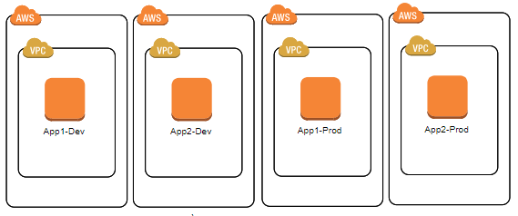
Mutli-account
Use case:
Multiple applications and environments
Big organizations
Pros
Best isolation
Cons
Harder to maintain
DIAGRAM
Notes:
Account per Application and Environment

Slide 20


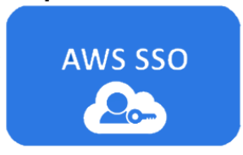

Accounts management
AWS Control Tower
AWS Organizations
AWS SSO
AWS Config
DIAGRAM
Notes:
Account per Application and Environment

Slide 21
VPC limits
5 VPCs per region per account
5 Elastic IP addresses per Region
200 subnets per VPC
Soft limits vs hard limits
Example:
IPv4 CIDR blocks per VPC - Default: 5 Max: 50
IPv6 CIDR blocks per VPC - Default: 1 Max: 1
More:
https://docs.aws.amazon.com/vpc/latest/userguide/amazon-vpc-limits.html
Notes:
Some limits for example
They have sensible values.
Some are hard to reach.
Some can be increased.

Slide 22
RELATED AWS SERVICES
Manage network routing & security
Subnets
Route tables
Security groups
Network ACLs
Internet Gateway
NAT Gateway
Endpoints
VPNs
Peering Connection
Transit Gateway
Traffic mirroring

Slide 23
Q&A

Slide 24

DEMO
AWS VPC Demo

Slide 25


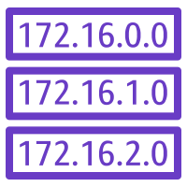


SUBNETS
Key Attributes, Public & Private subnet. Internet Gateway. NAT Gateway.

Slide 26
SUBNETS – Key attributes
Subset of VPC CIDR Block
Subnets cannot overlap
Reside in only one AZ
5 IPs from each Subnet are reserved for Amazon

Slide 27
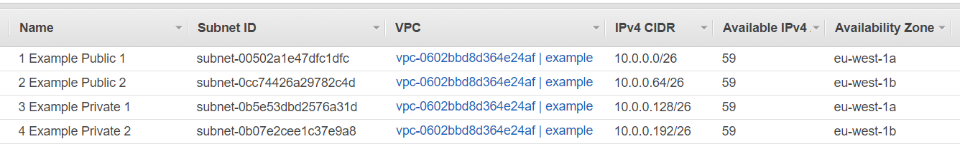
Subnets - example
VPC CIDR Block 10.0.0.0/24 = 256 hosts
divided in 4 subnets, 64 host per subnet (59 available)
2 public and 2 private subnets
in 2 Availability Zones

Slide 28
Subnets - public and private
Public subnets:
Reachable from the internet (inbound traffic) through Internet Gateway
Contains Private IPs
Private subnets:
Not directly reachable from the Internet
Allow access to the internet (outbound traffic) through NAT Gateway
Not AWS resource types. They are configuration and a standard practice.

Slide 29
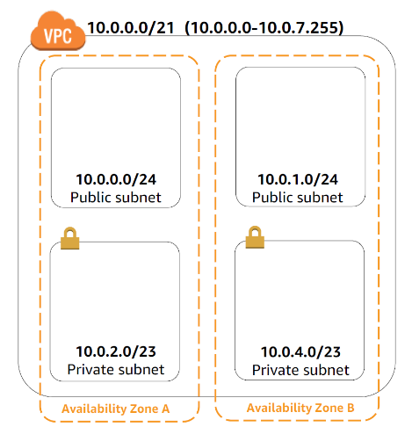
Subnets - public and private

Slide 30
Subnets – Usage examples
Databases ➔ Private subnet
Back-end ➔ Private subnet
Private API
Batch/Scheduled processing
External Applications Integration
HTTP server/Public API ➔ Public subnet

Slide 31
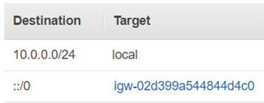
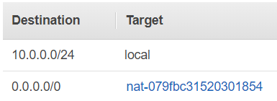
Route tables
Direct network traffic
Contains row for each routing rule
Precedence of more specific destination
Each VPC has a default route table
Best to have one route table for each subnet
Public Subnet - Route Table: Private Subnet - Route Table:
All traffic is directed to Internet Gateway All traffic directed to NAT Gateway
Notes:
Subnets which have no explicit associatin with Route Table are associated with the default RT

Slide 32
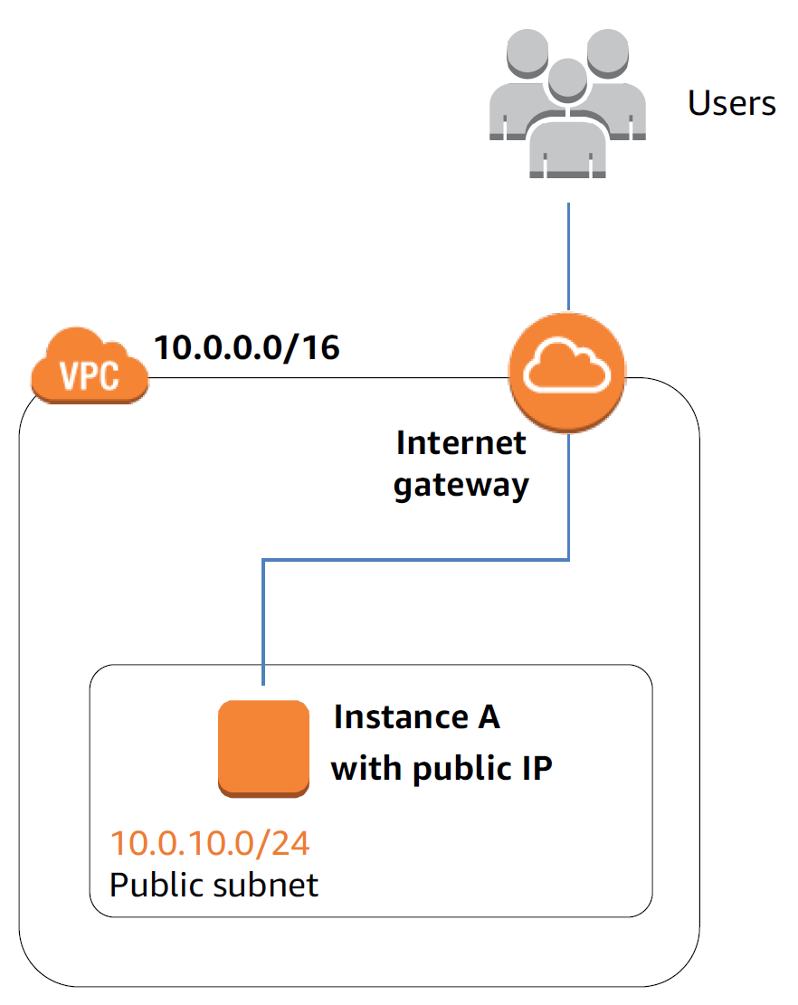
Internet gateway
Allows communication with Internet
Acts as NAT between public and private IPs
Horizontally scaled, redundant, highly-available

Slide 33
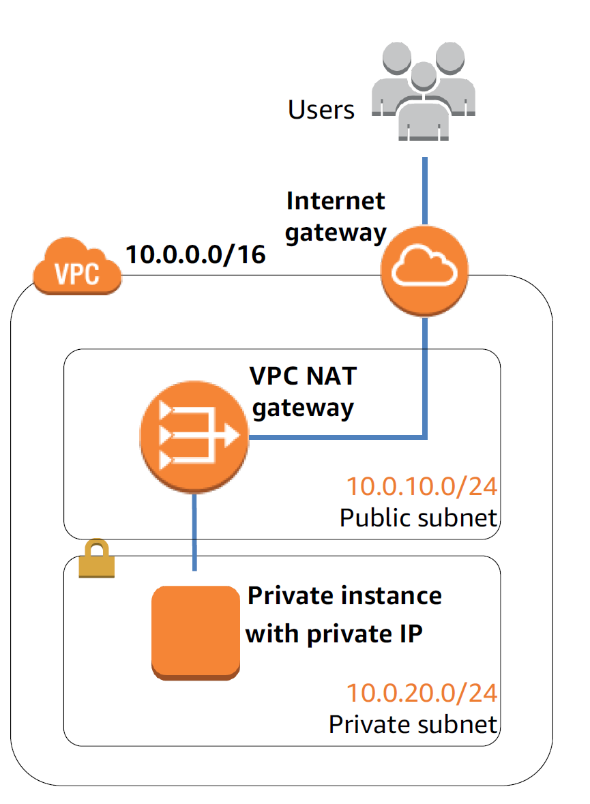
NAT gateway
Allows outbound traffic from the private subnet to the Internet
Prevents inbound traffic from the Internet to the private subnet
Has Elastic IP

Slide 34
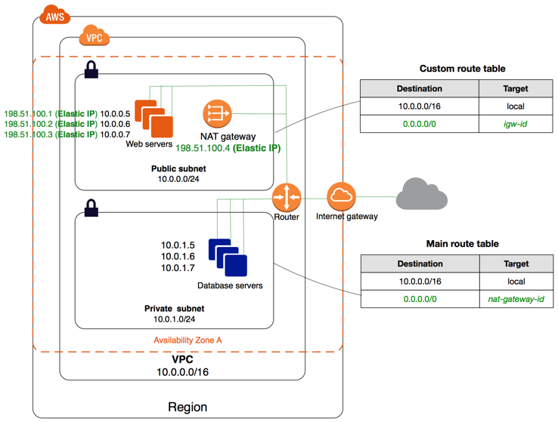
Routing example
Notes:
Inbound Public
Outbound public
Outbound Private
Inbound Private

Slide 35
Q&A

Slide 36
DEMO
AWS VPC Demo

Slide 37

Lab time
Time for you to practice
Lab Exercise - Part I to IV

Slide 38
Security
Security groups. NCLs.

Slide 39
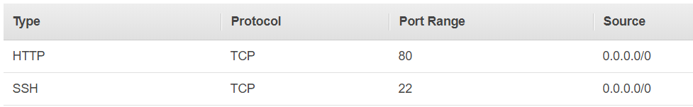
Security groups
Virtual Firewalls
Restrict by Protocol TCP/UDP, Port, IP
Only Allow rules
Stateful (remembers if traffic is a response to a request in the opposite direction)
Attached to AWS resources explicitly
Provides fine granularity and flexibility
Default - Outbound: All, Inbound: None

Slide 40
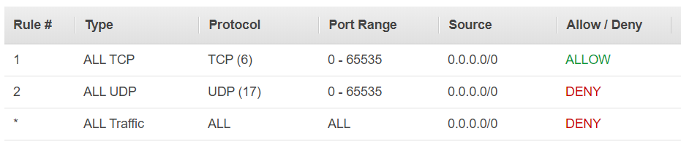
Network ACLs
Firewalls
Restrict by Protocol TCP/UDP, Port, IP
Both Allow and Deny
Stateless (does not remember where the traffic is initiated)
Attached at subnet boundary and implicitly applied to all instances
Provides prevention from too bread access
Default – Outbound: Allow All, Inbound: Allow All

Slide 41
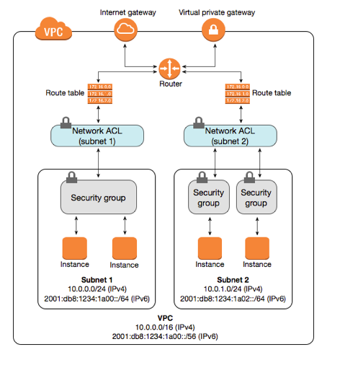
vpc example

Slide 42
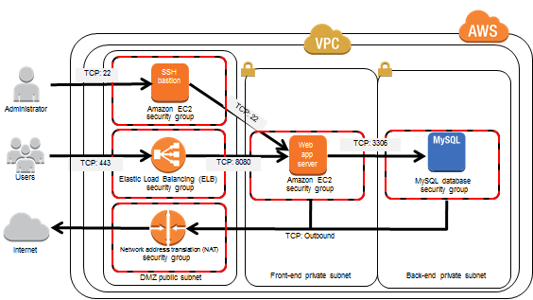
Real life example

Slide 43
Q&A

Slide 44
DEMO
AWS VPC Demo

Slide 45
Other services
Endpoints and Endpoint Service
Enables access to AWS Services without leaving the Amazon network
Does not require internet gateway, NAT, VPN or AWS Direct Connect
VPNs
Site-to-Site IP Sec VPN (Layer 3 OSI)
Virtual Private Gateway
AWS side
Customer Gateway
Client side
Peering Connections
Transit Gateway
Connect VPCs, AWS Direct Connect, and AWS Site-to-Site VPN connections
Examples: https://docs.aws.amazon.com/vpc/latest/tgw/transit-gateway-centralized-router.html
Traffic Mirroring
Direct copy of all traffic to external appliance for security and monitoring

Slide 46
Lab time
Time for you to practice
Lab Exercise - Part V and VI

