Slide 1
AccelRR8 Consortium NonProfit Products Plan
August 14, 2026

Slide 2
Consortium Services (our Products)
Service | Accelerators | Description
Professional Networking | Network Effects AI | FOR enterprising leaders involved or interested in the Tech Services industry THIS SERVICE connects a global AccelRR8 professional network, supported by AI THAT helps leaders to network and practice growing value exponentially at scale together, to accelerate success for themselves, their industry, and all humanity. Due to network effects, value for all collaborators grows exponentially as their numbers grow linearly.
Open Knowledge Sharing | Viral Ideation Generative Learning AI | FOR enterprising leaders involved or interested in the Tech Services industry THIS SERVICE facilitates viral ideation across the AccelRR8 network, supported by AI THAT helps leaders rapidly share ideas and align on authoritative best practices for growing value exponentially at scale. High-value ideas go viral, propagating exponentially fast and wide across the network. Successful ideas are added via generative learning to the AccelRR8 Body of Knowledge, curated with the help of expert advisors.
Industry Innovation | Compounding Innovation Generative Learning AI | FOR enterprising leaders involved or interested in the Tech Services industry THIS SERVICE develops innovative solutions to vexing industry challenges THAT help leaders grow value exponentially at scale, accelerating material success for themselves, their enterprises, their industry, and all humanity. Patrons finance and support compounding innovation, provided by generative teams supported by AI, to develop exponential solutions that address priority industry challenges, advance the state-of-the-art, and benefit humanity.
Notes:
This is a double click on our Consortium’s first Product Priority, “To improve our services and be credible, we should use Lean Product Management”
We have defined the scope of our Services using Lean Product Management

Slide 3
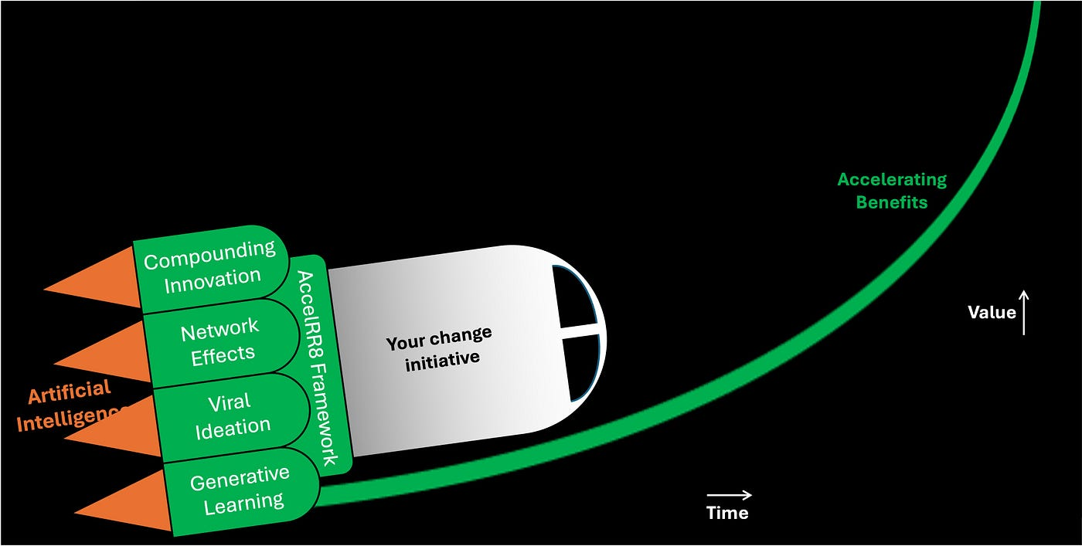
Consortium Product Plan
Using our own Framework to grow Consortium value exponentially
Use LPM to Develop Consortium Services and ignite compounding innovation
Industry Innovation Service
1
Develop concepts that resonate
…industry innovation using LPM to develop relevant solutions…
Professional Networking Service
2
Build enough momentum; use a platform to grow the professional network
6
…attracting more collaborators to join our network…
Open Knowledge Sharing Service
…igniting…
…creating a virtuous cycle !!
3
Build enough credibility; attract influencers who openly share knowledge
5
…adding content to the Body of Knowledge and attracting more influencers…
Attract enough initial innovators who donate labor and/or technology for agile teams and AI…
…attracting patrons who invest in additional agile teams and better AI…
4
7
and AI…
WE ARE HERE
Launch: Version 1 of Consortium Services
Climb / Scale: V2+ of Consortium Services
Notes:
In this view we show how we will use the AccelRR8 Framework to launch and grow the AccelRR8 Consortium’s value exponentially as it climbs toward achieving exponential benefits at scale.
This is how we will achieve one of our key Success Factors: “Our own success will be a key proof point of our core premise”
Specific actions we will take, and leading indicators we will measure, are shown in both Launch and Climb / Scale stages.
These actions are organized into 3 services: Professional Networking, Open Knowledge Sharing, and Industry Innovation

Slide 4
Roadmap to Launch - Baseline
Service | Soon | When Feasible
Professional Networking | Develop the service hypothesis and lean business case Explore platforms to enhance collaboration (e.g., LinkedIn Groups, Discord) Develop the value proposition for Subscribers Grow the number of Subscribers to 100 via the Board of Directors Prepare a campaign to grow the number of Subscribers to 300 Learn from ASUG, Toastmasters, and PMI leaders how they grew their networks | Identify service leader Run MVP for collaboration platform Run campaigns to grow the number of Subscribers to 300 and then to 1,000
Open Knowledge Sharing | Develop the service hypothesis and lean business case Explore platforms for publishing and curating the AccelRR8 Framework and AccelRR8 Body of Knowledge (e.g., Github) Identify advisory board leaders for various topics Explore ways to enhance our credibility with Tech Services leaders, e.g., awards, influencer endorsements, podcasts, webinars Learn from ASUG and PMI leaders how they developed and curate their BOKs | Identify service leader Publish the AccelRR8 Framework and ABOK on KM platform with help from Advisory board Run MVPs for podcasts and/or webinars with influencers
Industry Innovation | Develop the service hypothesis and lean business case Develop the value proposition for Patrons Engage with initial Patrons (e.g., Bronze-level) Learn from ASUG and PMI leaders how they generate revenues from Patrons Learn from AI for Good leaders how they use technology to help humanity | Identify service leader Explore opportunities to learn from and help initial and prospective Patrons
Services Platform | Develop the services platform hypothesis and lean business case Use Lean Product Management to publish Services info on our LinkedIn page Explore low-cost options for setting up a website (e.g., Wordpress) Experiment with and practice using AI to help our Consortium scale | Identify services platform leader Set up a website Prepare the website for launch Publish learnings (e.g., how we’re using AI) in the AccelRR8 Body of Knowledge
1
1
2
2
3
3
3
3
4
1
1
2
2
3
3
3
4
1
1
3
3
3
4
4
1
1
1
2
2
3
5
5
#
Alignment to Consortium Priorities
Notes:
These are specific actions we are taking for our Services during the Launch Stage. The Consortium priority each aligns to is indicated by the numbered circle.

Slide 5
Roadmap to Launch - Status
Service | Soon | When Feasible
Professional Networking | Develop the service hypothesis and lean business case Explore platforms to enhance collaboration (e.g., LinkedIn Groups, Discord) Develop the value proposition for Subscribers Grow the number of Subscribers to 100 via the Board of Directors Prepare a campaign to grow the number of Subscribers to 300 Learn from ASUG, Toastmasters, and PMI leaders how they grew their networks | Identify service leader Run MVP for collaboration platform Run campaigns to grow the number of Subscribers to 300 and then to 1,000
Open Knowledge Sharing | Develop the service hypothesis and lean business case Explore platforms for publishing and curating the AccelRR8 Framework and AccelRR8 Body of Knowledge (e.g., Github) Identify advisory board leaders for various topics Explore ways to enhance our credibility with Tech Services leaders, e.g., awards, influencer endorsements, podcasts, webinars Learn from ASUG and PMI leaders how they developed and curate their BOKs | Identify service leader Publish the AccelRR8 Framework and ABOK on KM platform with help from Advisory board Run MVPs for podcasts and/or webinars with influencers
Industry Innovation | Develop the service hypothesis and lean business case Develop the value proposition for Patrons Engage with initial Patrons (e.g., Bronze-level) Learn from ASUG and PMI leaders how they generate revenues from Patrons Learn from AI for Good leaders how they use technology to help humanity | Identify service leader Explore opportunities to learn from and help initial and prospective Patrons
Services Platform | Develop the services platform hypothesis and lean business case Use Lean Product Management to publish Services info on our LinkedIn page Explore low-cost options for setting up a website (e.g., Wordpress) Experiment with and practice using AI to help our Consortium scale | Identify services platform leader Set up a website Prepare the website for launch Publish learnings (e.g., how we’re using AI) in the AccelRR8 Body of Knowledge
1
1
2
2
3
3
3
3
4
1
1
2
2
3
3
3
4
1
1
3
3
3
4
4
1
1
1
2
2
3
5
5
#
Alignment to Consortium Priorities
Notes:
These are specific actions we are taking for our Services during the Launch Stage. The Consortium priority each aligns to is indicated by the numbered circle.

Slide 6
Maturing our Services as we Scale
Service | Free (v1 Services) | Premium / For-Fee (v2+ Services)
Professional Networking | Enterprising Tech Services leaders can join the AccelRR8 Consortium network as collaborators | (Like Toastmasters) Individual leaders can join a club / local chapter for $X new member fee and $Y / month (Like ASUG) Organizations can pay an annual fee that covers Professional Networking fees for all employees
Open Knowledge Sharing | Collaborators can share ideas with one another via an online platform Collaborators can access the AccelRR8 Body of Knowledge, including the AccelRR8 Framework Collaborators can participate in Consortium webinars | (Like PMI) Individual leaders can take an exam for $XX and maintain a certification for $YY per year (Like ASUG) Organizations can pay an annual fee that covers Open Knowledge Sharing fees for all employees (Like various standards bodies) Organizations can pay an annual fee to help govern and evolve the AccelRR8 BOK
Industry Innovation | Individuals and organizations can join the AccelRR8 Consortium as innovators (free advertising, e.g., Bronze Tier) who donate labor and/or technology to co-develop exponential solutions for priority industry challenges | Individuals and organizations can pay an annual fee and become patrons (e.g., Diamond, Platinum, Gold, Silver) to co-develop exponential solutions for priority industry challenges
Notes:
These are potential features and pricing models for our Services when we enter the Climb Stage, and our services begin to achieve scale

