Slide 1
AccelRR8 Framework Grow Value Exponentially
August 6, 2026

Slide 2
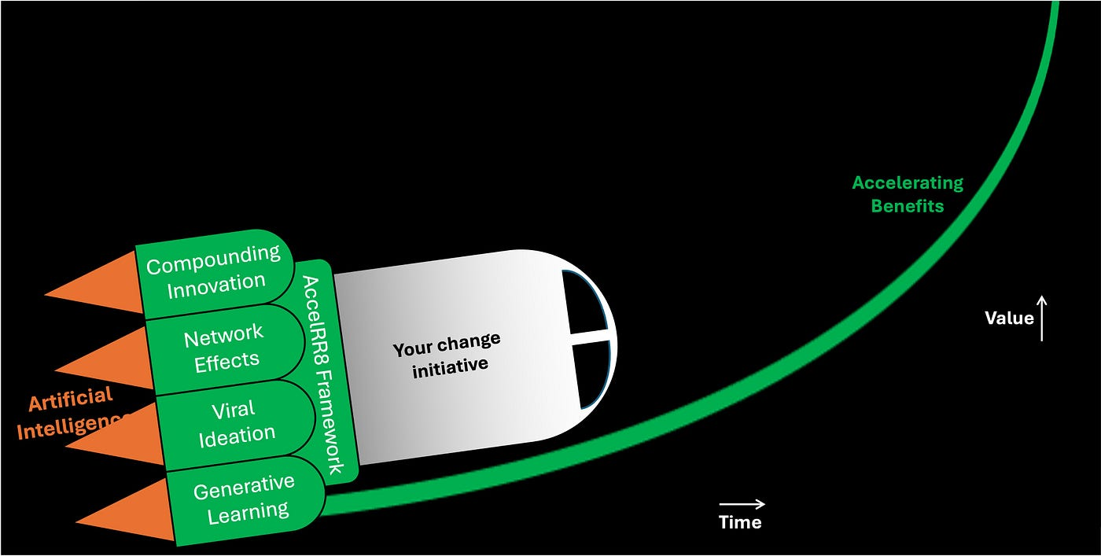
Using the AccelRR8 Framework to grow value exponentially
Launch
Climb
Soar
https://medium.com/@socialmedianp/rocket-to-your-aspirations-using-the-accelrr8-framework-ed2eb71aee2c
https://medium.com/@socialmedianp/use-the-accelrr8-framework-to-grow-value-exponentially-2754e04062ce
Notes:
The AccelRR8 Framework is the conceptual foundation for the AccelRR8 Consortium Non-Profit.
It is an actionable tool that helps IT Services leaders use proven methods to generate exponentially better products, services, financials, and inspiration in complex, large scale enterprises and ecosystems.
We imagine the AccelRR8 Framework as an engine leaders can use to rocket to their aspirations. A rocket applies a force to its payload while it burns, accelerating its velocity faster and faster, and lifting it exponentially higher and higher off the ground.
Like a rocket, the AccelRR8 Framework is packed with accelerators. Strap it to your change initiative and watch its velocity accelerate and its benefits climb exponentially higher.

Slide 3
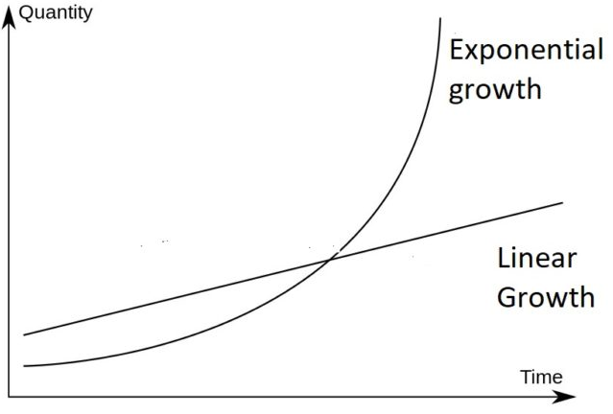
Our Center of Gravity: we help leaders grow value exponentially
In our research we have identified proven accelerators capable of growing value exponentially…
Existing research on how to grow value exponentially is fragmented
Using Chain of Thought prompts with ChatGPT, we isolated 5 accelerators mathematically capable of growing value exponentially
Each accelerator is a technique that transforms linear changes in production inputs into exponential changes in outputs and outcomes
The mathematical basis for each accelerator is a transformation equation which performs exponential operations on production inputs.
These exponential mathematical operations are what make it possible to systematize growing value exponentially; without these, any exponential growth happens by chance
…these 5 accelerators include:
Compounding Innovation: continuous reinvestment of returns in innovation accelerates ROI via the compound interest formula
Network Effects: increases in participants in a network increase the value of the network for each user via Reed’s law which is 2^{n}
Viral Ideation: rapid and broad sharing of ideas among individuals through networks via the virality equation where the coefficient of virality > 1
Generative Learning: continuous reinvestment of learnings in teams’ improvements accelerates productivity via the compound interest formula
Artificial Intelligence: continuous reinvestment of machine learnings in AI model improvements accelerates productivity via the compound interest formula, used to further grow the value produced by all above accelerators exponentially
CORE PREMISE
Harnessing 5 proven accelerators makes it mathematically feasible to grow value exponentially
Value
Exponential
growth
https://blog.ucsusa.org/doug-boucher/world-population-growth-exponential/
Notes:
The AccelRR8 Consortium’s Mission is to help enterprising Tech Services industry leaders harness proven accelerators to grow value exponentially at scale
Therefore, our entire Consortium revolves around our Center of Gravity, which is the set of proven accelerators that make it mathematically feasible to grow value exponentially
So far, our research has isolated five proven accelerators; we’ll incorporate others (if any) as we identify them

Slide 4
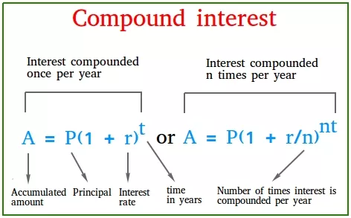
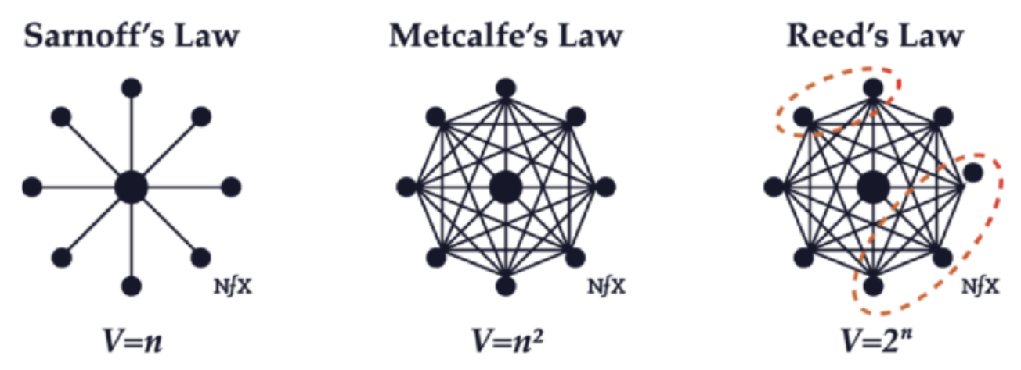
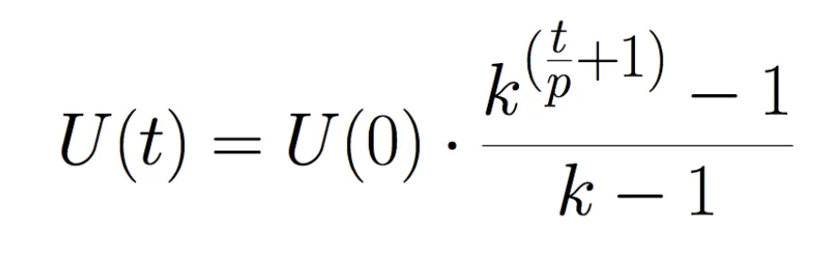
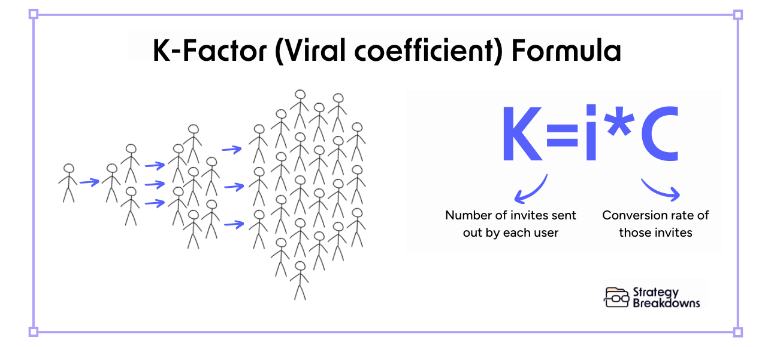
Our Center of Gravity: we help leaders grow value exponentially
1
…these 5 accelerators include:
Compounding Innovation: continuous reinvestment of returns in innovation accelerates ROI via the compound interest formula
Network Effects: increases in participants in a network increase the value of the network for each user via Reed’s law which is 2^{n}
Viral Ideation: rapid and broad sharing of ideas among individuals through networks via the virality equation where the coefficient of virality > 1
Generative Learning: continuous reinvestment of learnings in teams’ improvements accelerates productivity via the compound interest formula
Artificial Intelligence: continuous reinvestment of machine learnings in AI model improvements accelerates productivity via the compound interest formula, used to further grow the value produced by all above accelerators exponentially
2
1
2
3
3
1
1
Notes:
Add comment on effect of quantum computing – will be a further accelerant of using this framework
We ought to get some university partners to do some research / theses on this stuff – do some modeling and simulation – you get the most value out of these 2 in this situation – could become an FFRDC

Slide 5
Using the AccelRR8 Framework to grow value exponentially
Value growth curve over time = Initial value x ( Value growth factor ) ^{time}
Value growth accelerators
x
Value growth drivers
Notes:
Enterprise initiatives often achieve Value growth that can be modeled using a Compound Annual Growth Rate (CAGR), which is an approximation representing exponential growth using a compound-interest-like approach
Various traditional Value Growth Drivers contribute to this Value growth
However, Enterprises can accelerate Value growth using one or more Value Growth Accelerators

Slide 6
Using the AccelRR8 Framework: Business valuation example
Valuation growth curve over time = Initial valuation x ( Valuation growth factor ) ^{time}
Valuation growth accelerators:
x
Valuation growth drivers:
Integration
COO: Margin Expansion (e.g., Productivity)
CPO (Product): Product Growth and Profitability (e.g., CLV, P&L)
CMO: Market Growth (e.g., Unqualified Pipe, Conversion Rates)
CRO: Customer Growth (e.g., Sales, Revenues)
CDO (Delivery): Cust. Retention, Profitability (e.g., CSat, P&L)
CHRO: People Engagement
CFO: Investor Engagement (e.g., Financial Posture)
CTO: Tech Community Engagement (e.g., “Street Cred”)
CPO (Property): Supplier Engagement
CRO (Responsibility): Public Engagement
Go-to-Market
Support
Notes:
For example, businesses often achieve Valuation growth that can be modeled using a Compounding Annual Growth Rate (CAGR), which is an approximation representing exponential growth using a compound-interest-like approach
Various traditional Value Growth Drivers contribute to this Business Valuation growth
However, Enterprises can accelerate Business Valuation growth using one or more Value Growth Accelerators

Slide 7
Using the AccelRR8 Framework: Business valuation example
Valuation growth curve over time = Initial valuation x ( Valuation growth factor ) ^{time}
Valuation growth accelerators (product of):
(
)
Artificial Intelligence
Compounding Innovation
Network Effects
Viral Ideation
Generative Learning
x
x
x
x
x
Valuation growth drivers (product of):
(
)
Integration
COO: Margin Expansion (e.g., Productivity)
CPO (Product): Product Growth and Profitability (e.g., CLV, P&L)
CMO: Market Growth (e.g., Unqualified Pipe, Conversion Rates)
CRO: Customer Growth (e.g., Sales, Revenues)
CDO (Delivery): Cust. Retention, Profitability (e.g., CSat, P&L)
CHRO: People Engagement
CFO: Investor Engagement (e.g., Financial Posture)
CTO: Tech Community Engagement (e.g., “Street Cred”)
CPO (Property): Supplier Engagement
CRO (Responsibility): Public Engagement
Go-to-Market
Support
Notes:
The benefits of each Value Growth Accelerator multiply when they are used together.

Slide 8
Using the AccelRR8 Framework: Value growth accelerators
Value growth curve over time = Initial value x ( Value growth factor ) ^{time}
Value growth accelerators (product of):
(
)
Artificial Intelligence
Compounding Innovation
Network Effects
Viral Ideation
Generative Learning
x
x
x
x
Launch
Practice using AI to launch the rocket…
Develop concepts that resonate
Reach new supporters and customers
Build momentum with ideas that go viral
Ramp up productivity across teams of teams
Climb
…climb to new heights…
Lean product management gets value and feedback flowing
Platforms link collaborators across silos and ecosystems
Participant rewards encourage fearless sharing of viral ideas
Practitioners of agile-at-scale keep teams of teams aligned
Soar
…and soar to your success!
Grow ROI exponentially via Compounding Innovation
Grow reach exponentially via Network Effects
Grow momentum exponentially via Viral Ideation
Grow productivity exponentially via Generative Learning
x
Value growth drivers
Notes:
Each Value Growth Accelerator can accelerate growth continuously throughout the change initiative’s journey
To keep the change initiative’s rocket accelerating throughout its flight, each accelerator packed into the rocket has boosters that must be activated at each stage of the rocket’s flight.

Slide 9

Using the AccelRR8 Framework: Value growth accelerators
Launch
Climb
Soar
Develop concepts that resonate
Lean product management gets value and feedback flowing
Grow ROI exponentially via Compounding Innovation
Reach new customers and supporters
Platforms link collaborators across silos and ecosystems
Grow reach exponentially via Network Effects
Practice using AI and rocket…
…to your success!
Build momentum with ideas that go viral
Participant rewards encourage fearless sharing of viral ideas
Grow momentum exponen-tially via Viral Ideation
Ramp up productivity across teams of teams
Practitioners of agile-at-scale keep teams of teams aligned
Grow productivity exponen-tially via Generative Learning
Notes:
We find this is an easier way to visualize the stages of the rocket’s flight.
To keep the change initiative’s rocket accelerating throughout its flight, each accelerator packed into the rocket has boosters that must be activated at each stage of flight.
Other Notes:
Scale? Enablers? Accelerants? (are these the ingredients). Propellants? Propel
1st Stage, 2nd Stage, 3rd Stage
LEAN because too much weight / friction
Governance is the control system
It takes money to build the rocket

Slide 10
Using the AccelRR8 Framework to grow value exponentially
Notes:
Look again at the AccelRR8 Framework in comparison to the previous graphic
On the left are the accelerators packed into the AccelRR8 Framework rocket. Each has the potential to deliver the exponential benefits shown throughout the rocket’s journey from Launch through Climb to Soar.
On the right in grey are the challenges leaders face when their change initiative (payload strapped to the AcceelRR8 Framework rocket) Climbs toward achieving exponential benefits at scale.
At this Climb/Scale stage, using the proven Solutions shown to the right will activate the boosters in each accelerator, propelling the rocket past the challenges and soaring to success
“DRAG” – different levels of the atmosphere – different co-efficients

Slide 11
Using the AccelRR8 Framework to grow value exponentially
Growing a change initiative’s value exponentially
Develop concepts that resonate
Lean product management gets value and feedback flowing
…
Reach new customers and supporters
Platforms link collaborators across silos and ecosystems
…
Build momentum with ideas that go viral
Participant rewards encourage fearless sharing of viral ideas
…
Ramp up productivity across teams of teams
Practitioners of agile-at-scale keep teams of teams aligned
…
Practice using AI to launch the rocket…
… develop AI skills and experience to climb to new heights …
…
Launch
Climb / Scale
Notes:
In this view we show how to use the AccelRR8 Framework to launch and grow a change initiative’s value exponentially as it climbs toward achieving exponential benefits at scale.

Slide 12
Using the AccelRR8 Framework to grow value exponentially
Growing a change initiative’s value exponentially
Use LPM to guide the change initiative and ignite compounding innovation
1
Do the concepts resonate?
Are they innovating continuously?
2
Who are the people involved? Are they connected to one other?
6
Are others jumping on the bandwagon?
3
Are they sharing viral ideas with one another?
5
Are they sharing their innovations?
Are they forming teams? Are they learning together? Are they using AI?
Are investors opening their wallets to fund more agile teams, AI, and innovation?
4
7
Are they using AI?
Launch: build credibility and momentum
Climb / Scale: create a virtuous cycle
Notes:
In this view we show in greater detail how to use the AccelRR8 Framework to launch and grow a change initiative’s value exponentially as it climbs toward achieving exponential benefits at scale.
Specific leading indicators of success are shown in both Launch and Climb / Scale stages.

