Slide 1
PT Engine
Function explain

Slide 2

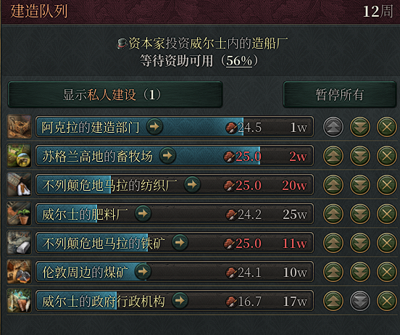
Task model (system)
Like most of Simulation business games’ Task System
Concepts:
Clock
Task
Entity

Slide 3
Task Queue

Slide 4
Task: produce
to factory_a: [1.1, 5.4, 1.2]
to factory_b: [0, 3.13, 0]

Slide 5

Task: produce
to factory_a: [1.1, 5.4, 1.2]
to factory_b: [0, 3.13, 0]
+ [1.1, 5.4, 1.2]
Entity:
factory_a

Slide 6
Task: produce
to factory_b: [0, 3.13, 0]
+ [1.1, 5.4, 1.2]
to
Entity:
factory_a
factory_a
: [1.1, 5.4, 1.2]
Task: produce
to factory_c: [1.0, 0, 0]

Slide 7
Task: produce
to factory_c: [1.0, 0, 0]
Task: produce
to factory_b: [0, 3.13, 0]
factory_a
Task: produce
…

Slide 8

+1 day
Task: produce
to factory_c: [1.0, 0, 0]
Task: produce
…
Task: produce

Slide 9
All Models
Task Queue: executing by time
Entities’ Structure
Entity
Entity
Entity
Environment
Entity
Person List
Entity List
Map
Entity List
Map Graph
Natural Resources

