Slide 1

The Accessible Ukulele The Joule Jugglers
Dominic Pedavoli Kaleb Keller Kameron Lund Ryan Loar

Slide 2
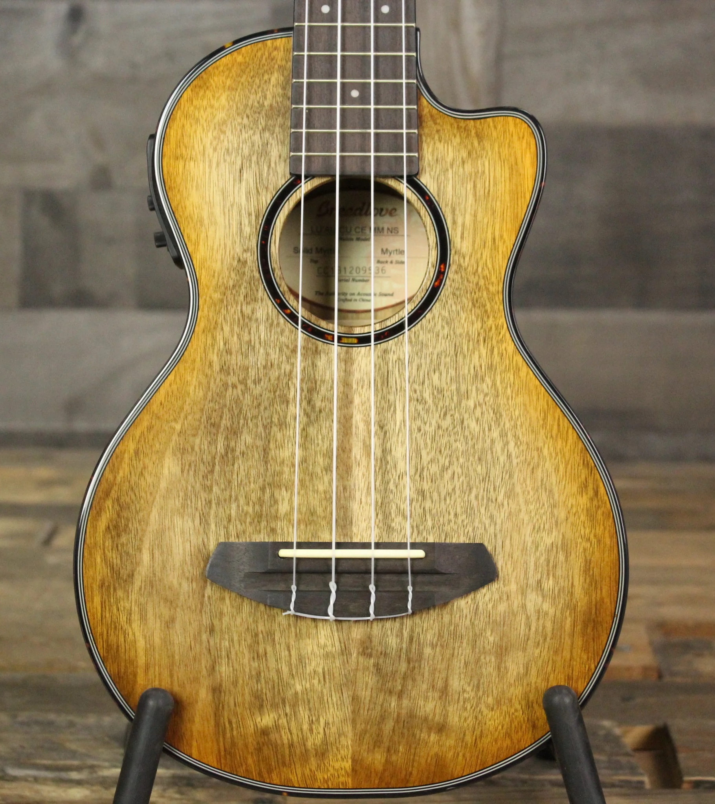
For The Love of Music
Form of expression
Relaxing
Outlet to relieve stress
Not always accessible to everyone

Slide 3
Problem Statement
The ability to play music is not accessible to everyone. Those with a fine motor control disability can find it difficult to play music as an outlet of expression. This problem can begin to be solved by simplifying the way instruments can be played.

Slide 4
Outline
Our Target Market
Design Inspiration
Expected Timeline
Cost of Materials
Original Circuit Diagrams
Plans for Testing
Goals
Definition of Success

Slide 5
Client Introduction – Our Target Market
Intended for those who lack fine motor control in hands
Not trying to replace the ukulele
Simplifying the way, it's played and giving options to those in need

Slide 6
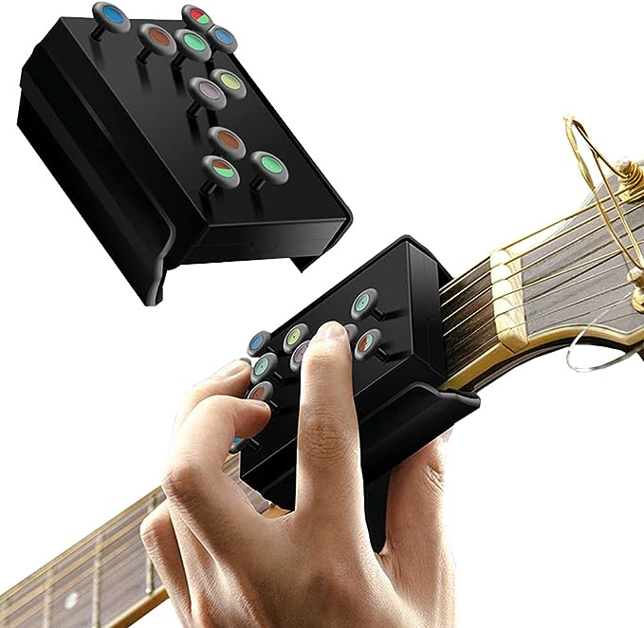
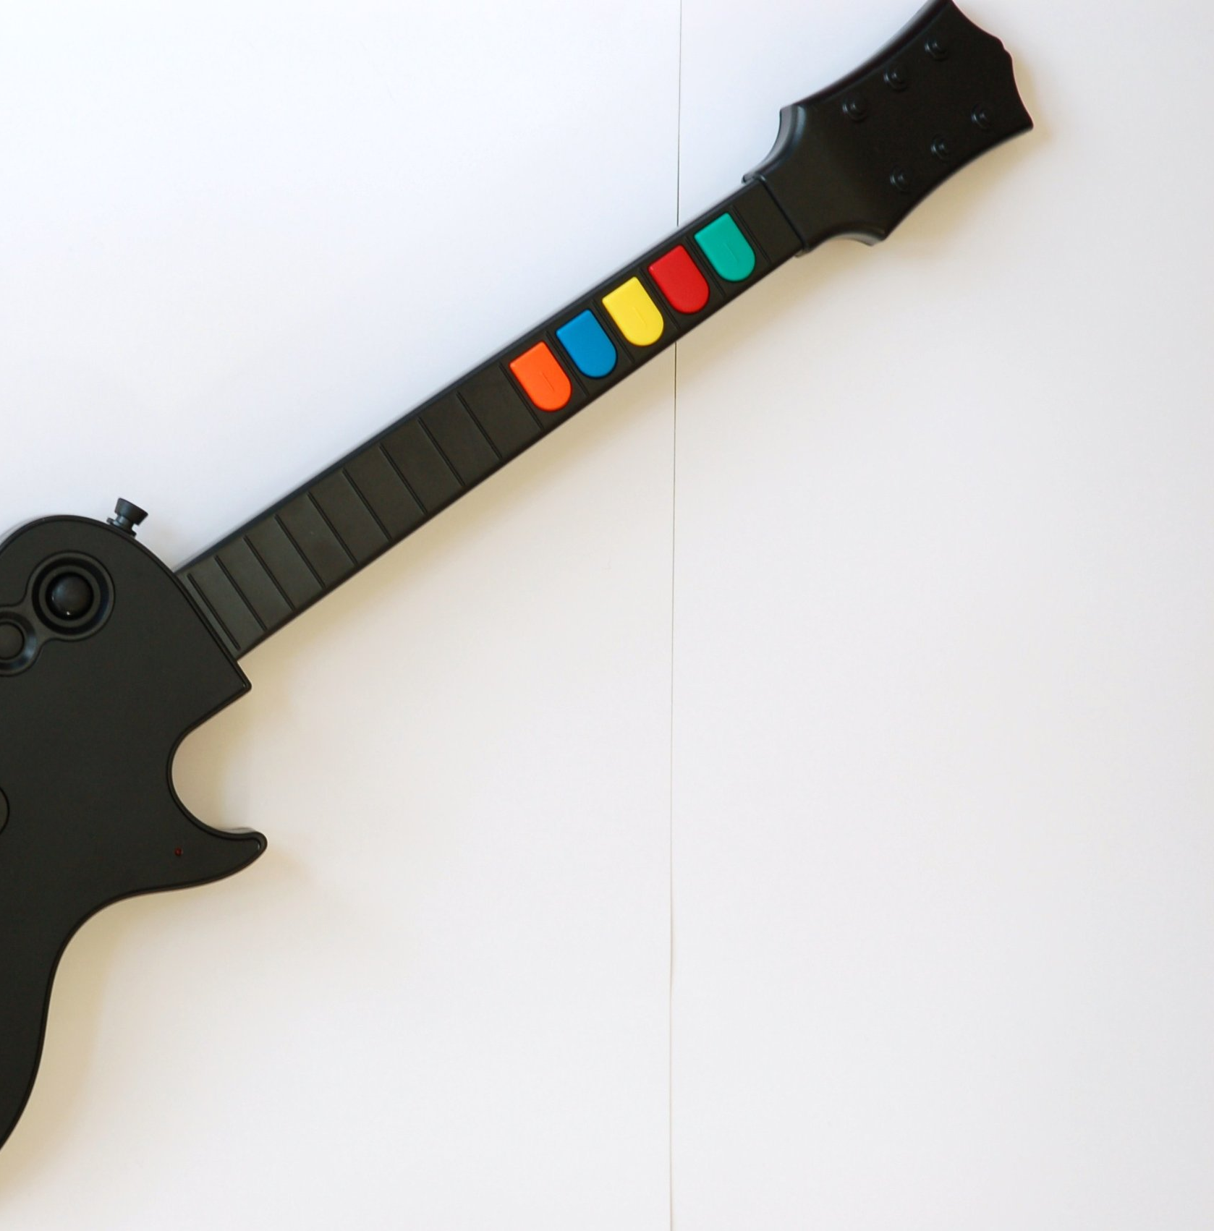
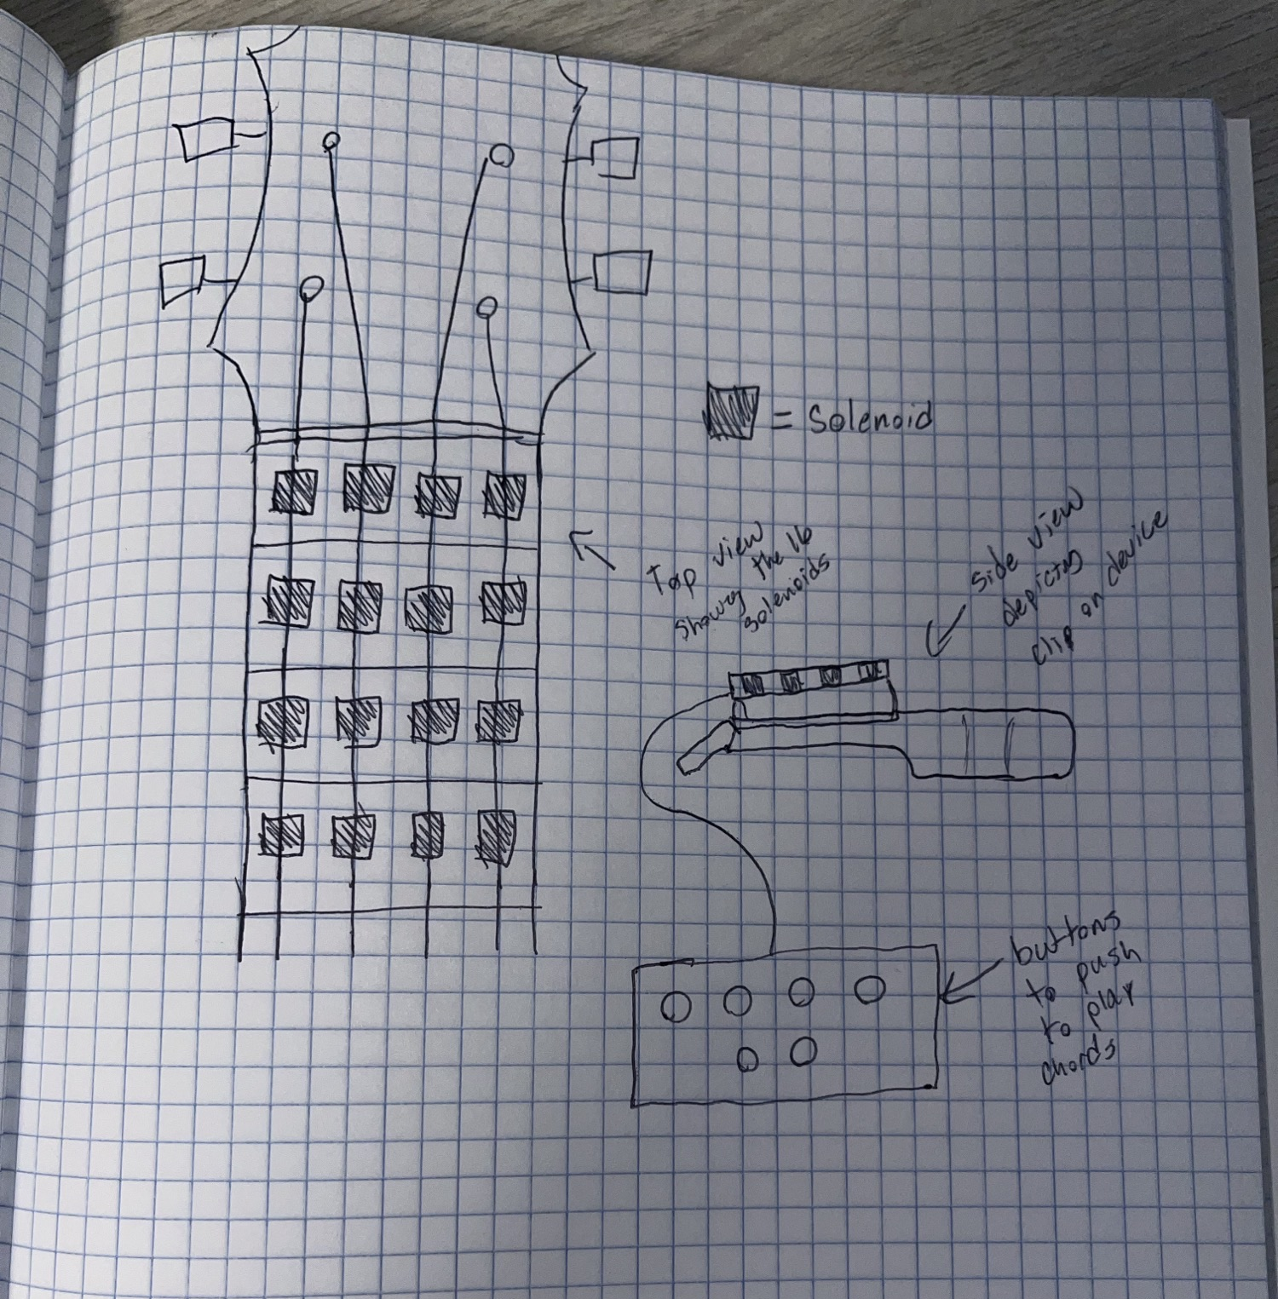
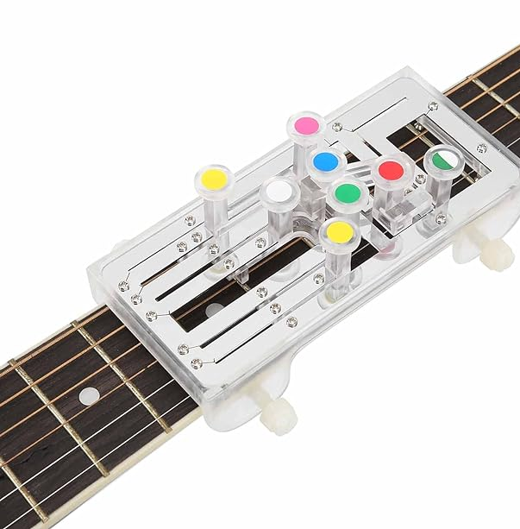
Design Inspiration
Guitar Hero (Top Right)
Beginner Chord (Top Left)
EZ Fret (Bottom Left)
Our Initial Design Idea (Bottom Left)

Slide 7
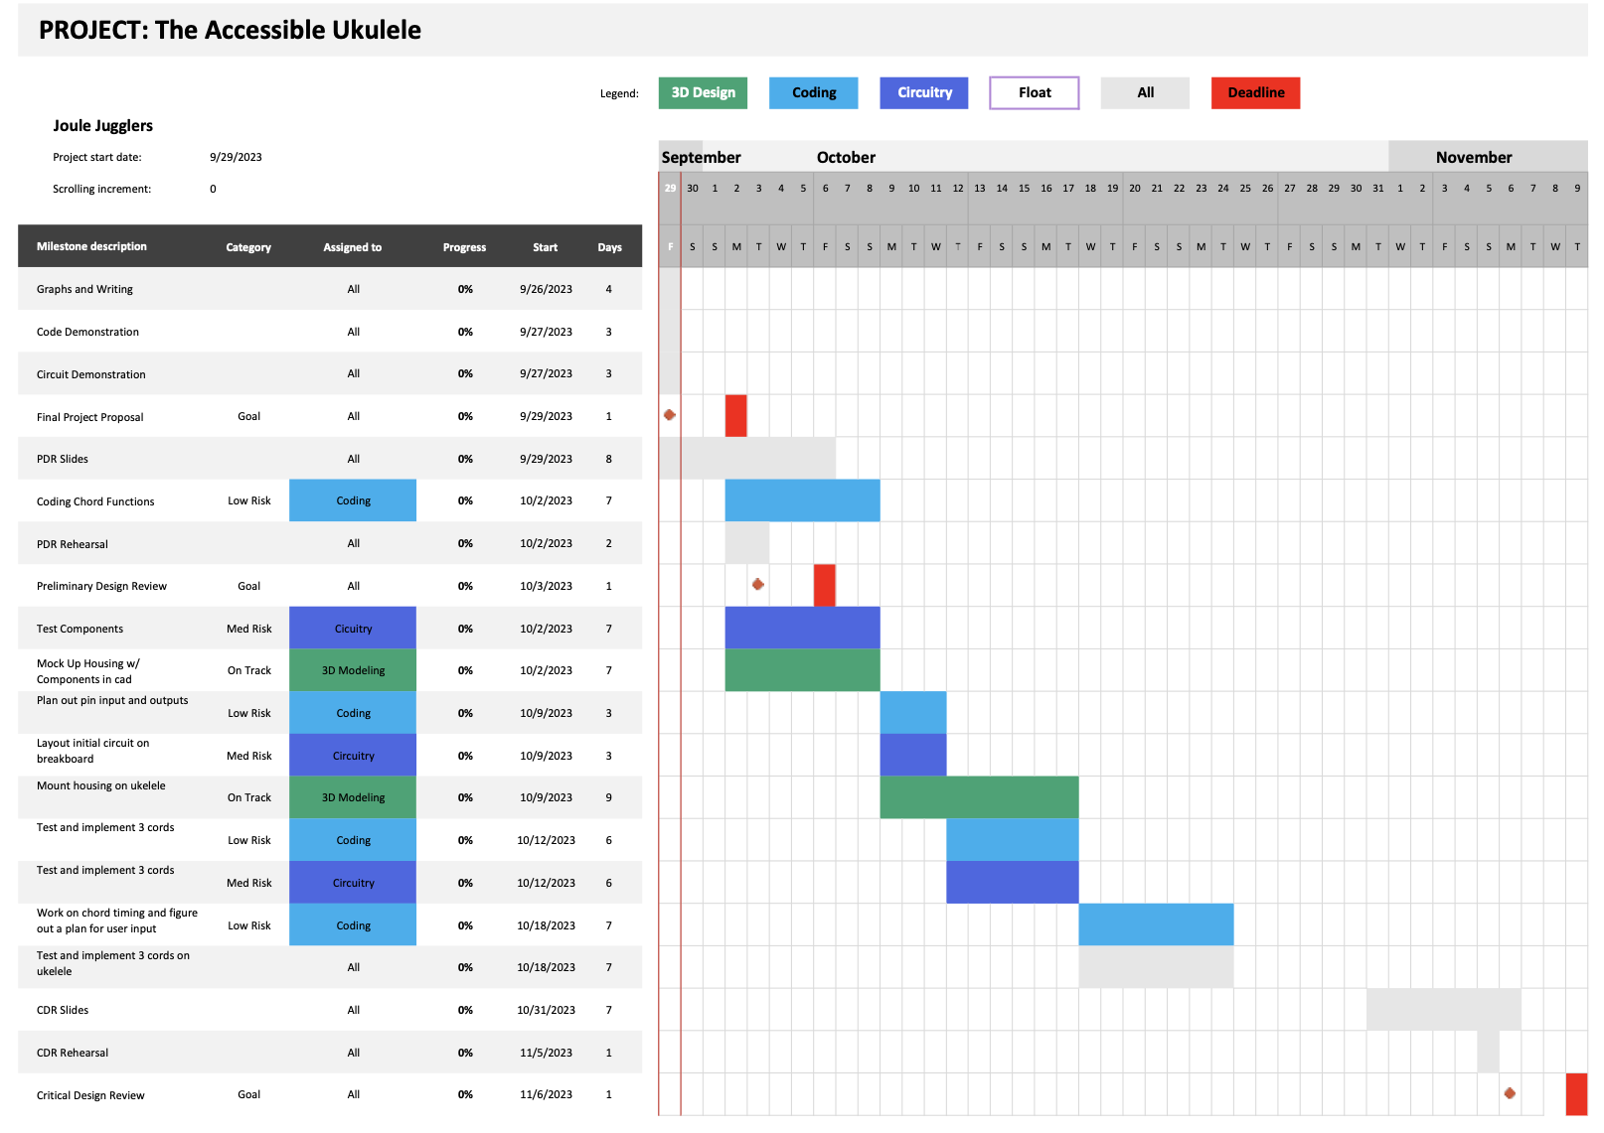
Timeline/Task Assignments
Kameron - coding
Dominic - circuitry
Kaleb - 3D design
Ryan - float
Organizing time based on musical milestone
Design as individuals and come back together to test and iterate as a group
Gantt chart of our timeline

Slide 8
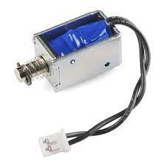
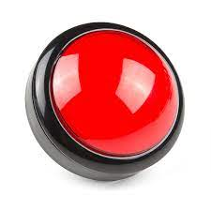
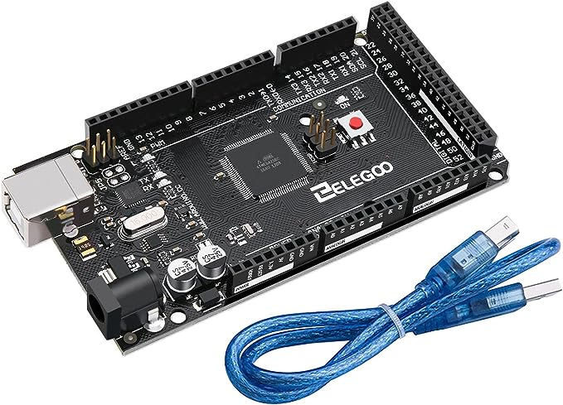
Budget/Bill of Materials
Solenoids (x16):
Buttons (x4):
Arduino Mega (Elegoo) (x1):
Transistors (x16)
Miscellaneous:
Total:
Budget Maximum:
Margin:
$88.00
$51.80
$21.00
$0.00
$15.00
$175.80
$300.00
$124.20

Slide 9
Plans for Testing
Test materials immediately after their arrival
Test code consistently and thoroughly as we develop it
Test circuits on breadboard before soldering wires
Print housing and parts early
Test compilation of parts
Regularly test all tasks together once completed

Slide 10
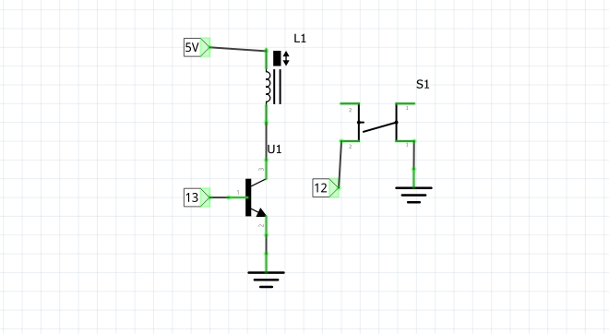
Circuit Diagram
*Diagram for 1 of 16 solenoids

Slide 11
Definition of Success
With this project we will…
Respect and preserve the individual creativity of the musician
Fundamentally change the range of physical motion required for musical expression​
Respect the instrument for its complexity (it's not a toy)
Design in a way that maximizes accessibility while minimizing triviality
Separate music as an art form from physical ability

Slide 12
Conclusion
Ease the process of playing stringed instruments
Keep outcomes (sound) the same
Regularly test (physical and digital)
Explore new input avenues (buttons vs motion control vs app)
Explore coding solutions to physical problems (manage button switching)

Slide 13
Any Questions?

Slide 14
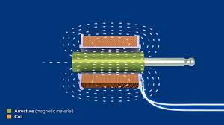
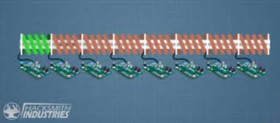
How Do Solenoids Work?

Slide 15
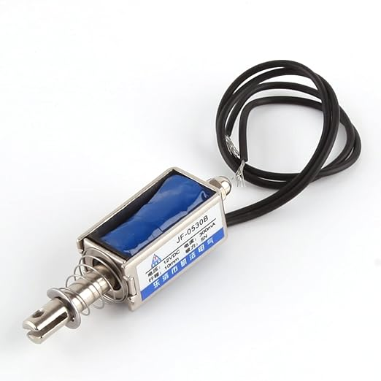
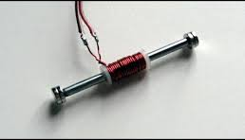
What If The Solenoids Don't Work?

