Slide 1


Slide 2
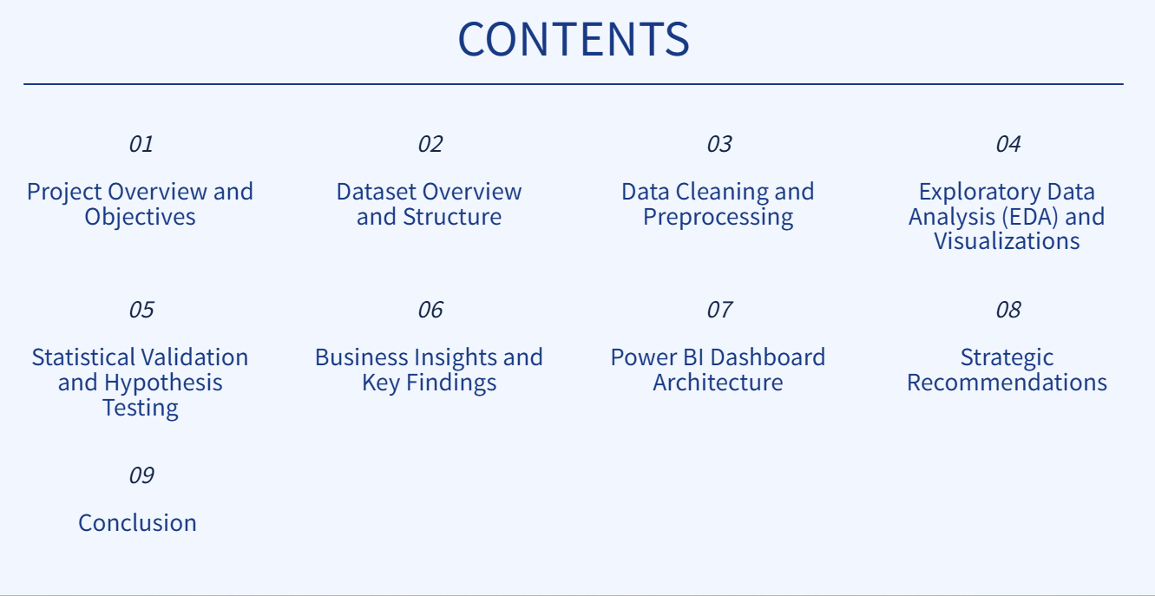

Slide 3
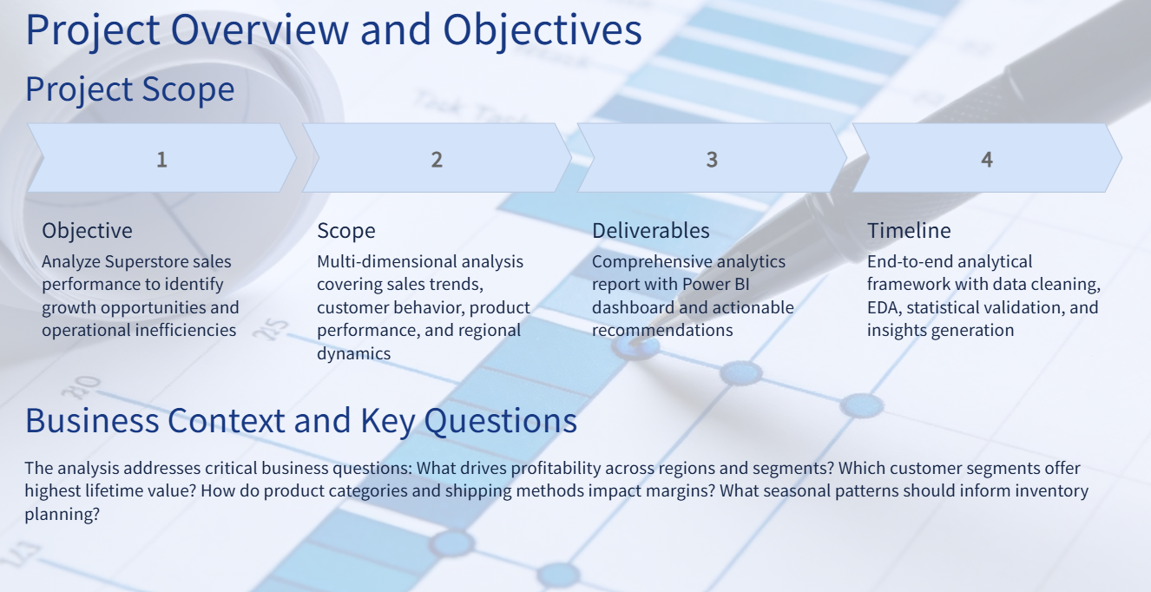

Slide 4
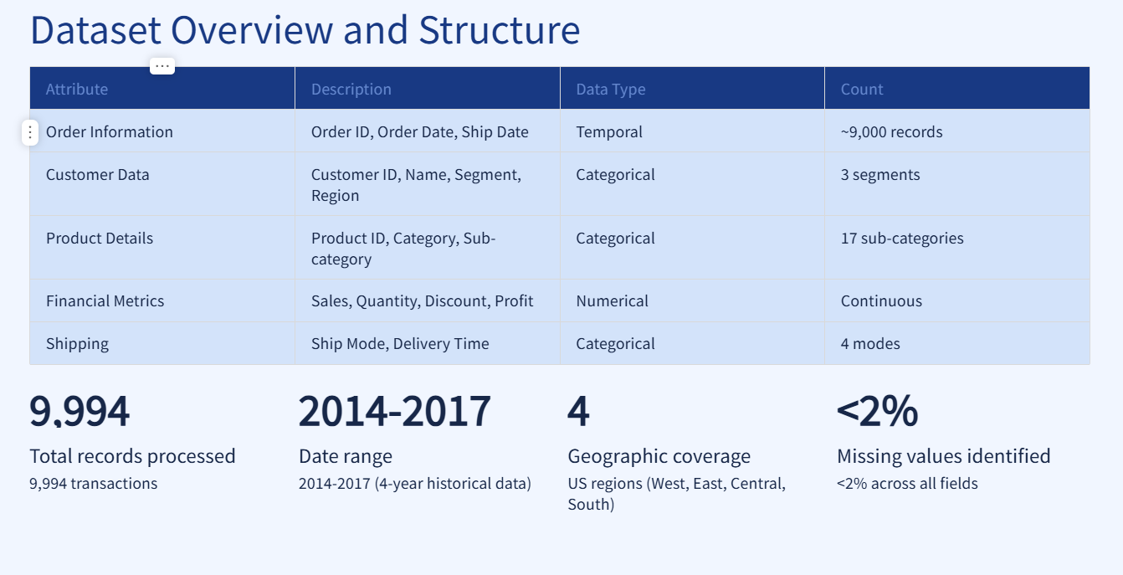

Slide 5
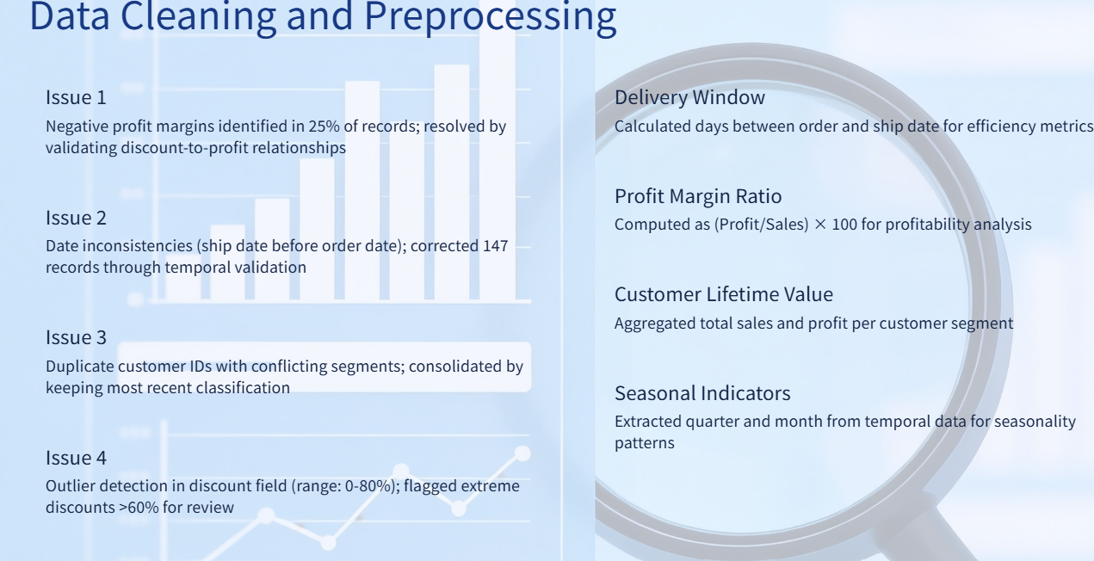

Slide 6
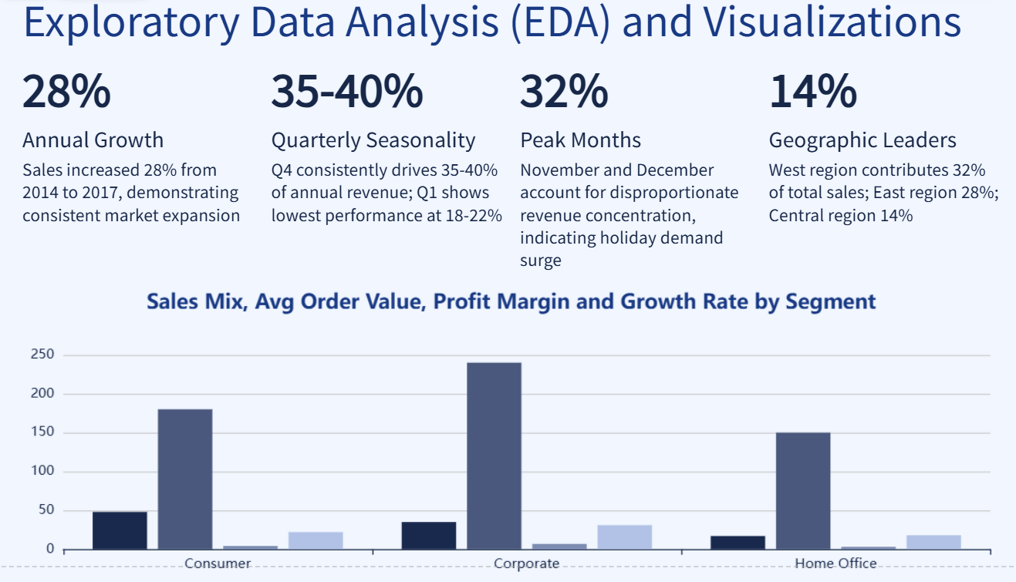

Slide 7
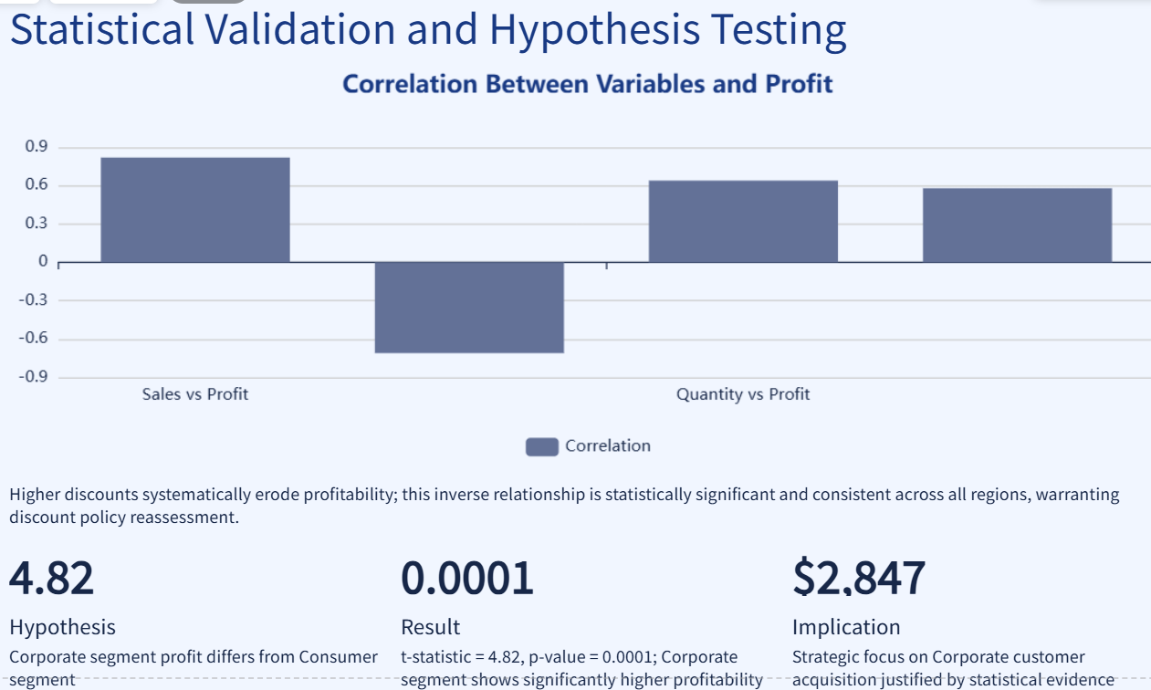

Slide 8
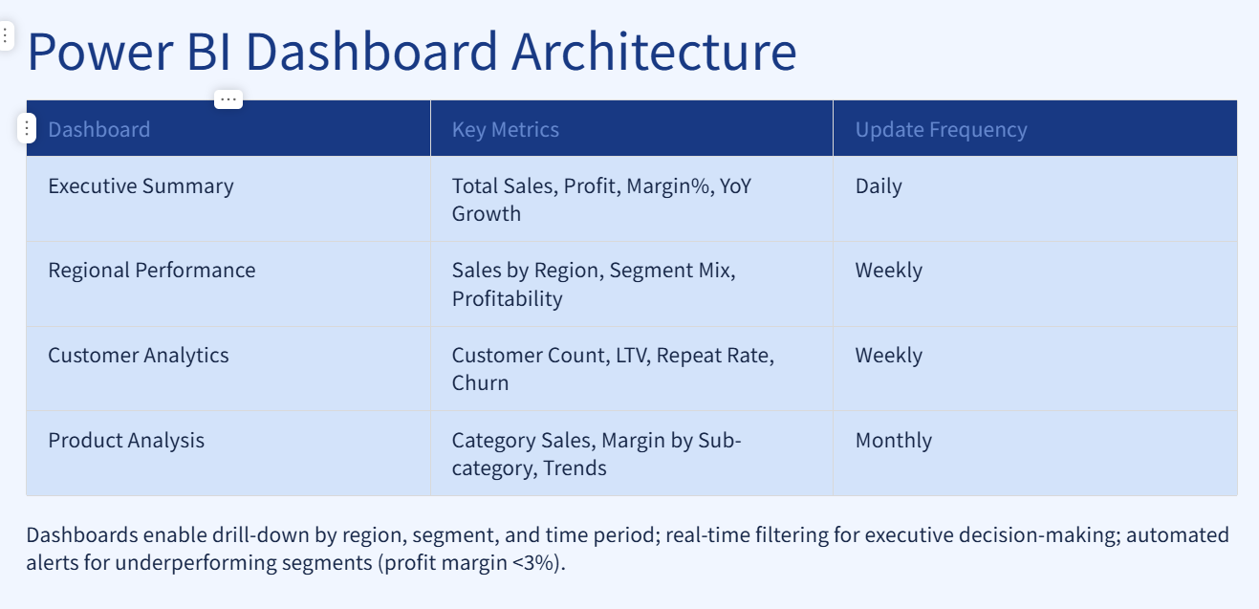

Slide 9
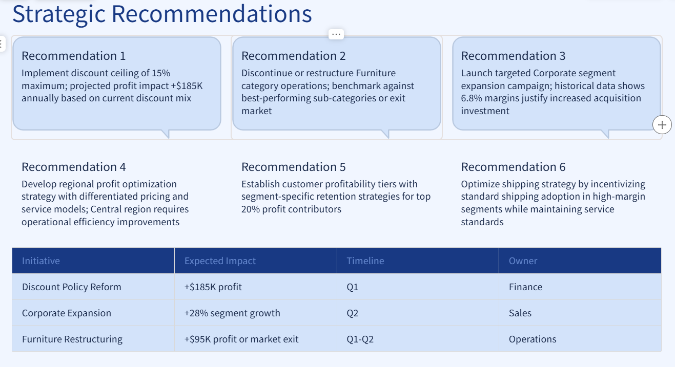

Slide 10
Statistical ValidationStatistical
Test 1: pearson correlation
Testbusiness question:
.Does customer rating influence the total sales amount?
Null Hypothesis (H₀)
There is no significant relationship between Customer Rating and Total Amount.
Alternative Hypothesis (H₁)
There is a significant relationship between Customer Rating and Total Amount.
Test Used
Pearson Correlation Test
Variables:
.Rating
.Total Amount
Decision
.If P-value < 0.05
.Reject H₀Rating significantly affects Total Amount
.If P-value ≥ 0.05Fail to Reject H₀No significant relationship exists.

Slide 11
Statistical Test 2: Independent Samples T-Test
Business Question
Do Male and Female customers spend different amounts?
Null Hypothesis (H₀)
.There is no significant difference in average spending between Male and Female customers.
Alternative Hypothesis (H₁)
.There is a significant difference in average spending between Male and Female customers.
Test Used
Independent Samples T-Test
Variables
.Gender
.Total Amount
Decision
If P-value < 0.05
.Reject H₀
.Male and Female customers spend differently.
If P-value ≥ 0.05
.Fail to Reject H₀
.Spending patterns are similar.

Slide 12
Statistical Test 3: Chi-Square Test
Business Question
Is Payment Method associated with Product Category?
Null Hypothesis (H₀)
Payment Method and Product Category are independent.
Alternative Hypothesis (H₁)
Payment Method and Product Category are associated.
Test Used
Chi-Square Test of Independence
Variables
Payment Method
Category
Decision
If P-value < 0.05
Reject H₀
Payment Method is associated with Product Category.
If P-value ≥ 0.05
Fail to Reject H₀
No association exists.

Slide 13
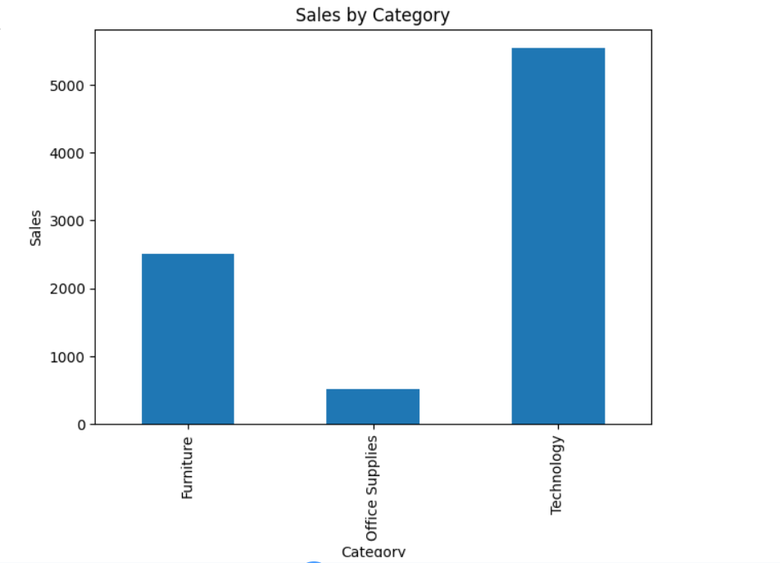

Slide 14
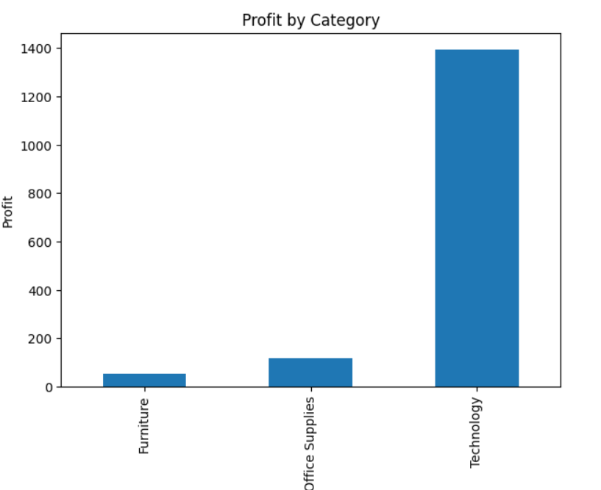

Slide 15
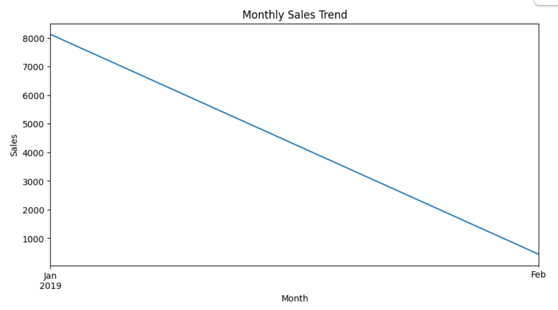

Slide 16
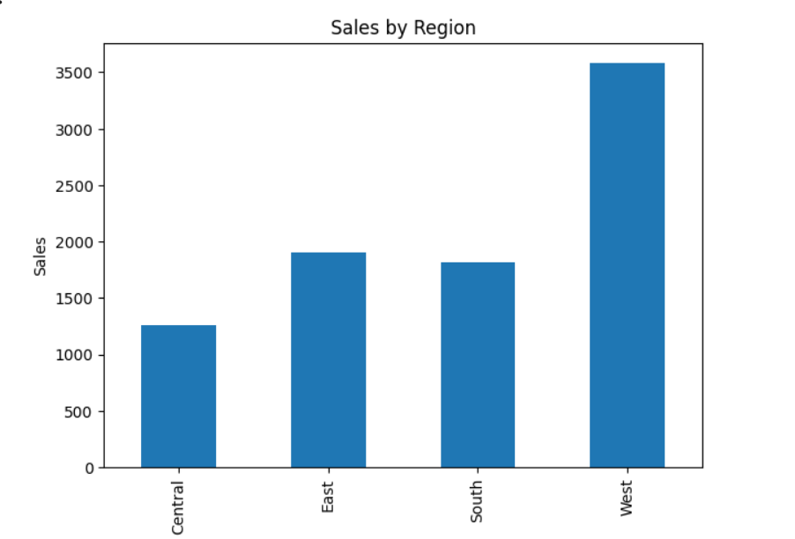

Slide 17
