Slide 1


Slide 2


Our Team
Maryam Gamal
Youssef Hossam
Rahma Atia
Feras Khlil

Slide 3
Maryam Gamal:
Collected, cleaned, and analyzed infected dashboard data.
Defined key performance indicators (KPIs).
Created visuals and developed the dashboard.
Prepared and delivered the presentation.

Slide 4
Yousef Hossam:
Defined key performance indicators (KPIs).
Created visuals and designed the interactive dashboard.
Collected, cleaned, and analyzed death dashboard data.

Slide 5
Rahma Atia:
Collected, cleaned, and analyzed government dashboard data.
Defined key performance indicators (KPIs).
Created visuals and developed the dashboard.
Prepared and delivered the presentation.

Slide 6
Feras Khalil :
Collected, cleaned, and analyzed ambulance dashboard data.
Defined key performance indicators (KPIs).
Created visuals and designed the interactive dashboard.

Slide 7
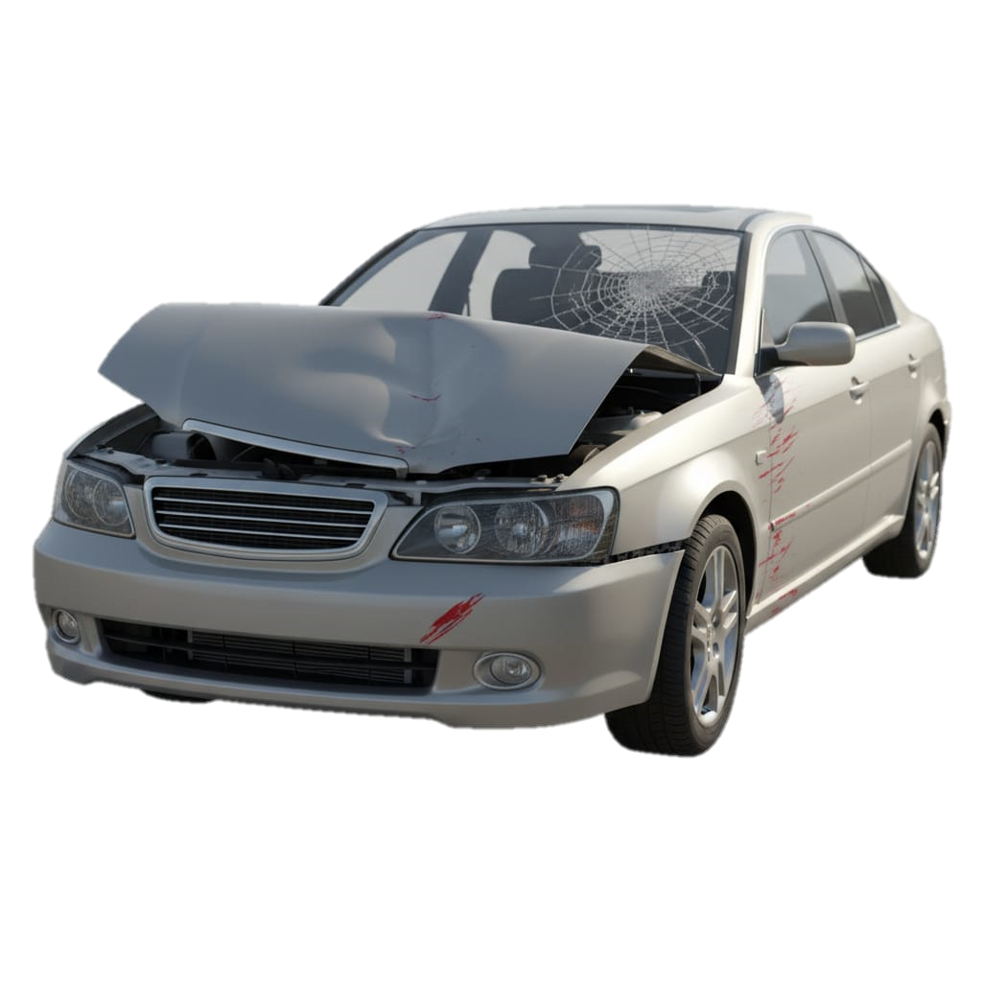

Introduction
Our project aims to analyze road accident data to identify patterns of injuries, high-risk age groups, and dangerous road segments. By transforming this data into actionable insights, we seek to support decision-making processes that enhance road safety and help reduce accident rates

Slide 8

Value
The dashboard is a key tool to understand road accidents, helping reduce risks, improve traffic safety, optimize emergency services and guide better planning
By analyzing age groups and vehicle types, the dashboard guides actions to improve road safety and traffic flow
By tracking emergency cases and outcomes, the dashboard supports faster response and improved medical readiness
It highlights high-risk roads and locations, guiding better planning and safety measures

Slide 9
The dashboard is a key tool to understand road accidents, helping reduce risks, improve traffic safety, optimize emergency services and guide better planning
Value
It highlights high-risk roads and locations, guiding better planning and safety measures
By analyzing age groups and vehicle types, the dashboard guides actions to improve road safety and traffic flow
By tracking emergency cases and outcomes, the dashboard supports faster response and improved medical readiness

Slide 10
It highlights high-risk roads and locations, guiding better planning and safety measures
The dashboard is a key tool to understand road accidents, helping reduce risks, improve traffic safety, optimize emergency services and guide better planning
Value
By analyzing age groups and vehicle types, the dashboard guides actions to improve road safety and traffic flow
By tracking emergency cases and outcomes, the dashboard supports faster response and improved medical readiness

Slide 11
It highlights high-risk roads and locations, guiding better planning and safety measures
The dashboard is a key tool to understand road accidents, helping reduce risks, improve traffic safety, optimize emergency services and guide better planning
Value
By tracking emergency cases and outcomes, the dashboard supports faster response and improved medical readiness
By analyzing age groups and vehicle types, the dashboard guides actions to improve road safety and traffic flow

Slide 12


Data
Set
Central Agency for Public Mobilization and Statistics
(CAPMAS)
The dataset contains information on road accidents and injuries over recent years, including details such as accident type, location, number of injuries and fatalities, age group, gender, vehicle type, and governorate-level infrastructure data
Data link
Check it !!!!

Slide 13
Data
Set
Central Agency for Public Mobilization and Statistics
(CAPMAS)
The dataset contains information on road accidents and injuries over recent years, including details such as accident type, location, number of injuries and fatalities, age group, gender, vehicle type, and governorate-level infrastructure data
Data link
Check it !!!!

Slide 14
Data
Set
Central Agency for Public Mobilization and Statistics
(CAPMAS)
The dataset contains information on road accidents and injuries over recent years, including details such as accident type, location, number of injuries and fatalities, age group, gender, vehicle type, and governorate-level infrastructure data
Data link
Check it !!!!

Slide 15

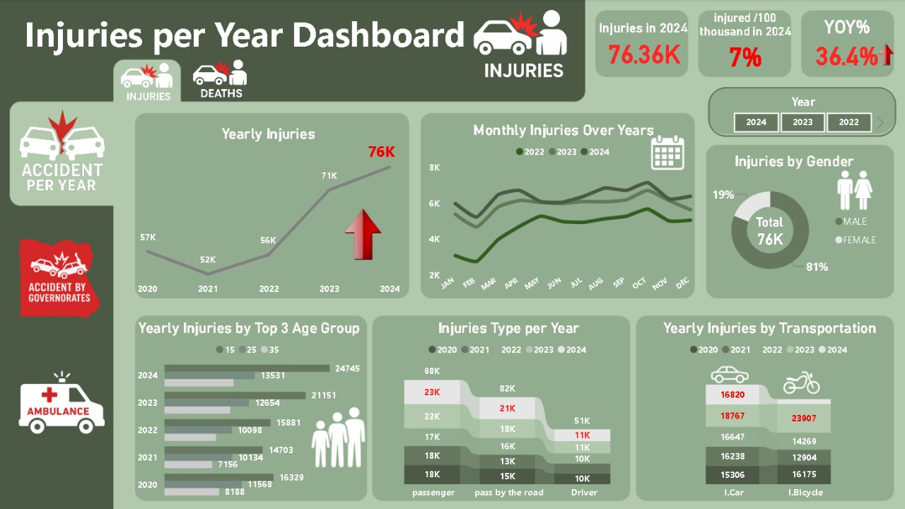
Dashboards
No.4
No.3
No.1
No.2

Slide 16
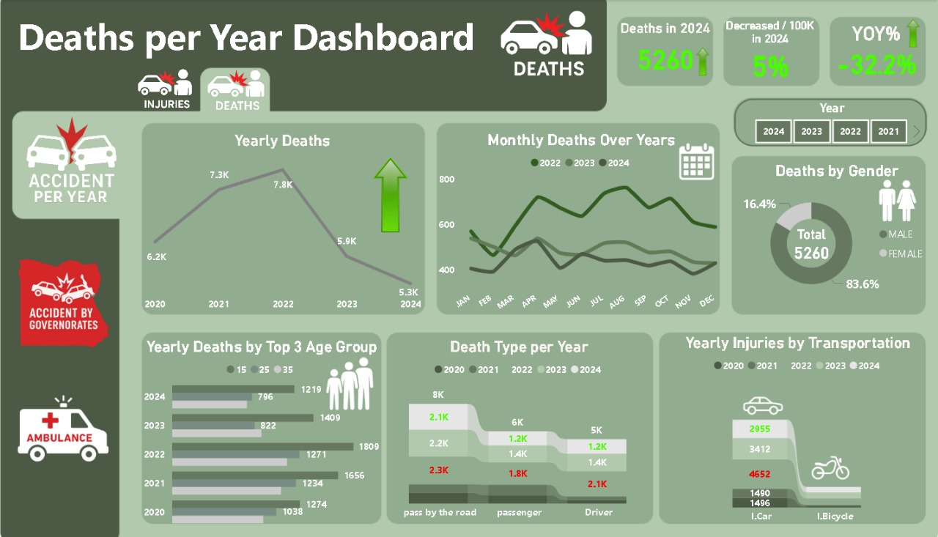
Dashboards
No.3
No.4
No.2
No.1

Slide 17
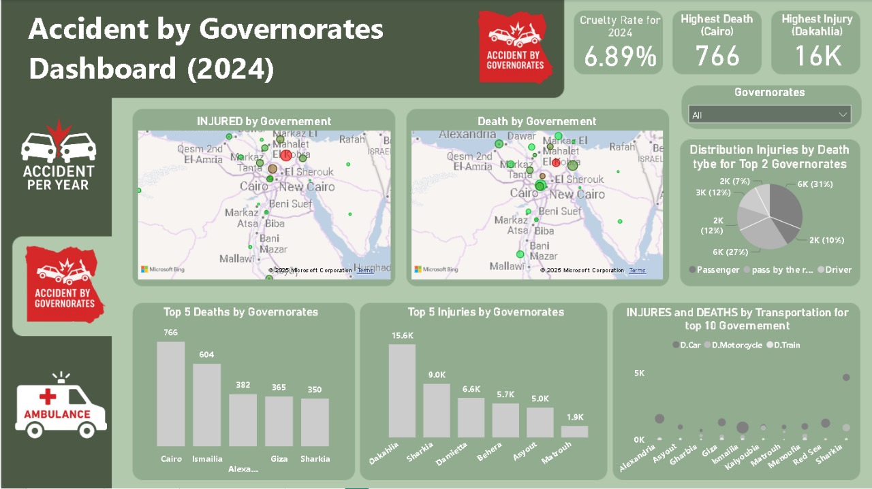
Dashboards
No.4
No.1
No.3
No.2

Slide 18
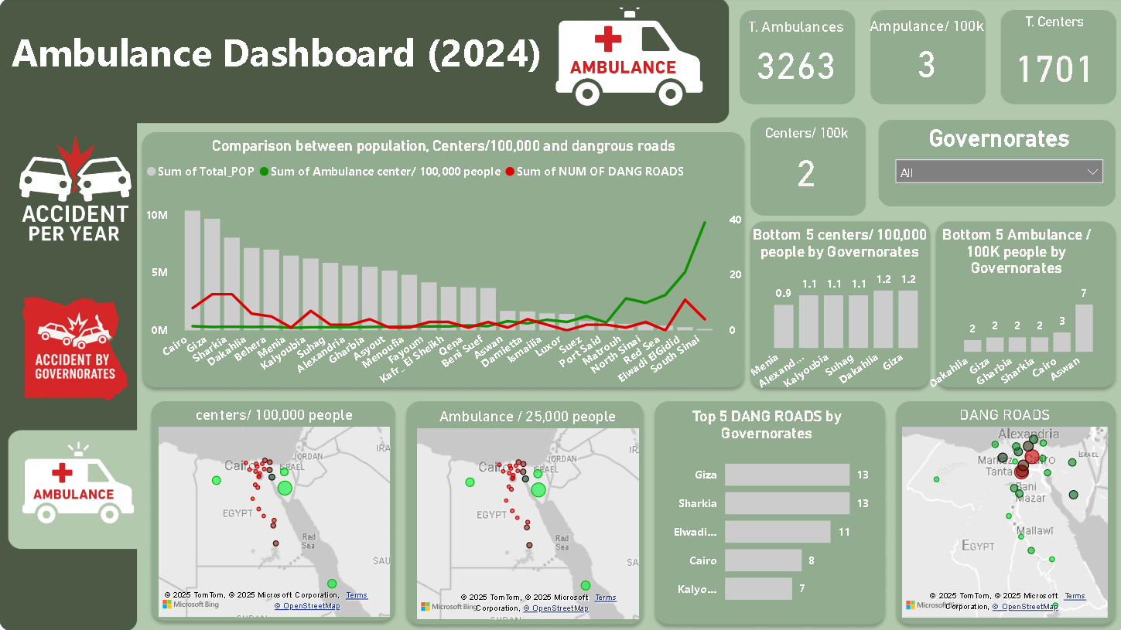
Dashboards
No.1
No.2
No.4
No.3

Slide 19





Slide 20

Total Injuries in 2024
Increase NO.OF Injuries from 56k (2022)
to 76K (2024)

Slide 21
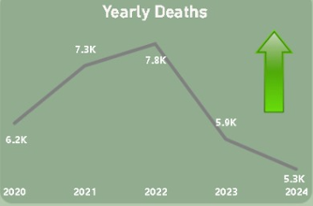
Total Injuries in 2024
Cruelty Rate for 2024
Increase NO.OF Injuries from 56k (2022)
to 76K (2024)
Decrease the rate from 8.3%to 6.8% due to decrease NO.OF death from 5.9K to 5.3K

Slide 22

Total Injuries in 2024
Cruelty Rate for 2024
Total Ambulances
Increase NO.OF Injuries from 56k (2022)
to 76K (2024)
Decrease the rate from
8.3%to 6.8% due to decrease NO.OF death from 5.9K to 5.3K
Increase t.ambulance cars with total centers 1701

Slide 23
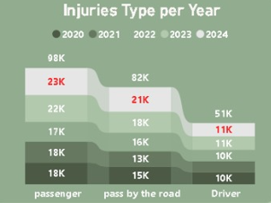
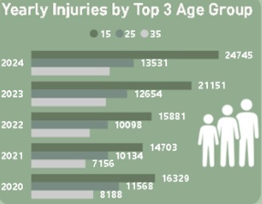
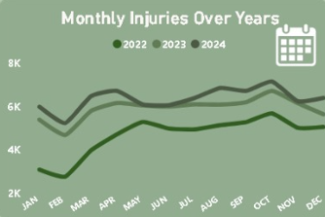
Insight
The highest number of injuries over the past five years was recorded among individuals aged 15 to 25
The high rate of injuries within this age group can be attributed to the nature of adolescence and increased physical activities
No.3
Traffic officers should ensure that young drivers within this age group hold valid driving licenses and vehicle permit

Slide 24
Insights
October recorded the highest rate of accidents over the past five years
The rise in accidents during October may be attributed to the start of the academic year and the growing number of private universities located far from residential areas, leading to increased traffic congestion due to student commuting
No.4

Slide 25
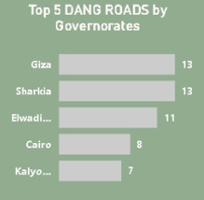
Insights
Although Passenger injuries recorded the highest numbers, Pedestrian injuries also represent a significant proportion.
Highlights the need to raise awareness through posts, advertisements and awareness sessions about following speed limits and traffic signals.
No.1

Slide 26
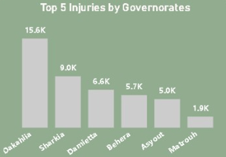
Insights
These governorates contain the highest number of Dangerous roads.
It is recommended to improve road infrastructure by enhancing lighting, widening lanes, separating directions, increasing rest areas, and conducting regular maintenance to ensure safety and reduce accidents
No.2

Slide 27
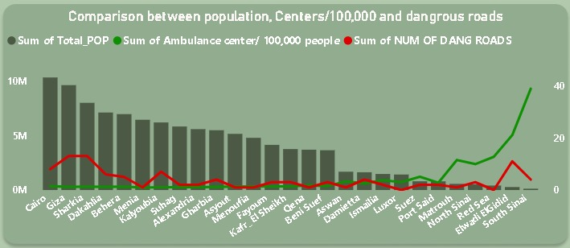
Insights
These governorates record the highest number of injuries
The most of them were previously identified as having a high number of hazardous roads
No.1

Slide 28
Insights
Increase ambulance coverage and improve distribution in high-injury areas to ensure faster response and better emergency care
Governorates with the highest number of dangerous roads have the lowest rate of ambulance centers per 100,000 people.
No.2

Slide 29

Recommendations
Applying the Vision Zero Strategy According to the Ministry of Health Standards

Slide 30
Recommendations
Applying the Vision Zero Strategy According to the Ministry of Health Standards
Use alcohol detection devices (Ignition Interlock Devices) in vehicles to prevent drunk driving

Slide 31
Recommendations
Applying the Vision Zero Strategy According to the Ministry of Health Standards
Use alcohol detection devices (Ignition Interlock Devices) in vehicles to prevent drunk driving
Require regular medical and drug examination for drivers.

Slide 32
Recommendations
Build traffic islands and launch awareness campaigns targeting youth.

Slide 33
Recommendations
Build traffic islands and launch awareness campaigns targeting youth.
Place warning signs on dangerous roads and intersections

Slide 34
Recommendations
Build traffic islands and launch awareness campaigns targeting youth.
Place warning signs on dangerous roads and intersections
Separate heavy transport routes from private car lanes.

Slide 35
Recommendations
Apply ITS (Intelligent Transportation System)

Slide 36
Recommendations
Apply ITS (Intelligent Transportation System)
Construct pedestrian tunnels to ensure safe crossing

Slide 37
Recommendations
Apply ITS (Intelligent Transportation System)
Construct pedestrian tunnels to ensure safe crossing
Impose regular rest periods for drivers to reduce fatigue-related accidents.

Slide 38
Recommendations
Reduce the allowed penalty points and increase speeding fines

Slide 39
Recommendations
Reduce the allowed penalty points and increase speeding fines
Enhance road lighting for better visibility at night.

Slide 40
Recommendations
Reduce the allowed penalty points and increase speeding fines
Enhance road lighting for better visibility at night.
Apply Trauma Stabilization unit each 30-40km

Slide 41
Ai-Model
1. Data Acquisition & Integration :
Data Sources: Merged two distinct datasets to ensure Data Diversity:
Pothole Dataset: For detecting road surface defects.
Indian Driving Dataset (IDD): For pedestrian detection (selected due to the high similarity between Indian and Egyptian chaotic traffic environments).
The Challenge: Handling Heterogeneous Data formats; Pothole annotations were in XML while Pedestrian data was in YOLO TXT format.
2. The Preprocessing Pipeline:
The Logic: Developed a custom Automated Python Script to perform the following:
Parsing: Extracting raw coordinates from legacy XML files.
Conversion: Transforming corner coordinates (xmin, ymin) into YOLO format (Center-X, Center-Y).
Normalization: Scaling coordinates relative to image dimensions to achieve a unified 0-1 Scale.
Outcome: Created a clean, Unified Dataset ready for training.
3. Model Architecture & Training:
Architecture: Selected YOLOv8 Nano for two key reasons:
Lightweight: Minimal computational cost.
Edge-Device Ready: Optimized for mobile and embedded deployment.
Methodology: Utilized Transfer Learning (initializing with pre-trained weights) to accelerate learning, and trained the model for 30 Epochs to reach optimal Convergence.
4. Inference & Performance Latency:
Achieved an ultra-fast inference speed of ~7ms per image.
Frame Rate (FPS): The system operates at +140 FPS, making it a robust Real-Time System (approx. 4x faster than standard cameras).
Functionality: Instantaneous detection and precise localization (Bounding Boxes) for both Potholes and Pedestrians.

Slide 42
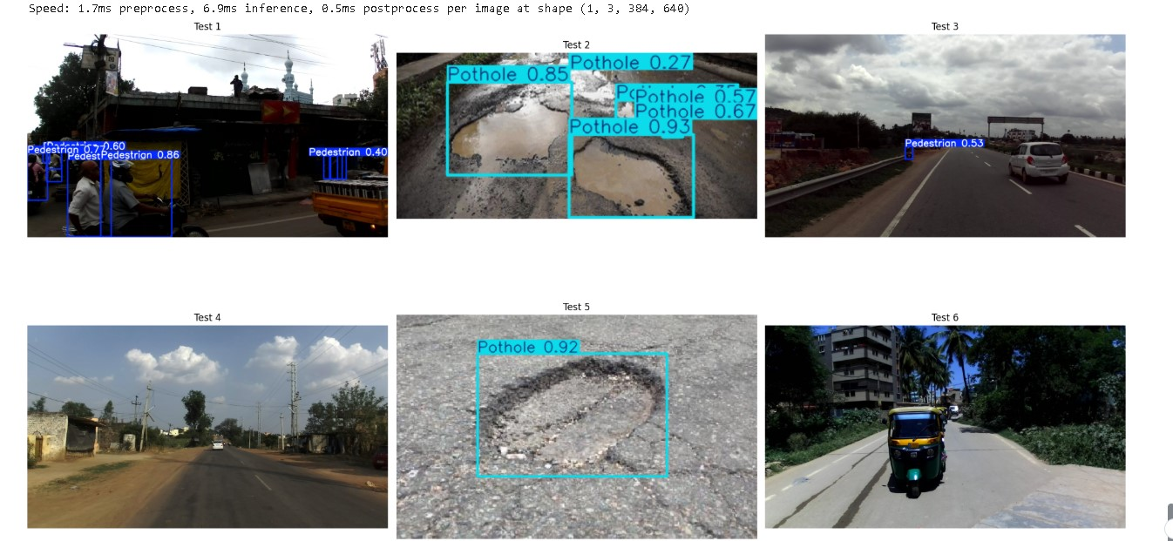
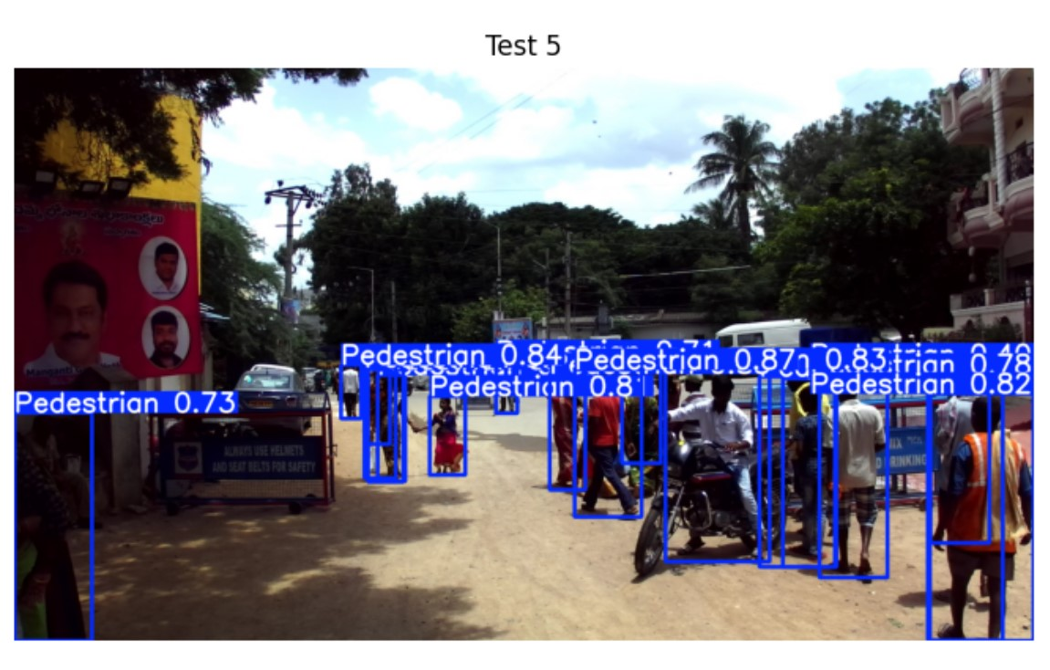
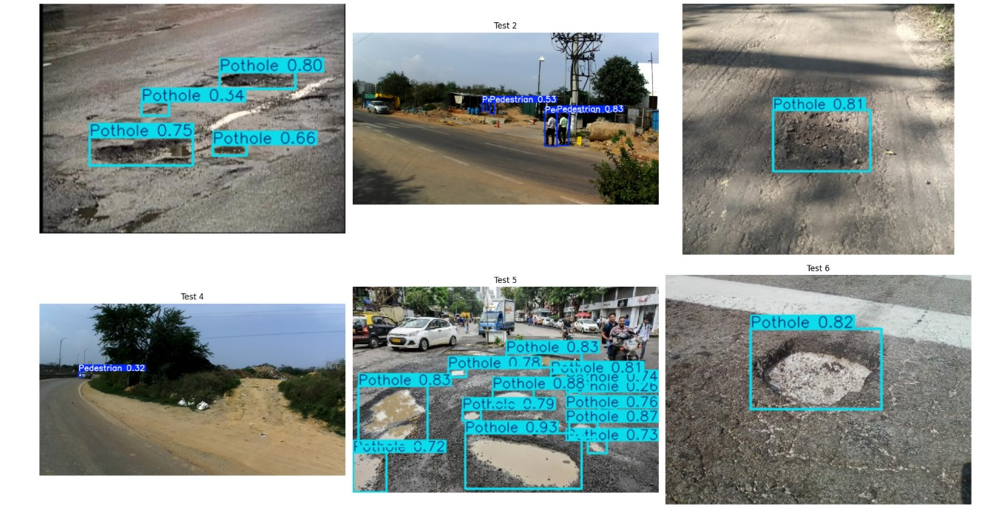
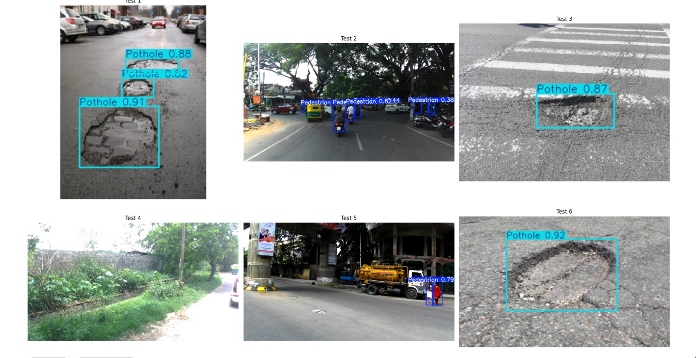

Slide 43

conclusion
reducing road accidents is not just about rules — it’s about understanding the data behind every crash, every injury, and every life affected. Through data analysis and smart traffic systems like ITS, we can turn numbers into real solutions and make our roads safer for everyone. Our work today isn’t just statistics — it’s a step toward saving lives

