Slide 1
FairTest: A Service for Uncovering Privacy Bugs in Data Driven Applications
V. Atlidakis and X. He

Slide 2
Motivation
Data-driven applications collect and process vast amounts of data
Little has been done to allow developers understand the use of these data
Lack of transparency may lead to privacy implications and discrimination treatment of users

Slide 3
Motivation
Websites vary prices based on certain user’s information, such as location
Residents of a borough consistently receive higher prices than residents of another.
This may lead into discriminatory behavior based on sensitive attributes (e.g., race or income)

Slide 4
Motivation
‘’Staples’’ example: Differential treatment of users
Discovered by Wall Street Journal investigators in 2012 [1]
Staples Inc. displayed different prices to people after estimating their locations in the following ways:
Consider the person’s distance from a rival brick-and-mortar store.
If rival stores within 20 miles or so, showed a discounted price.
Implication: Areas that tended to see discounted prices had higher average income than areas that tended to see higher price.

Slide 5
Related Work
Define statistical parity of individuals within a set
Study fairness on the treatment of individuals
[1] Dwork et al: “Fairness Through Awareness”
Two individuals who are similar with respect to a particular task should be classified similarly
[2] Friedler et al: “Certifying and removing disparate impact”
Removing Disparate impact and target on neutral selection of individuals

Slide 6
Statistical Parity
For two sets of users S, S’ and an output O, the users of set S are equally probable with the users of set S’ to see output O.
Equivalently for a user X:
|Pr {O | x ∈ S} − Pr {O | x ∈ S’ }| ≤ Ɛ (1).

Slide 7
Applying Statistical Parity
An example with Discriminatory behavior
Population | #Members | Price Low High | Statistical Parity (for high price)
A B C | 30 30 40 | 10 20 16 14 21 19 | 0.198 = |20/30 - 33/70| 0.09 0.09
Total | 100 | 47 53 | -

Slide 8
Relaxing Statistical Parity:
Introducing Business Necessity
There are cases of reasonable discrimination, a.k.a. business necessity or requirement.
Let users be discriminated on two sets: users in R meet a requirement and users in R’ not.
Apply statistical parity separately on R and R’.
|P{O | x ∈S∩R} − P{O | x ∈ T∩R}| ≤ Ɛ (1),
|Pr {O | x ∈ S∩R’ } − Pr {O | x ∈ T∩R’}| ≤ Ɛ (2)

Slide 9
Applying Relaxed Statistical Parity
An example with business necessity:
Without credit history a user cannot have personal loan
Naive approach:
25% more users of A than B receive Payday loans (high interest).
Statistical parity condition |Pr {O | x ∈ S} − Pr {O | x ∈ S’ }| yields: |85/100 - 60/100| = 0.25
Credit History | Loan Type (Population A) Payday Personal Total | Loan Type (Population A) Payday Personal Total
YES NO | 5 15 20 80 0 80 | 15 40 55 45 0 45
Total | 85 15 100 | 60 40 100

Slide 10
Applying Relaxed Statistical Parity
An example with business necessity (cont’d)
Relaxed statistical parity approach:
|P{O | x ∈S∩R} − P{O | x ∈ T∩R}| ≤ Ɛ(1)
|P{O | x ∈S∩R’} − P{O | x ∈ T∩R’}| ≤ Ɛ (2)
Condition (1) yields: |5/20 - 15/55| = 0.02
Condition (2) yields: |80/80 - 45/55| = 0
Credit History | Loan Type (Population A) Payday Personal Total | Loan Type (Population A) Payday Personal Total
YES NO | 5 15 20 80 0 80 | 15 40 55 45 0 45
Total | 85 15 100 | 60 40 100

Slide 11
Fairtest
Service for data-driven applications, such as online stores
Uncover privacy bugs that lead to discriminatory behavior of populations
Find violations of statistical parity for outputs and “protected attributes”
Applications use it through a REST-ful API

Slide 12
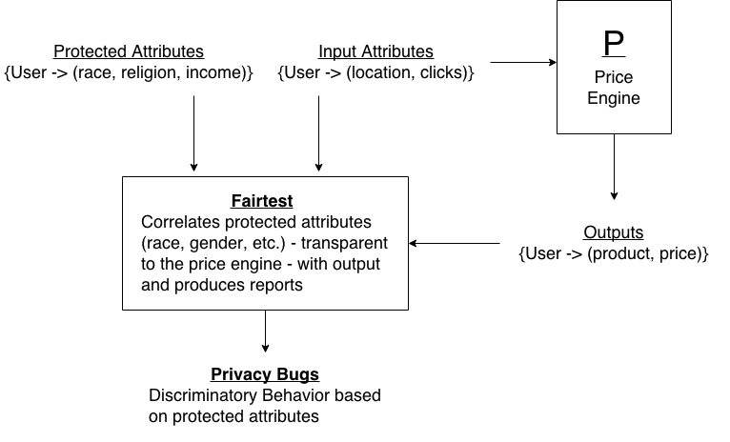
Fairtest - Overview
Fairtest Data Flow

Slide 13
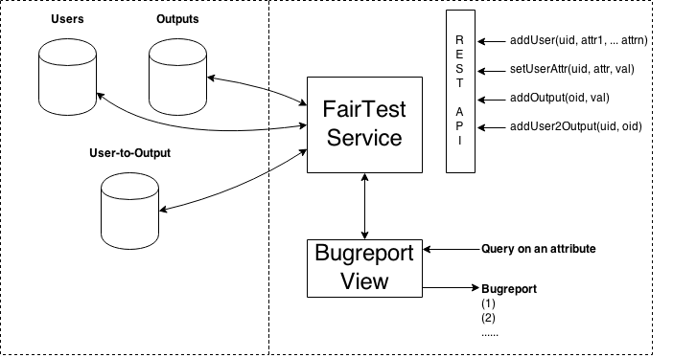
Fairtest - Architecture

Slide 14
Evaluation
5,000 synthetic generated users (provided by a project of E6998-11)
Using U.S. census data to simulate the actual demographics in and between zip codes
A sample price engine
Based on proximity of user’s location with certain actual locations:
The business (i.e. Staples stores)
Competitors (i.e. Office Depot stores)
Measurements
Deployed Fairtest to the price engine, which returns a “low” or “high” price with a probability set according to the location data

Slide 15
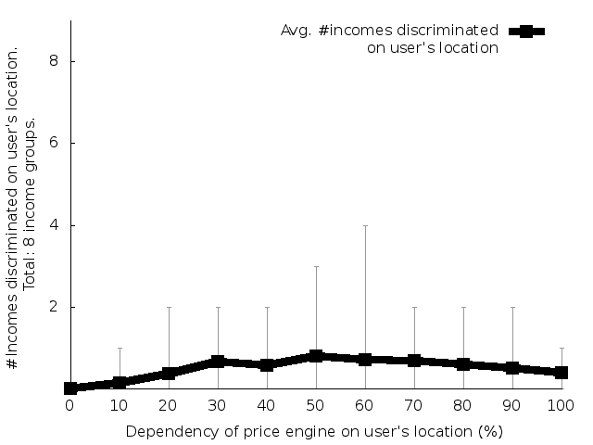
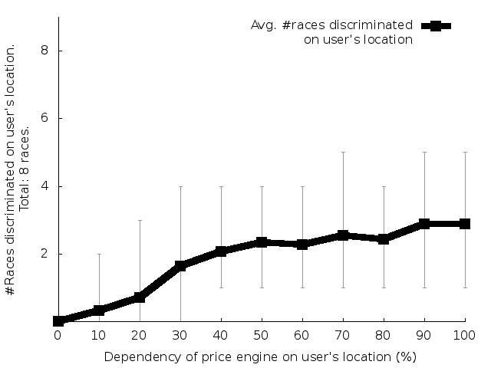
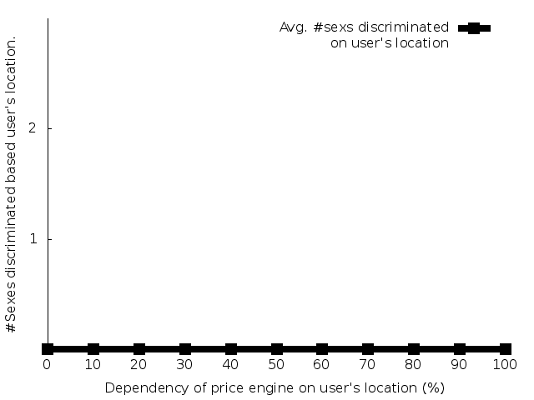
Results
Figures: Statistical parity and its dependency on user's location. Shows the dependency of statistical parity, i.e., number of samples that violate condition: |Pr {O | x ∈ S} − Pr {O | x ∈ S’ }| ≤ Ɛ for Ɛ = 0.05, as a function of (a) user's income, (b) user's race, and (c) user's sex.
Summary: Statistical parity on user’s races correlates with the dependency of the price engine on user's location, but not user’s income and user’s sex.

Slide 16
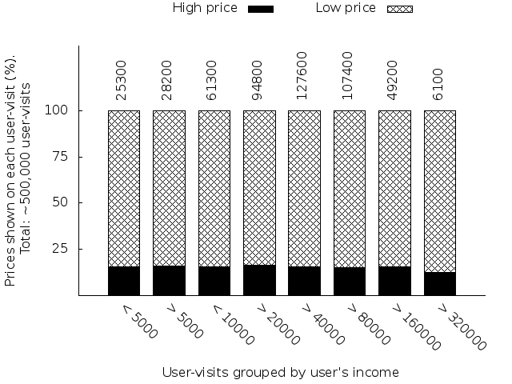
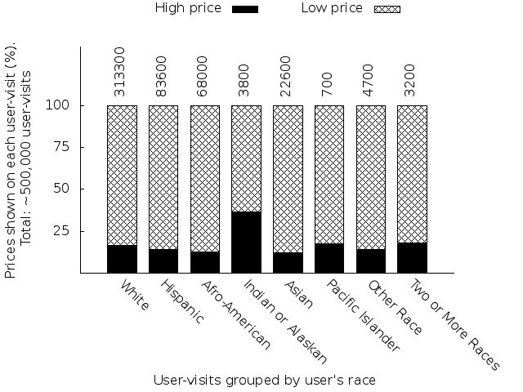
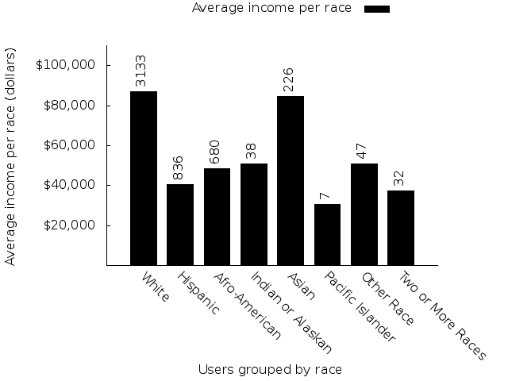
Results (cont’d)
Left, Center: Proportions of groups that see the high versus low price. It is significant in the test data result that Indian or Alaskan population see high prices significantly more. Also persons with >USD $320000 income are the least likely group to receive high price.
Right: U. S. average income based on race. Despite Indian or Alaskan population receives higher price, they have relatively lower average income.

Slide 17
Conclusions & Future Work
We built and evaluated a prototype of FairTest: a service to uncover and report discriminatory behavior of populations
Repeat experiments at larger scale in terms of users (~100,000 users)
Study different price engines
Apply mixed models [3] and relaxed statistical parity

Slide 18
References
[1] Dwork et al: “Fairness Through Awareness”
[2] Friedler et al: “Certifying and removing disparate impact”
[3] D. Hsu et al: Learning Mixtures of Spherical Gaussians: Moment Methods and Spectral Decompositions

Slide 19
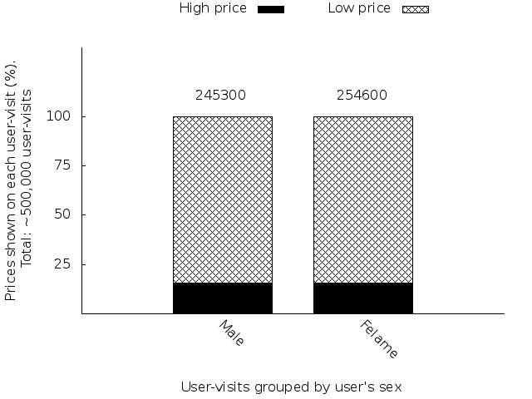
Backup Slides

