Slide 1
Why quantum mechanics? Several key experiments motivate it
Photoelectric effect
Absorption and emission spectra
Electron diffraction
Blackbody radiation

Slide 2
Photoelectric effect and absorption and emission spectra are explained by photons
Image: http://hyperphysics.phy-astr.gsu.edu/hbase/mod1.html
Notes:
Energy of emitted electrons depends only on energy of incident photon, NOT on intensity of light
Below some threshold frequency, no electrons emitted regardless of intensity

Slide 3
Electron diffraction is explained by the wave properties of particles
Image: Wikipedia

Slide 4
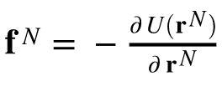
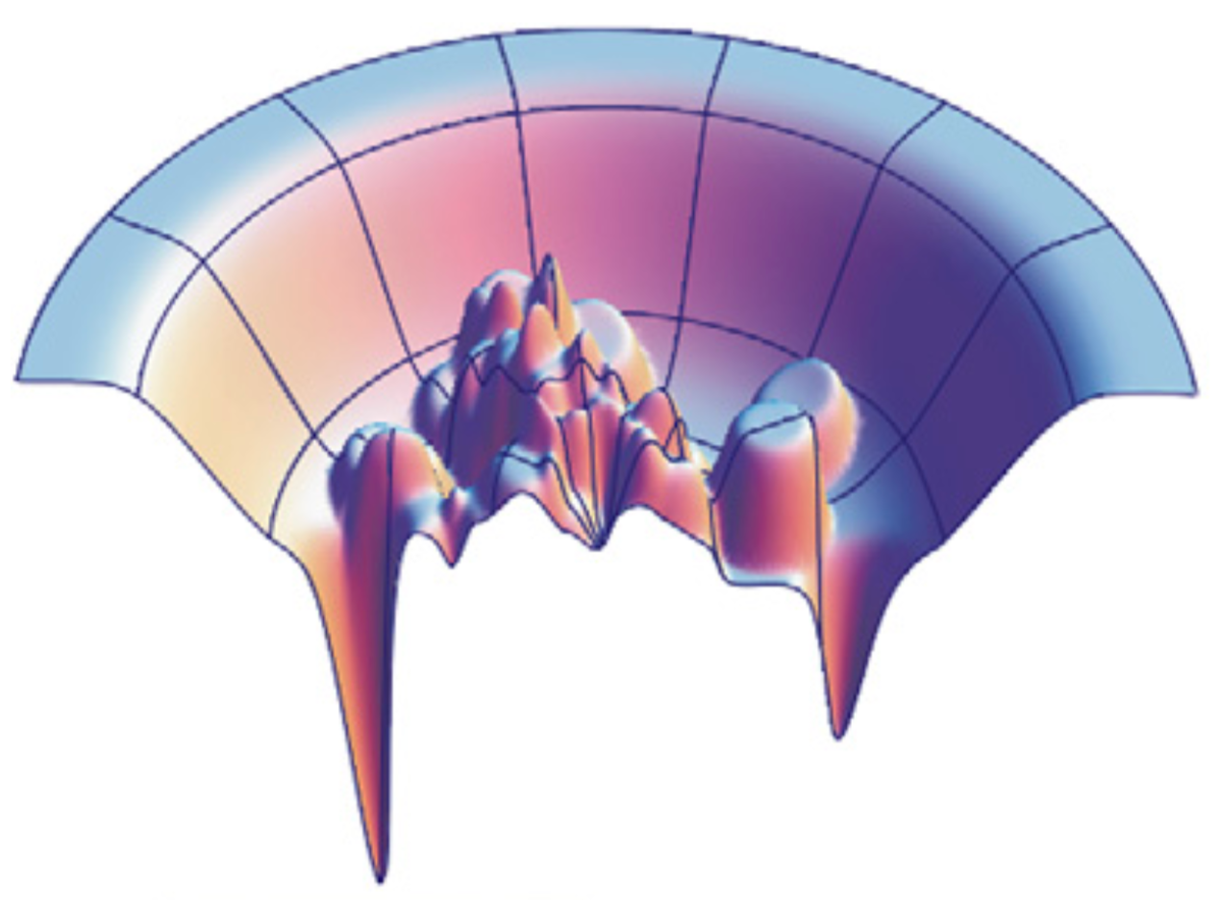
QM is a more rigorous approach to generating energy landscapes
From Lecture 2: Classical physics
Classical models approximate the quantum mechanical energy surface
How do we obtain the QM energy?

Slide 5





The Schrödinger equation describes quantum systems
For a single particle in a potential V:
where V is the potential, m the mass, and constants include:
Notes:
Explain that this is a differential equation
We won’t do much with it here but we want to go over it and what it means.
h is Planck’s constant; describes size of QM effects

Slide 6

The Schrödinger equation describes quantum systems
For a single particle in a potential V:
Kinetic energy
Potential energy
Notes:
Psi is the wavefunction, a function of coordinates and time, that can be complex-valued; completely specifies state of system. H is the Hamiltonian.
We think of H and E as being “operators”, things that operate on the wavefunction and do something to it. H has kinetic and potential energy “operator” components

Slide 7


The Schrödinger equation describes quantum systems
For a single particle in a potential V:
If the potential is time-independent:
The wavefunction is normalized; the probability of a state is:
Notes:
Psi is the wavefunction, a function of coordinates and time, that can be complex-valued; completely specifies state of system. H is the Hamiltonian.
We think of H and E as being “operators”, things that operate on the wavefunction and do something to it. H has kinetic and potential energy “operator” components

Slide 8




States are specified
completely by the wavefunction
The expectation value of any operator is given by:
Eigenvalues and eigenfunctions have the property
For example, for the Hamiltonian operator:
Eigenfunctions form an orthonormal basis set; all other wavefunctions can be expressed in terms of these:

Slide 9
Only a few problems can be solved analytically
Particle in a box
Harmonic oscillator
Hydrogen atom
Common element: Energy levels are “quantized”
Notes:
Here we’ll focus on hydrogen atom
Explain energy level quantization

Slide 10


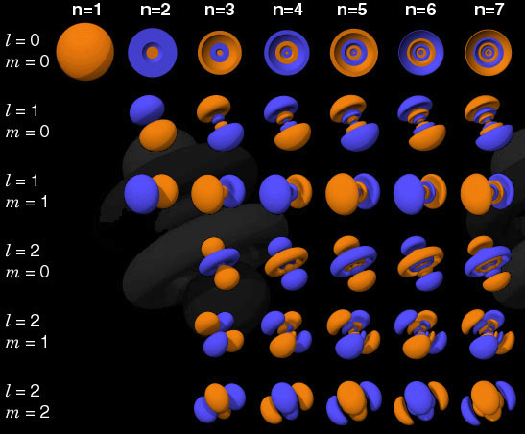


The hydrogen atom (and one electron atoms) can be solved analytically
Hamiltonian
Solutions:
n, l, m are quantum numbers:
n = 1, 2, 3, ....: Shell of electron
l = 0, 1, ... (n-1): Type of orbital (0 = s, l = p, 2 = d, 3 = f)
m = -l, -l+1, ..., 0, ..., l
where
http://chemistry.beloit.edu/Stars/images/orbitals.jpg
Notes:
Mention which parts are kinetic, potential
Rnls are radial parts involving a Laguerre polynomial (see Leach) and Ylms are spherical harmonics, involving theta and phi parts.

Slide 11
These basic orbital shapes provide tremendous insight into chemical bonding and reactions
http://chemistry.beloit.edu/Stars/images/orbitals.jpg

Slide 12
The Born-Oppenheimer approximation is for systems with multiple nuclei
In principle, motion of electrons is coupled to motion of nuclei
But electrons are faster
Born-Oppenheimer: Assume electrons respond instantaneously, and then take:
Practically: Fix nuclear positions, solve for wavefunctions
Etot = Enuc(nuc,nuc) + E(elec-nuc and elec-elec)
When we talk about energy, we will be referring to E(elec-nuc and elec-elec)
Now we solve electronic wavefunction for specific nuclear configurations
Notes:
Under B-O. approx, energy separates.
Solving electronic wavefunction for specific nuclear configurations is important, as it allows us to solve the problem in a piecewise way:
- Can compare effect of different nuclear positions on wavefunctions and energies
- Can do geometry optimizations, etc.

Slide 13
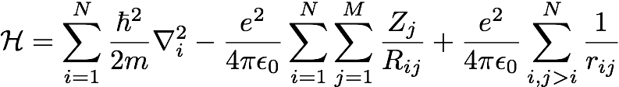
Polyelectronic atoms present challenges
Three-body problem: No analytical solutions for three or more interacting particles
Approximate solutions are possible; can have various forms
Electron spin: When dealing with multiple electrons, we must account for spin
No two electrons can have the same quantum state and spin (so only two electrons per quantum state)
Indistinguishability: Electrons are indistiguishable and the wavefunction must change sign on swapping any two electrons
Generally:
No analytical solution past hydrogenic atoms
Notes:
Define terms in final equation. First sum for kinetic energy, second is interactions between electrons and nuclei, and third is electron-electron (this assumes Born-Oppenheimer). Note i ... N sum runs over electrons and j over nuclei.

Slide 14
Variational theory enables approximate solutions and simple tests
Any trial wavefunction will give an energy greater than or equal to the ground state energy of the true solution
Can thus find approximate solutions by finding the trial solution that minimizes the energy.
Provides upper bound on energies
Notes:
Remember that the goal is to solve the Schrodinger equation.

Slide 15

The variational principle allows for “guessing” of solutions
Guess a functional form
Adjust parameters to minimize the energy
The lowest energy solution is the closest to the true solution
, adjusting the cn to minimize the energy
Notes:
For a suitable choice of phi, can accurately approximate ANY wavefunction, at least with a large enough set of phi

Slide 16
Hartree-Fock: Come up with a simple functional form for the wavefunction
and use the variational theorem
Express the wavefunction as a product of single-electron wavefunctions
Use hydrogen orbitals (or something like that) as a starting point
Use the variational theorem to minimize energy, optimize solution
Notes:
Explain notation 3/4 way down -- numbers are for the particular electrons
Note that this is not Hartree-Fock yet -- we are starting to work towards it

Slide 17

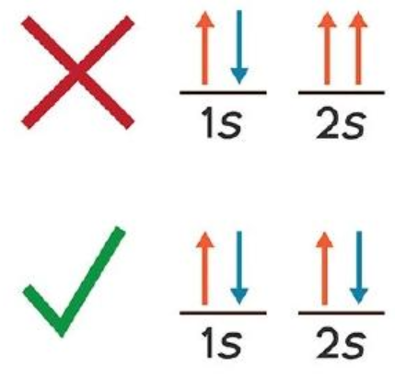
Hartree-Fock uses the variational theorem with a particular trial wavefunction to obtain an approximate solution
We do need to track electron spin in addition to spatial wavefunction
Denote spin by α, β
Wavefunction now , where s is α or β
Idea: Write solution for N electrons as product of individual spin orbital solutions (Hartree product):
Doesn’t meet exchange criteria, where swapping two particles changes the sign:
https://chem.libretexts.org/Core/Physical_and_Theoretical_Chemistry/Electronic_Structure_of_Atoms_and_Molecules/Electronic_Configurations/Pauli_Exclusion_Principle
Notes:
Explain notation 3/4 way down -- numbers are for the particular electrons
Note that this is not Hartree-Fock yet -- we are starting to work towards it

Slide 18

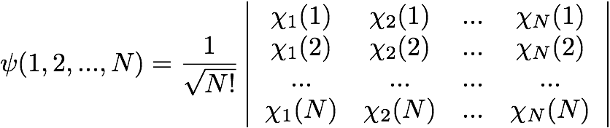
Slater determinants provide a way to get antisymmetric wavefunctions
How do we get antisymmetric wavefunction?
For two particles, could do this:
Note that now
An easy way to accomplish this generally is with a Slater determinant:
Changes sign if we swap any two rows/columns
Zero if two rows or columns are identical (meeting Pauli exclusion principle, no two electrons can have same orbital and spin)

Slide 19
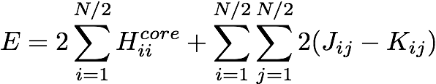
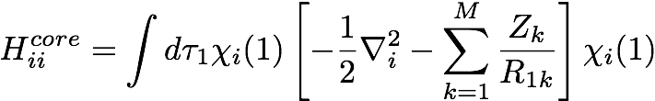


Let’s see what happens if we apply this approach to a general molecular system
General N-electron system, closed shell (Leach sec 2.4.2):
(Leach eq. 2.106, 2.107, 2.110, 2.120)
where
NOTE: Switched to reduced (atomic) units
gives kinetic and potential energy for electrons around nuclei
is Coulomb repulsion between elec.
is the “exchange” interaction
and results from Pauli -- electrons of same spin can’t be in same state (no classical counterpart)
Notes:
Assume here all electrons are paired; there are special techniques for dealing with unpaired electrons
The first term is the interactions of electrons with nuclei. Note switch to reduced units.

Slide 20
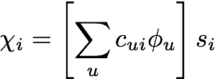


Well, now we have an expression for the energy, which is fine, but how do we get the wavefunctions and orbitals?
Remember: No single “correct” solution since it can’t be solved analytically
Apply variational theorem from some reasonable starting point
Let’s just combine analytic atomic orbitals from hydrogen atom (LCAO: linear combination of atomic orbitals)
Optimize coefficients cui
How do we optimize? Find the minimum energy set of coefficients:
with
the wavefunctions for H
Notes:
si are spins
We want to obtain the orbitals of a molecule, so we can build those up from individual atoms

Slide 21
This results in a big nasty equation which has to be solved “self-consistently”
Notes:
In E, off-diagonal elements are zero
Must be solved iteratively (explain iteratively) since F and S depend on coefficients cui

Slide 22
That was Hartree-Fock: Why isn’t this the end of the story on QM?
Number of orbitals required:
Minimum number of orbitals is equal to the number of electrons in the system. More allows treatment of unoccupied energy levels, can enhance accuracy
Mean-field approximation:
More importantly: It is a mean-field solution, which means that each electron movies in the average field due to the presence of the other electrons
Notes:
It is a mean-field solution BECAUSE we have to solve self-consistently. Any solution we find by solving for one electron affects the solutions for the other electrons, and so on. We can repeat this process until the solutions for all electrons quit changing the others anymore -- but in the process we are making it mean-field.
This neglects coupling and correlation of motions.

Slide 23
Also, there are numerical challenges relating to ‘basis sets’
The radial functions involve Laguerre polynomials, which have a complicated functional form
Slater suggested instead using orbitals of the form
These are called “Slater-type orbitals” (STO) and follow the Laguerre polynomials reasonably well
But these are hard to use too
Hard to deal with orbitals centered at different nuclei
Instead of the STOs, Gaussians are often used instead to approximate the STOs
Notes:
A ‘basis set’ just refers to how we represent the underlying atomic orbitals.
STOs are are actually the first term in a Taylor expansion of the Laguerre polynomials
Dealing with orbitals centered at different nuclei is numerically challenging because of the functional form.

Slide 24
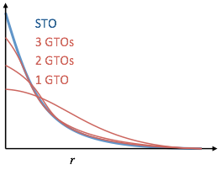
Gaussian-type orbitals (GTOs) approximate the STOs well fairly quickly
Gaussians are easy to work with because the product of two Gaussians centered in different places is just another Gaussian
Makes the calculations very fast
Figure from M. S. Shell

Slide 25
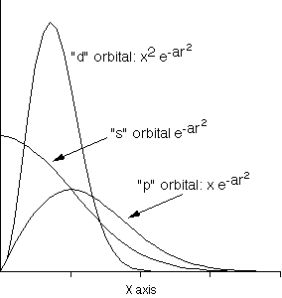
Remember, we’re just trying to represent the region of electrons using these GTOs and STOs
http://www.quimica.urv.es/~bo/MOLMOD/Mike_Colvin/qc/bs.html

Slide 26
A basis set is a collection of orbitals to represent the electronic wave function
STO-nG:
Minimal basis sets using n Gaussian functions to represent STO; 3 is the absolute minimum for n.
Minimal in that they use only a single s-type function for hydrogen, only 1s, 2s, and 2p for lithium to neon, etc.
Useful for quickly computing geometries, but limited accuracy
3-21G:
Three Gaussians for core orbitals
Split basis set for valence electrons: Two for contracted part, one for diffuse
6-31G:
Same as above, six gaussians for core, four for valence. More accurate.
Notes:
The minimal-ness here can be a problem because we are working with approximations to atomic orbitals. So we might need more to represent the real orbitals well.
Minimal basis sets especially problematic for atoms at the end of a period, such as oxygen or fluorine.
Split basis sets important for these, where expansion and contraction is important in response to environment.

Slide 27
Basis sets continued
6-31G*:
Same as above, but allowing polarization (distortion) of non-hydrogen orbitals
i.e. a polar hydrogen atom should attract extra electron density at neighboring atoms
** version adds polarization on hydrogens also
Relatively standard moderate-accuracy calculation (used for many force fields) but tends to be overpolarized
Anions and molecules with lone pairs present challenges
“+” basis sets add diffuse functions further out, i.e. 3-21+G, 6-31+G*
Complete basis set limit:
Increasing the size of the basis set can change results; ultimately, this should stop at the complete basis set limit, where results have reached their final value for the particular calculation
Notes:
The minimal-ness here can be a problem because we are working with approximations to atomic orbitals. So we might need more to represent the real orbitals well.
Minimal basis sets especially problematic for atoms at the end of a period, such as oxygen or fluorine.
Split basis sets important for these, where expansion and contraction is important in response to environment.
DRAW Polarization

Slide 28
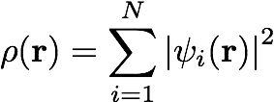

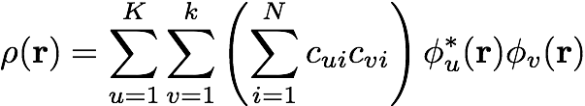
Computing the electron density
Electron density closely related to important properties:
Dipole and multipole moments
Starting point for developing fixed-charged models
Note
If written as a sum of basis functions, then:

Slide 29
Summary of Hartree-Fock
Approximate the wavefunction as a product of wavefunctions for individual electrons
Expand these wavefunctions in terms of hydrogen-like basis functions
Approximate these as a sum of Gaussian-type orbitals with coefficients chosen to reproduce Slater-type orbitals
Optimize coefficients self-consistently to find the minimum energy, subject to orthonormality
Compute physical properties such as electron density from resulting wavefunctions

Slide 30
Side note: Hartree-Fock (HF) is also referred to the self-consistent field method (SCF). You’ll use this method in the Jupyter notebook.

Slide 31


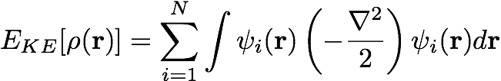

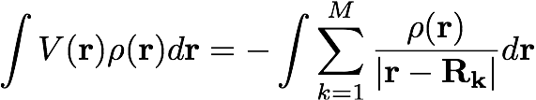
Density functional theory is concerned only with the electron density,
not the wavefunction
Hohenberg and Kohn: Ground state energy and other properties are uniquely determined by a functional of the electron density:
Square brackets denote functional: It depends on complete behavior of density, not density at a particular point
i.e. is a functional of y
Kohn & Sham: This can be written as
KE (approximation: for noninteracting electrons)
Hartree term (electron-electron repulsion)
Interaction with external potentials (nuclei)
Notes:
KE: A system of noninteracting electrons with SAME DENSITY as real system
Last term, XC, is exchange-correlation term

Slide 32


Exchange-correlation term is not known exactly, but it is universal
There are a variety of approximations for it
Simplest is the Local Density Approximation (LDA):
Only the local electron density affects the exchange-correlation energy in this approximation
often from simulations of homogeneous electron gas
Sometimes fitted, for example one proposal:
Notes:
Universal meaning that it does not depend on specific system
Includes exchange and correlation effects, as well as the difference between the true kinetic energy and the approximate one

Slide 33


Solving for the density involves finding the density that minimizes the energy
To find the minimum, we set
is a constant (Lagrange multiplier) ensuring normalization
To solve, we write in terms of orbital equations:
Evaluating the minimization gives the Kohn-Sham equation:
Solved self-consistently: (1) Guess initial density
(2) Derive orbitals, like in Hartree-Fock
(3) Update density
Iterate 2-3 until converged
Notes:
This uses the calculus of variations and is a functional minimization, minimizing an entire function

Slide 34
Ab initio molecular dynamics
Car and Parrinello strategy moves nuclei along with electrons, allowing motion of whole system
So far we examined only properties for fixed nuclear positions
Sets up equations of motion for coefficients
Approximately follow the orbital coefficients one would find from a DFT solution to the electronic structure for each nuclear position
Choosing fictitious “masses” for the coefficients allows this to reproduce the time-evolution of the electronic structure along with motions of nuclear positions
Ab initio calculations are very expensive
Only ~100 atoms feasible
Car-Parinello dynamics, up to around 10 ps.
Expense scales roughly as ~N⁴

Slide 35
Semi-empirical methods
Semi-empirical methods achieve better speeds and scaling than HF and DFT approaches
Only treat valence electrons explicitly
Have many parameters fitted to experimental data to make up for missing details
Can treat ~1000 atoms and longer timescales (ns)
Large parameter sets are required
Subject to overparameterization in some cases?
Often neglect dispersion interactions?

Slide 36
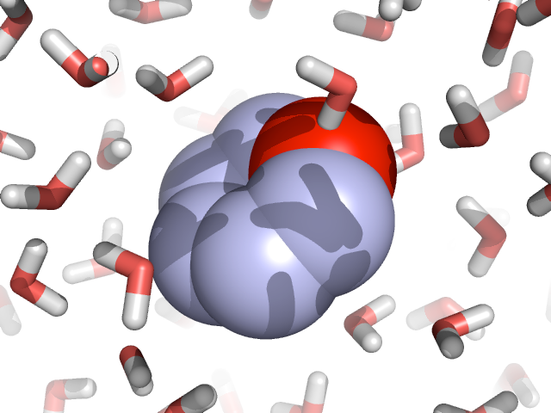
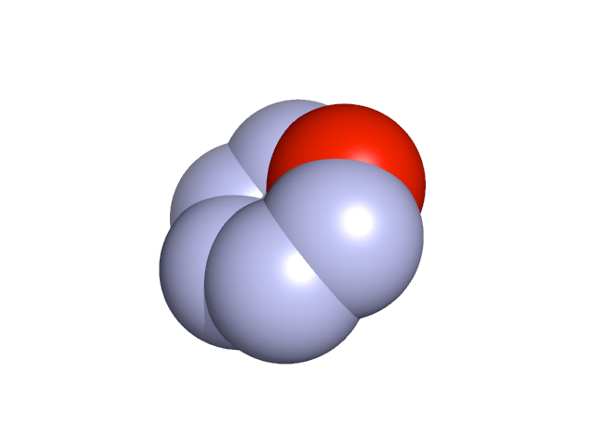
Most chemistry doesn’t happen in the gas: Continuum solvent models try to capture this
Explicit solvent
-
+
Continuum solvent models
-
+
-
+
+
+
+
-
-
-

Slide 37
One important effect: Molecules are more polarized in solution than in vacuum

Slide 38
But also: We might be interested in predicting solvation/solubility

