Slide 1
Signal Processing on Databases
Jeremy Kepner
Lecture 1: Using Associative Arrays
This work is sponsored by the Department of the Air Force under Air Force Contract #FA8721-05-C-0002. Opinions, interpretations, recommendations and conclusions are those of the authors and are not necessarily endorsed by the United States Government.
Notes:
Title slide.

Slide 2
Outline
Citation Data
Schema
Pipeline
Observations
Graph Construction
Multi-Hyper Graphs
Summary
Notes:
Outline slide.

Slide 3
Exploded Schema (Key Table)
Accumulo Table: TkeyT
Input Data
 | ut/1234 | ut/1243 | ut/4321
auth/a | 1
auth/b |  | 1
docid/b |  | 1
docid/c |  |  | 1
ref.docid/a | 1
ref.docid/c |  |  | 1
ut | auth | docid | ref.docid
1234 | a |  | a
1243 | b | b
4321 |  | c | c
 | auth/a | auth/b | docid/b | docid/c | ref.docid/a | ref.docid/c
ut/1234 | 1 |  |  |  | 1
ut/1243 |  | 1 | 1
ut/4321 |  |  |  | 1 |  | 1
Accumulo Table: Tkey
Holds structured citation data
Primary table for constructing graphs
Values hold position in record (i.e. 1st, 2nd, 3rd author/reference …)
Notes:
Triple store and associative arrays enable a novel data schema.

Slide 4
Exploded Schema (Txt Table)
Accumulo Table: Ttxt
 | ref | title | abstract
ref.docid/1234 | a
ut/1243 | b | b | b
ut/4321 |  | c | c
Traditional table for holding long formatted reference, title, and abstract strings
Eliminates inconvenient long strings from key table
Typically only used for manual verification
Notes:
Traditional schemas are also used for unindexed data.

Slide 5
Exploded Schema (Ngram Table)
Accumulo Table: TngramT
Input Data
 | ut/1234 | ut/1243 | ut/4321
title/1gram/a | 1,3 | 1
title/1gram/b | 2
title/2gram/a b | 1
abstract/1gram/c | 1
abstract/1gram/d | 2 |  | 1
abstract/2gram/c d | 1
ut | title | abstract
1234 | a b a … | c d …
1243 | b …
4321 |  | d …
 | title/1gram/a | title/1gram/b | title/2gram/a b | abstract/1gram/c | abstract/1gram/d | abstract/2gram/c d
ut/1234 | 1,3 | 2 | 1 | 1 | 2 | 1
ut/1243 | 1
ut/4321 |  |  |  |  | 1
Accumulo Table: Tngram
Holds 1, 2, 3-grams for titles and abstract (5x larger than key table)
Values hold word position(s) in record
Separation allows ngram ingest to be done independently
Notes:
Unstructured text data can be indexed by representing n-grams in an exploded schema.

Slide 6
Typical Processing Chain
Accumulo
.xml.zip
.xml
D4M
assoc
arrays
Tkey
TkeyT
Tngram
TngramT
triples
Ttxt
Uncompressed XML file [once]
Read XML into binary structure and parse into triples [a few times to finalize parse code]
Construct D4M associative arrays from triples to check data [once]
Insert triples into Accumulo [once per database]
Used several intermediate files so that fewest steps need to be redone during development
Notes:
A typical ingest processing pipeline consists of four steps.

Slide 7
Single Node 42M Record Times
Accumulo
.xml.zip
.xml
D4M
assoc
arrays
Tkey
TkeyT
Tngram
TngramT
triples
Ttxt
Uncompress XML file [~1 hour]
Read XML into binary structure and parse into triples [~2 hours]
Construct D4M associative arrays from triples to check data [~1 day]
Insert triples into Accumulo [key ~2 days, txt ~1 day, ngram ~10 days]
Single node sustained insert rate of 10,000 – 100,000 entries/sec.
Performance is sufficient that entire data set can be hosted on a single node
Notes:
The high performance of triple stores such as Accumulo allow problems that would normally require a parallel computer to be handled on a single computer.

Slide 8
Outline
Citation Data
Graph Construction
Citation
Author
Institution
Keyword
Uncertainty
Pedigree
Multi-Hyper Graphs
Summary
Notes:
Outline slide.

Slide 9
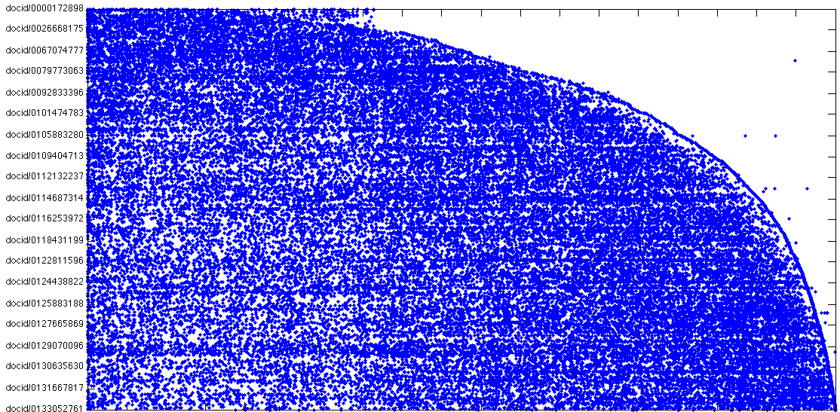
Adjacency Matrix
Source Document
Cited Document
Document ID increases with time (as expected)
Notes:
Using a small data set it is possible to visualize the entire citation graph using an associative array.

Slide 10
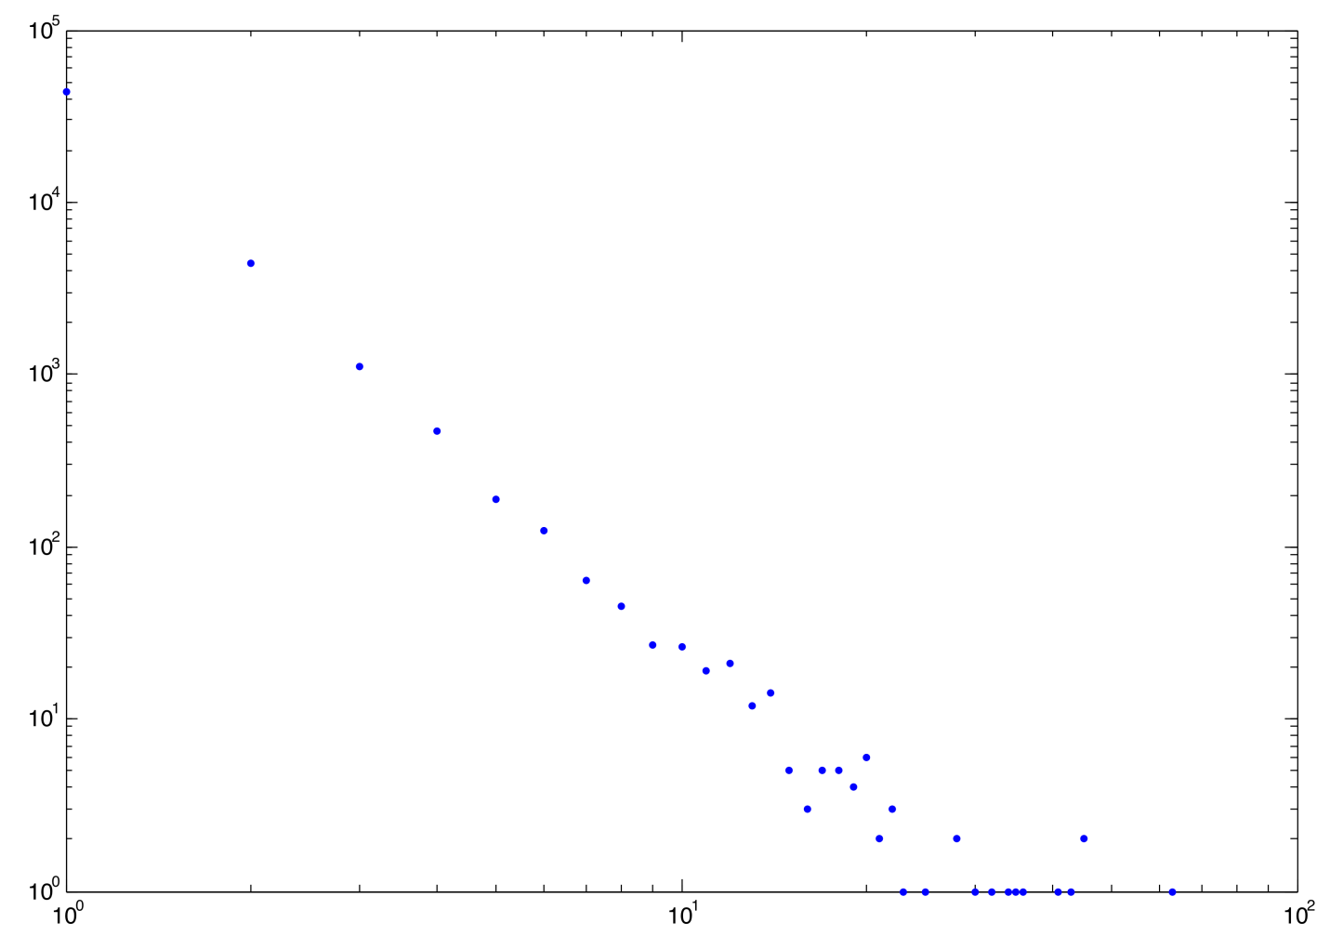
Degree Distribution
Number of Records
Number of citations
Power law (as expected)
Notes:
The distribution of citations is power law.

Slide 11
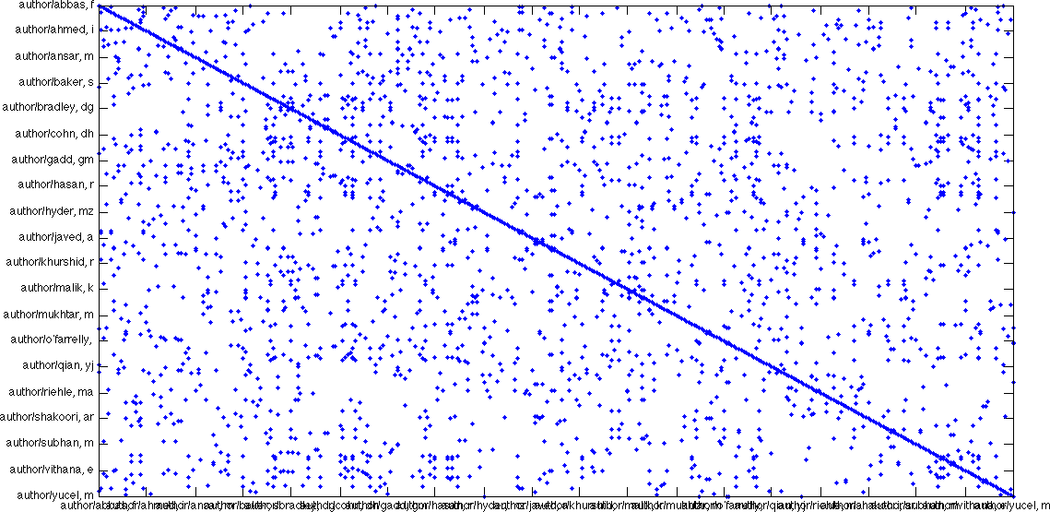
Author Graph
E(:,StartsWith('author/,'))^{t} * E(:, StartsWith('author/')
Author
Author
Counts how many times a pair of Authors are in the same DoclD
Notes:
The schema holds the incidence matrix. Graphs are constructed by multiplying parts of the incidence matrix together. This matrix multiply produces the document co-author graph.

Slide 12
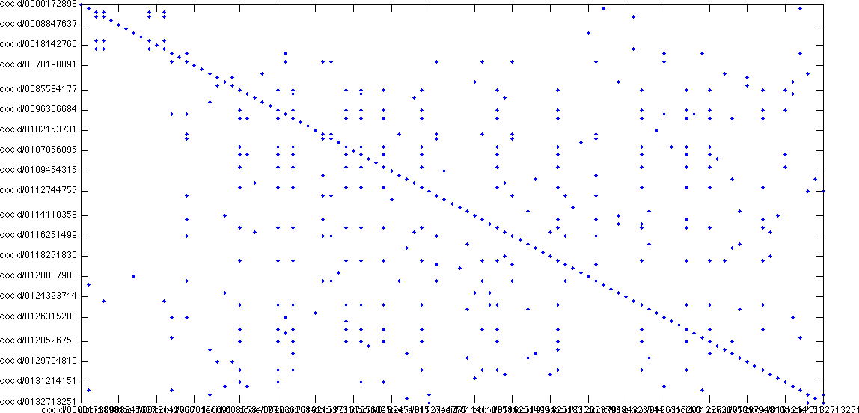
Author DoclD Graph
E(:,StartsWith('author/,')) * E(:, StartsWith('author/’)^{t}
DocID
DocID
Counts how many times a pair of DoclDs share an Author
Notes:
The schema holds the incidence matrix. Graphs are constructed by multiplying parts of the incidence matrix together. This matrix multiply produces the author co-document graph.

Slide 13
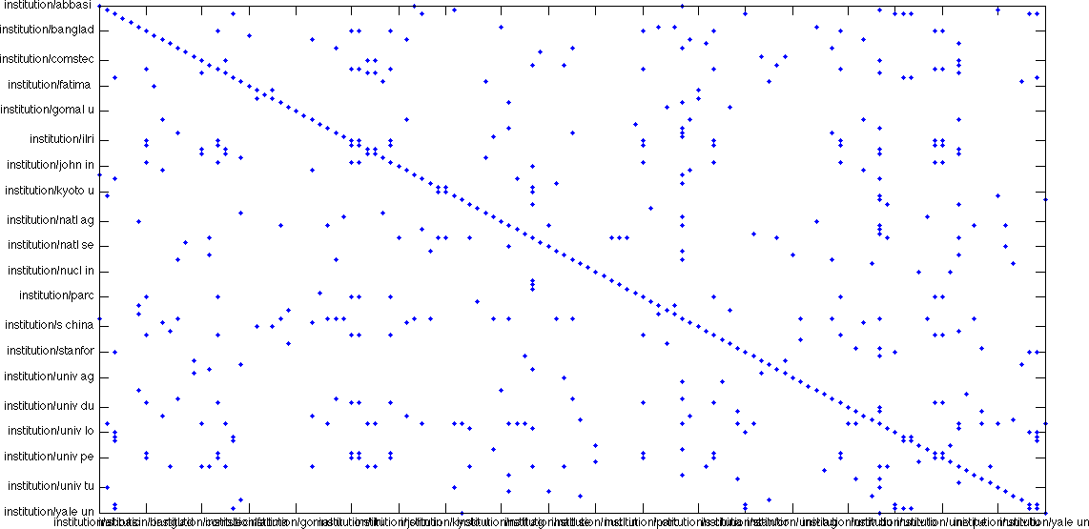
Institution Graph
E(:,StartsWith('institution/,'))^{t} * E(:, StartsWith('institution/')
Institution
Institution
Counts how many times a pair of Institutions are the same DoclD
Notes:
The schema holds the incidence matrix. Graphs are constructed by multiplying parts of the incidence matrix together. This matrix multiply produces the document co-institution graph.

Slide 14
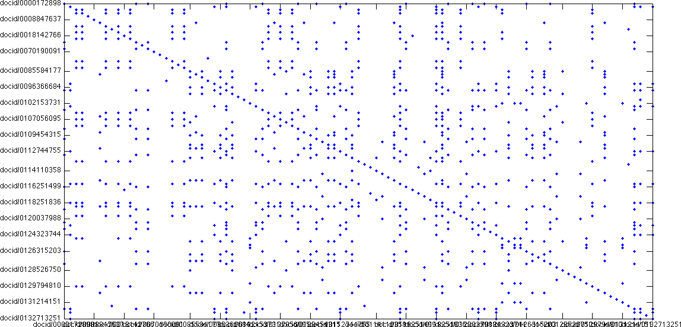
Institution DoclD Graph
E(:,StartsWith('institution/,')) * E(:, StartsWith('institution/’)^{t}
DoclD
DoclD
Counts how many times a pair of DoclDs share an Institution
Notes:
The schema holds the incidence matrix. Graphs are constructed by multiplying parts of the incidence matrix together. This matrix multiply produces the institution co-document graph.

Slide 15
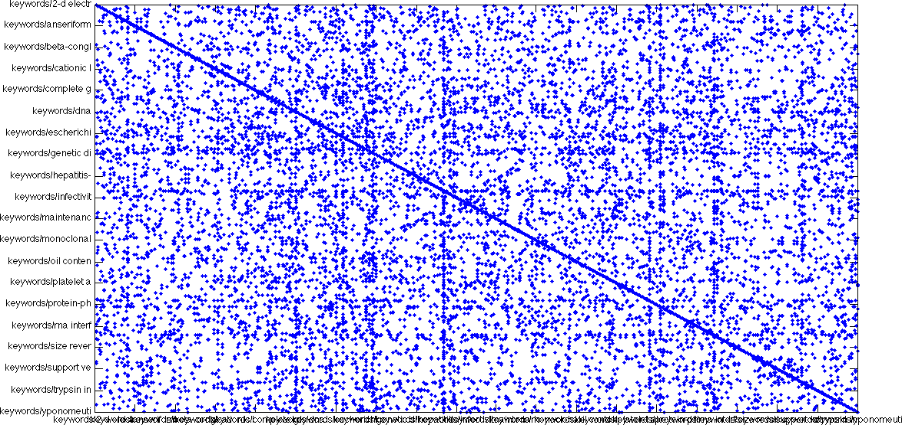
Keyword Graph
E(:,StartsWith('keyword/,'))^{t} * E(:, StartsWith('keyword/')
Keyword
Keyword
Counts how many times a pair of Keywords are in the same DoclD
Notes:
The schema holds the incidence matrix. Graphs are constructed by multiplying parts of the incidence matrix together. This matrix multiply produces the document co-keyword graph.

Slide 16
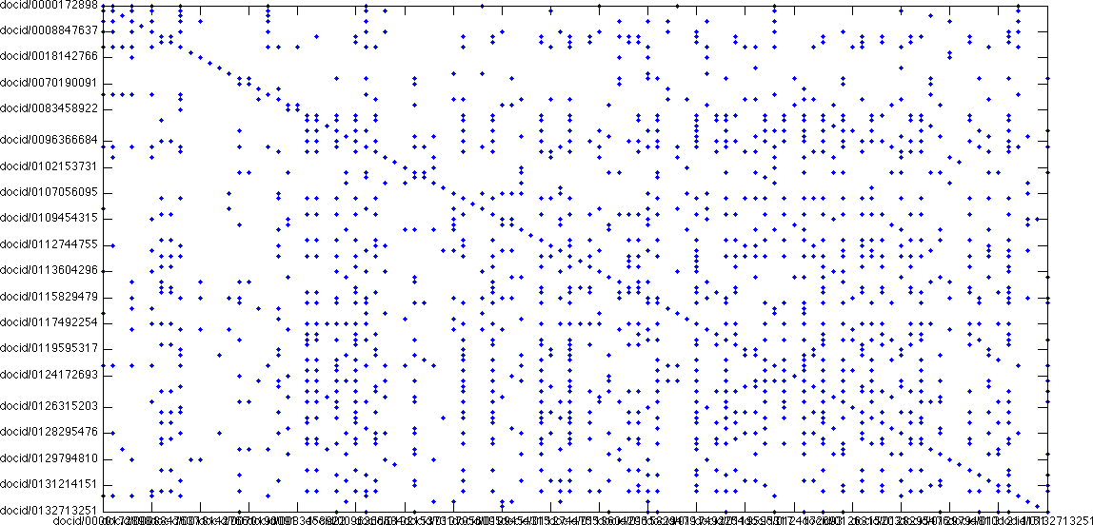
Keyword DoclD Graph
E(:,StartsWith('keyword/,')) * E(:, StartsWith('keyword/’)^{t}
DoclD
DoclD
Counts how many times a pair of DoclDs share a Keyword
Notes:
The schema holds the incidence matrix. Graphs are constructed by multiplying parts of the incidence matrix together. This matrix multiply produces the keyword co-document graph.

Slide 17
Outline
Citation Data
Graph Construction
Multi-Hyper Graphs
Undirected
Directed
Multi
Hyper
Summary
Notes:
Outline slide.

Slide 18
Directed Graph
1
2
→
4
7
5
3
6
A^{T}
x
A^{T}x
Directed graphs can be represented as a sparse matrices
Multiply by adjacency matrix – step to neighbor vertices
Work-efficient implementation from sparse data structures
The real world is far more complex than directed graphs
Directed, multi, hypergraphs
Notes:
Adjacency matrices are a natural way to represent graphs. Adjacency matrices are limited. Incidence matrices can represent more complex graphs.

Slide 19
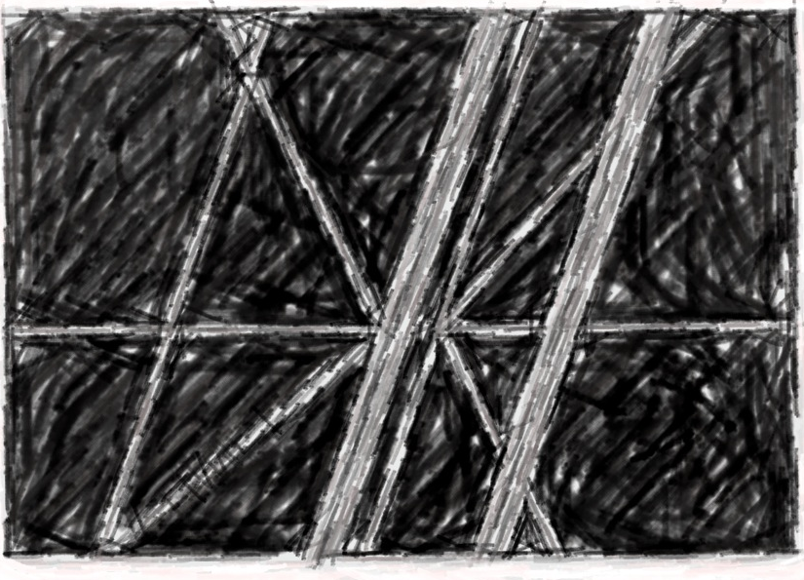
Digraphs are Black & White
Notes:
Digraphs only show the existence and possible the weight of connections between vertices.

Slide 20
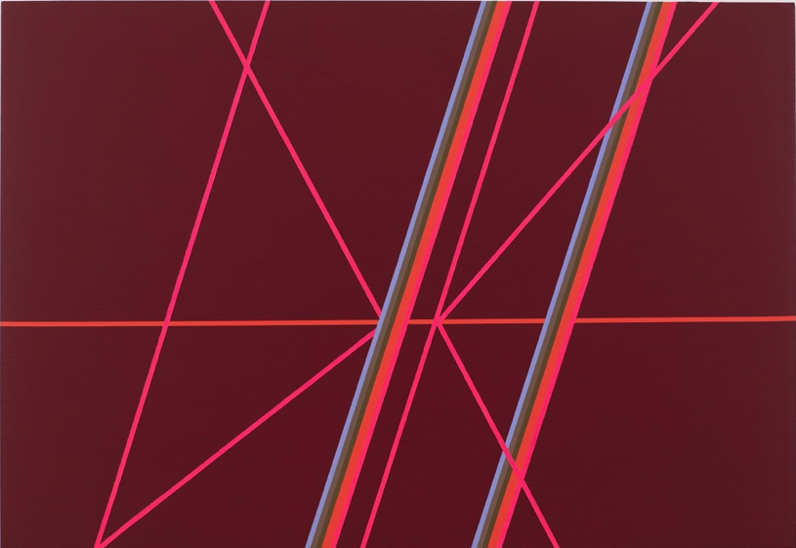
The World is Color
Artist: Ann Pibal; Painting: “XCRS”
Notes:
Real world graphs are more complex than what digraphs can be represent.

Slide 21
5 Edge Colors
Blue
Silver
Green
Orange
Pink
Artist: Ann Pibal; Painting: “XCRS”
Notes:
Edges can have different properties.

Slide 22
20 Vertices
V12
V14
V3
V17
V8
V19
V13
V7
V9
V11
V2
V16
V6
V20
V5
V10
V1
V15
V4
V18
Artist: Ann Pibal; Painting: “XCRS”
Notes:
Vertices are at the end points of edges.

Slide 23
1 Isolated Standard Edge
P4
Artist: Ann Pibal; Painting: “XCRS”
Notes:
Edges can connect more than one vertex.

Slide 24
12 Multi Edges
B1,S1,G1,O1,O2,P1
B2,S2,G2,O3,O4,P2
Artist: Ann Pibal; Painting: “XCRS”
Notes:
There can be multiple edges between vertices.

Slide 25
18 Hyper Edges
P5
B1,S1,G1,O1,O2,P1
B1,S1,G1,O1,O2,P1
P8
B2,S2,G2,O3,O4,P2
B2,S2,G2,O3,O4,P2
O5
P7
P3
P6
Artist: Ann Pibal; Painting: “XCRS”
Notes:
Edges can connect more than one vertex.

Slide 26
27 Edge Orderings
O5 < P3,P6,P7,P8
O5 < B1,S1,G1,O1,O2,P1
O5 < B2,S2,G2,O3,O4,P2 < P7,P8
P5
B1,S1,G1,O1,O2,P1
P8
B2,S2,G2,O3,O4,P2
O5
P7
P3
P6
Artist: Ann Pibal; Painting: “XCRS”
Notes:
Edges can have an order of occurrence.

Slide 27
52 Standard Multi Edges
P5x2
(B1,S1,G1,O1,O2,P1)x2
P8x2
(B2,S2,G2,O3,O4,P2)x4
O5x5
P7x2
P3x3
P6x2
Artist: Ann Pibal; Painting: “XCRS”
Notes:
In standard digraph form, the above picture would have 53 standard edges.

Slide 28
Summary Observations
Standard edge representation fragments hyper edges
Information is lost
Digraph representation compresses multi-edges
Information is lost
Matrix representation drops edge labels
Information is lost
Standard graph representation drops edge order
Information is lost
Need edge representation that preserves information
Artist: Ann Pibal; Painting: “XCRS”
Notes:
Standard graphs representations cannot describe many relationships that are found in the real world.

Slide 29
Solution: Incidence Matrix
Edge | Color | Order | V01 | V02 | V03 | V04 | V05 | V06 | V07 | V08 | V09 | V10 | V11 | V12 | V13 | V14 | V15 | V16 | V17 | V18 | V19 | V20
B1 | Blue | 2 | 1 | 1 | 1
S1 | Silver | 2 | 1 | 1 | 1
G1 | Green | 2 | 1 | 1 | 1
O1 | Orange | 2 | 1 | 1 | 1
O2 | Orange | 2 | 1 | 1 | 1
P1 | Pink | 2 | 1 | 1 | 1
B2 | Blue | 2 |  |  |  | 1 | 1 | 1 | 1 | 1
S2 | Silver | 2 |  |  |  | 1 | 1 | 1 | 1 | 1
G2 | Green | 2 |  |  |  | 1 | 1 | 1 | 1 | 1
O3 | Orange | 2 |  |  |  | 1 | 1 | 1 | 1 | 1
O4 | Orange | 2 |  |  |  | 1 | 1 | 1 | 1 | 1
P2 | Pink | 2 |  |  |  | 1 | 1 | 1 | 1 | 1
O5 | Orange | 1 |  | 1 |  |  |  | 1 |  |  | 1 |  | 1 |  |  |  |  | 1 |  |  |  | 1
P3 | Pink | 2 |  |  |  |  |  |  |  |  |  | 1 | 1 |  | 1 | 1
P4 | Pink | 2 |  | 1 |  |  |  |  |  |  |  | 1
P5 | Pink | 2 |  | 1 |  |  |  |  |  |  |  |  |  | 1 | 1
P6 | Pink | 2 |  |  |  |  |  |  |  |  |  |  |  |  |  |  | 1 | 1 | 1
P7 | Pink | 3 |  |  |  |  | 1 |  |  |  |  |  |  |  |  |  | 1 |  |  | 1
P8 | Pink | 3 |  |  |  |  |  |  | 1 |  |  |  |  |  |  |  |  | 1 |  |  | 1
Artist: Ann Pibal; Painting: “XCRS”
Notes:
Incidence matrix can represent a diverse range of relationships.

Slide 30
Example Code & Assignment
Example Code
tools/d4m_api/examples/1Intro/2EdgeArt
Assignment
Select a picture
Label the edges and vertices
Create the incidence matrix E
Compute adjacency matrix from the incidence matrix using the formula A=E’E
Notes:
Homework assignment.

