Slide 1
Signal Processing on Databases
Jeremy Kepner
Lecture 0: Introduction
3 October 2012
This work is sponsored by the Department of the Air Force under Air Force Contract #FA8721-05-C-0002. Opinions, interpretations, recommendations and conclusions are those of the authors and are not necessarily endorsed by the United States Government.
Notes:
Title slide.

Slide 2
Acknowledgements
Nicholas Arcolano
Michelle Beard
Nadya Bliss
Josh Haines
Matthew Schmidt
Ben Miller
Benjamin O’Gwynn
Tamara Yu
Bill Arcand
Bill Bergeron
David Bestor
Chansup Byun
Matt Hubbell
Pete Michaleas
Julie Mullen
Andy Prout
Albert Reuther
Tony Rosa
Charles Yee
Dylan Hutchinson
Notes:
Many folks have contributed to this work.

Slide 3
Outline
Introduction
Course Outline
Example Implementation
Summary
Notes:
Outline slide.

Slide 4

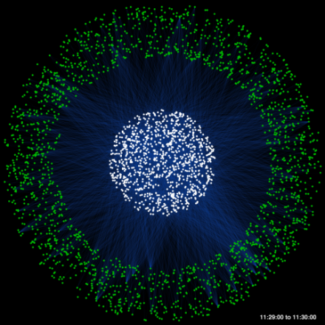

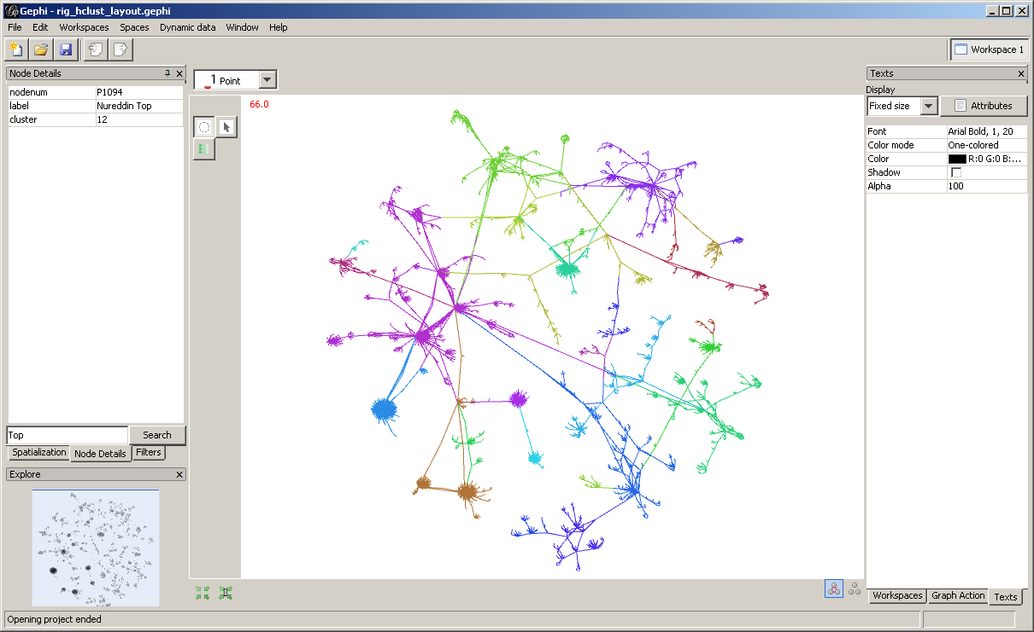
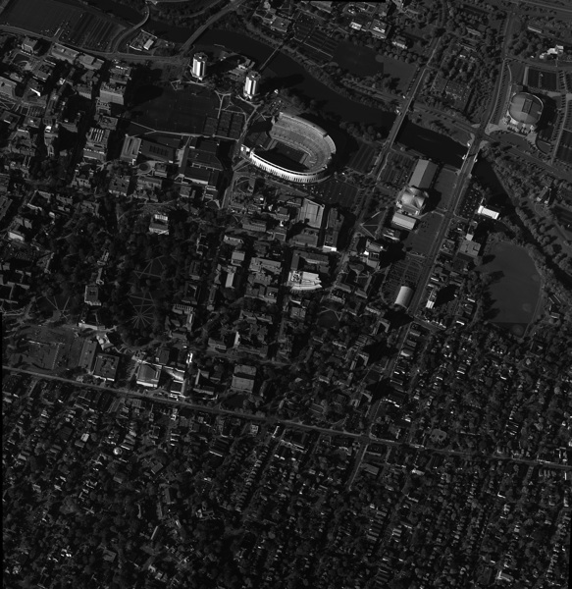

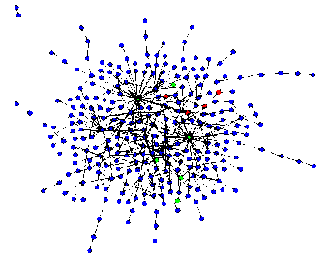
Example Applications of Graph Analytics
ISR
Social
Cyber
Graphs represent entities and relationships detected through multi-INT sources
1,000s – 1,000,000s tracks and locations
GOAL: Identify anomalous patterns of life
Graphs represent relationships between individuals or documents
10,000s – 10,000,000s individual and interactions
GOAL: Identify hidden social networks
Graphs represent communication patterns of computers on a network
1,000,000s – 1,000,000,000s network events
GOAL: Detect cyber attacks or malicious software
Cross-Mission Challenge: Detection of subtle patterns in massive multi-source noisy datasets
Notes:
Graphs analysis has proven to be useful in a number of different application areas. This reason for this is likely due to graph analytics proclivity for being able to identify patterns of coordination. The application of graph analytics grows harder as the patterns of coordination grow more subtle and the background graph grows larger and noisier.

Slide 5
Example Applications of Graph Analytics
ISR
ISR
Social
Social
Cyber
Graphs represent entities and relationships detected through multi-INT sources
1,000s – 1,000,000s tracks and locations
GOAL: Identify anomalous patterns of life
Graphs represent entities and relationships detected through multi-INT sources
1,000s – 1,000,000s tracks and locations
GOAL: Identify anomalous patterns of life
Graphs represent relationships between individuals or documents
10,000s – 10,000,000s individual and interactions
GOAL: Identify hidden social networks
Graphs represent relationships between individuals or documents
10,000s – 10,000,000s individual and interactions
GOAL: Identify hidden social networks
Graphs represent communication patterns of computers on a network
1,000,000s – 1,000,000,000s network events
GOAL: Detect cyber attacks or malicious software
Cross-Mission Challenge: Detection of subtle patterns in massive multi-source noisy datasets
Notes:
This talk will focus on a cyber example.

Slide 6
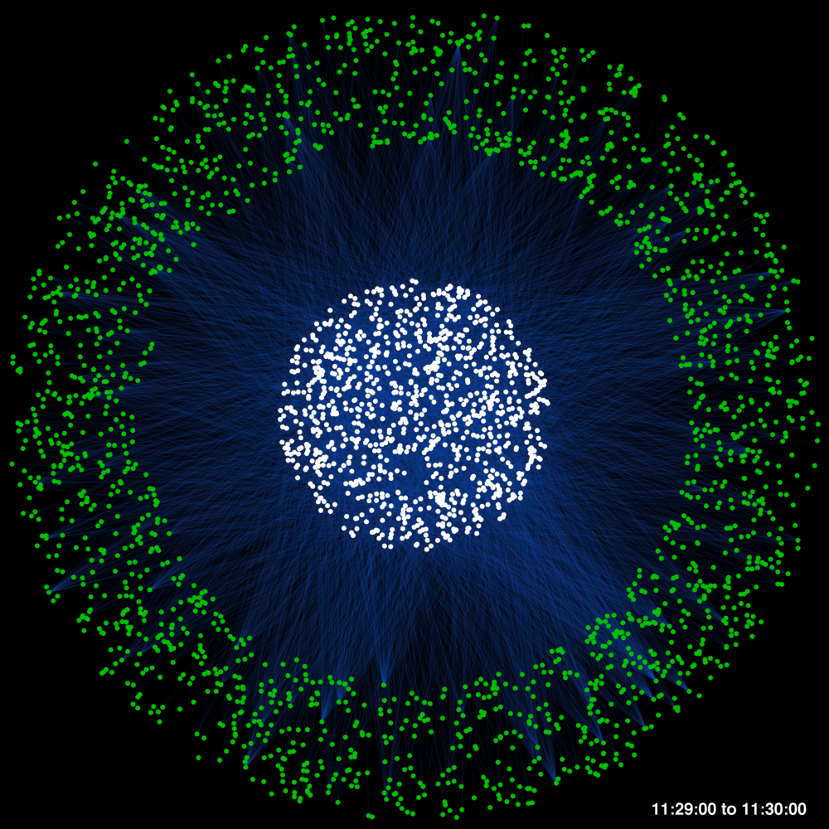
Example: Web Traffic Graph
Graph Statistics
90 minutes worth of traffic
1 frame = 1 minute of traffic
Number of source computers: 4,063
Number of web servers: 16,397
Number of logs: 4,344,148
Source Computer IPs
Traffic (Proxy Logs)
Malicious Activity Statistics
Number of infected IPs: 1
Number of event logs: 16,000
% infected traffic: 0.37%
Existing tools did not detect event
Detection took 10 days and required manual log inspection
Web Server IPs
Challenge: Activity signature is typically a weak signal
Notes:
Web traffic data is a large bipartite graph.

Slide 7
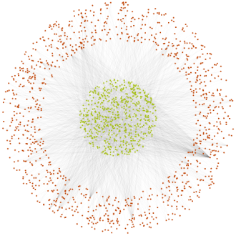
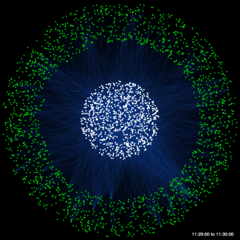
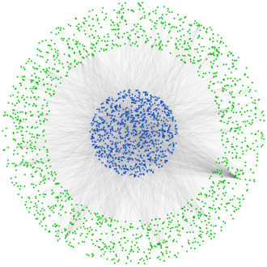
Big Data Challenge: Data Representation
Data Sources
DHCP Logs
DHCP Logs
DHCP Logs
SMTP Logs
Raw data sources are rarely stored in a graph format
Data is often derived from multiple collection points
E-mail From:
E-mail To:
Timestamp
DHCP Logs
DHCP Logs
E-mail Address Traffic
DHCP Logs
Web Proxy Logs
Graph Construction
Many different graphs can be built from a single data source
Constructing a single graph may require many sources
Building multi-graphs requires that entities be normalized
Source IP
Server IP
Timestamp
DHCP Logs
DHCP Logs
DHCP Logs
DHCP Logs
IP – MAC
IP-IP Web Traffic
DHCP Logs
DHCP Logs
DHCP Logs
Config Logs
MAC – Host
Host
Domain
Timestamp
Host-Domain Web Traffic
Challenge: Raw data source representations do not enable the efficient construction of graphs of interest
Notes:
Representing web data as a graph is a significant challenge.

Slide 8
Technology Stack
Graph Analytics
Applicability
Cyber, COIN, ISR, Bioinformatics
Resiliency
Uncertainty in data and observation
High Level Languages
Scalability
Parallel language support
Programmability
Automated performance optimization
Distributed Storage and Indexing
Portability
Bindings to multiple databases
Elasticity
Virtual machine development
High Performance Processing
Performance
Novel instruction set architectures
Efficiency
Specialized circuitry and communication
Notes:
Addressing this problem requires looking at the entire technology stack.

Slide 9
Outline
Introduction
Course Outline
Example Implementation
Summary
Notes:
Outline slide.

Slide 10
The MIT Formula
Theory
Experiment
Discovery
Academics
Departments
EECS, Math, Physics, …
Mathematics
Algorithms
Software
Research
Laboratories
Lincoln, CSAIL, Media, …
Measurement
Data
Bytes
+
=
MIT is the #1 Science and Engineering University on Earth
A simple formula for success permeates all of MIT
Implementing this formula often reduces to software and bytes
Notes:
This field requires an interdisciplinary approach.

Slide 11
Software and Bytes Live on Parallel Computers
Memory Hierarchy
Parallel Architecture
Unit of Memory
Implications
CPU
CPU
CPU
CPU
High
High
Registers
RAM
RAM
RAM
RAM
Instruction Operands
disk
disk
disk
disk
Cache
Blocks
Network Switch
Bandwidth
Programmability
Local Memory
Latency
Capacity
CPU
CPU
CPU
CPU
Messages
Remote Memory
RAM
RAM
RAM
RAM
Pages
disk
disk
disk
disk
Disk
High
High
Nearly all modern computers are Von Neumann architectures with multi-level memory hierarchies
The architecture selects the algorithms and data that run well on it
Notes:
Standard computer hierarchy plays a large role in determining the problems that can be solved.

Slide 12
Software Performance vs. Parallel Programmer Effort
Goal
Parallel Programming Models
DMA = Direct Memory Access
MPI = Message Passing
DA = Distributed Arrays
MW = Manager/Worker
MR = Map/Reduce
D4M = Dynamic Distributed
Dimensional Data Model
C++/DMA
Assembly
/DMA
C/DA
C/DMA
C++/DA
C/MPI
C++/MW
C++
/MPI
C/MW
Matlab/
D4M
Matlab/DA
Relative Speedup
Matlab/
MW
Matlab/
MPI
Java/MR
Assembly
C
C++
Matlab
Java
Relative Effort
Goal: Software that does a lot with the least effort
Notes:
The best approaches are not always the most intuitive.

Slide 13
Data Use Cases
all
Serial Program
Serial or Parallel Program
+ Files
Parallel Program
+ Parallel Files
Data Request Size
Serial Program
Serial or Parallel Program
+ Database
Parallel Program
+ Parallel Database
word
serial
memory
parallel
memory
/
serial
storage
parallel
storage
Total Data Volume
Data volume and data request size determine best approach
Always want to start with the simplest and move to the most complex
Notes:
The path to effectively using a data base begins with using flat files.

Slide 14
The Fast Path
Hardware Limit
100
Expert
10
Acceptable
performance speedup
Novice
1
0.1
Hours
Days
Weeks
Months
Programmer Effort
The class teaches the highest performance and lowest effort software techniques that are currently known
Notes:
Up front training can make a large difference in the time to a solution.

Slide 15
Key Course Concepts
Bigger definition of a graph
How to move beyond random, undirected, unweighted graphs to power-law, directed, multi-hyper graphs
Bigger definition of linear algebra
How to move beyond real numbers to doing math with words and strings
Bigger definition of processing
How to move beyond map/reduce to distributed arrays programming
These abstract concepts are the foundation for high performance signal processing on large unstructured data sets
Notes:
Expanding traditional definitions of key concepts is core to signal processing on databases.

Slide 16
Course Outline
Introduction
Review course goals and structure
Using Associative Arrays
Schemas, incidence matrices, and directed multi-hyper graphs
Group Theory
Extending linear algebra to words using fuzzy algebra
Entity Analysis in Unstructured Data
Reading and parsing unstructured data
Analysis of Structured Data
Graph traversal queries
Power Law Data
Models and fitting
Cross Correlation
Sequence data, computing degree distributions, and finding matches
Parallel Processing
Kronecker graphs, parallel data generation and computation
Databases
Relational, triple store, and exploded schemas
Notes:
Course introduces concepts first, then applies them later in the course.

Slide 17

References
Book: “Graph Algorithms in the Language of Linear Algebra”
Editors: Kepner (MIT-LL) and Gilbert (UCSB)
Contributors:
Bader (Ga Tech)
Bliss (MIT-LL)
Bond (MIT-LL)
Dunlavy (Sandia)
Faloutsos (CMU)
Fineman (CMU)
Gilbert (USCB)
Heitsch (Ga Tech)
Hendrickson (Sandia)
Kegelmeyer (Sandia)
Kepner (MIT-LL)
Kolda (Sandia)
Leskovec (CMU)
Madduri (Ga Tech)
Mohindra (MIT-LL)
Nguyen (MIT)
Radar (MIT-LL)
Reinhardt (Microsoft)
Robinson (MIT-LL)
Shah (USCB)
Notes:
Text provides a mathematical foundation for many of the concepts in the course.

Slide 18
Outline
Introduction
Course Outline
Example Implementation
Summary
Notes:
Outline slide.

Slide 19
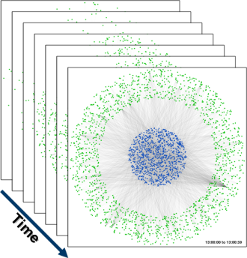
Constructing Graph Representations of Raw Data Source
Raw Data
Vertex and Edge Lists
(1) Parse edge and vertex information from raw data
(2) Convert edge lists into adjacency matrices
Developed Once Per Data Source Per Graph
Developed Once
Raw data sources can contain information about multiple types of relations between entities
The process of constructing a graph representation is specific to both the data source and the relationships represented by the graph
The development time of parsing and graph construction algorithms can overwhelm the runtime of the algorithm
Notes:
Developing a conversion algorithm for every type of graph we’d like to analyze in a given data source is cost-prohibitive

Slide 20
Graph Construction Using D4M
Raw Data
CSV Files
Distributed Database
Assoc.Arrays
(1) Parse fields from raw data
(4) Convert associative arrays into adjacency matrices
Developed Once Per Data Source
D4M
(2) Explode schema and store in database
(3) Construct associative arrays using D4M queries
D4M
Developed Once Per Graph
D4M provides needed flexibility in the construction of large-scale, dynamic graphs at different resolutions and scopes
Notes:
By modularizing the process we avoid repeating development. Additionally D4M automates some of the steps in the process.

Slide 21
Graph Construction Using D4M: Parsing Raw Data Into Dense Tables
Raw Data
CSV Files
Distributed Database
Assoc.Arrays
Proxy Logs
128.0.0.1 208.29.69.138 "-" [10/May/2011:09:52:53] "GET http://www.thedailybeast.com/ HTTP/1.1“ 200 1024 8192 "http://www.theatlantic.com/" "Mozilla/5.0 (X11; U; Linux x86_64; en-US; rv:1.9.2.13) Gecko/20101209 CentOS/3.6-2.el5.centos Firefox/3.6.13" "bl“ - "text/html" "MITLAB“ 0.523 "-" Neutral TCP_MISS
192.168.1.1 157.166.255.18 “-” [12/May/2011:13:24:11] "GET http://www.cnn.com/ HTTP/1.1“ 335 256 10296 "-" "Mozilla/5.0 (X11; U; Linux x86_64; en-US; rv:1.9.2.13) Gecko/20101209 CentOS/3.6-2.e15.centos Firefox/3.6.13" “bu" - "text/html" “MITLAB" 0.784 "-“ Neutral TCP_MISS
...
Dense Table
log_id | src_ip | server_ip | time_stamp | req_line | ...
001 | 128.0.0.1 | 208.29.69.138 | 10/May/2011:09:52:53 | GET http://www.thedailybeast.com/ HTTP/1.1 | …
002 | 192.168.1.2 | 157.166.255.18 | 12/May/2011:13:24:11 | GET http://www.cnn.com/ HTTP/1.1 | …
003 | 128.0.0.1 | 74.125.224.72 | 13/May/2011:11:05:12 | GET http://www.google.com/ HTTP/1.1 | …
Notes:
The first step in the process is to separate the data in the logs in the various fields of the data.

Slide 22
Graph Construction Using D4M: Explode Schema
Raw Data
CSV Files
Distributed Database
Assoc.Arrays
Dense Table
log_id | src_ip | server_ip
001 | 128.0.0.1 | 208.29.69.138
002 | 192.168.1.2 | 157.166.255.18
003 | 128.0.0.1 | 74.125.224.72
Create columns for each unique type/value pair
Use as row indices
 | src_ip|128.0.0.1 | src_ip|192.168.1.2 | server_ip|157.166.255.18 | server_ip|208.29.69.138 | server_ip|74.125.224.72
log_id|001 | 1 | 0 | 0 | 1 | 0
log_id|002 | 0 | 1 | 1 | 0 | 0
log_id|003 | 1 | 0 | 0 | 0 | 1
Exploded Table
Notes:
The next step is to explode the table so that each piece of data can be represented as a triple.

Slide 23
Graph Construction Using D4M: Storing Exploded Data as Triples
Raw Data
CSV Files
Distributed Database
Assoc.Arrays
Exploded Table
 | src_ip|128.0.0.1 | src_ip|192.168.1.2 | server_ip|157.166.255.18 | server_ip|208.29.69.138 | server_ip|74.125.224.72
log_id|001 | 1 | 0 | 0 | 1 | 0
log_id|002 | 0 | 1 | 1 | 0 | 0
log_id|003 | 1 | 0 | 0 | 0 | 1
D4M stores the triple data representing both the exploded table and its transpose
Table Triples
Table Transpose Triples
Row | Column | Value
log_id|001 | src_ip|128.0.0.1 | 1
log_id|001 | server_ip|208.29.69.138 | 1
log_id|002 | src_ip|192.168.1.2 | 1
log_id|002 | server_ip|157.166.255.18 | 1
log_id|003 | src_ip|128.0.0.1 | 1
log_id|003 | server_ip|74.125.224.72 | 1
Row | Column | Value
server_ip|157.166.255.18 | log_id|002 | 1
server_ip|208.29.69.138 | log_id|001 | 1
server_ip|74.125.224.72 | log_id|003 | 1
src_ip|128.0.0.1 | log_id|001 | 1
src_ip|128.0.0.1 | log_id|003 | 1
src_ip|192.168.1.2 | log_id|002 | 1
Notes:
This triple data is then stored in a distributed database. We have been using Accumulo. D4M provides methods for automating this process.

Slide 24
Graph Construction Using D4M: Construct Associative Arrays
Raw Data
CSV Files
Distributed Database
Assoc.Arrays
D4M Query #1
keys = T(:,’time_stamp|10/May/2011:00:00:00’,:, ... ’time_stamp|13/May/2011:23:59:59’,);
(‘log_id|001’,‘time_stamp|11/May/2011:09:52:53’,1)
(‘log_id|002’,‘time_stamp|12/May/2011:13:24:11’,1)
(‘log_id|003’,‘time_stamp|13/May/2011:11:05:12’,1)
...
Notes:
The first step in building the graphs form the triple data is to query for a chunk of data of interest.

Slide 25
Graph Construction Using D4M: Construct Associative Arrays
Raw Data
CSV Files
Distributed Database
Assoc.Arrays
D4M Query #1
keys = T(:,’time_stamp|10/May/2011:00:00:00’,:, ... ’time_stamp|13/May/2011:23:59:59’,);
D4M Query #2
data = T(Row(keys), :);
(‘log_id|001’,‘server_ip|208.29.69.138’,1)
(‘log_id|001’,‘src_ip|128.0.0.1’,1)
(‘log_id|001’,‘time_stamp|11/May/2011:09:52:53’,1)
...
(‘log_id|002’,‘server_ip|157.166.255.18’,1)
(‘log_id|002’,‘src_ip|192.168.1.2’,1)
(‘log_id|002’,‘time_stamp|12/May/2011:13:24:11’,1)
...
(‘log_id|003’,‘server_ip|74.125.224.72’,1)
(‘log_id|003’,‘src_ip|128.0.0.1’,1)
(‘log_id|003’,‘time_stamp|13/May/2011:11:05:12’,1)
...
Notes:
The second step is to get all of the triples associated with the period of interest.

Slide 26
Graph Construction Using D4M: Construct Associative Arrays
Raw Data
CSV Files
Distributed Database
Assoc.Arrays
Raw Data
CSV Files
Distributed Database
Assoc.Arrays
D4M Query #1
keys = T(:,’time_stamp|10/May/2011:00:00:00’,:, ... ’time_stamp|13/May/2011:23:59:59’,);
D4M Query #2
data = T(Row(keys), :);
Associative Array Algebra
G = data(:,’src_ip|*’).’ * data(:,’server_ip|*’);
(‘src_ip|128.0.0.1’,‘server_ip|208.29.69.138’,1)
(‘src_ip|128.0.0.1’,‘server_ip|74.125.224.72’,1)
(‘src_ip|192.168.1.2’,‘server_ip|157.166.255.18’,1)
...
Notes:
The final part is to use D4M to perform the associative array algebra that builds the graph

Slide 27

Graph Construction Using D4M: Construct Associative Arrays
Raw Data
CSV Files
Distributed Database
Assoc.Arrays
D4M Query #1
keys = T(:,’time_stamp|10/May/2011:00:00:00’,:, ... ’time_stamp|13/May/2011:23:59:59’,);
D4M Query #2
data = T(Row(keys), :);
Associative Array Algebra
G = data(:,’src_ip|*’).’ * data(:,’server_ip|*’);
Adj(G);
Graphs can be constructed with minimal effort using D4M queries and associative array algebra
Notes:
Due to the way D4M stores associative arrays, they can easily be converted into sparse adjacency matrices, which are typically the input for graph analytics

Slide 28
Constructing Graph Representation of One Week’s Worth of Proxy Data
Raw Data
CSV Files
Distributed Database
Assoc.Arrays
Parsing and ingestion done in parallel using 128 processors
Graph data generated in parallel using 7 processors (one per day)
Completed in less than 2 hours
Completed in 3 hours
Ingested ~130 million proxy log records resulting in ~4.5 billion triples
Constructed 604,800 secondwise source IP to server IP graphs
Constructing graphs with different vertex types could be done without re-parsing or re-ingesting data
Utilizing D4M could allow analysis to be run in nearly real-time (dependent on raw data availability)
Notes:
We’ve implemented this framework for ingesting the proxy log data. We were able to construct a week’s worth of graphs in less than 5 hours with a high degree of parallelization.

Slide 29
Summary
Big data is found across a wide range of areas
Document analysis
Computer network analysis
DNA Sequencing
Currently there is a gap in big data analysis tools for algorithm developers
D4M fills this gap by providing algorithm developers composable associative arrays that admit linear algebraic manipulation
Notes:
Summary.

Slide 30
Example Code and Assignment
Example code
D4Muser_share/Examples/1Intro/1Assoclntro
Assignment
Test your LLGrid account and D4M
Copy the D4Muser_share/Examples to your LL Grid home directory
Verify that you can run the above examples
Start Matlab
CD to your copy of the example
Run the Examples
Notes:
Course assignment.

