Slide 1
Signal Processing on Databases
Jeremy Kepner
Lecture 7: Kronecker graphs, data generation, and performance
This work is sponsored by the Department of the Air Force under Air Force Contract #FA8721-05-C-0002. Opinions, interpretations, recommendations and conclusions are those of the authors and are not necessarily endorsed by the United States Government.
Notes:
Title slide

Slide 2
Outline
Introduction
Graph500
Kronecker Graphs
B^{⊗K} Graphs
(B+I)^{⊗K} Graphs
Performance
Summary
Notes:
Outline slide

Slide 3

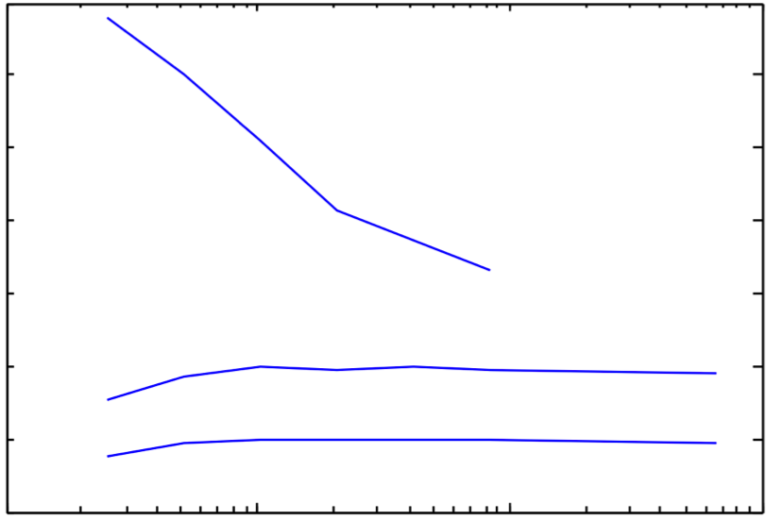
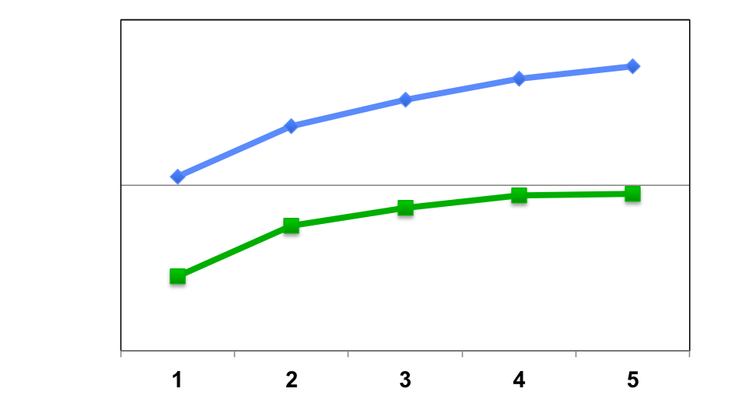
Graph500 Benchmark Performance
10⁶
Parallel D4M
Inserts/Sec
10⁵
Parallel D4M + Accumulo DB
7
x 10⁴
10⁴
6
Serial D4M
5
Number of Inserters
4
Inserts/Sec
Graph500 generates power law data
D4M (in memory) + Accumulo (storage) provides scalable high performance
3
2
Serial D4M + Accumulo DB
1
0
10⁵
10⁶
10⁷
10⁸
Table Entries
Notes:
3
Graph Analysis/Graph500 benchmark is used to generate the largest graphs in the world.

Slide 4
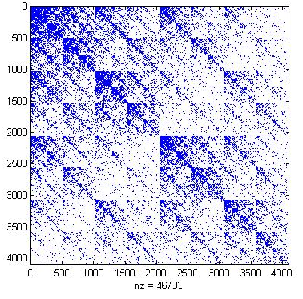
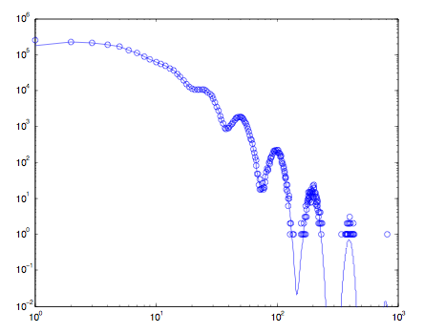
Power Law Modeling of Kronecker Graphs
Adjacency Matrix
Vertex In Degree Distribution
Power Law
Number of Vertices
In Degree
Real world data (internet, social networks, …) has connections on all scales (i.e power law)
Can be modeled with Kronecker Graphs: G^{⊗k} = G^{⊗k-1} ⊗ G
Where “⊗”denotes the Kronecker product of two matrices
Notes:
Real world data (internet, social networks, …) has connections on all scales (i.e power law).
These data can be modeled with Kronecker Graphs: G^{⊗k} = G^{⊗k-1} ⊗ G

Slide 5
Outline
Introduction
B^{⊗K} Graphs
Definitions
Bipartite Graphs
Degree Distribution
(B+I)^{⊗K} Graphs
Performance
Summary
Notes:
Outline slide

Slide 6
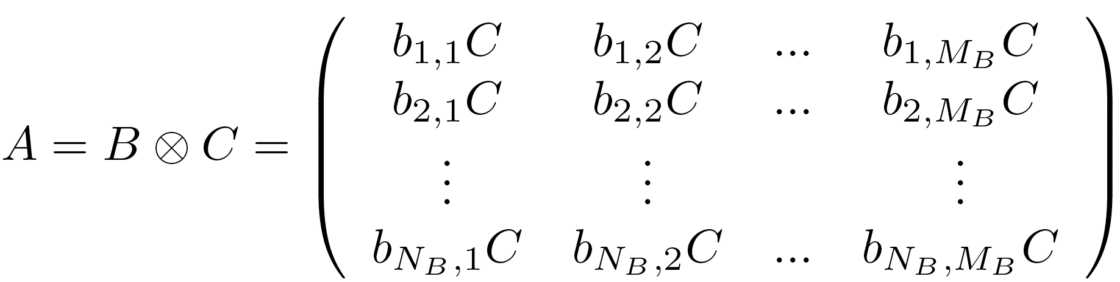

Kronecker Products and Graph
Kronecker Product
Let B be a N_{B}xN_{B} matrix
Let C be a N_{C}xN_{C} matrix
Then the Kronecker product of B and C will produce a N_{B}N_{C}xN_{B}N_{C} matrix A:
Kronecker Graph (Leskovec 2005 & Chakrabati 2004)
Let G be a NxN adjacency matrix
Kronecker exponent to the power k is:
Notes:
Definition of Kronecker produce and Kronecker Graph.

Slide 7
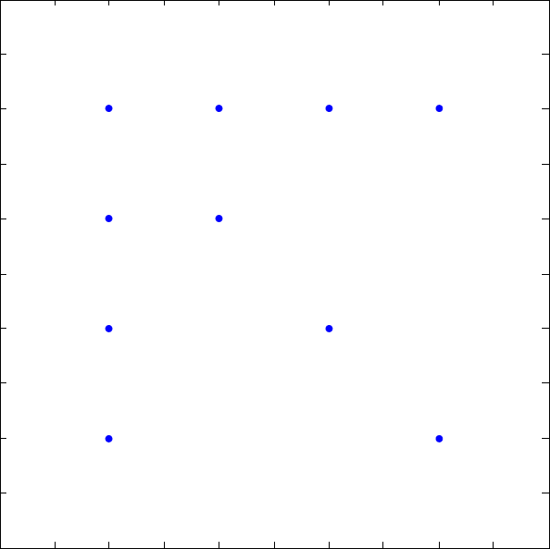
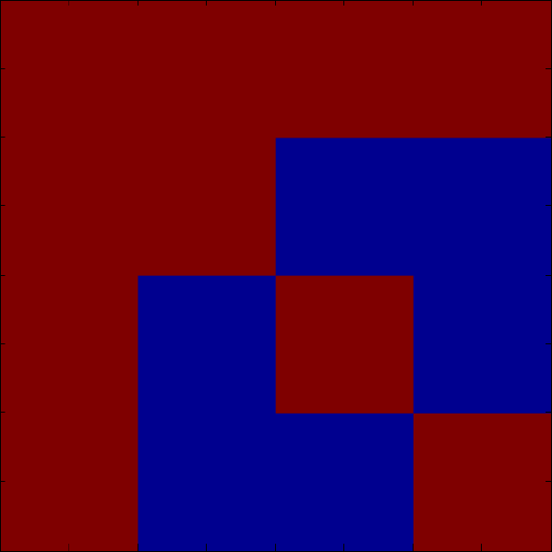
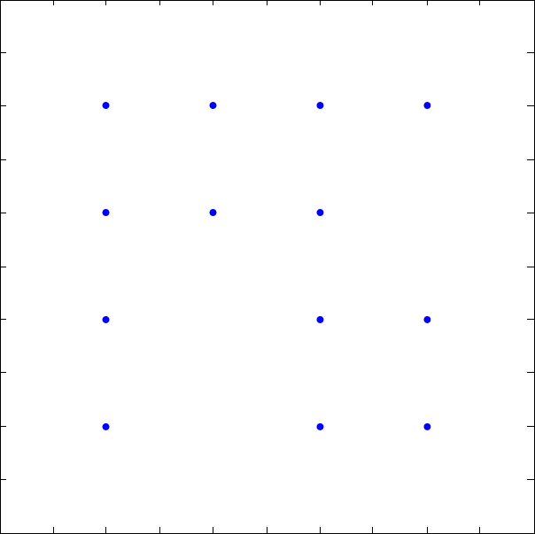
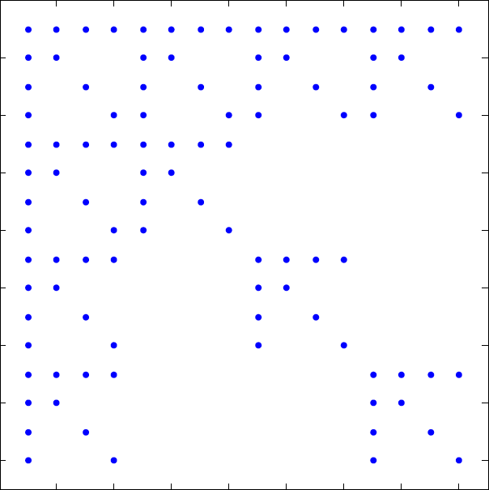
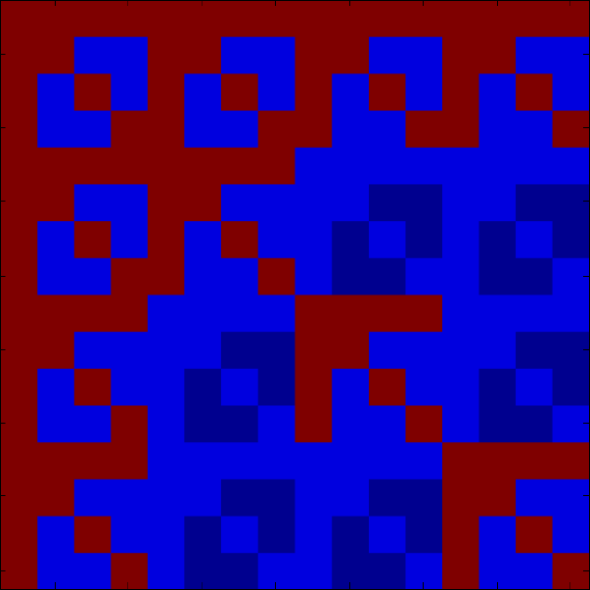
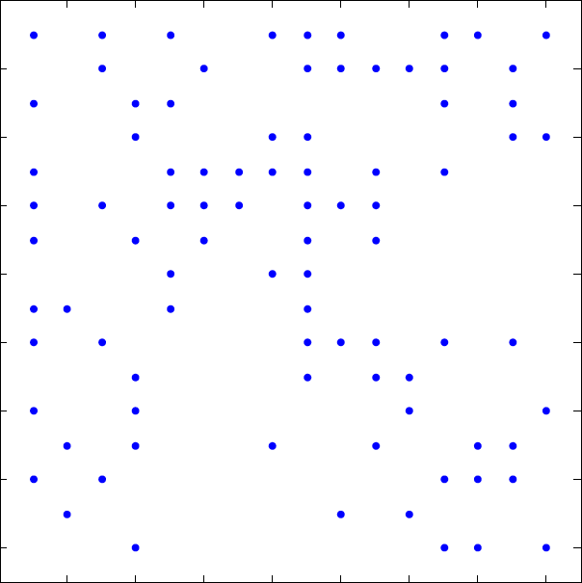
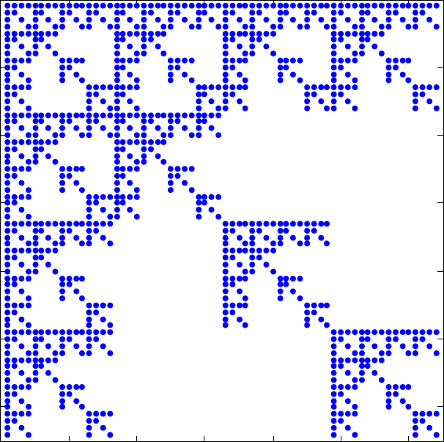
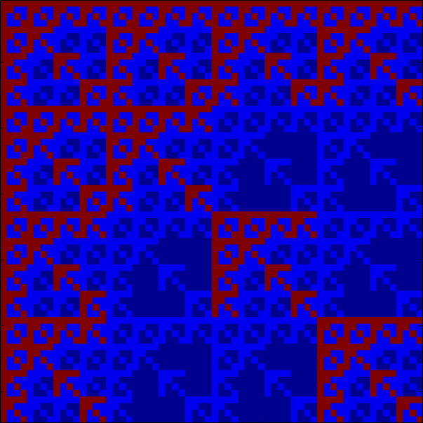
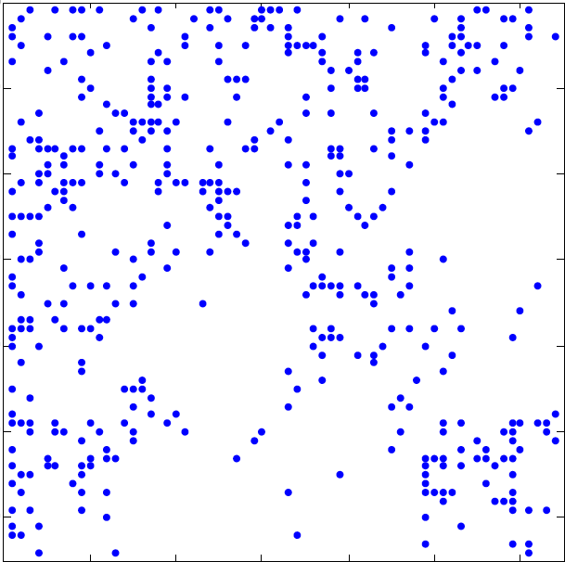
Types of Kronecker Graphs
Explicit
Stochastic
Instance
Explicit
G only 1 and 0s
Stochastic
G contains probabilities
Instance
A set of M points (edges) drawn from a stochastic
G^{⊗1}
G^{⊗2}
G^{⊗3}
Notes:
Kronecker Adjacency Matrices. The explicit, stochastic and an instance matrix for a star plus identity matrix: G = S(4) + I(4), where Ne = 8Nv.

Slide 8
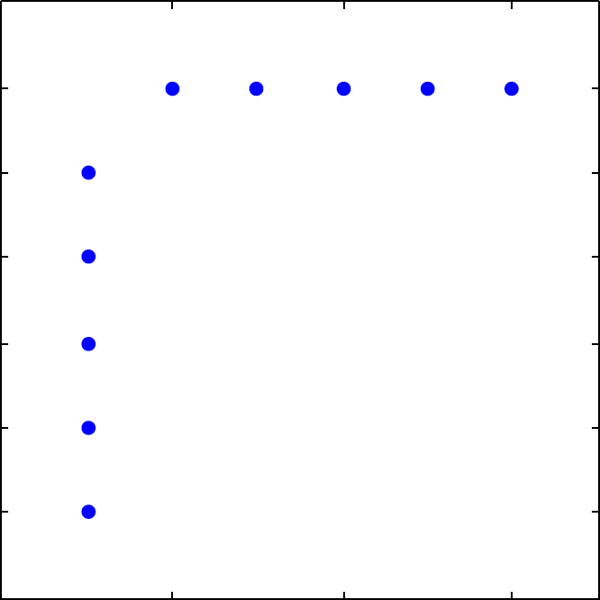
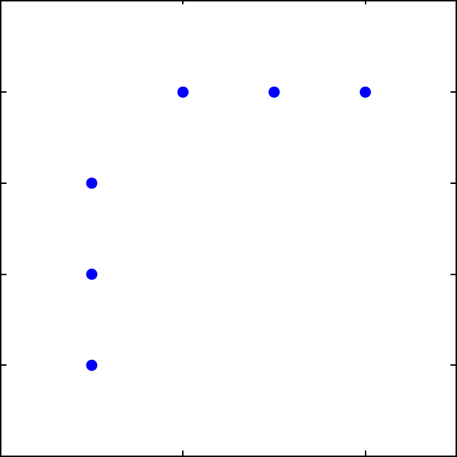
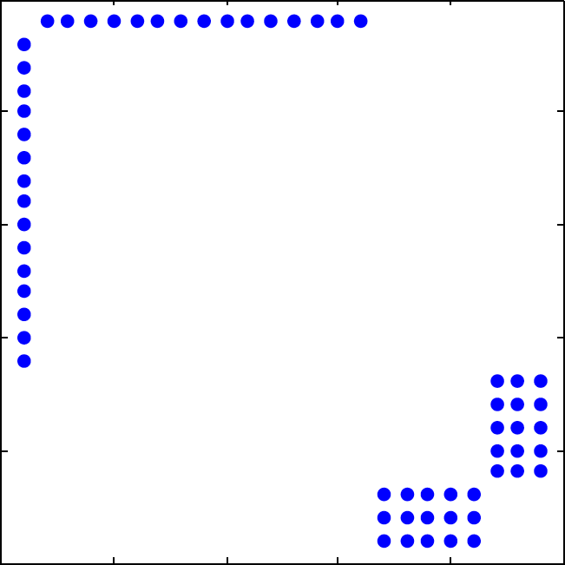
Kronecker Product of a Bipartite Graph
P
⊗
=
Equal with the right
permutation
P
⊗
=
⊗
B(3,1)
P
B(5,1)
=
B(15,1) ∪ B(3,5)
Fundamental result [Weischel 1962] is that the Kronecker product of two complete bipartite graphs is two complete bipartite graphs
More generally
Notes:
Graph Kronecker Product. Complementary representations of the Kronecker product of two graphs.

Slide 9
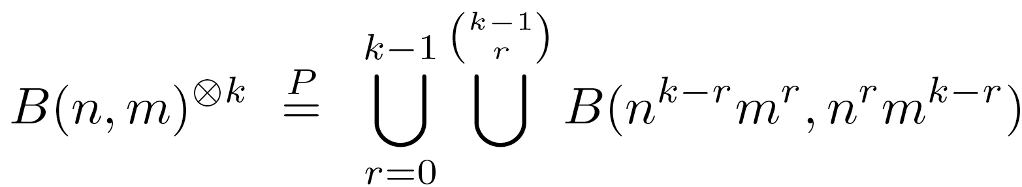
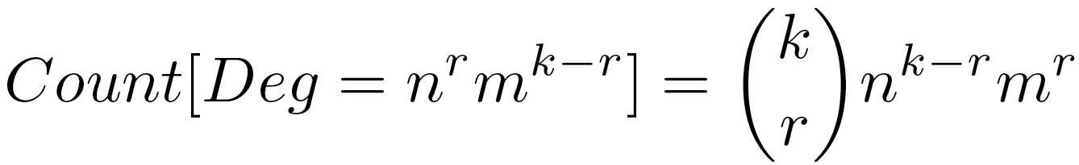
Degree Distribution of Bipartite Kronecker Graphs
Kronecker exponent of a bipartite graph produces many independent bipartite graphs
Only k+1 different kinds of nodes in this graph, with degree distribution
Notes:
Kronecker exponent of a bipartite graph produces many independent bipartite graphs.

Slide 10
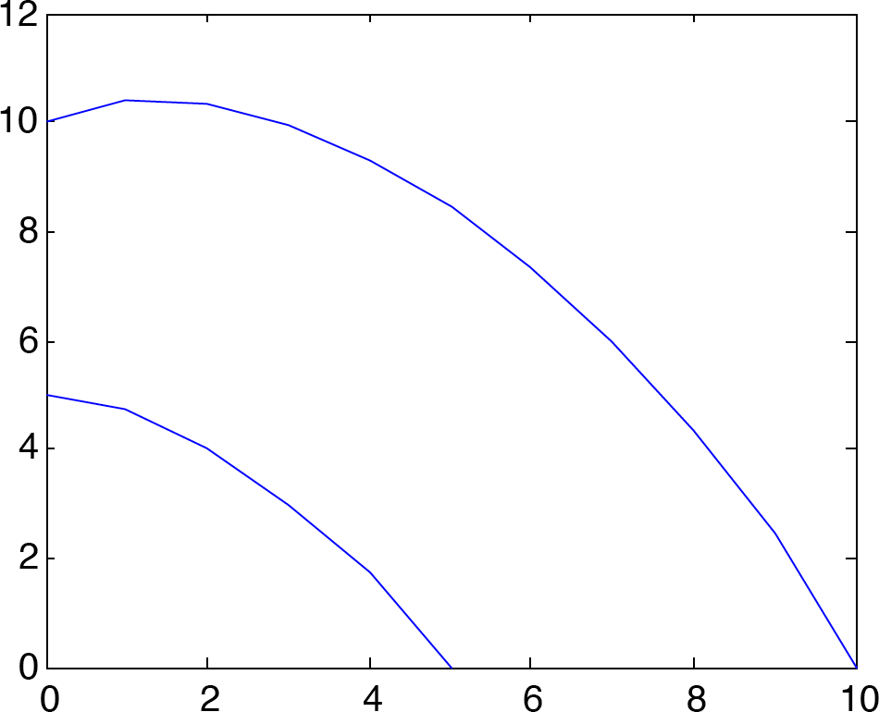
Explicit Degree Distribution
Kronecker exponent of bipartite graph naturally produces exponential distribution
B(n=5,1)^{⊗k=10}
slope=-1
log_{n}(Number of Vertices)
B(n=10,1)^{⊗k=5}
slope=-1
log_{n}(Vertex Degree)
Notes:
Theoretical Degree Distribution. Degree distribution derived from the Kronecker product of bipartite graphs. The slope over any symmetric interval is always -1.

Slide 11
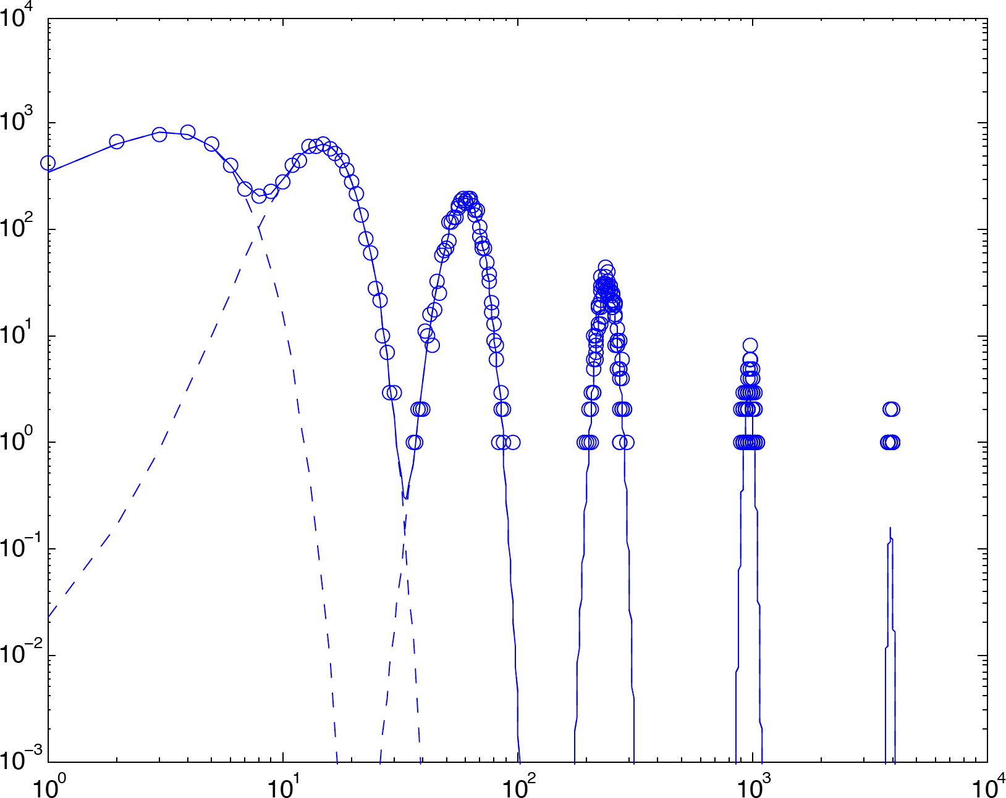
Instance Degree Distribution
1M Edges ← B(4,1)^{⊗6}
Number of Vertices
An instance graph drawn from a stochastic bipartite graph is just the sum of Poisson distributions taken from the explicit bipartite graph
Notes:
An instance graph drawn from a stochastic bipartite graph is just the sum of Poisson distributions taken from the explicit bipartite graph.

Slide 12
Outline
Introduction
B^{⊗K} Graphs
(B+I)^{⊗K} Graphs
Bipartite + Identity Graphs
Permutations and substructure
Degree Distribution
Iso Parametric Ratio
Performance
Summary
Notes:
Outline slide

Slide 13
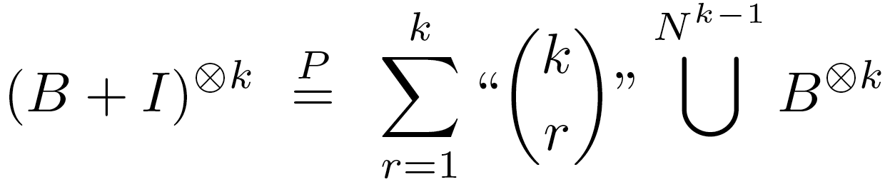
Theory
Bipartite Kronecker graphs highlight the fundamental structures in a Kronecker graph, but
Are not connected (i.e. many independent bipartite graphs)
Adding identity matrix creates connections on all scales
Resulting explicit graph has diameter = 2
Sub-structures in the graph are given by
Where “” indicates permutations are required to add the matrices
Sub-structure can be revealed by applying permutation that “groups” vertices by their bipartite sub-graph
Notes:
Bipartite Kronecker graphs highlight the fundamental structures in a Kronecker graph, but are not connected (i.e. many independent bipartite graphs).
Adding identity matrix creates connections on all scales.

Slide 14
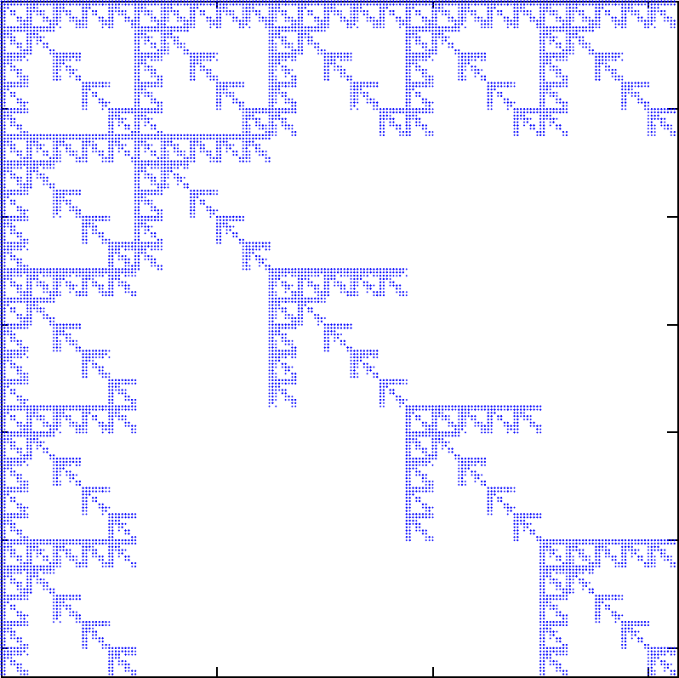
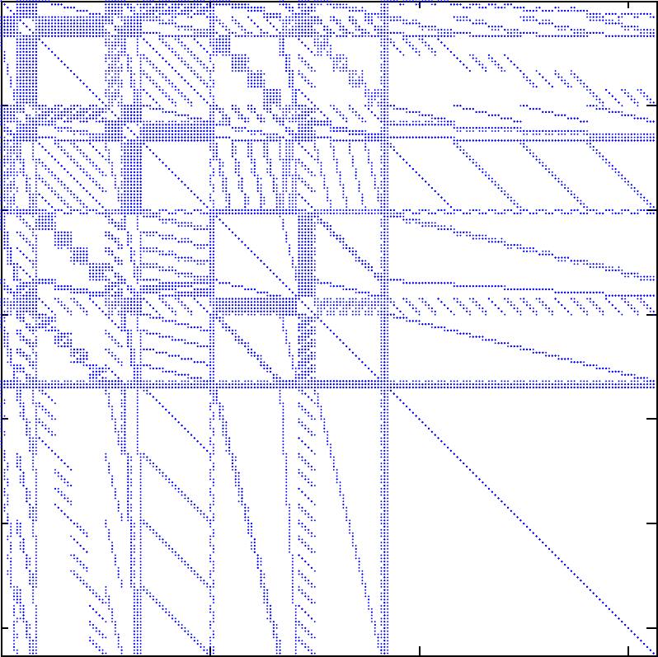
Bipartite Permutation
(B(4,1)+I)^{⊗4}
P₄((B(4,1)+I)^{⊗4})
Left: unpermuted (B+I)^{⊗4} kronecker graph
Right: permuted (B+I)^{⊗4} kronecker graph
Notes:
Recursive Bipartite Permutation. The left ﬁgure shows the unpermuted (B+I)^{⊗k} for n = 4, m = 1, and k = 4. The right ﬁgure shows the same adjacency matrix after applying the recursive bipartite permutation P_{k} .

Slide 15
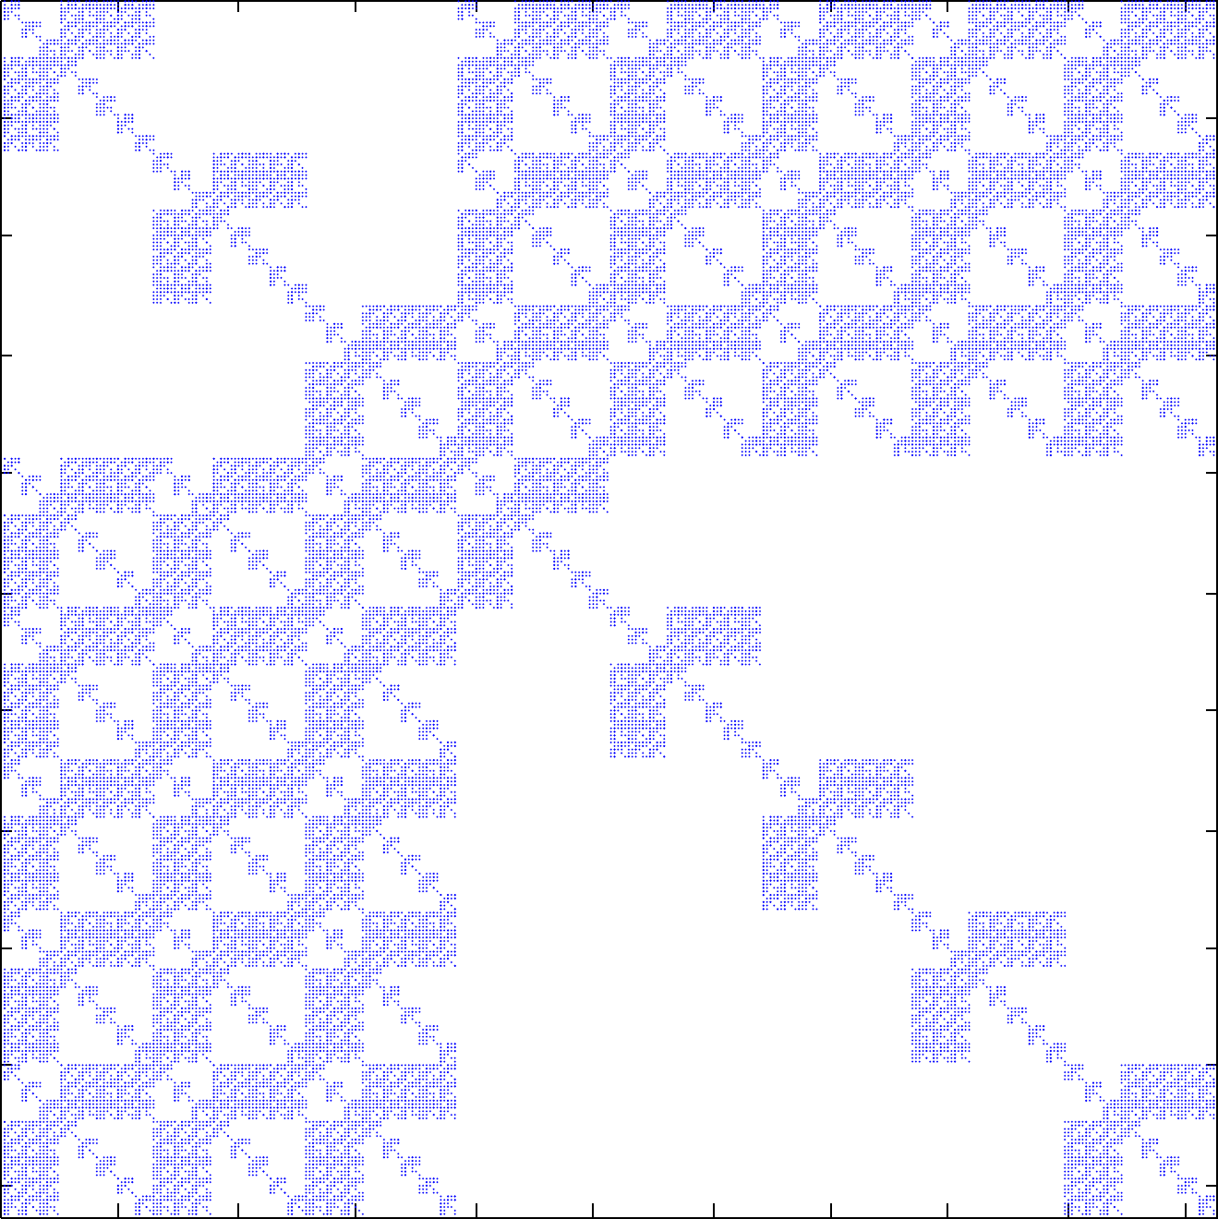
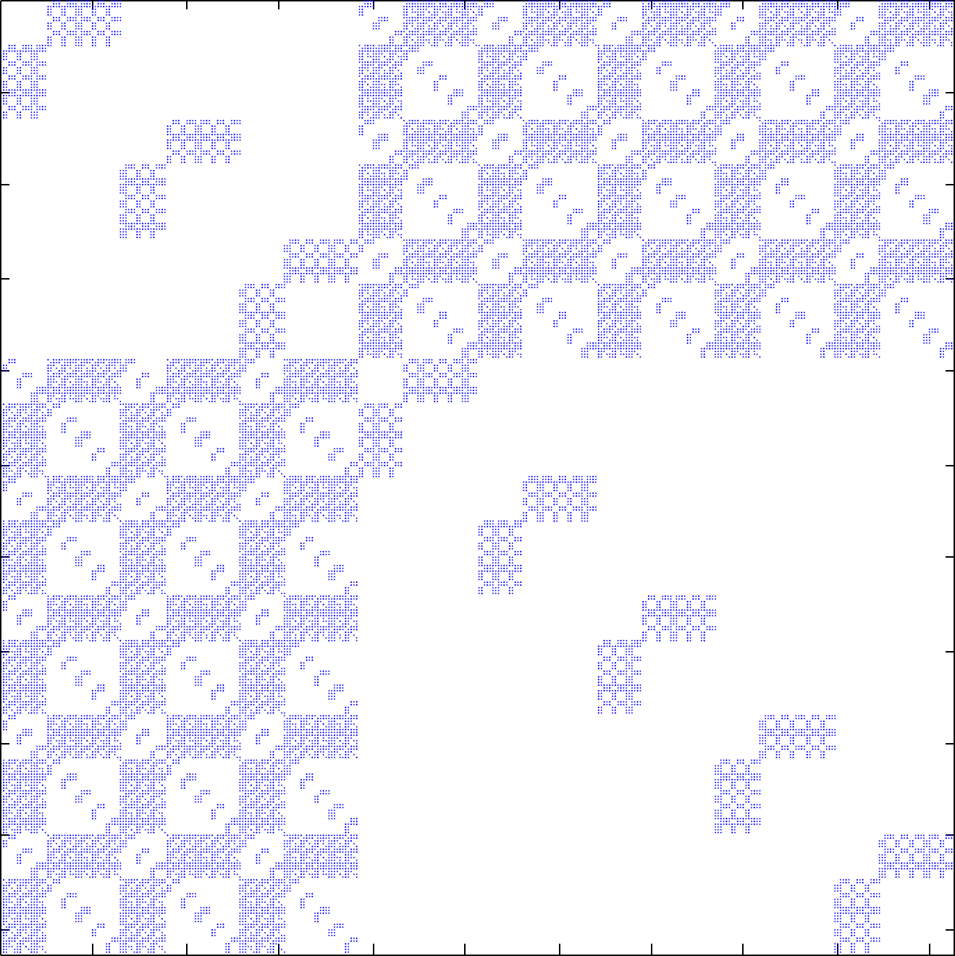
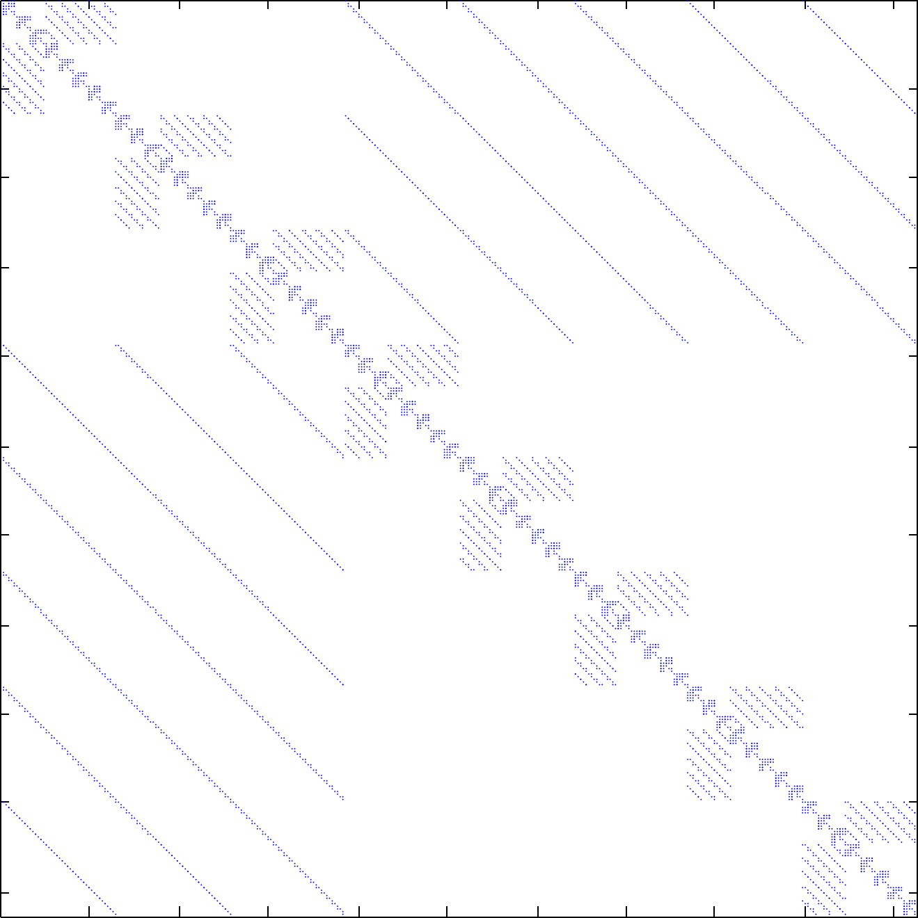
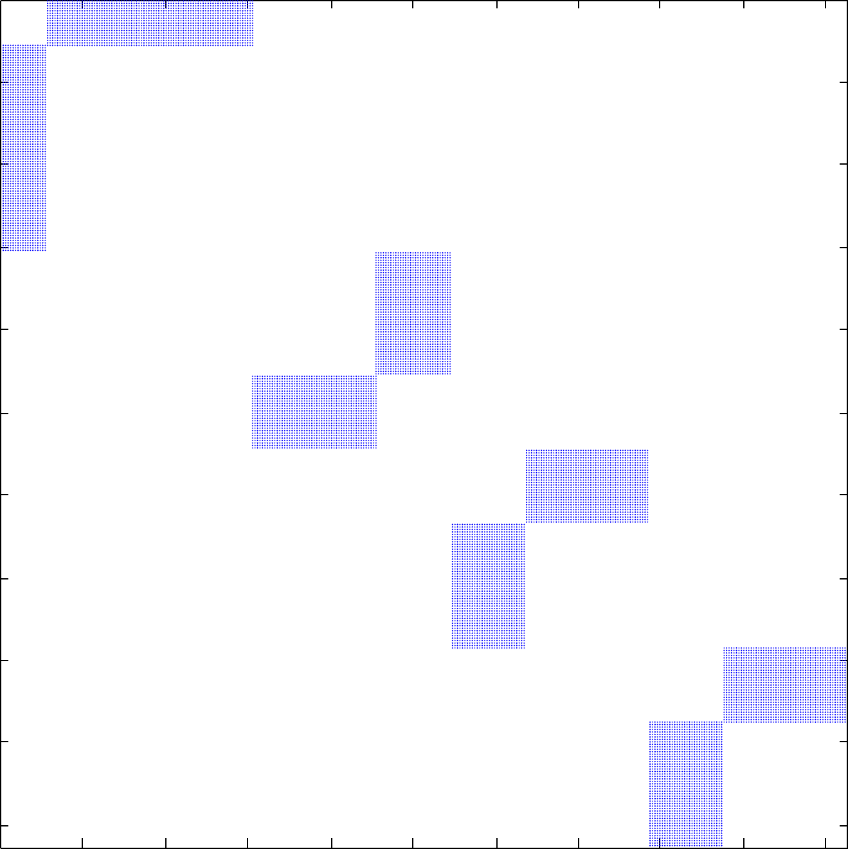

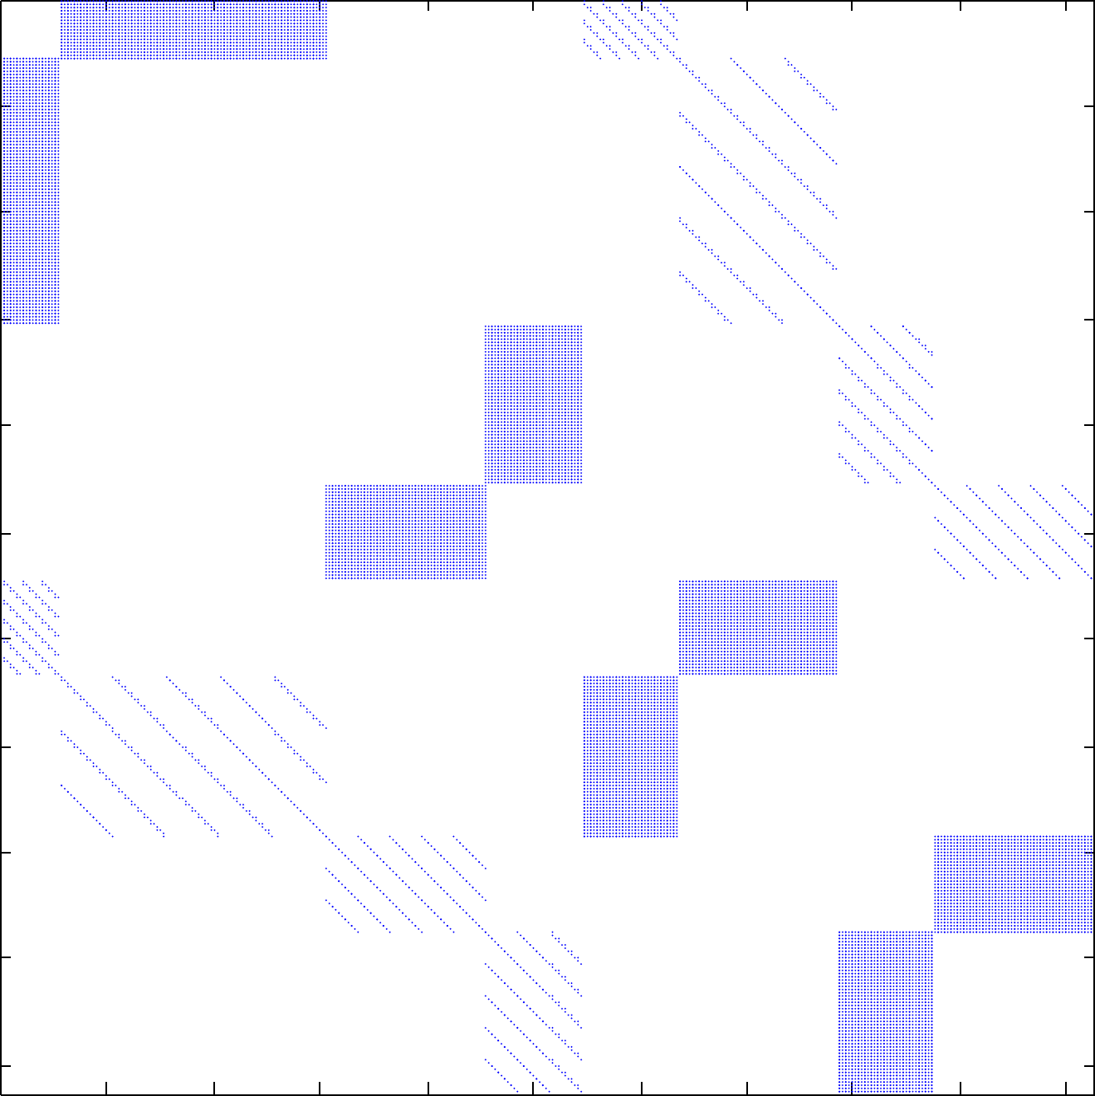
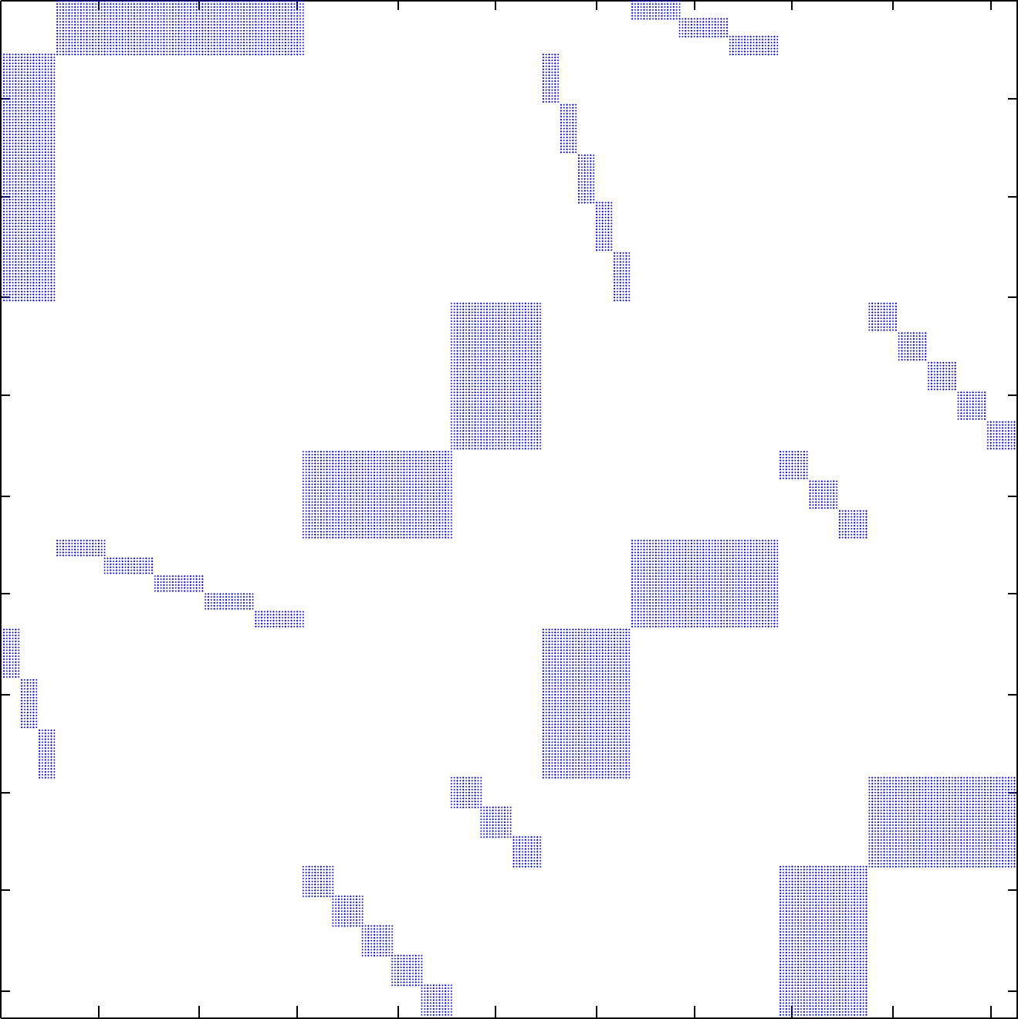
Identifying Substructure
(B+I)^{⊗3}
1st+2nd Order
Higher Order
-
=
P₃(B^{⊗3})
-
-
P₃(B^{⊗3}+B⊗B⊗I)
-
-
P₃(B^{⊗3}+B⊗I⊗B)
P₃(B^{⊗3}+ I⊗B⊗B)
Permuting specific terms shows their contributions to the graph
Notes:
The Revealed Structure of (B + I)^{⊗3}. Upper part shows that the large fraction of the non-zero elements are do to the ﬁrst and second order terms. Lower part shows each of the 2nd order terms after the recursive bipartite permutation has been applied.

Slide 16
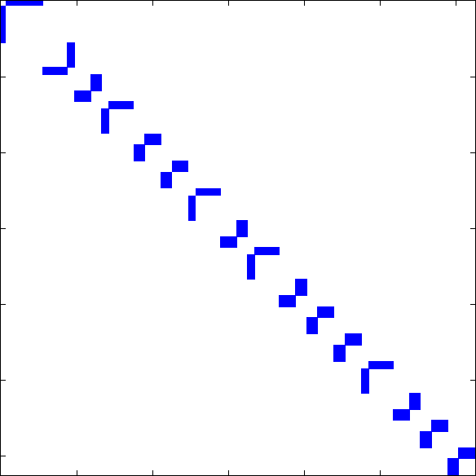
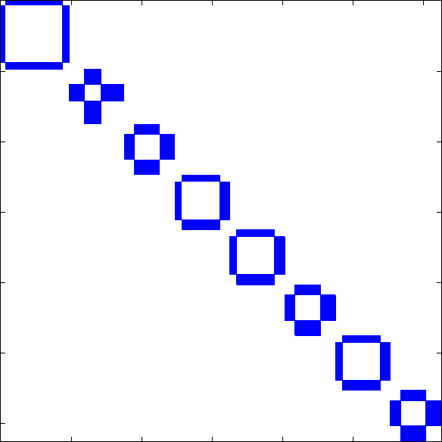
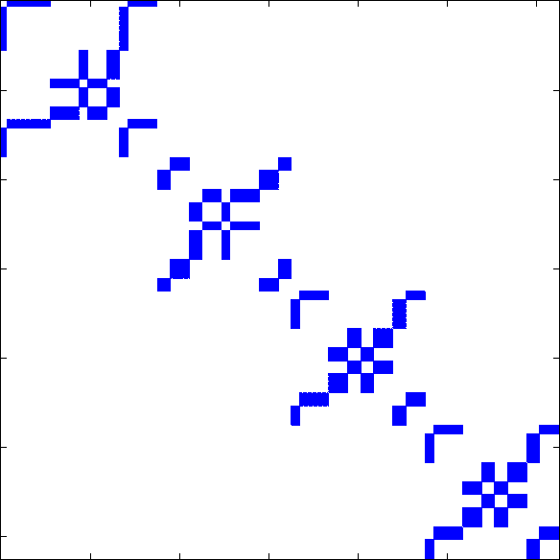
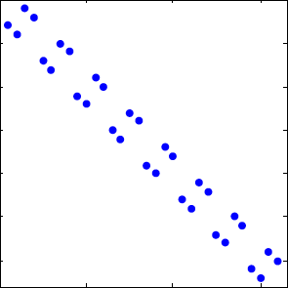
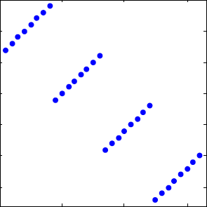
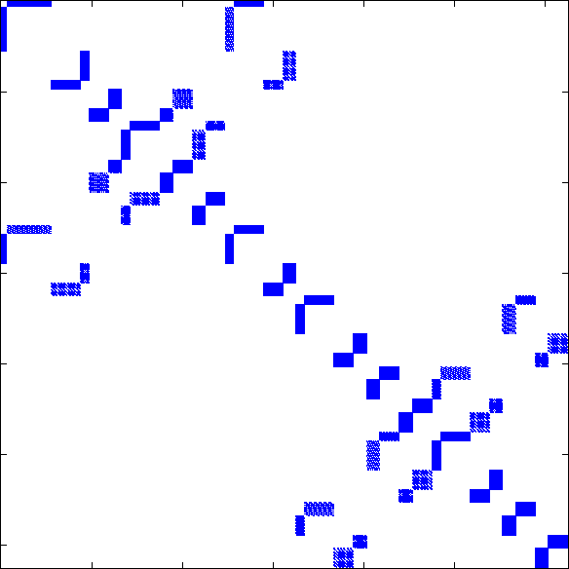
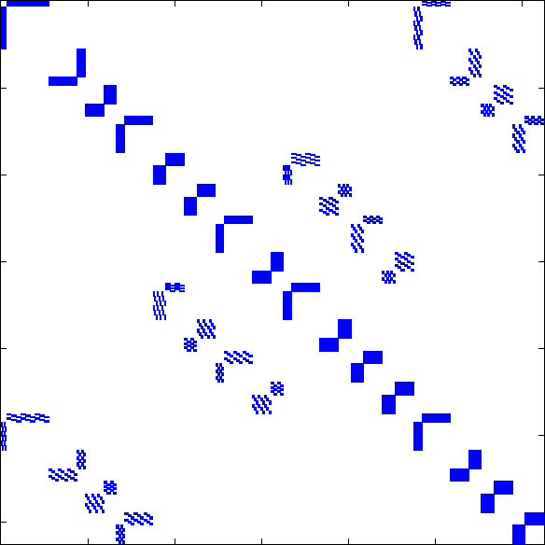
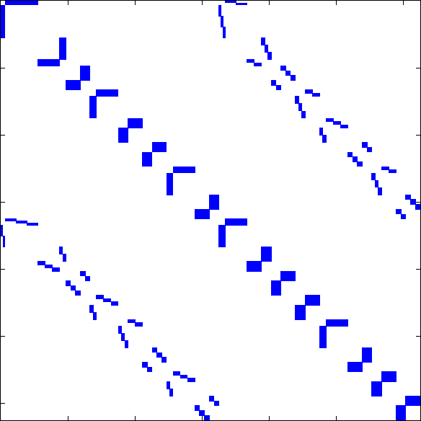
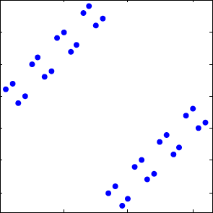
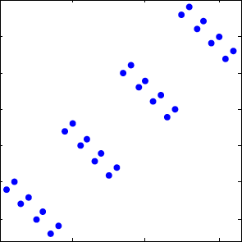
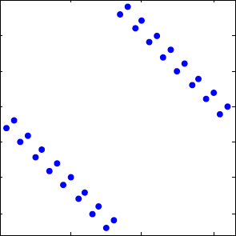
Quantifying Substructure
P₅(B^{⊗5})
P₅(B^{⊗5}+B^{⊗4}⊗I⊗B^{⊗0})
P₅(B^{⊗5}+B^{⊗3}⊗I⊗B^{⊗1})
χ₀⁵
χ₁⁵
P₅(B^{⊗5}+B^{⊗2}⊗I⊗B^{⊗2})
P₅(B^{⊗5}+B^{⊗1}⊗I⊗B^{⊗3})
P₅(B^{⊗5}+B^{⊗0}⊗I⊗B^{⊗4})
χ₂⁵
χ₃⁵
χ₄⁵
Connections between bipartite subgraphs are the Kronecker product of corresponding 2x2 matrices, e.g. B(1,1)^{⊗4}⊗I(2)
Notes:
Structure of (B + I)^{⊗5} and corresponding χ⁵_{l}.

Slide 17
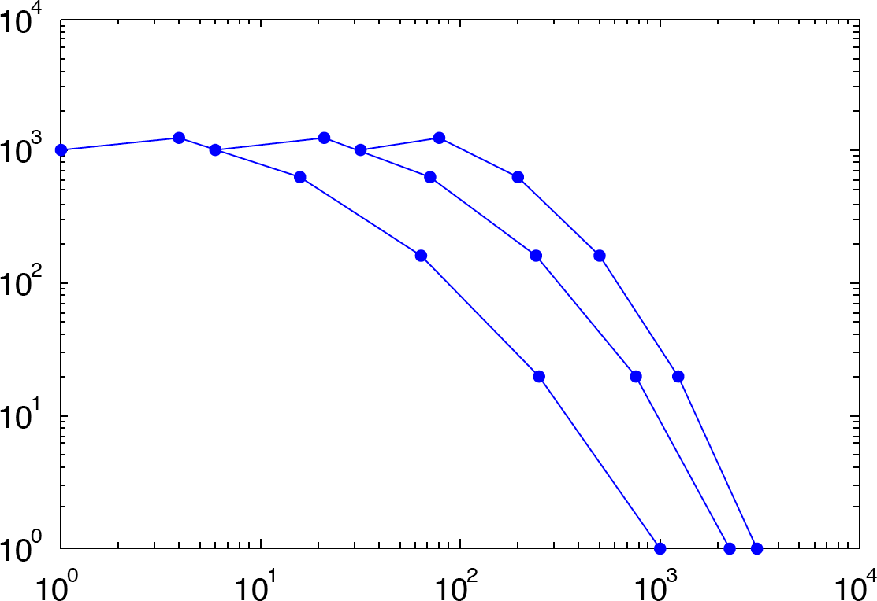
Substructure Degree Distribution
B^{⊗k} +
2nd Order
B^{⊗k}
(B+I)^{⊗k}
Number of Vertices
Vertex Degree
Only k+1 different kinds of nodes in this graph, with same degree distribution, only differing values of vertex degree
(B+I)^{⊗k} is steeper than B^{⊗k}
Notes:
Degree Distribution of Higher Orders. The degree distribution of the higher orders is a simple horizontal oﬀset of the degree distribution of B^{⊗k}. Values shown are for n=4, m=1, and k=5.

Slide 18
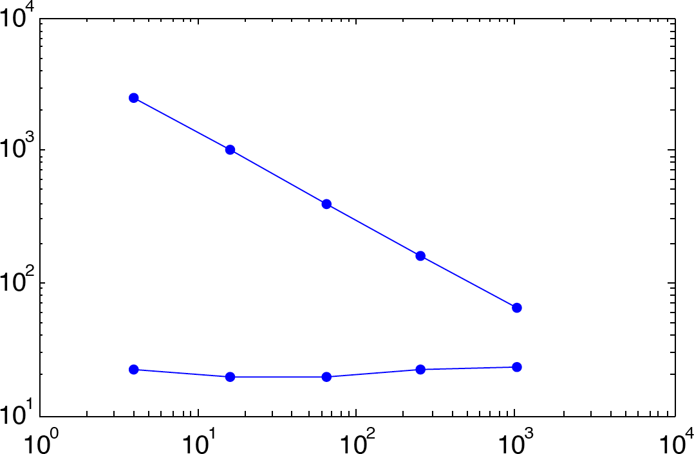
Example Result: Iso-Parametric Ratio
IsoPar(n^{r})
“half” of bipartite sub-graph
Iso-Parametric Ratio
IsoPar(n^{r} ∪ n^{k-r})
“all” of bipartite sub-graph
Sub-graph size = n^{r}
Iso-parametric ratios measure the “surface” to “volume” of a sub-graph
Can analytically compute for a Kronecker graph: (B+I)^{⊗k}
Shows large effect of including “half” or “all” of bipartite sub-graph
Notes:
Iso-Parametric Ratios. The iso-parametric ratios as a function of input set for (B+I)^{⊗k}. Values shown are for n=4, m=1, and k=5.

Slide 19






Kronecker Graph Theory -Summary of Current Results-
Quantity | Graph: B(n,m)^{⊗k} | Graph: (B+I)^{⊗k}
Degree Distribution
Betweenness Centrality
Diameter
Eigenvalues
Iso-parametric Ratio “half”
Iso-parametric Ratio “all”
Notes:
Summary of current analytics results on Kronecker graphs.

Slide 20
Outline
Introduction
B^{⊗K} Graphs
(B+I)^{⊗K} Graphs
Performance
Insert
Query
Matrix multiply
Summary
Notes:
Outline slide

Slide 21
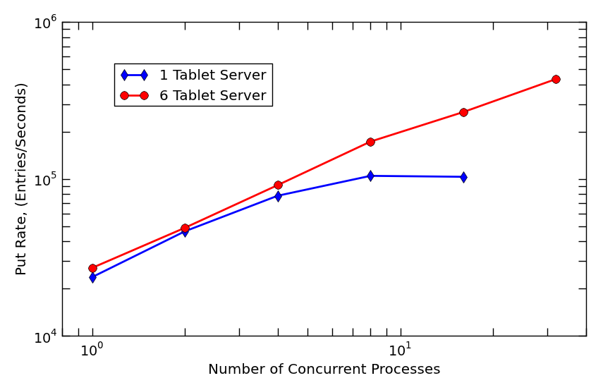
Accumulo Data Ingestion Scalability pMATLAB Application Using D4M
Notes:
Scalability study for Accumulo database ingestion performance was performed on a Accumulo cluster of dual single-core processors machines. For a single tablet server case, as increasing the number of clients, the ingestion rate increases linearly initially, up to 4 clients and then, flattened out beyond 8 clients. When using 8 MATLAB clients, the ingestion rate peaked at about 105K entries/second and then decreased with 16 clients. However, if 6 tablet servers (one tablet server per each Hadoop HDFS data node) are running, the ingestion rate continues to scale well up to 32 clients.

Slide 22
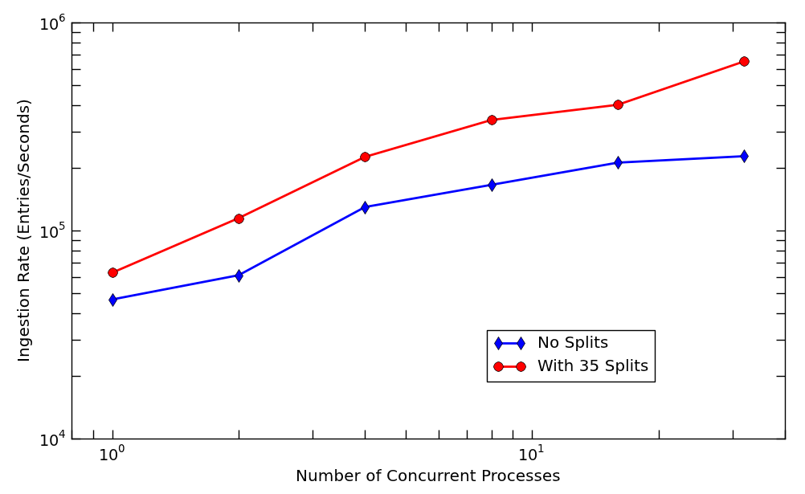
Effect of Pre-Split
Accumulo with 8 tablet servers
Notes:
Effect of pre-splitting Accumulo database on ingestion performance was studied on a Accumulo database running 8 tablet servers.

Slide 23
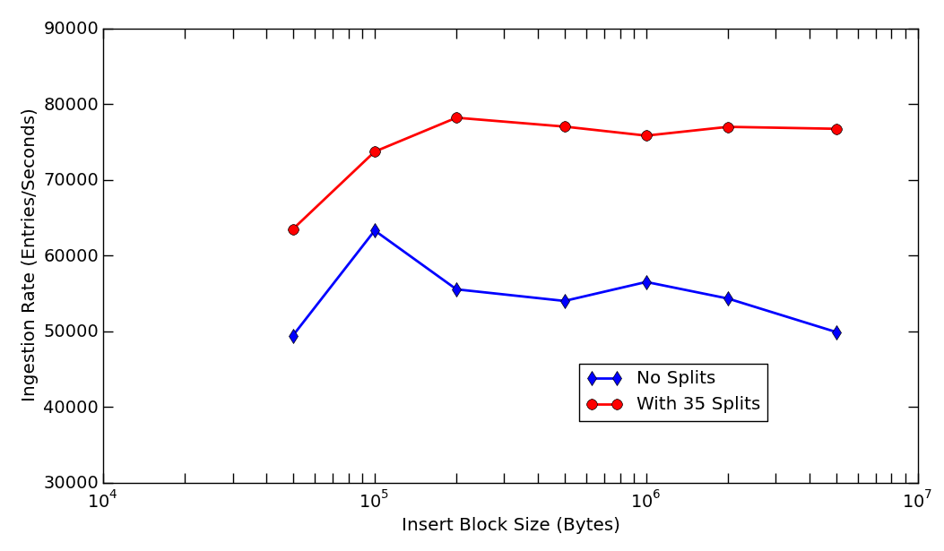
Effect of Ingestion Block Size
Accumulo with 8 tablet servers
Notes:
Effect of ingestion block size on ingesiton rate to Accumulo database was studied on a Accumulo database running 8 tablet servers.

Slide 24
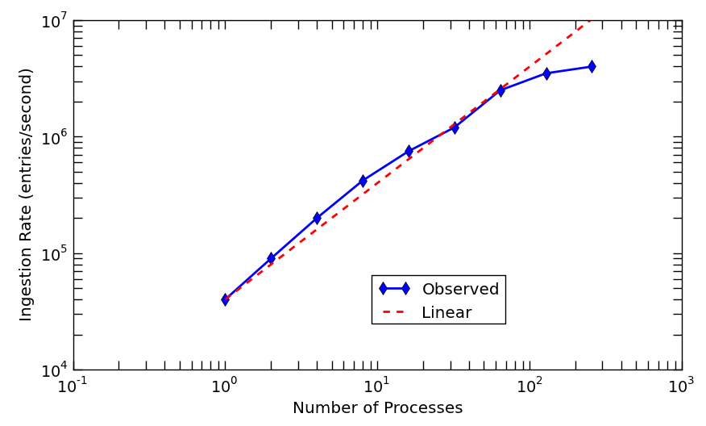
Accumulo Ingestion Scalability Study LLGrid MapReduce With A Python Application
Accumulo Database: 1 Master + 7 Tablet servers (24 cores/each)
4 Mil e/s
Data #1:
5 GB of 200 files
Data #2:
30 GB of 1000 files
Notes:
A set of web proxy log files were used for the ingestion scalability study on a Accumulo cluster (each node has dual 12-core processors with 64 GB RAM). In this case, two different sets of data were used. The size of the smaller set was 5GBytes, which holds 200 files, with sizes are ranging from 8 to 100 Mbytes. This set was used for the ingestion experiment with up to 64 processes. With 128 and 256 processes, we used another set of web proxy log files made up of 1000 files. The database used for the study was Accumulo (version 1.3.5) with 8 nodes (7 tablet servers). With 256 ingestion processes, we achieved about 4 million ingestions per sec with 256 processes.

Slide 25
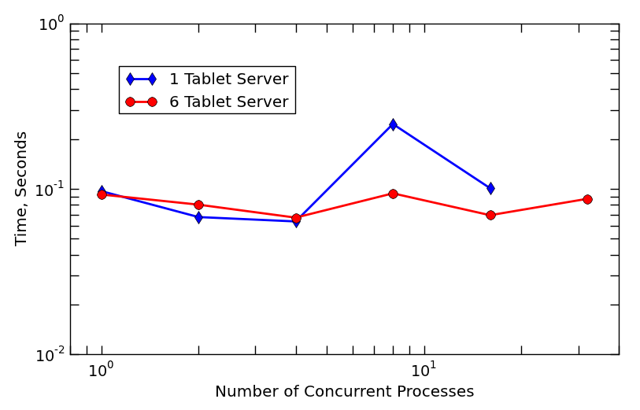
Accumulo Row Query Time pMATLAB Application Using D4M
Notes:
In this slide, we selected an arbitrary vertex in the graph, which was stored in the Accumulo database from the ingestion experiment, and queried any row entries associated with the vertex. The average time was measured for the row query for a given number of pMATLAB clients.

Slide 26
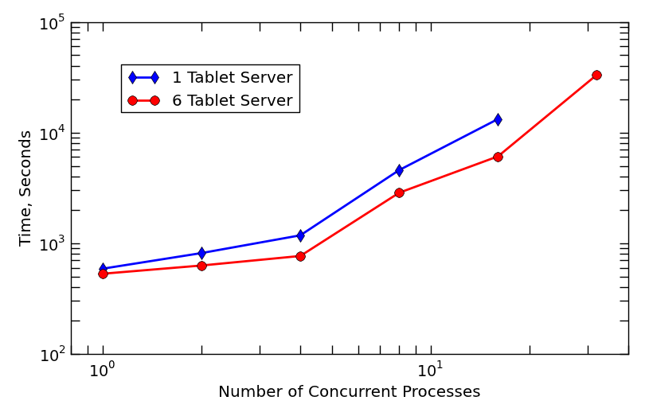
Accumulo Column Query Time pMATLAB Application Using D4M
Notes:
In this slide, we selected an arbitrary vertex in the graph, which was stored in the Accumulo database from the ingestion experiment, and queried any column entries associated with the vertex. The average time was measured for the column query for a given number of pMATLAB clients.

Slide 27
Matrix Multiply Performance
Dense Linear Algebra
~100% Efficient.
What COTS is designed to do.
1000x
Fraction of Peak Performance
Sparse Linear Algebra
~0.1% Efficient.
What network analysis requires.
100x
Sparse String Correlation
~0.001% Efficient.
What semantic analysis requires.
Fraction of Memory Used
Sparse correlation (matrix multiply) is at the heart of graph algorithms
Huge efficiency gap between what COTS processors are designed to do and what we need them to do ☹
Notes:
How is it done today, and what are the limits of current practice?

Slide 28
Data Use Cases
all
Serial Program
Serial or Parallel Program
+ Files
Parallel Program
+ Parallel Files
Data Request Size
Serial Program
Serial or Parallel Program
+ Database
Parallel Program
+ Parallel Database
word
serial
memory
parallel
memory
/
serial
storage
parallel
storage
Total Data Volume
Data volume and data request size determine best approach
Always want to start with the simplest and move to the most complex
Notes:
The path to effectively using a data base begins with using flat files.

Slide 29
Summary
Power law graphs are the dominant type of data
Graph500 relies on Kronecker graphs
Kronecker graphs have a rich theoretical structure that can be exploited for theory
Parallel computations are implemented in D4M via pMatlab
Complex graph algorithms are ultimately limited by hardware sparse matrix multiply performance
Notes:
Summary

Slide 30
Example Code & Assignment
Example Code
D4Muser_share/Examples/3Scaling/1KroneckerGraph
D4Muser_share/Examples/3Scaling/2ParallelDatabase
D4Muser_share/Examples/3Scaling/3MatrixPerformance
Assignment
None
Notes:
Homework assignment.

