Slide 1


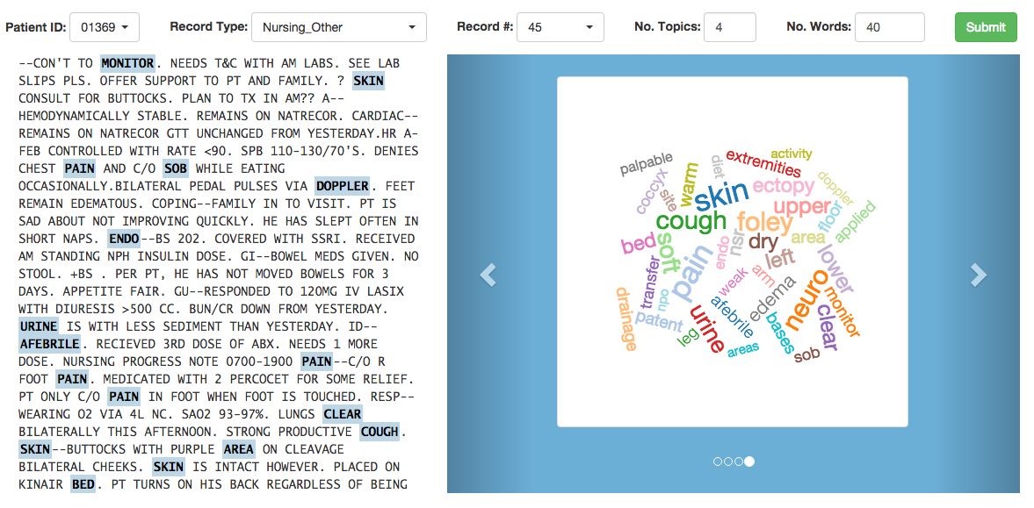

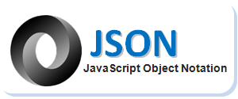
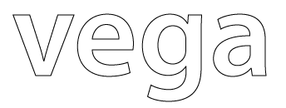

Technologies for Visualization of Big Medical Text Data
Leilani Battle² Lauren Edwards¹ Vijay Gadepally^{1,2} Brendan Gavin^{1,5} Braden Hancock^{1,6} Dylan Hutchison^{1,2,3} Jeremy Kepner^{1,2,4} Andrew Moran^{1,2}
¹MIT Lincoln Laboratory ²MIT Computer Science & AI Lab ³Univ. of Washington ⁴MIT Math Department ⁵Univ. of Massachusetts ⁶Stanford University
ABSTRACT
DATA
TECH
D4M
The ISTC Big Data Analytics Working Group (BigDAWG) project allows users to explore and analyze heterogeneous data sets that vary in size, schema, and organization. One use case for BigDawg is the MIMIC II public data set, which contains multiple years of ICU reports for thousands of patients at Boston’s Beth Israel Deaconess Hospital.
In this poster, we highlight the technologies that enable topic modeling over the corpus of MIMIC documents: D4M, Graphulo, and Vega. The result is a prototype system that visualizes the content of a given medical report using the BigDAWG API.
Raw
Text
A1
Process with D4M into (row,col,val) triples
cited
File System
B1
cited
word | heart
Store triples in Accumulo
A2
word | lung
word | icu
D4M is used as an Octave library composing Associative Array algebra with database queries.
Doc001 | 1
Doc002 |  | 3
Doc003 |  |  | 7
Invoke Graphulo server-side ops
SYSTEM PROTOTYPE
Degree filter out insignificant words
Restrict words to a medical dictionary
Weigh words with TF-IDF*
The diagram to the right depicts the steps for processing data into query-ready form, and then steps to answer a visualization query from a client through the BigDAWG web service. We show a sample of input data, the technology used for processing, and a sample of resulting data for each step. Data originates from raw text files, Accumulo stores intermediate and processed data, and a client web browser presents a query and visualization interface.
All operations except for the Non-negative matrix factorization (NMF) step do not require holding an entire dataset in the memory of a single node. D4M's ingest step leverages pMATLAB to ingest triples into Accumulo from multiple processes; Graphulo runs within Accumulo's tablet servers, gaining parallelism and minimizing data movement; and Vega visualizes only the topics relevant to the client.
Graphulo
(’Doc001',’word|heart',’0.334’)
(’Doc002',’word|lung’ ,’0.167’)
(’Doc003',’word|icu’ ,’0.019’)
Perform NMF in Graphulo
Graphulo is a server-side matrix math and graph algorithm library for the Accumulo database.
A
=
W
H
Store W and H matrices in Accumulo
FUTURE WORK
Query document through BigDAWG
BigDAWG
- Use original ICU data directly from PostgreSQL by creating a BigDAWG "shim," instead of exporting from PostgreSQL to text files for pre-processing and loading into Accumulo.
- Accelerate an NMF variant that does not require holding data in memory, which enables distributed execution in an Accumulo instance via Graphulo.
- Explore alternative visualization tools for processed medical data, as well as techniques that consider word position beyond bag-of-words approaches.
Receive JSON for visualization with Vega
BigDAWG is a federated web service that marshals queries over a variety of databases and their distinct data models.
Client Browser
*Term Frequency−Inverse Document Frequency

