Slide 1


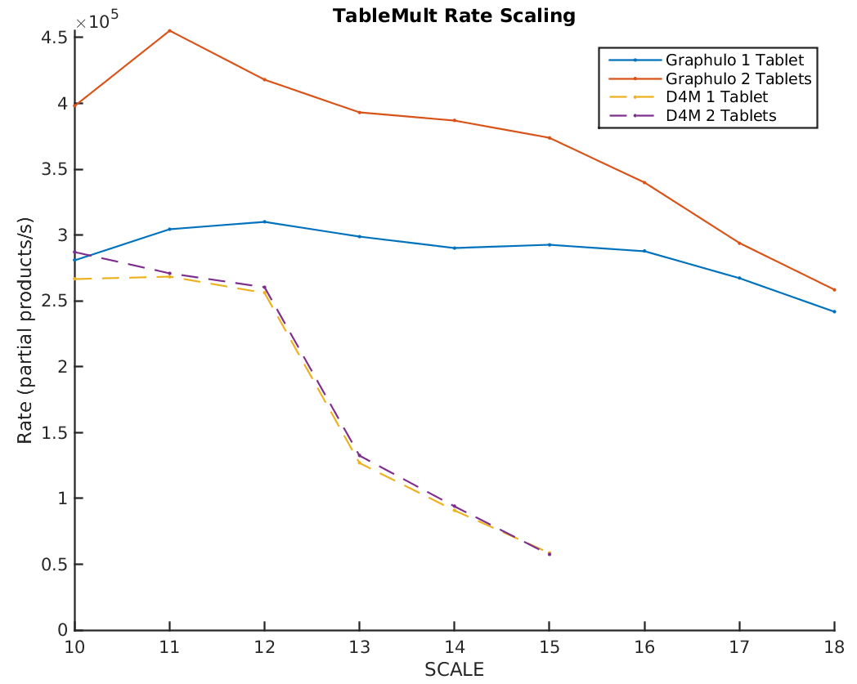
Graphulo: Graph Processing for Accumulo Databases
Dylan Hutchison^{1,2,3} Jeremy Kepner^{1,2,4} Vijay Gadepally^{1,2}
¹MIT Lincoln Laboratory ²MIT Computer Science & AI Laboratory ³University of Washington ⁴MIT Mathematics Department
Apache Accumulo
Distributed key/value store in Hadoop HDFS Java ecosystem
Best for large (TBs to PBs), de-normalized tables (NoSQL)
Cell-level visibility access control; row store by default
Performance record at 115M entries inserted/second³
Implements stored procedures via a Java iterator framework
Degree-filtered Breadth First Search
TF-IDF
Term frequency-Inverse document frequency transform
Jaccard Coefficients
k-Truss Subgraph
Graphulo
SpGEMM
SpRef
Apply
Reduce
SpEWiseX
Library for Accumulo to orchestrate server-side graph processing²
Implements GraphBLAS.org standard sparse matrix operations
Graphulo's clients use its core matrix math primitives to build algorithms
Open Source: http://graphulo.mit.edu
Adjacency Schema
Incidence Schema
Single-table Schema
Graphulo enables diverse graph algorithms atop the GraphBLAS primitives on many graph schemas in Accumulo
Graphulo Stored Procedure Calls
OneTable
Performance
SpEWiseX
Single-node matrix multiply experiment: Graphulo vs. multiply outside Accumulo in Matlab using D4M
Graphulo outer product alg. scales with Accumulo¹
Matlab network transfer cost is bottleneck
Future work is multi-node scale testing Graphulo
BatchScanner & IteratorSetting
TwoTableEWISE
SpEWiseSum
TwoTable
TwoTableNONE
child
: “is specialization of”
parent
TwoTableROW
Cartesian
TableMult
References
Random power law graphs with 2^{SCALE} nodes and 16 edges per node
TwoTableROW
Selector
D. Hutchison, J. Kepner, V. Gadepally, and A. Fuchs, “Graphulo implementation of server-side sparse matrix multiply in the Accumulo database,” in IEEE HPEC, 2015.
V. Gadepally, J. Bolewski, D. Hook, D. Hutchison, B. Miller, and J. Kepner, “Graphulo: Linear algebra graph kernels for NoSQL databases,” in IEEE IPDPSW, May 2015.
J. Kepner, W. Arcand, D. Bestor, B. Bergeron, C. Byun, V. Gadepally, M. Hubbell et al., “Achieving 100,000,000 database inserts per second using Accumulo and D4M,” in IEEE HPEC, 2014.
Reducer
Row Filter
Col Filter
Extra Iterators

