Slide 1

Graph Analytics in GraphBLAS
Vijay Gadepally, Jake Bolewski, Dan Hook, Dylan Hutchison, Ben Miller, Jeremy Kepner
May 2015
This material is based upon work supported by the National Science Foundation under Grant No. DMS-1312831.
Any opinions, findings, and conclusions or recommendations expressed in this material are those of the author(s) and do not necessarily reflect the views of the National Science Foundation.
Notes:
Title Page

Slide 2
Outline
Introduction
Degree Filtered Breadth First Search
K-Truss
Jaccard Coefficient
Non-Negative Matrix Factorization
Summary

Slide 3


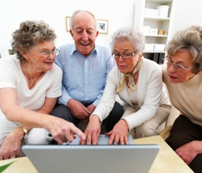
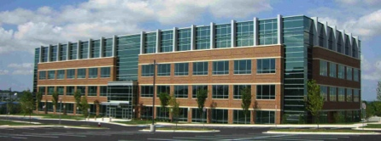
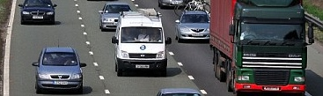
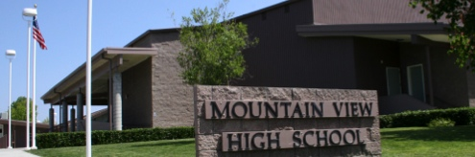
Big Data Challenge
Kids
Adults
Elderly
Humans
(deciders)
Rapidly increasing
- Data volume
- Data velocity
- Data variety
Things
Gap
Humans
10 Years Ago
5 Years Ago
Today
In 5 Years
Things
(providers)
Building
Security
Building
Environment
Building
Usage
Commuter
Vehicles
Work
Vehicles
Transport
Vehicles
Student
Smartphones
Classroom
Tablets
Fitness
Wearables
Notes:
Increasing data volume, velocity, and variety has created a growing gap between data and users.
Image Sources:
Operators: http://en.wikipedia.org/wiki/Air_and_Space_Operations_Center
Analysts: © Comstock http://www.gettyimages.com/detail/photo/businessman-at-computer-royalty-free-image/78479774.
Commanders: US Forces Korea General News http://www.usfk.mil/usfk/%28A%28dL8DLge1ywEkAAAAYzg4NWY4MzMtM2I0OS00YWI5LTljYjctMWQ0NDM4MGUwYzVmgU4GPacw1yQ4-d8XCgyTu_0lbjQ1%29S%28aw5nfc45hpuvapn5pihn0o45%29%29/news.annual.command.post.exercise.winds.down.in.korea.printview.648
OSINT: Acrobat logo is © Adobe Systems Inc., © Twitter and Office 2011 logos are © Microsoft
Weather: © Rebecca van Ommen : http://www.gettyimages.com/detail/photo/paper-craft-weather-royalty-free-image/180478515
HUMINT: U.S. Dept of State http://www.rewardsforjustice.net/index.cfm?page=zulkifli&language=english
C2: http://www.disa.mil/Services/Command-and-Control/GCCS-J
Ground: Staff Sgt. William Tremblay/U.S. Army via Wired : http://www.wired.com/dangerroom/2010/09/afghan-biometric-dragnet-could-snag-millions/
Maritime: This file is a work of a sailor or employee of the U.S. Navy, taken or made as part of that person's official duties. As a work of the U.S. federal government, the image is in the public domain. http://en.wikipedia.org/wiki/File:USS_Lake_Champlain_%28CG-57%29.JPG
Air: This image or file is a work of a U.S. Air Force Airman or employee, taken or made as part of that person's official duties. As a work of the U.S. federal government, the image or file is in the public domain. http://en.wikipedia.org/wiki/File:MQ-9_Reaper_in_flight_%282007%29.jpg
Space: This file is in the public domain because it was solely created by NASA. NASA copyright policy states that "NASA material is not protected by copyright unless noted". http://en.wikipedia.org/wiki/File:CloudSat_-_Artist_Concept.jpg
Cyber: © derrrek : http://www.gettyimages.com/detail/illustration/abstract-backgrounds-royalty-free-illustration/185548379
This graphic was previously approved for public release as MS-77705

Slide 4
Systems Architecture
Kids
Adults
Elderly
Humans
(deciders)
Web
Ingest & Enrichment
Databases
Ingest & Enrichment
Ingest
Analytics
Raw Data
Scheduler
Computing
Things
(providers)
Building
Security
Building
Environment
Building
Usage
Commuter
Vehicles
Work
Vehicles
Transport
Vehicles
Student
Smartphones
Classroom
Tablets
Fitness
Wearables
Notes:
Increasing data volume, velocity, and variety has created a growing gap between data and users.
Image Sources:
Operators: http://en.wikipedia.org/wiki/Air_and_Space_Operations_Center
Analysts: © Comstock http://www.gettyimages.com/detail/photo/businessman-at-computer-royalty-free-image/78479774.
Commanders: US Forces Korea General News http://www.usfk.mil/usfk/%28A%28dL8DLge1ywEkAAAAYzg4NWY4MzMtM2I0OS00YWI5LTljYjctMWQ0NDM4MGUwYzVmgU4GPacw1yQ4-d8XCgyTu_0lbjQ1%29S%28aw5nfc45hpuvapn5pihn0o45%29%29/news.annual.command.post.exercise.winds.down.in.korea.printview.648
OSINT: Acrobat logo is © Adobe Systems Inc., © Twitter and Office 2011 logos are © Microsoft
Weather: © Rebecca van Ommen : http://www.gettyimages.com/detail/photo/paper-craft-weather-royalty-free-image/180478515
HUMINT: U.S. Dept of State http://www.rewardsforjustice.net/index.cfm?page=zulkifli&language=english
C2: http://www.disa.mil/Services/Command-and-Control/GCCS-J
Ground: Staff Sgt. William Tremblay/U.S. Army via Wired : http://www.wired.com/dangerroom/2010/09/afghan-biometric-dragnet-could-snag-millions/
Maritime: This file is a work of a sailor or employee of the U.S. Navy, taken or made as part of that person's official duties. As a work of the U.S. federal government, the image is in the public domain. http://en.wikipedia.org/wiki/File:USS_Lake_Champlain_%28CG-57%29.JPG
Air: This image or file is a work of a U.S. Air Force Airman or employee, taken or made as part of that person's official duties. As a work of the U.S. federal government, the image or file is in the public domain. http://en.wikipedia.org/wiki/File:MQ-9_Reaper_in_flight_%282007%29.jpg
Space: This file is in the public domain because it was solely created by NASA. NASA copyright policy states that "NASA material is not protected by copyright unless noted". http://en.wikipedia.org/wiki/File:CloudSat_-_Artist_Concept.jpg
Cyber: © derrrek : http://www.gettyimages.com/detail/illustration/abstract-backgrounds-royalty-free-illustration/185548379
This graphic was previously approved for public release as MS-77705

Slide 5




Systems Architecture Data Volume ⇒ Many Clouds
MIT SuperCloud merges four clouds
Kids
Adults
Elderly
Humans
(deciders)
Enterprise Cloud
Compute Cloud
MIT
SuperCloud
Web
Ingest & Enrichment
Databases
Ingest & Enrichment
Ingest
Analytics
Compute on Encrypted Data
Raw Data
Big Data Cloud
Database Cloud
Scheduler
Computing
Things
(providers)
Building
Security
Building
Environment
Building
Usage
Commuter
Vehicles
Work
Vehicles
Transport
Vehicles
Student
Smartphones
Classroom
Tablets
Fitness
Wearables
LLSuperCloud: Sharing HPC Systems for Diverse Rapid Prototyping, IEEE HPEC 2013
Notes:
Increasing data volume, velocity, and variety has created a growing gap between data and users.
Image Sources:
Operators: http://en.wikipedia.org/wiki/Air_and_Space_Operations_Center
Analysts: © Comstock http://www.gettyimages.com/detail/photo/businessman-at-computer-royalty-free-image/78479774.
Commanders: US Forces Korea General News http://www.usfk.mil/usfk/%28A%28dL8DLge1ywEkAAAAYzg4NWY4MzMtM2I0OS00YWI5LTljYjctMWQ0NDM4MGUwYzVmgU4GPacw1yQ4-d8XCgyTu_0lbjQ1%29S%28aw5nfc45hpuvapn5pihn0o45%29%29/news.annual.command.post.exercise.winds.down.in.korea.printview.648
OSINT: Acrobat logo is © Adobe Systems Inc., © Twitter and Office 2011 logos are © Microsoft
Weather: © Rebecca van Ommen : http://www.gettyimages.com/detail/photo/paper-craft-weather-royalty-free-image/180478515
HUMINT: U.S. Dept of State http://www.rewardsforjustice.net/index.cfm?page=zulkifli&language=english
C2: http://www.disa.mil/Services/Command-and-Control/GCCS-J
Ground: Staff Sgt. William Tremblay/U.S. Army via Wired : http://www.wired.com/dangerroom/2010/09/afghan-biometric-dragnet-could-snag-millions/
Maritime: This file is a work of a sailor or employee of the U.S. Navy, taken or made as part of that person's official duties. As a work of the U.S. federal government, the image is in the public domain. http://en.wikipedia.org/wiki/File:USS_Lake_Champlain_%28CG-57%29.JPG
Air: This image or file is a work of a U.S. Air Force Airman or employee, taken or made as part of that person's official duties. As a work of the U.S. federal government, the image or file is in the public domain. http://en.wikipedia.org/wiki/File:MQ-9_Reaper_in_flight_%282007%29.jpg
Space: This file is in the public domain because it was solely created by NASA. NASA copyright policy states that "NASA material is not protected by copyright unless noted". http://en.wikipedia.org/wiki/File:CloudSat_-_Artist_Concept.jpg
Cyber: © derrrek : http://www.gettyimages.com/detail/illustration/abstract-backgrounds-royalty-free-illustration/185548379
This graphic was previously approved for public release as MS-77705

Slide 6
Systems Architecture Data Velocity ⇒ Databases
Kids
Adults
Elderly
Humans
(deciders)
Web
Ingest & Enrichment
Databases
Ingest & Enrichment
Ingest
Analytics
World Record Database Performance
Raw Data
Scheduler
Computing
Things
(providers)
Building
Security
Building
Environment
Building
Usage
Commuter
Vehicles
Work
Vehicles
Transport
Vehicles
Student
Smartphones
Classroom
Tablets
Fitness
Wearables
Achieving 100,000,000 database inserts per second using Accumulo and D4M, IEEE HPEC 2014
Notes:
Increasing data volume, velocity, and variety has created a growing gap between data and users.
Image Sources:
Operators: http://en.wikipedia.org/wiki/Air_and_Space_Operations_Center
Analysts: © Comstock http://www.gettyimages.com/detail/photo/businessman-at-computer-royalty-free-image/78479774.
Commanders: US Forces Korea General News http://www.usfk.mil/usfk/%28A%28dL8DLge1ywEkAAAAYzg4NWY4MzMtM2I0OS00YWI5LTljYjctMWQ0NDM4MGUwYzVmgU4GPacw1yQ4-d8XCgyTu_0lbjQ1%29S%28aw5nfc45hpuvapn5pihn0o45%29%29/news.annual.command.post.exercise.winds.down.in.korea.printview.648
OSINT: Acrobat logo is © Adobe Systems Inc., © Twitter and Office 2011 logos are © Microsoft
Weather: © Rebecca van Ommen : http://www.gettyimages.com/detail/photo/paper-craft-weather-royalty-free-image/180478515
HUMINT: U.S. Dept of State http://www.rewardsforjustice.net/index.cfm?page=zulkifli&language=english
C2: http://www.disa.mil/Services/Command-and-Control/GCCS-J
Ground: Staff Sgt. William Tremblay/U.S. Army via Wired : http://www.wired.com/dangerroom/2010/09/afghan-biometric-dragnet-could-snag-millions/
Maritime: This file is a work of a sailor or employee of the U.S. Navy, taken or made as part of that person's official duties. As a work of the U.S. federal government, the image is in the public domain. http://en.wikipedia.org/wiki/File:USS_Lake_Champlain_%28CG-57%29.JPG
Air: This image or file is a work of a U.S. Air Force Airman or employee, taken or made as part of that person's official duties. As a work of the U.S. federal government, the image or file is in the public domain. http://en.wikipedia.org/wiki/File:MQ-9_Reaper_in_flight_%282007%29.jpg
Space: This file is in the public domain because it was solely created by NASA. NASA copyright policy states that "NASA material is not protected by copyright unless noted". http://en.wikipedia.org/wiki/File:CloudSat_-_Artist_Concept.jpg
Cyber: © derrrek : http://www.gettyimages.com/detail/illustration/abstract-backgrounds-royalty-free-illustration/185548379
This graphic was previously approved for public release as MS-77705

Slide 7
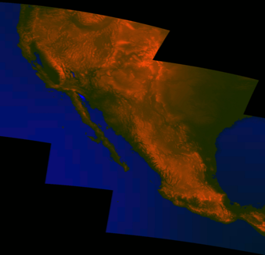


Systems Architecture Diversity ⇒ Databases
Kids
Adults
Elderly
SciDB; brings the power of databases to dense data
Humans
(deciders)
SAR
LIDAR
SONAR
HSI
EO
LAT
LON
TIME
HEIGHT
…
Web
Ingest & Enrichment
Databases
Ingest & Enrichment
Ingest
Analytics
- Dense data currently stored as raw, unindexed file
- SciDB dramatically reduces time to exploit dense data
Raw Data
Scheduler
Computing
Things
(providers)
Building
Security
Building
Environment
Building
Usage
Commuter
Vehicles
Work
Vehicles
Transport
Vehicles
Student
Smartphones
Classroom
Tablets
Fitness
Wearables
Notes:
Increasing data volume, velocity, and variety has created a growing gap between data and users.
Image Sources:
Operators: http://en.wikipedia.org/wiki/Air_and_Space_Operations_Center
Analysts: © Comstock http://www.gettyimages.com/detail/photo/businessman-at-computer-royalty-free-image/78479774.
Commanders: US Forces Korea General News http://www.usfk.mil/usfk/%28A%28dL8DLge1ywEkAAAAYzg4NWY4MzMtM2I0OS00YWI5LTljYjctMWQ0NDM4MGUwYzVmgU4GPacw1yQ4-d8XCgyTu_0lbjQ1%29S%28aw5nfc45hpuvapn5pihn0o45%29%29/news.annual.command.post.exercise.winds.down.in.korea.printview.648
OSINT: Acrobat logo is © Adobe Systems Inc., © Twitter and Office 2011 logos are © Microsoft
Weather: © Rebecca van Ommen : http://www.gettyimages.com/detail/photo/paper-craft-weather-royalty-free-image/180478515
HUMINT: U.S. Dept of State http://www.rewardsforjustice.net/index.cfm?page=zulkifli&language=english
C2: http://www.disa.mil/Services/Command-and-Control/GCCS-J
Ground: Staff Sgt. William Tremblay/U.S. Army via Wired : http://www.wired.com/dangerroom/2010/09/afghan-biometric-dragnet-could-snag-millions/
Maritime: This file is a work of a sailor or employee of the U.S. Navy, taken or made as part of that person's official duties. As a work of the U.S. federal government, the image is in the public domain. http://en.wikipedia.org/wiki/File:USS_Lake_Champlain_%28CG-57%29.JPG
Air: This image or file is a work of a U.S. Air Force Airman or employee, taken or made as part of that person's official duties. As a work of the U.S. federal government, the image or file is in the public domain. http://en.wikipedia.org/wiki/File:MQ-9_Reaper_in_flight_%282007%29.jpg
Space: This file is in the public domain because it was solely created by NASA. NASA copyright policy states that "NASA material is not protected by copyright unless noted". http://en.wikipedia.org/wiki/File:CloudSat_-_Artist_Concept.jpg
Cyber: © derrrek : http://www.gettyimages.com/detail/illustration/abstract-backgrounds-royalty-free-illustration/185548379
This graphic was previously approved for public release as MS-77705

Slide 8
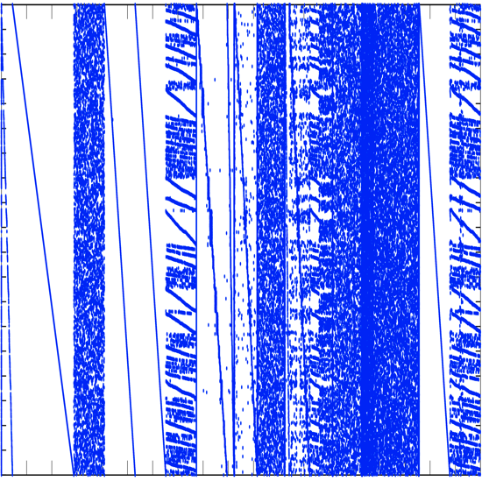
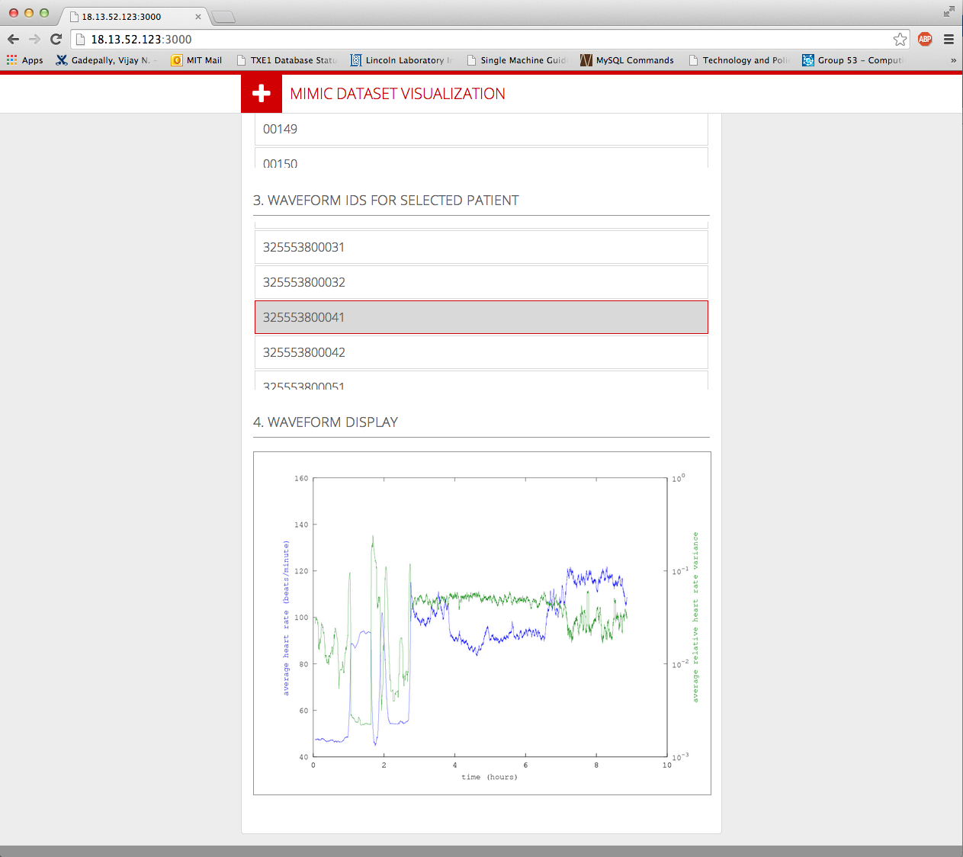
Systems Architecture Variety ⇒ D4M Schema
Kids
Adults
Elderly
Humans
(deciders)
D4M demonstrated a
universal approach to diverse data
Web
columns
raw
Ingest & Enrichment
Databases
Ingest & Enrichment
Ingest
Analytics
Raw Data
rows
Scheduler
Computing
Σ
Things
(providers)
intel reports, DNA, health records, publication citations, web logs, social media, building alarms, cyber, … all handled by a common 4 table schema
Building
Security
Building
Environment
Building
Usage
Commuter
Vehicles
Work
Vehicles
Transport
Vehicles
Student
Smartphones
Classroom
Tablets
Fitness
Wearables
Notes:
Increasing data volume, velocity, and variety has created a growing gap between data and users.
Image Sources:
Operators: http://en.wikipedia.org/wiki/Air_and_Space_Operations_Center
Analysts: © Comstock http://www.gettyimages.com/detail/photo/businessman-at-computer-royalty-free-image/78479774.
Commanders: US Forces Korea General News http://www.usfk.mil/usfk/%28A%28dL8DLge1ywEkAAAAYzg4NWY4MzMtM2I0OS00YWI5LTljYjctMWQ0NDM4MGUwYzVmgU4GPacw1yQ4-d8XCgyTu_0lbjQ1%29S%28aw5nfc45hpuvapn5pihn0o45%29%29/news.annual.command.post.exercise.winds.down.in.korea.printview.648
OSINT: Acrobat logo is © Adobe Systems Inc., © Twitter and Office 2011 logos are © Microsoft
Weather: © Rebecca van Ommen : http://www.gettyimages.com/detail/photo/paper-craft-weather-royalty-free-image/180478515
HUMINT: U.S. Dept of State http://www.rewardsforjustice.net/index.cfm?page=zulkifli&language=english
C2: http://www.disa.mil/Services/Command-and-Control/GCCS-J
Ground: Staff Sgt. William Tremblay/U.S. Army via Wired : http://www.wired.com/dangerroom/2010/09/afghan-biometric-dragnet-could-snag-millions/
Maritime: This file is a work of a sailor or employee of the U.S. Navy, taken or made as part of that person's official duties. As a work of the U.S. federal government, the image is in the public domain. http://en.wikipedia.org/wiki/File:USS_Lake_Champlain_%28CG-57%29.JPG
Air: This image or file is a work of a U.S. Air Force Airman or employee, taken or made as part of that person's official duties. As a work of the U.S. federal government, the image or file is in the public domain. http://en.wikipedia.org/wiki/File:MQ-9_Reaper_in_flight_%282007%29.jpg
Space: This file is in the public domain because it was solely created by NASA. NASA copyright policy states that "NASA material is not protected by copyright unless noted". http://en.wikipedia.org/wiki/File:CloudSat_-_Artist_Concept.jpg
Cyber: © derrrek : http://www.gettyimages.com/detail/illustration/abstract-backgrounds-royalty-free-illustration/185548379
This graphic was previously approved for public release as MS-77705

Slide 9
Graphulo Goals
Primary Goal
Open source Apache Accumulo Java library that enables many graph algorithms in Accumulo using Accumulo server-side constructs
Additional Goals
Enable a wide range of graph algorithms with a small number of functions on a range of graph schemas
Efficient and predictable performance; minimize maximum run time
Instructive and useful example programs; well written spec
Minimal external dependencies
Fully documented at graphulo.mit.edu
Drive Accumulo features (e.g., temporary tables, split API, user defined functions, …)
Focus on localized analytics within a neighborhood, as opposed to whole table analytics

Slide 10
Plan
Phase 1: Graph Mathematics Specification
Define library mathematics
Define example applications and data sets
Phase 2: Graph Mathematics Prototype
Implement example applications in Accumulo prototyping environment
Verify that example applications can be effectively implemented
Phase 3: Java Implementation
Implement in Java and test at scale

Slide 11
GraphBLAS
The GraphBLAS is an effort to define standard building blocks for graph algorithms in the language of linear algebra
More information about the group: http://istc-bigdata.org/GraphBlas/
Background material in book by J. Kepner and J. Gilbert: Graph Algorithms in the Language of Linear Algebra. SIAM, 2011
Draft GraphBLAS functions:
SpGEMM, SpM{Sp}V, SpEWiseX, Reduce, SpRef, SpAsgn, Scale, Apply
Goal: show that these functions can perform the types of analytics that are often applied to data represented in graphs
GraphBLAS is a natural starting point Graphulo Mathematics

Slide 12
Examples of Graph Problems
Algorithm Class | Description | Algorithm Examples
Exploration & Traversal | Algorithms to traverse or search vertices | Depth First Search, Breadth First Search
Centrality & Vertex Nomination | Finding important vertices or components within a graph | Betweenness Centrality, K-Truss sub graph detection
Similarity | Finding parts of a graph which are similar in terms of vertices or edges | Graph Isomorphism, Jaccard Index, Neighbor matching
Community Detection | Look for communities (areas of high connectedness or similarity) within a graph | Topic Modeling, Non-negative matrix factorization, Principle Component Analysis
Prediction | Predicting new or missing edges | Link Prediction
Shortest Path | Finding the shorted distance between two vertices | Floyd Warshall, Bellman Ford, A* algorithm, Johnson’s algorithm

Slide 13
Accumulo Graph Schema Variants
Adjacency Matrix (directed/undirected/weighted graphs)
row = start vertex; column = vertex; value = edge weight
Incidence Matrix (multi-hyper-graphs)
row = edge; column = vertices associated with edge; value = weight
D4M Schema
Standard: main table, transpose table, column degree table, row degree table, raw data table
Multi-Family: use 1 table with multiple column families
Many-Table: use different tables for different classes of data
Single-Table
use concatenated v1|v2 as a row key, and isolated v1 or v2 row key implies a degree
Graphulo should work with as many of Accumulo graph schemas as is possible

Slide 14
Algorithms of Interest
Degree Filtered Breadth First Search
Very common graph analytic
K-Truss
Finds the clique-iness of a graph
Jaccard Coefficient
Finds areas of similarity in a graph
Topic Modeling through Non-negative matrix factorization
Provides a quick topic model of a graph

Slide 15
Outline
Introduction
Degree Filtered Breadth First Search
K-Truss
Jaccard Coefficient
Non-Negative Matrix Factorization
Summary

Slide 16
Degree Filtered Breadth First Search
Used for searching in a graph starting from a root node
Very often, popular nodes can significantly slow down the search process and may not lead to results of interest
A degree filtered breadth first search, first filters out high degree nodes and then performs a BFS on the remaining graph
A graph G=(V,E) can be represented by an adjacency matrix A where A(i,j)=1 if there is an edge between v_{i} and v_{j}
Alternately, one can represent a graph G using an incidence matrix representation E where rows are edges, columns are nodes, and E(i,j) = 1 if e_{i} goes into v_{j} and E(i,j) = -1 if e_{i} leaves v_{j}
The Degree Filtered BFS can be computed using either representation

Slide 17
Adjacency Matrix based Degree Filtered BFS
Uses the adjacency matrix representation of a graph G to perform the BFS.
Algorithm Inputs:
v₀: Starting vertex set
k: number of hops to go
T: Accumulo table of graph adjacency matrix
T_{in} = sum(T,1).'; % Accumulo table in-degree
T_{out} = sum(T,2); % Accumulo table out-degree
d_{min}: minimum allowable degree
d_{max}: maximum allowable degree
Algorithm Output:
A_{k}: adjacency matrix of sub-graph

Slide 18
Adjacency Matrix based Degree Filtered BFS
The algorithm begins by retaining vertices whose degree are between d_{min} and d_{max}
Algorithm:
v_{k} = v₀; % Initialize seed set
for i=1:k
u_{k} = Row(d_{min} ≤ str2num(T_{out}(v_{k},:)) ≤ d_{max}); % Check d_{min} and d_{max}
A_{k} = T(u_{k},:); % Get graph of u_{k}
v_{k} = Col(A_{k}); % Neighbors of u_{k}
end

Slide 19
Incidence Matrix based Degree Filtered BFS
Uses the incidence matrix representation of a graph G to perform the BFS.
Algorithm Inputs
v₀: starting vertex set
k: number of hops to go
T: Accumulo table of graph incidence matrix
T_{col} = sum(logical(T==-1),1).'; % Node out-degrees
d_{min}: minimum allowable degree
d_{max}: maximum allowable degree
Algorithm Output
E_{k}: adjacency matrix of sub-graph

Slide 20
Incidence Matrix based Degree Filtered BFS
The algorithm begins by retaining vertices whose degree are between d_{min} and d_{max}
Algorithm:
v_{k} = v₀; % Initialize seed set
for i=1:k
u_{k} = Row(d_{min} ≤ str2num(T_{col}(v_{k},:)) ≤ d_{max}); % Check d_{min} and d_{max}
E_{k} = T(Row(T(:,u_{k})),:); % Get graph of u_{k}
v_{k} = Col(E_{k}==1); % Get neighbors of u_{k}
end

Slide 21
Outline
Introduction
Degree Filtered Breadth First Search
K-Truss
Jaccard Coefficient
Non-Negative Matrix Factorization
Summary

Slide 22
K-Truss
A graph is a k-truss if each edge is part of at least k-2 triangles
A generalization of a clique (a k-clique is a k-truss), ensuring a minimum level of connectivity within the graph
Traditional technique to find a k-truss subgraph:
Compute the support for every edge
Remove any edges with support less than k-2 and update the list of edges
When all edges have support of at least k-2, we have a k-truss
Example 3-truss

Slide 23
K Truss in Terms of Matrices
If E is the unoriented incidence matrix (rows are edges and columns are vertices) of graph G, and A is the associated adjacency matrix
If G is a k-truss, the following must be satisfied:
AND((E*A == 2) * 1 > k – 2)
where AND is the logical and operation
Why?
E*A: each row of the result is the sum of rows in A associated with the two vertices of an edge in G
E*A == 2: Result is 1 where vertex pair of edge have a common neighbor
(E*A ==2) * 1 : Result is the sum of number of common neighbors for vertices of each edge
(E*A ==2) * 1 > k – 2: Result is 1 if more common neighbors than k-2

Slide 24
As an iterative algorithm
Strategy: start with the whole graph and iteratively remove edges that don’t find the k-truss criteria
Adjacency Matrix (A) = E^{T}E – diag(E^{T}E)
Algorithm:
R ← E*A
x ← find(( R = 2 )*𝟏 < k − 2) % x is edges preventing a k-truss
While x is not empty, do:
E_{𝑥} ← E(x, ∶) % get the edges to remove
E ← E(x_{c}, ∶) % keep only the complementary edges
R ← E(x_{c}, ∶)*A % remove the rows associated with non-truss edges
R ← R−E * [E_{𝑥}E_{𝑥}^{𝑇}− ( diag(E_{𝑥}E_{𝑥}^{𝑇}) ) ] %update R
x ← find(( R==2 )*𝟏< k−2 ) %update x
GraphBLAS kernels required: SpGEMM, SpMV

Slide 25
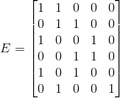
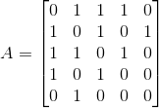
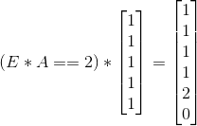

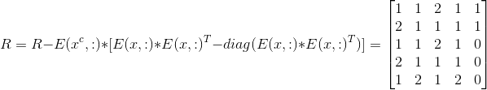
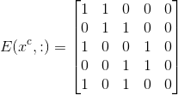
For example: find a 3-truss of G
2
5
e6
e1
1
e2
e5
e3
3
For 3 truss, k=3
4
e4
3 truss SubGraph given by
Notes:
A = \begin{bmatrix}
1 & 1 & 0 & 0 & 0\\
0 & 1 & 1 & 0 & 0\\
1 & 0 & 0 & 1 & 0\\
0 & 0 & 1 & 1 & 0\\
1 & 0 & 1 & 0 & 0\\
0 & 1 & 0 & 0 & 1
\end{bmatrix}
A = \begin{bmatrix}
0 & 1 & 1 & 1 & 0\\
1 & 0 & 1 & 0 & 1\\
1 & 1 & 0 & 1 & 0\\
1 & 0 & 1 & 0 & 0\\
0 & 1 & 0 & 0 & 0
\end{bmatrix}
x=6\\
x^{c} = \begin{bmatrix}
1 & 2 & 3 & 4 & 5
\end{bmatrix}^{T}
E(x^{c},:) = \begin{bmatrix}
1 & 1 & 0 & 0 & 0\\
0 & 1 & 1 & 0 & 0\\
1 & 0 & 0 & 1 & 0\\
0 & 0 & 1 & 1 & 0\\
1 & 0 & 1 & 0 & 0
\end{bmatrix}

Slide 26
Outline
Introduction
Degree Filtered Breadth First Search
K-Truss
Jaccard Coefficient
Non-Negative Matrix Factorization
Summary

Slide 27

Jaccard Index
The Jaccard coefficient measures the neighborhood overlap of two vertices in an unweighted, undirected graph
Expressed as (for vertices v_{i} and v_{j}), where N is the neighbors:
Given the connection vectors (a column or row in the adjacency matrix A) for vertices v_{i} and v_{j} (denoted as a_{i} and a_{j}) the numerator and denominator can be expressed as a_{i}^{T}a_{j} where the we replace multiplication with the AND operator in the numerator and the OR operator in the denominator
This gives us:
Where ./ represents the element by element division
Notes:
J = \frac{| N(v_{i}) \cap N(v_{j}) |}{| N(v_{i}) \cup N(v_{j}) |}

Slide 28
Algorithm to Find Jaccard Index
Using the standard operations, A²_{AND} is the same as A²
Also, the inclusion-exclusion principle gives us a way to compute A²_{OR} when we have the degrees of the vertex neighbors d_{i} and d_{j}: A²_{OR} = Σd_{i} + Σd_{j} - A²_{AND}
So, an algorithm to compute the Jaccard in linear algebraic terms would be:
Initialize J to A^{2:} J = triu(A²) %Take upper triangular portion
Remove diagonal of J: J = J-diag(J)
For each non zero entry in J given by index i and j that correspond to vertices v_{i} and v_{j}:
J_{ij} = J_{ij}/(d_{i} + d_{j} – J_{ij})

Slide 29
Example Jaccard Calculation
2
5
1
3
4

Slide 30
Efficiently Computing triu(A²)
Since only the upper triangular part of A² is needed, we can exploit the symmetry of the matrix A, and its lack of nonzero values on the diagonal, to avoid some unnecessary computation
Let A=(L+U), where L and U are strictly lower and upper triangular, respectively
Note that L = U^{T}, since A is symmetric
Then A² = (U^{T})²+U^{T}U+UU^{T}+U²
Note that (U^{T})² is lower triangular and U² is upper triangular
Then triu(A²) can be efficiently computed as follows:
U ← triu(A)
X ← U*U^{T}
Y ← U^{T}*U
X ← triu(X) + triu(Y) + U*U
Now triu(X) is the same as triu(A²)

Slide 31
triu, tril, diag as element-wise products
A Hadamard (entrywise) matrix product can be used to implement functions that extract the upper- and lower-triangular parts of a matrix in the GraphBLAS framework
To implement triu, tril, and diag on a matrix A, we perform A ⊗ 1
Where ⊗ = f(i,j) is a user defined multiply function that operates on indices of the non-zero element of A
For triu(A) = A ⊗ 1, the upper triangle, f(i,j) = {A(i,j): i ≤ j , 0 otherwise}
For tril(A) = A ⊗ 1, the lower triangle, f(i,j) = {A(i,j): i ≥ j, 0 otherwise}
For diag(A) = A ⊗ 1, the diagonal, f(i,j) = {A(i,j): i==j, 0 otherwise}
triu, tril, and diag all represent GraphBLAS utility functions than can be built with user defined multiplication capabilities found in the GraphBLAS

Slide 32
Outline
Introduction
Degree Filtered Breadth First Search
K-Truss
Jaccard Coefficient
Non-Negative Matrix Factorization
Summary

Slide 33
Topic Modeling
Common tool for individuals working with big data
Quick summarization
Understanding of common themes in dataset
Used extensively in recommender systems and similar systems
Common techniques: Latent dirichlet allocation, Latent semantic analysis, Non-negative matrix factorization (NMF)
Non-negative matrix factorization is a (relatively) recent algorithm for matrix factorization that has the property that the results will be positive
NMF applied on a matrix A_{mxn}:
where W, H are the resultant matrices and k is the number of desired topics
Columns of W can be considered as basis for matrix A and rows of H being the associated weights needed to reconstruct A (or vice versa)

Slide 34
NMF through Iteration
One way to compute the NMF is through an iterative technique known as alternating least squares given below:
A challenge implementing the above is in determining the matrix inverse (essentially the solution of a least squares problem for alternating W and H)

Slide 35
Matrix Inversion through Iteration
A (not too common) way to solve a least squares problem is to use the relation that
In matrix notation,
Thus, to compute the least squares solution, we can use an algorithm as below:

Slide 36
Combining NMF and matrix inversion
The previous two slides can be combined to provide an algorithm that uses only GraphBLAS kernels to determine the factorization of a matrix A (which can be a matrix representation of a graph)

Slide 37
Mapping to GraphBLAS
In order to implement the NMF using the formulation, the functions necessary are:
SpRef/SpAsgn
SpGEMM
SpEWiseX
Scale
Reduce
Addition/Subtraction (can be realized over (min,+) semiring with scale operator)
Challenges:
Major challenge is making sure pieces are sparse. The matrix inversion process may lead to dense matrices. Looking at other ways to solve the least squares problem through QR factorization (however same challenge applies)
Complexity of the proposed algorithm is quite high

Slide 38
Summary
The GraphBLAS effort aims to standardize the kernels used to express graph algorithms in terms of linear algebraic operations
One of the important aspects in standardizing these kernels is in the ability to perform common graph algorithms
This presentation highlights the applicability of the current GraphBLAS kernels applied to four popular analytics:
Degree Filtered Breadth First Search
K-Truss
Jaccard Index
Non-negative matrix factorization

