Slide 1

Server-side Sparse Matrix Multiply in the Accumulo Database
Dylan Hutchison¹²* Vijay Gadepally¹* Jeremy Kepner¹* Adam Fuchs³
¹MIT Lincoln Laboratory ²University of Washington ³Sqrrl Inc.
2015 August
*This material is based upon work supported by the National Science Foundation under Grant No. DMS-1312831.
Any opinions, findings, and conclusions or recommendations expressed in this material are those of the author(s) and do not necessarily reflect the views of the National Science Foundation.
Notes:
Title Page

Slide 2
This work is NOT
Creating the best system
for a particular task (matrix multiply)
Notes:
Many systems exist for good matrix multiply; SciDB, Vertica, TileDB, …

Slide 3
This work is NOT
Creating the best system
for a particular task (matrix multiply)
This work IS
Adding graph analytic capabilities
(matrix multiply) to an all-around good
system used in practice today (Accumulo)
Notes:
Many systems exist for good matrix multiply; SciDB, Vertica, TileDB, …

Slide 4
Outline
Intro to Graphulo
Intro to Matrix Multiply
Intro to Accumulo
Matrix Multiply pre-Graphulo
Inner Product
Outer Product
Accumulo Implementation
Performance
Conclusions

Slide 5

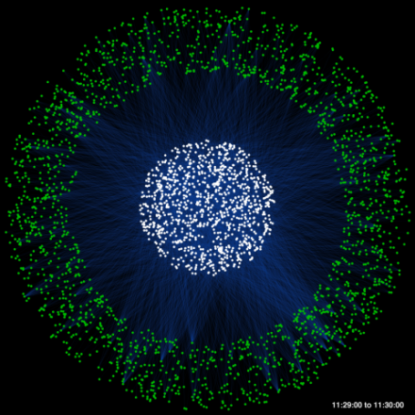

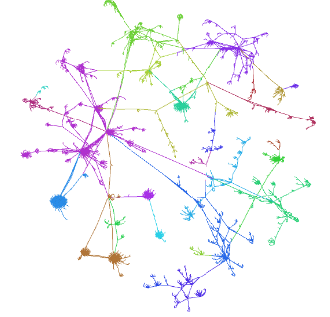
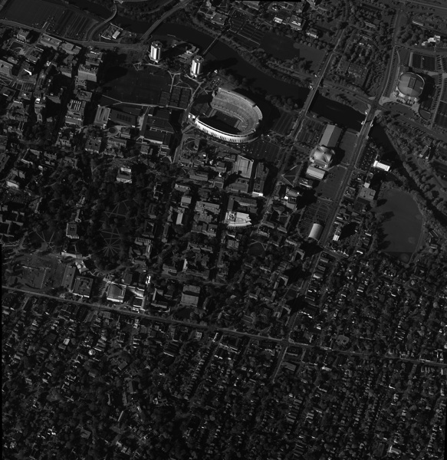

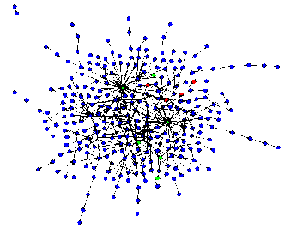
Real Graph Analytics used in Accumulo
ISR
Social
Cyber
Graphs represent entities and relationships detected through multi-INT sources
1,000s – 1,000,000s tracks and locations
GOAL: Identify anomalous patterns of life
Graphs represent relationships between individuals or documents
10,000s – 10,000,000s individual and interactions
GOAL: Identify hidden social networks
Graphs represent communication patterns of computers on a network
1,000,000s – 1,000,000,000s network events
GOAL: Detect cyber attacks or malicious software
Many groups store graph data in Accumulo
➔ Need tools for graph analysis in Accumulo
Notes:
Graphs analysis has proven to be useful in a number of different application areas. This reason for this is likely due to graph analytics proclivity for being able to identify patterns of coordination. The application of graph analytics grows harder as the patterns of coordination grow more subtle and the background graph grows larger and noisier.
Reuters data, core DNS netflow

Slide 6
Why Accumulo?
115M/s
(MIT LL 2014)
108M/s
(BAH 2013)
4M/s
(MIT LL 2012)
1M/s
(Google 2014)
140K/s (Oracle 2013)
Accumulo ingest performance is 100x greater than competing technologies

Slide 7
Graphulo Overview
Primary Goal
Open source Apache Accumulo Java library that enables many graph algorithms in Accumulo
Core primitives: GraphBLAS
3 Graph Schemas
Adjacency, Incidence, Single-Table
4 Demonstration Graph Algorithms
Degree-filtered Breadth First Search, Jaccard coefficients, k-Truss subgraph, Non-negative Matrix Factorization
Focus on Interactive Computing
"Queued" / Localized analytics within a neighborhood, as opposed to whole table analytics
Low latency more important than high throughput
Progress monitoring for user sanity
Is the library working or stuck?

Slide 8
GraphBLAS initial function list
Function | Parameters | Returns | Math Notation
SpGEMM | - sparse matrices A and B - unary functors (op) | sparse matrix | C = op(A) * op(B)
SpM{Sp}V (Sp: sparse) | - sparse matrix A - sparse/dense vector x | sparse/dense vector | y = A * x
SpEWiseX | - sparse matrices or vectors - binary functor and predicate | in place or sparse matrix/vector | C = A .* B
Reduce | - sparse matrix A and functors | dense vector | y = sum(A, op)
SpRef | - sparse matrix A - index vectors p and q | sparse matrix | B = A(p,q)
SpAsgn | - sparse matrices A and B - index vectors p and q | none | A(p,q) = B
Scale | - sparse matrix A - dense matrix or vector X | none | check manual
Apply | - any matrix or vector X - unary functor (op) | none | op(X)
Notes:
GraphBLAS initial function list

Slide 9
Outline
Intro to Graphulo
Intro to Matrix Multiply
Intro to Accumulo
Matrix Multiply pre-Graphulo
Inner Product
Outer Product
Accumulo Implementation
Performance
Conclusions

Slide 10

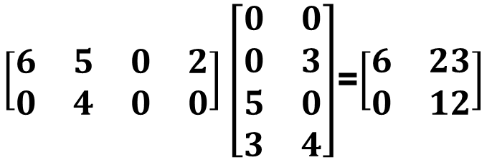
Matrix Multiply on Big Data
Traditional Matrix Multiply: $AB=C$
$\left[\begin{matrix}6 & 5 & 0 & 2 \\ 0 & 4 & 0 & 0\end{matrix}\right]\left[\begin{matrix}0 & 0 \\ 0 & 3 \\ 5 & 0 \\ 3 & 4\end{matrix}\right]$=$\left[\begin{matrix}6 & 23 \\ 0 & 12\end{matrix}\right]$

Slide 11
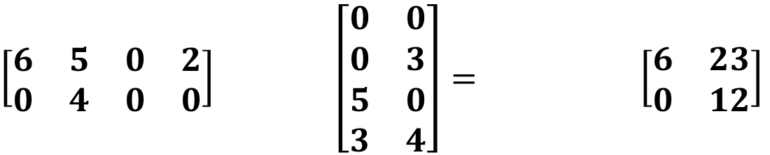
Matrix Multiply on Big Data
Traditional Matrix Multiply: $AB=C$
$\left[\begin{matrix}6 & 5 & 0 & 2 \\ 0 & 4 & 0 & 0\end{matrix}\right]\left[\begin{matrix}0 & 0 \\ 0 & 3 \\ 5 & 0 \\ 3 & 4\end{matrix}\right]$=$\left[\begin{matrix}6 & 23 \\ 0 & 12\end{matrix}\right]$
Row & Column Labels
Database Table Multiply
tod|0500
tod|0800
tod|0900
tod|1400
word|dew
word|hot
word|dew
word|hot
tod|0500
tod|0800
tod|0900
tod|1400
$\left[\begin{matrix}6 & 5 & 0 & 2 \\ 0 & 4 & 0 & 0\end{matrix}\right]$ $\left[\begin{matrix}0 & 0 \\ 0 & 3 \\ 5 & 0 \\ 3 & 4\end{matrix}\right]=$ $\left[\begin{matrix}6 & 23 \\ 0 & 12\end{matrix}\right]$
word|coffee
word|desert
word|coffee
word|desert
Notes:
Correlation between words

Slide 12
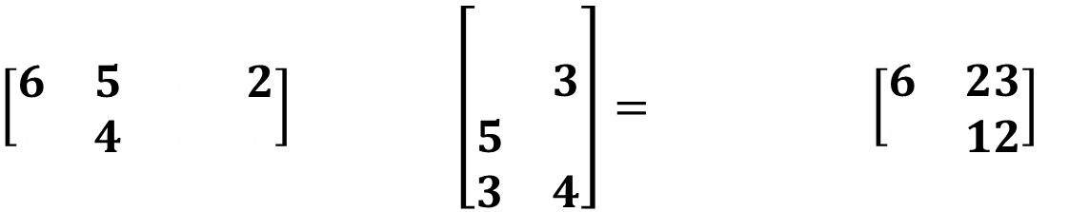
Matrix Multiply on Big Data
Traditional Matrix Multiply: $AB=C$
$\left[\begin{matrix}6 & 5 & 0 & 2 \\ 0 & 4 & 0 & 0\end{matrix}\right]\left[\begin{matrix}0 & 0 \\ 0 & 3 \\ 5 & 0 \\ 3 & 4\end{matrix}\right]$=$\left[\begin{matrix}6 & 23 \\ 0 & 12\end{matrix}\right]$
Row & Column Labels
Sparse
Database Table Multiply
tod|0500
tod|0800
tod|1400
word|dew
word|hot
word|dew
word|hot
tod|0800
tod|0900
tod|1400
$\left[\begin{matrix}6 & 5 & 0 & 2 \\ 0 & 4 & 0 & 0\end{matrix}\right]$ $\left[\begin{matrix}0 & 0 \\ 0 & 3 \\ 5 & 0 \\ 3 & 4\end{matrix}\right]=$ $\left[\begin{matrix}6 & 23 \\ 0 & 12\end{matrix}\right]$
word|coffee
word|desert
word|coffee
word|desert
Notes:
Words tweeted at a certain time of day

Slide 13
Matrix Multiply on Big Data
Traditional Matrix Multiply: $AB=C$
$\left[\begin{matrix}6 & 5 & 0 & 2 \\ 0 & 4 & 0 & 0\end{matrix}\right]\left[\begin{matrix}0 & 0 \\ 0 & 3 \\ 5 & 0 \\ 3 & 4\end{matrix}\right]$=$\left[\begin{matrix}6 & 23 \\ 0 & 12\end{matrix}\right]$
Row & Column Labels
Sparse
Associative Array
Mathematics¹
Database Table Multiply
tod|0500
tod|0800
tod|1400
word|dew
word|hot
word|dew
word|hot
tod|0800
tod|0900
tod|1400
$\left[\begin{matrix}6 & 5 & 0 & 2 \\ 0 & 4 & 0 & 0\end{matrix}\right]$ $\left[\begin{matrix}0 & 0 \\ 0 & 3 \\ 5 & 0 \\ 3 & 4\end{matrix}\right]=$ $\left[\begin{matrix}6 & 23 \\ 0 & 12\end{matrix}\right]$
word|coffee
word|desert
word|coffee
word|desert
¹J. Kepner and V. Gadepally. "Adjacency matrices, incidence matrices, database schemas, and associative arrays" in International Parallel & Distributed Processing Symposium Workshops (IPDPSW). IEEE, 2014
Notes:
Database tables have a formal mathematics in the form of associative arrays. Associative arrays have very similar properties to traditional linear algebra.

Slide 14
Application: Multi-Source Breadth-First Search
1
2
4
7
5
3
6
A^{T}
B
Sparse array representation => space efficient
Sparse matrix-matrix multiplication => work efficient
Three possible levels of parallelism: searches, vertices, edges
Basis for a wide range of graph algorithms
Notes:
Multiple-source breadth-first search

Slide 15
Application: Multi-Source Breadth-First Search
1
2
→
4
5
7
3
6
A^{T}
B
A^{T} • B
Sparse array representation => space efficient
Sparse matrix-matrix multiplication => work efficient
Three possible levels of parallelism: searches, vertices, edges
Basis for a wide range of graph algorithms
Notes:
Multiple-source breadth-first search

Slide 16
Outline
Intro to Graphulo
Intro to Matrix Multiply
Intro to Accumulo
Matrix Multiply pre-Graphulo
Inner Product
Outer Product
Accumulo Implementation
Performance
Conclusions

Slide 17

Background on Accumulo
Best for:
Large, de-normalized tables (NoSQL)
Hadoop HDFS / Java ecosystem
Huge data volume – TBs to PBs
Cell-level visibility
Robust horizontal scaling
Row store by default
Scan over rows for O(log n) lookup & sorted order
Log-structured Merge Tree design
Iterator processing framework
Key |  |  |  |  | Value
Row ID | Column |  |  | Timestamp
 | Family | Qualifier | Visibility
Use Transpose Tables
see D4M Schema¹
Notes:
CP part of CAP
Consistency and Partition tolerance at the expense of Availability
Zookeeper, FATE

Slide 18
Background on Accumulo
Best for:
Large, de-normalized tables (NoSQL)
Hadoop HDFS / Java ecosystem
Huge data volume – TBs to PBs
Cell-level visibility
Robust horizontal scaling
Row store by default
Scan over rows for O(log n) lookup & sorted order
Log-structured Merge Tree design
Iterator processing framework
Key |  |  |  |  | Value
Row ID | Column |  |  | Timestamp
 | Family | Qualifier | Visibility
Use Transpose Tables
see D4M Schema¹
¹D4M 2.0 Schema: A General Purpose High Performance Schema for the Accumulo Database
Kepner et al, IEEE HPEC 2013
Notes:
For indexing on columns. We'll see how transpose tables play a role in matrix multiplication in a bit.

Slide 19
Outline
Intro to Graphulo
Intro to Matrix Multiply
Intro to Accumulo
Matrix Multiply pre-Graphulo
Inner Product
Outer Product
Accumulo Implementation
Performance
Conclusions

Slide 20
Table Multiply Before Graphulo
A
Accumulo
B
Client

Slide 21
Table Multiply Before Graphulo
Scan
A
Accumulo
A
B
B
Client

Slide 22
Table Multiply Before Graphulo
A
Accumulo
A
B
B
Multiply
in-memory*
Client
C
*Blocked algorithms exist for large tables at reduced efficiency

Slide 23
Table Multiply Before Graphulo
A
Accumulo
A
B
B
Client
C
C
Write

Slide 24
Table Multiply Before Graphulo
Scan
A
Accumulo
A
B
B
Multiply
in-memory*
Client
C
C
Write
Old: DB = Indexed Storage
*Blocked algorithms exist for large tables at reduced efficiency

Slide 25
Table Multiply Before Graphulo
Scan
A
Accumulo
A
B
B
Multiply
in-memory*
Client
C
C
Write
Old: DB = Indexed Storage
New: DB = Indexed Storage + Computation Engine
*Blocked algorithms exist for large tables at reduced efficiency

Slide 26
Outline
Intro to Graphulo
Intro to Matrix Multiply
Intro to Accumulo
Matrix Multiply pre-Graphulo
Inner Product
Outer Product
Accumulo Implementation
Performance
Conclusions

Slide 27
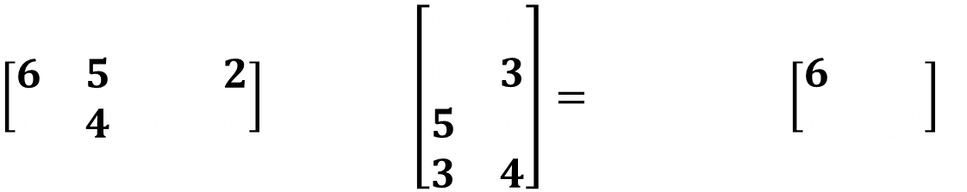
Inner Product
tod|0500
tod|0800
tod|1400
word|dew
word|hot
word|dew
word|hot
tod|0800
tod|0900
tod|1400
$\left[\begin{matrix}6 & 5 & 0 & 2 \\ 0 & 4 & 0 & 0\end{matrix}\right]$ $\left[\begin{matrix}0 & 0 \\ 0 & 3 \\ 5 & 0 \\ 3 & 4\end{matrix}\right]=$ $\left[\begin{matrix}6 & 23 \\ 0 & 12\end{matrix}\right]$
①
word|coffee
word|desert
word|coffee
word|desert
= 2
= 2
= 4

Slide 28
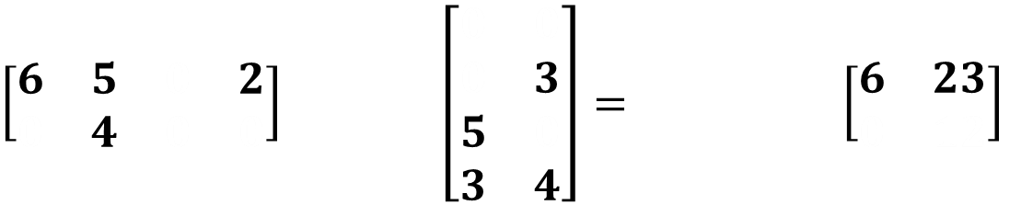
Inner Product
tod|0500
tod|0800
tod|1400
word|dew
word|hot
word|dew
word|hot
tod|0800
tod|0900
tod|1400
$\left[\begin{matrix}6 & 5 & 0 & 2 \\ 0 & 4 & 0 & 0\end{matrix}\right]$ $\left[\begin{matrix}0 & 0 \\ 0 & 3 \\ 5 & 0 \\ 3 & 4\end{matrix}\right]=$ $\left[\begin{matrix}6 & 23 \\ 0 & 12\end{matrix}\right]$
①
②
word|coffee
word|desert
word|coffee
word|desert
1st Scan
= 2
= 2
= 4

Slide 29
Inner Product
tod|0500
tod|0800
tod|1400
word|dew
word|hot
word|dew
word|hot
tod|0800
tod|0900
tod|1400
$\left[\begin{matrix}6 & 5 & 0 & 2 \\ 0 & 4 & 0 & 0\end{matrix}\right]$ $\left[\begin{matrix}0 & 0 \\ 0 & 3 \\ 5 & 0 \\ 3 & 4\end{matrix}\right]=$ $\left[\begin{matrix}6 & 23 \\ 0 & 12\end{matrix}\right]$
①
②
word|coffee
word|desert
word|coffee
word|desert
= 2
= 2
= 4

Slide 30

Inner Product
tod|0500
tod|0800
tod|1400
word|dew
word|hot
word|dew
word|hot
tod|0800
tod|0900
tod|1400
$\left[\begin{matrix}6 & 5 & 0 & 2 \\ 0 & 4 & 0 & 0\end{matrix}\right]$ $\left[\begin{matrix}0 & 0 \\ 0 & 3 \\ 5 & 0 \\ 3 & 4\end{matrix}\right]=$ $\left[\begin{matrix}6 & 23 \\ 0 & 12\end{matrix}\right]$
①
②
word|coffee
word|desert
word|coffee
word|desert
③
2nd Scan
= 2
= 2
= 4

Slide 31
Inner Product
+ Write locality (sorted)
+ Pre-sum partial products
(3 entries written)
– N scans over table B
tod|0500
tod|0800
tod|1400
word|dew
word|hot
word|dew
word|hot
tod|0800
tod|0900
tod|1400
$\left[\begin{matrix}6 & 5 & 0 & 2 \\ 0 & 4 & 0 & 0\end{matrix}\right]$ $\left[\begin{matrix}0 & 0 \\ 0 & 3 \\ 5 & 0 \\ 3 & 4\end{matrix}\right]=$ $\left[\begin{matrix}6 & 23 \\ 0 & 12\end{matrix}\right]$
①
②
word|coffee
word|desert
word|coffee
word|desert
③
2nd Scan
= 2
= 2
= 4

Slide 32
Outline
Intro to Graphulo
Intro to Matrix Multiply
Intro to Accumulo
Matrix Multiply pre-Graphulo
Inner Product
Outer Product
Accumulo Implementation
Performance
Conclusions

Slide 33
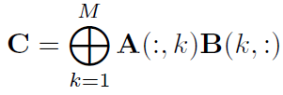
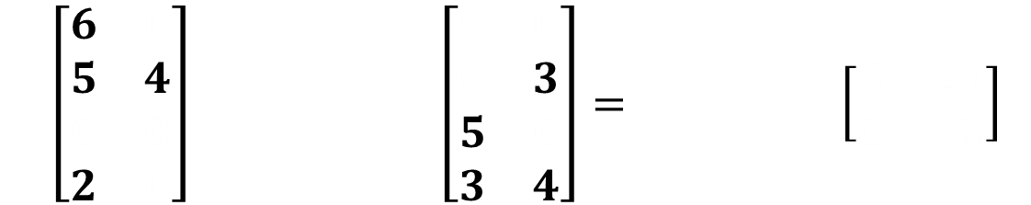
Outer Product
word|coffee
word|desert
word|dew
word|hot
Now explicitly showing A^{T}
tod|0500
tod|0800
tod|1400
tod|0800
tod|0900
tod|1400
$\left[\begin{matrix}6 & 0 \\ 5 & 4 \\ 0 & 0 \\ 2 & 0\end{matrix}\right]$ $\left[\begin{matrix}0 & 0 \\ 0 & 3 \\ 5 & 0 \\ 3 & 4\end{matrix}\right]=$ $\left[\begin{matrix}6 & 23 \\ 0 & 12\end{matrix}\right]$
= 4
= 2
= 2

Slide 34
Outer Product
1. Align Rows
word|coffee
word|desert
word|dew
word|hot
tod|0500
tod|0800
tod|1400
tod|0800
tod|0900
tod|1400
$\left[\begin{matrix}6 & 0 \\ 5 & 4 \\ 0 & 0 \\ 2 & 0\end{matrix}\right]$ $\left[\begin{matrix}0 & 0 \\ 0 & 3 \\ 5 & 0 \\ 3 & 4\end{matrix}\right]=$ $\left[\begin{matrix}6 & 23 \\ 0 & 12\end{matrix}\right]$
= 4
= 2
= 2

Slide 35
Outer Product
1. Align Rows
word|coffee
word|desert
word|dew
word|hot
tod|0500
tod|0800
tod|1400
tod|0800
tod|0900
tod|1400
$\left[\begin{matrix}6 & 0 \\ 5 & 4 \\ 0 & 0 \\ 2 & 0\end{matrix}\right]$ $\left[\begin{matrix}0 & 0 \\ 0 & 3 \\ 5 & 0 \\ 3 & 4\end{matrix}\right]=$ $\left[\begin{matrix}6 & 23 \\ 0 & 12\end{matrix}\right]$
= 4
= 2
= 2

Slide 36
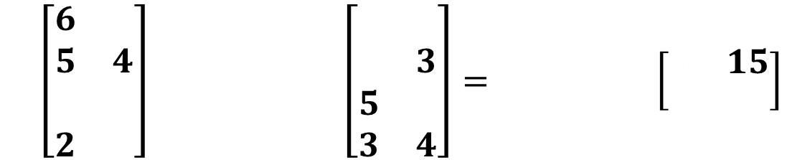
Outer Product
2. Cartesian Product
word|coffee
word|desert
word|dew
word|hot
word|dew
word|hot
tod|0500
tod|0800
tod|1400
tod|0800
tod|0900
tod|1400
$\left[\begin{matrix}6 & 0 \\ 5 & 4 \\ 0 & 0 \\ 2 & 0\end{matrix}\right]$ $\left[\begin{matrix}0 & 0 \\ 0 & 3 \\ 5 & 0 \\ 3 & 4\end{matrix}\right]=$ $\left[\begin{matrix}6 & 15 \\ 0 & 12\end{matrix}\right]$
①
word|coffee
word|desert
= 4
= 2
= 2

Slide 37
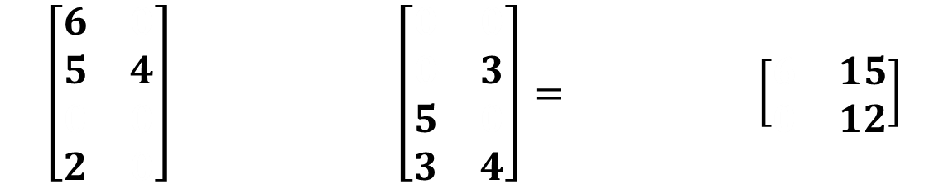
Outer Product
2. Cartesian Product
word|coffee
word|desert
word|dew
word|hot
word|dew
word|hot
tod|0500
tod|0800
tod|1400
tod|0800
tod|0900
tod|1400
$\left[\begin{matrix}6 & 0 \\ 5 & 4 \\ 0 & 0 \\ 2 & 0\end{matrix}\right]$ $\left[\begin{matrix}0 & 0 \\ 0 & 3 \\ 5 & 0 \\ 3 & 4\end{matrix}\right]=$ $\left[\begin{matrix}6 & 15 \\ 0 & 12\end{matrix}\right]$
①
word|coffee
word|desert
②
= 4
= 2
= 2

Slide 38
Outer Product
1. Align Rows
word|coffee
word|desert
word|dew
word|hot
word|dew
word|hot
tod|0500
tod|0800
tod|1400
tod|0800
tod|0900
tod|1400
$\left[\begin{matrix}6 & 0 \\ 5 & 4 \\ 0 & 0 \\ 2 & 0\end{matrix}\right]$ $\left[\begin{matrix}0 & 0 \\ 0 & 3 \\ 5 & 0 \\ 3 & 4\end{matrix}\right]=$ $\left[\begin{matrix}6 & 15 \\ 0 & 12\end{matrix}\right]$
①
word|coffee
word|desert
②
= 4
= 2
= 2

Slide 39
Outer Product
1. Align Rows
word|coffee
word|desert
word|dew
word|hot
word|dew
word|hot
tod|0500
tod|0800
tod|1400
tod|0800
tod|0900
tod|1400
$\left[\begin{matrix}6 & 0 \\ 5 & 4 \\ 0 & 0 \\ 2 & 0\end{matrix}\right]$ $\left[\begin{matrix}0 & 0 \\ 0 & 3 \\ 5 & 0 \\ 3 & 4\end{matrix}\right]=$ $\left[\begin{matrix}6 & 15 \\ 0 & 12\end{matrix}\right]$
①
word|coffee
word|desert
②
= 4
= 2
= 2

Slide 40
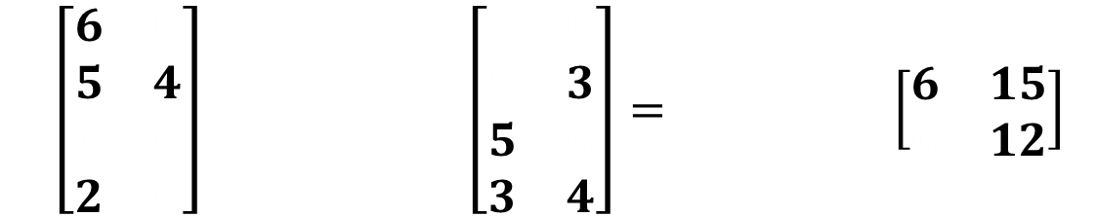
Outer Product
2. Cartesian Product
word|coffee
word|desert
word|dew
word|hot
word|dew
word|hot
tod|0500
tod|0800
tod|1400
tod|0800
tod|0900
tod|1400
$\left[\begin{matrix}6 & 0 \\ 5 & 4 \\ 0 & 0 \\ 2 & 0\end{matrix}\right]$ $\left[\begin{matrix}0 & 0 \\ 0 & 3 \\ 5 & 0 \\ 3 & 4\end{matrix}\right]=$ $\left[\begin{matrix}6 & 15 \\ 0 & 12\end{matrix}\right]$
③
①
word|coffee
word|desert
②
= 4
= 2
= 2

Slide 41

Outer Product
*Lazy ⊕:
Accumulo stores both 15 and 8 until next scan or compaction
2. Cartesian Product
word|coffee
word|desert
word|dew
word|hot
word|dew
word|hot
tod|0500
tod|0800
tod|1400
tod|0800
tod|0900
tod|1400
$\left[\begin{matrix}6 & 0 \\ 5 & 4 \\ 0 & 0 \\ 2 & 0\end{matrix}\right]$ $\left[\begin{matrix}0 & 0 \\ 0 & 3 \\ 5 & 0 \\ 3 & 4\end{matrix}\right]=$ $\left[\begin{matrix}6 & 23 \\ 0 & 12\end{matrix}\right]$
③
①
word|coffee
word|desert
④*
②
= 4
= 2
= 2

Slide 42
Outer Product
No write locality; unsorted writes
Hard to pre-sum partial products
(4 entries written)
+ Single scan
over table B
*Lazy ⊕:
Accumulo stores both 15 and 8 until next scan or compaction
word|coffee
word|desert
word|dew
word|hot
word|dew
word|hot
tod|0500
tod|0800
tod|1400
tod|0800
tod|0900
tod|1400
$\left[\begin{matrix}6 & 0 \\ 5 & 4 \\ 0 & 0 \\ 2 & 0\end{matrix}\right]$ $\left[\begin{matrix}0 & 0 \\ 0 & 3 \\ 5 & 0 \\ 3 & 4\end{matrix}\right]=$ $\left[\begin{matrix}6 & 23 \\ 0 & 12\end{matrix}\right]$
③
①
word|coffee
word|desert
④*
②
= 4
= 2
= 2

Slide 43
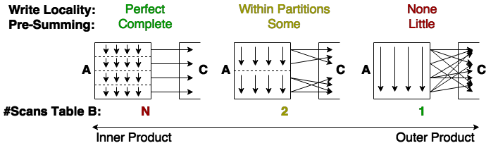
Inner vs. Outer Product
Outer product best for Accumulo
Single pass over table B = single disk read
BatchWriter ingest handles unsorted writes
Combiners handle ⊕
Less extra partial products written for sparse data
Inner product still has merit
Better for dense data
Hybrid 2D-like algorithm possible

Slide 44
Outline
Intro to Graphulo
Intro to Matrix Multiply
Intro to Accumulo
Matrix Multiply pre-Graphulo
Inner Product
Outer Product
Accumulo Implementation
Performance
Conclusions

Slide 45
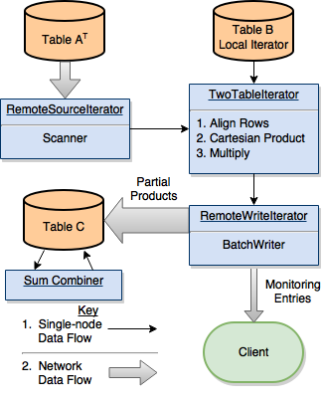
Outer Product in Graphulo Iterators
Custom ⊗
Custom ⊕
Notes:
Open client-side Scanners and BatchWriters in the Accumulo server approx. # of partial products = #rows * avg#cols/rowA * avg#cols/rowB

Slide 46
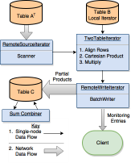
Accumulo Distributes Graphulo Iterators
Scan
Multiply
Write
Sum on Flush, Compact,
or Scan
Tablet of A
Tablet of B
Tablet of C
Imm
}
Imm
Rfile
Rfile
Tablet of A
Tablet of B
Tablet of C
Imm
}
Imm
Rfile
Rfile
Key
Imm: In-Memory Map
Rfile: Hadoop File
Tablets can be hosted on any tablet server
Accumulo load balances tablet allocation
Matrix multiply iterators run on B's tablets in parallel
Scan from A's tablets in parallel
BatchWrite to C's tablets in parallel

Slide 47
Outline
Intro to Graphulo
Intro to Matrix Multiply
Intro to Accumulo
Matrix Multiply pre-Graphulo
Inner Product
Outer Product
Accumulo Implementation
Performance
Conclusions

Slide 48
Performance Experiment
Compare to pre-Graphulo alternative:
D4M Matlab client as Middleman
Scaled / Weak scaling study:
How multiply rate varies with increasing problem size at fixed resources
Ideal: constant multiply rate
Fixed / Strong scaling study:
How multiply rate varies with increasing resources at fixed problem size
Ideal: multiply rate scales linearly with increasing resources
Environment:
Laptop, 16GB RAM, 2 Dual-core i7 processors, Accumulo 1.6.1
Vary problem size between SCALE 10 and 18
Unpermuted Power law graph generator
# of nodes in each input table is 2^{SCALE}. Used 16 edges/node
Vary resources with # Accumulo Tablets (Varies # Threads)

Slide 49
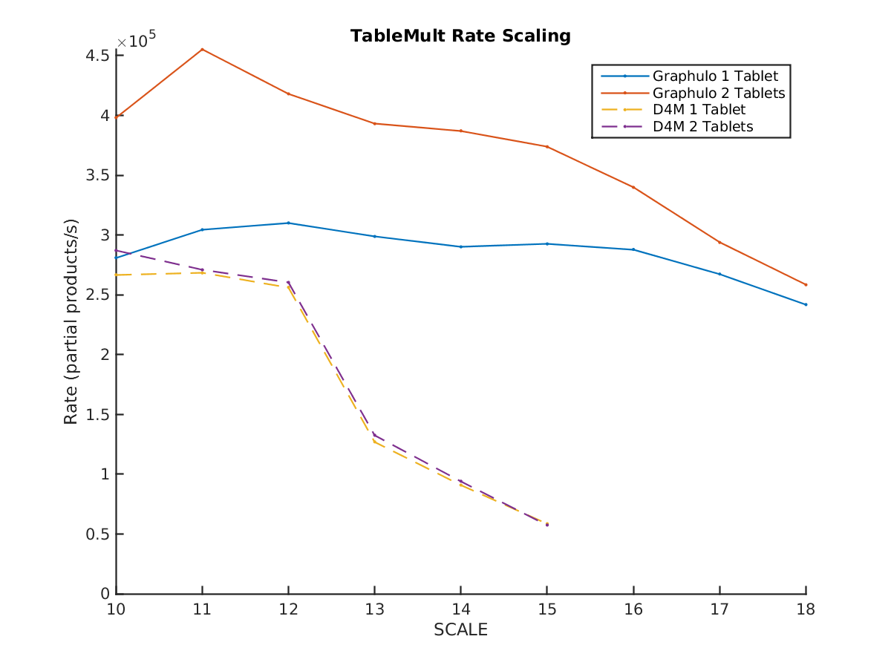
Performance Experiment

Slide 50
Outline
Intro to Graphulo
Intro to Matrix Multiply
Intro to Accumulo
Matrix Multiply pre-Graphulo
Inner Product
Outer Product
Accumulo Implementation
Performance
Conclusions

Slide 51
Conclusion
Promising performance
Write rates near 400k / sec, near highest single-node recorded rates
Experiments on a larger cluster will confirm weak & strong scaling
Outer product better suited to Accumulo
Hybrid inner-outer product algorithms worth studying
Current Graphulo research is
implementing remaining GraphBLAS
developing graph algorithms
Notes:
Alter high school curricula to include outer product matrix multiply method

Slide 52
Backup

Slide 53
Inner-Outer Hybrid Algorithm
P = N – Inner Product
P = 1 – Outer Product

Slide 54
D4M Schema for Sparse Arrays in Key/Value Databases (Accumulo)
Accumulo Table: Ttranspose
Input Data
 | 01-01-2001 | 02-01-2001 | 03-01-2001
Col1|a | 1
Col1|b |  | 1
Col2|b |  | 1
Col2|c |  |  | 1
Col3|a | 1
Col3|c |  |  | 1
Time | Col1 | Col2 | Col3
2001-01-01 | a |  | a
2001-01-02 | b | b
2001-01-03 |  | c | c
 | Col1|a | Col1|b | Col2|b | Col2|c | Col3|a | Col3|c
01-01-2001 | 1 |  |  |  | 1
02-01-2001 |  | 1 | 1
03-01-2001 |  |  |  | 1 |  | 1
Accumulo Table: T
Tabular data expanded to create many type/value columns
Transpose pairs allows quick look up of either row or column
¹D4M 2.0 Schema: A General Purpose High Performance Schema for the Accumulo Database
Kepner et al, IEEE HPEC 2013
Notes:
Exploded schema allow fast access to row and columns.

